Slide 1
Market Update on Impact of ORDC Blend and Shift
Wholesale Market Working Group
Market Analysis & Validation
04/22/2019

Slide 2
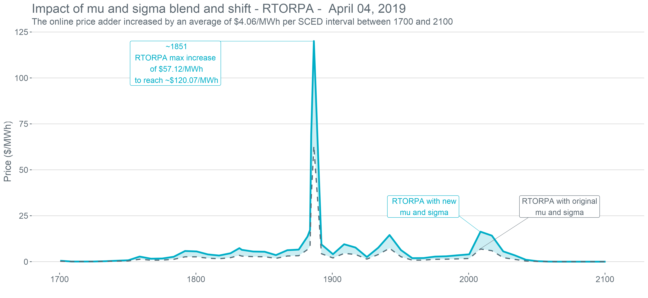
RTORPA – April 04, 2019
Average | RTORPA ($/MWh)
Without Blend and Shift | 3.92
With Blend and Shift | 7.98

Slide 3
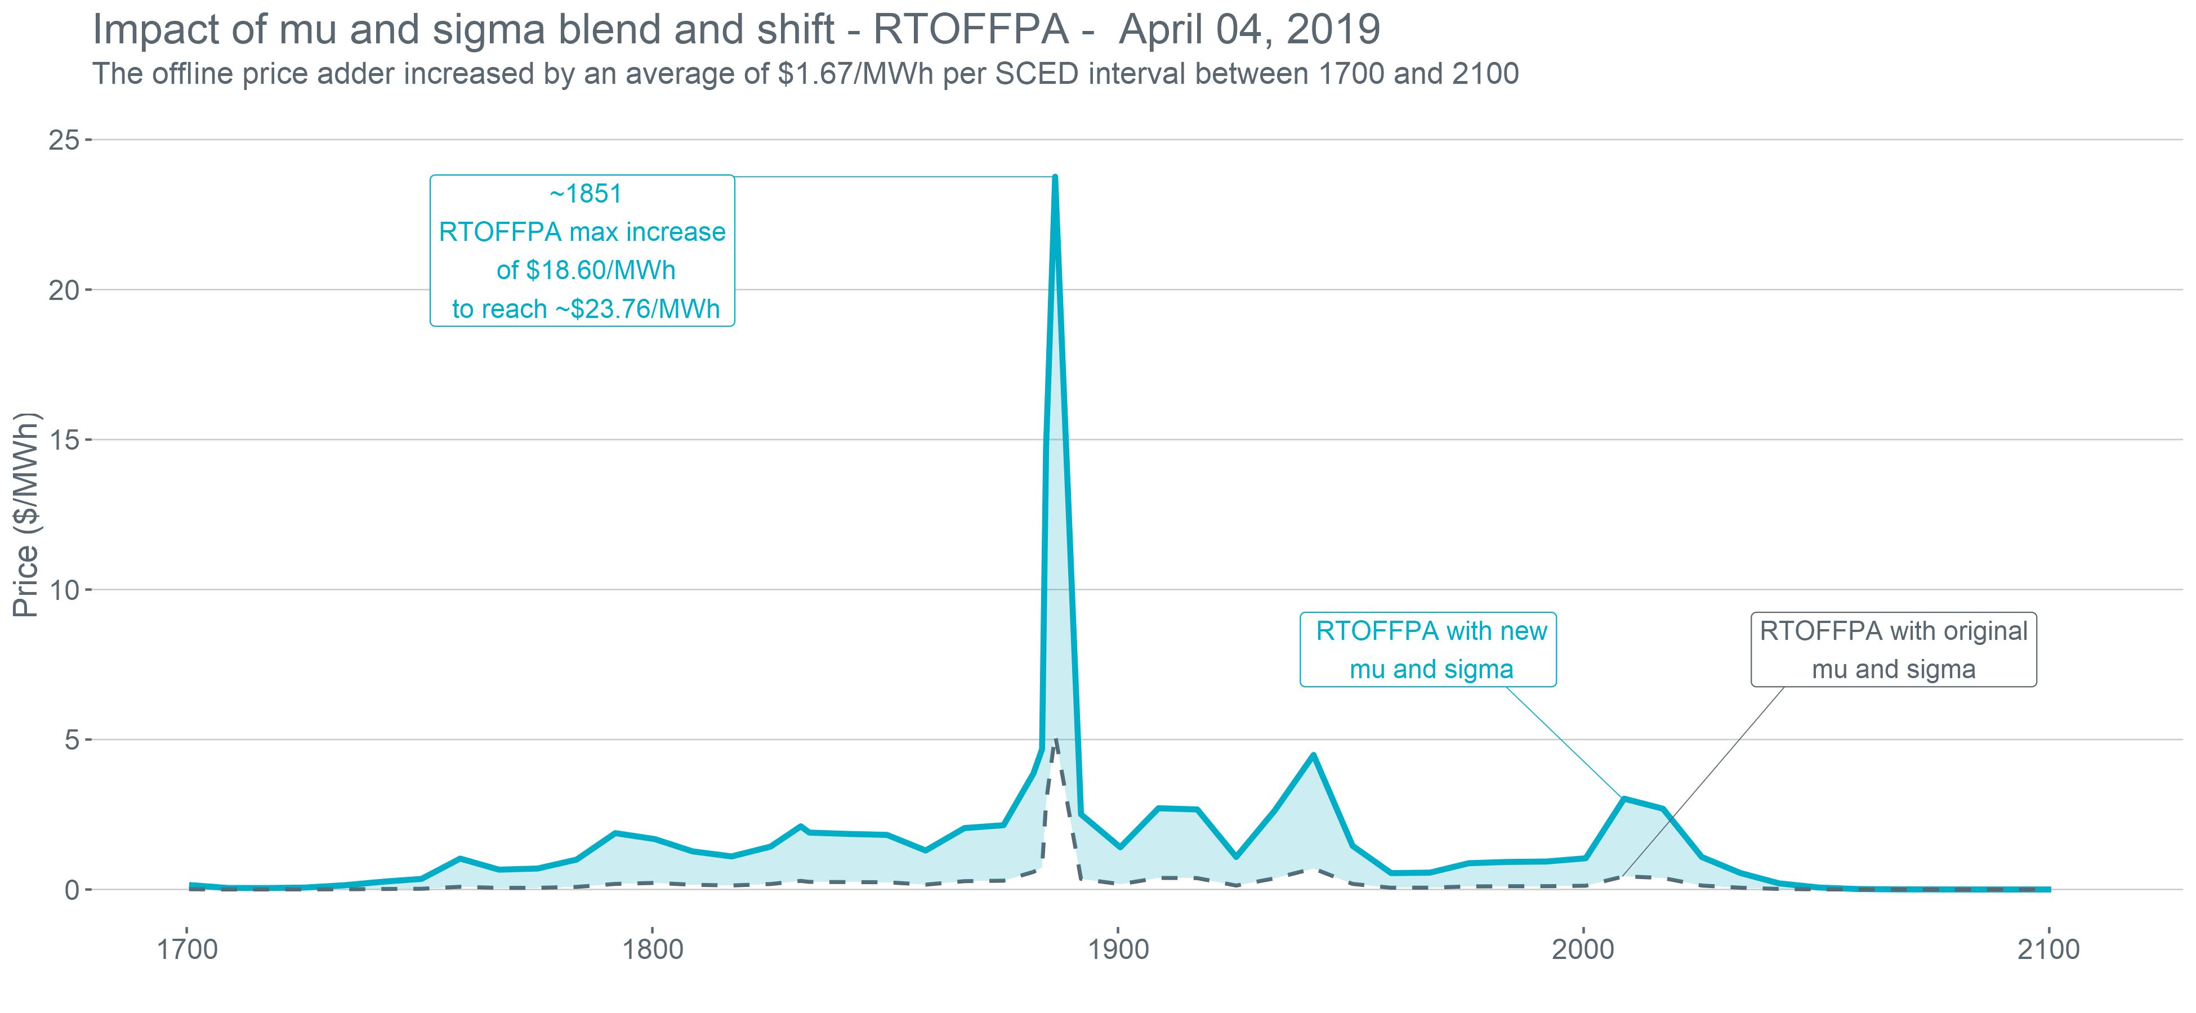
RTOFFPA – April 04, 2019
Average | RTOFFPA ($/MWh)
Without Blend and Shift | 0.32
With Blend and Shift | 1.99

Slide 4
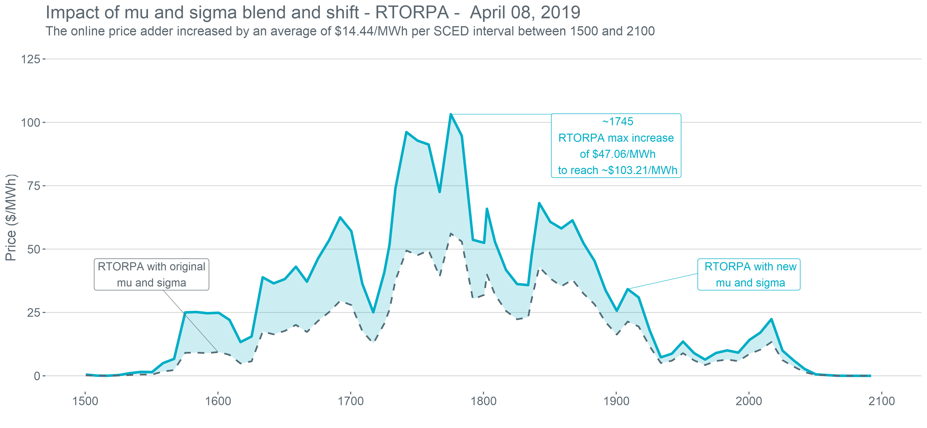
RTORPA – April 08, 2019
Average | RTORPA ($/MWh)
Without Blend and Shift | 17.30
With Blend and Shift | 31.73

Slide 5
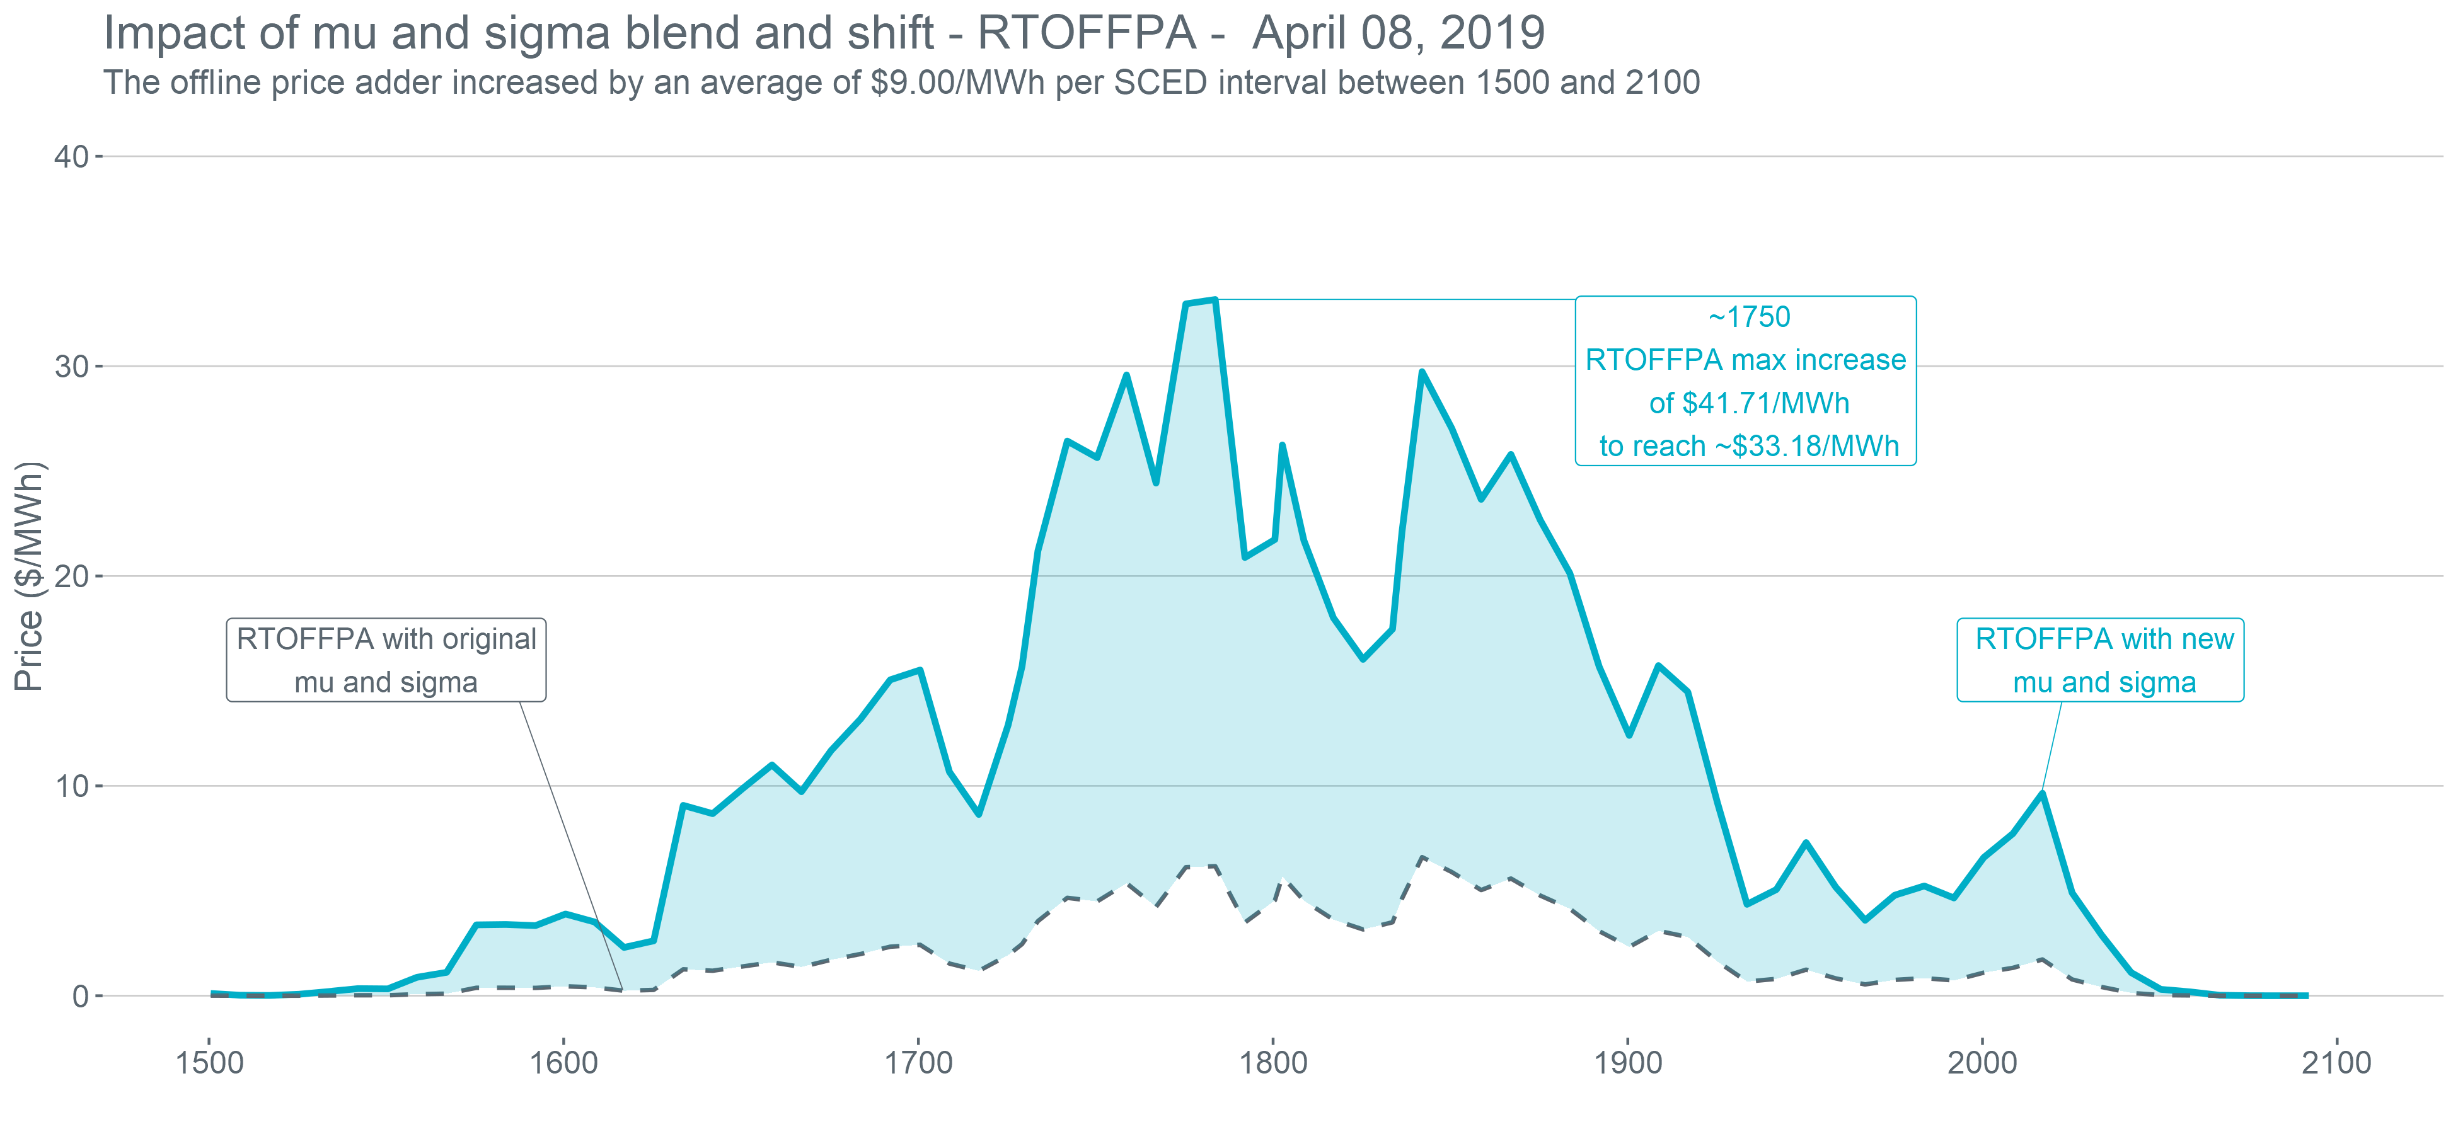
RTOFFPA – April 08, 2019
Average | RTOFFPA ($/MWh)
Without Blend and Shift | 2.00
With Blend and Shift | 11.00

Slide 6
Reference
ORDC parameter values for spring 2019 before and after ORDC methodology change implemented with OBDRR011, ORDC OBD Revisions for PUCT Project 48551
Start Hour | End Hour | Original μ | New μ+0.25σ | Original σ | New σ
1 | 2 | 118 | 644 | 1,176 | 1,213
3 | 6 | 616 | 644 | 1,107 | 1,213
7 | 10 | 742 | 644 | 1,223 | 1,213
11 | 14 | 153 | 644 | 1,217 | 1,213
15 | 18 | 112 | 644 | 1,165 | 1,213
19 | 22 | 144 | 644 | 1,178 | 1,213
23 | 24 | 118 | 644 | 1,176 | 1,213

