Slide 1
Analysis of RTORDPA Relaxation and Triggering Proposals
Market Analysis
4/22/2019

Slide 2
Introduction
The current design of the Real-Time On-Line Reliability Deployment Price Adder (RTORDPA) has known weaknesses
Non-zero price adders when zero price adders might be “expected”
Zero price adders when non-zero price adders might be “expected”
For further discussion see the presentation from the 12/3/2018 QMWG
Several approaches have been discussed as design enhancements
ERCOT programmed, ran, and compared the results from four approaches and two options for triggering the price adder
This was a substantial effort
This presentation contains the results

Slide 3
Four Approaches to Relaxation in the RTORDPA
The current method in production
Three alternatives discussed at previous WMWG meetings
One alternative: do not relax LDLs of non-ONRUC Resources
Two additional alternatives: make relaxation of both LDLs and HDLs of non-ONRUC Resources conditional on the dispatch run base points being not equal to LDL or HDL (respectively)
Relax to either Ancillary Service (AS) limits (LASL and HASL) (referred to as “Conditional 1”) or Sustainable Limits (LSL and HSL) (referred to as “Conditional 2”)

Slide 4
Four Methods of Setting HDL and LDL of Non-ONRUC Resources
Methods | Relaxation of dispatchable non-ONRUC units’ LDL and HDL in SCED Pricing Run
 | LDL= | HDL=
Production | max(LASL, MW-60*RampDown) | min(HASL, MW+60*RampUp)
No LDL Relaxation | Dispatch Run LDL | min(HASL, MW+60*RampUp)
Conditional 1 (max AS Limits) | If Dispatch BP=LDL, Then Dispatch Run LDL Else max(LASL, MW-60*RampDown) | If Dispatch BP=HDL, Then Dispatch Run HDL Else min(HASL, MW+60*RampUp)
Conditional 2 (max sustainable limits) | If Dispatch BP=LDL, Then Dispatch Run LDL Else max(LSL, MW-60*RampDown) | If Dispatch BP=HDL, Then Dispatch Run HDL Else min(HSL, MW+60*RampUp)

Slide 5
Two Triggers for Calculating the Reliability Deployment Price Adder
The Reliability Price Adder is calculated as
min(max(0, pricing run system lambda – dispatch run system lambda), 9000 – dispatch run system lambda – ORDC online adder)
These two trigger methods were evaluated for the periods studied
Any ONRUC status Resource inside a RUC commitment block (“Always”)
Any ONRUC status Resource with BP=LDL inside a RUC commitment block (“BP=LDL”)
The “BP=LDL” triggering method is intended to address cases in which there is non-zero price adder, even when the ONRUC status Resource has an equivalent BP in both the dispatch and pricing runs
These methods would not preclude other reliability deployments from triggering the RTORDPA as they currently do

Slide 6
Developing a Target for Comparison
Different approaches give different prices—what are the “right” prices?
Need a point of comparison to say which approach is closer to the “right” price
RTORDPA is intended to mitigate the impact of the must-take LDL energy from the ONRUC Resource(s)
If the ONRUC Resource had LDL=0, would not have any must-take energy. This is why the pricing run relaxes the ONRUC LDL to zero.
Created a sequential SCED execution with the ONRUC LDL=0 in the dispatch run to create a reference for the “right” price
Does not need a pricing run because the dispatch run allows ONRUC capacity to be price-setting all the way to BP=0

Slide 7
Modeled SCED Intervals
Modeled the alternative pricing run approaches and triggers for all SCED intervals with ONRUC Resources between 8/1/2018 and 12/31/2018
719 SCED intervals covering about 60 hours of time
Includes RUC commitments for capacity and transmission constraints

Slide 8
Statistics of the Results
Statistics from 719 SCED intervals
 | Relaxation Scenario | RTORDPA Trigger | Avg. | 50th | 75th | 90th | 95th | 99th | Max.
System Lambda | Sequential SCED | NA | 106.66 | 39.44 | 50.80 | 75.41 | 944.38 | 1354.29 | 1497.05
 | Dispatch | NA | 96.58 | 37.67 | 47.57 | 74.99 | 379.22 | 1263.40 | 1385.40
System Lambda + RTORDPA | Production | Always | 99.23 | 40.01 | 50.43 | 75.07 | 379.22 | 1266.81 | 1385.40
 |  | BP=LDL | 99.21 | 40.00 | 50.43 | 75.07 | 379.22 | 1266.81 | 1385.40
 | No LDL Relaxation | Always | 98.80 | 39.36 | 48.52 | 75.24 | 379.22 | 1266.81 | 1385.40
 |  | BP=LDL | 98.80 | 39.36 | 48.52 | 75.24 | 379.22 | 1266.81 | 1385.40
 | Conditional 1 | Always | 108.72 | 39.92 | 50.48 | 75.41 | 482.23 | 1493.44 | 1497.09
 |  | BP=LDL | 106.93 | 39.92 | 50.48 | 75.41 | 428.17 | 1493.44 | 1497.09
 | Conditional 2 | Always | 106.89 | 39.71 | 50.10 | 75.29 | 482.23 | 1493.44 | 1497.09
 |  | BP=LDL | 105.65 | 39.71 | 50.10 | 75.24 | 400.00 | 1493.44 | 1497.09

Slide 9
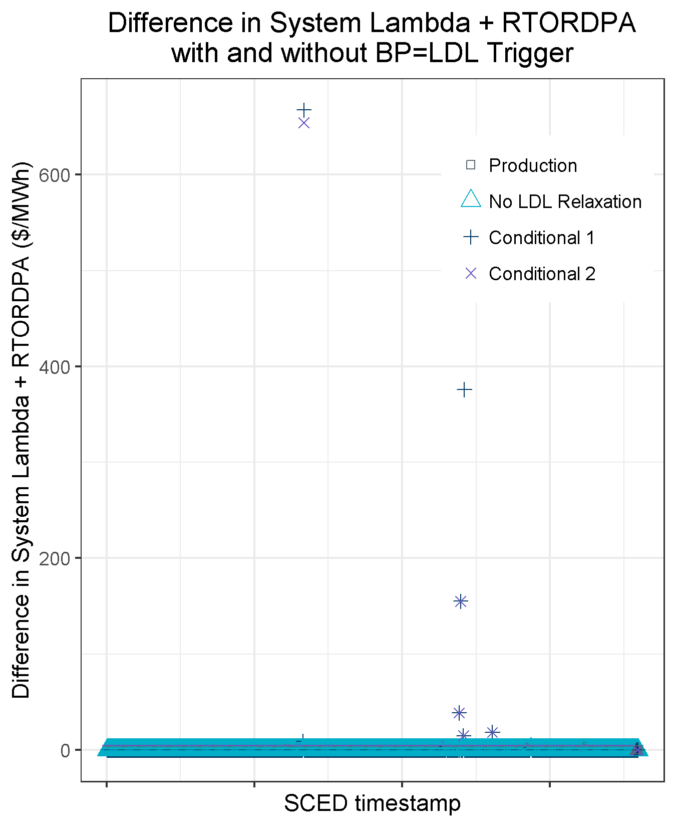
BP=LDL Trigger Had Minimal Impact
In 49 out of 2876 cases (1.7%) the BP=LDL trigger had an impact
Often the ONRUC Resource BP=LDL so the adder is calculated either way
In some cases where the ONRUC Resource BP>LDL the adder is zero
The System Lambda + RTORDPA statistics show minimal change due to the BP=LDL trigger
Given the minimal impact, the additional complexity added by this trigger may not be warranted

Slide 10
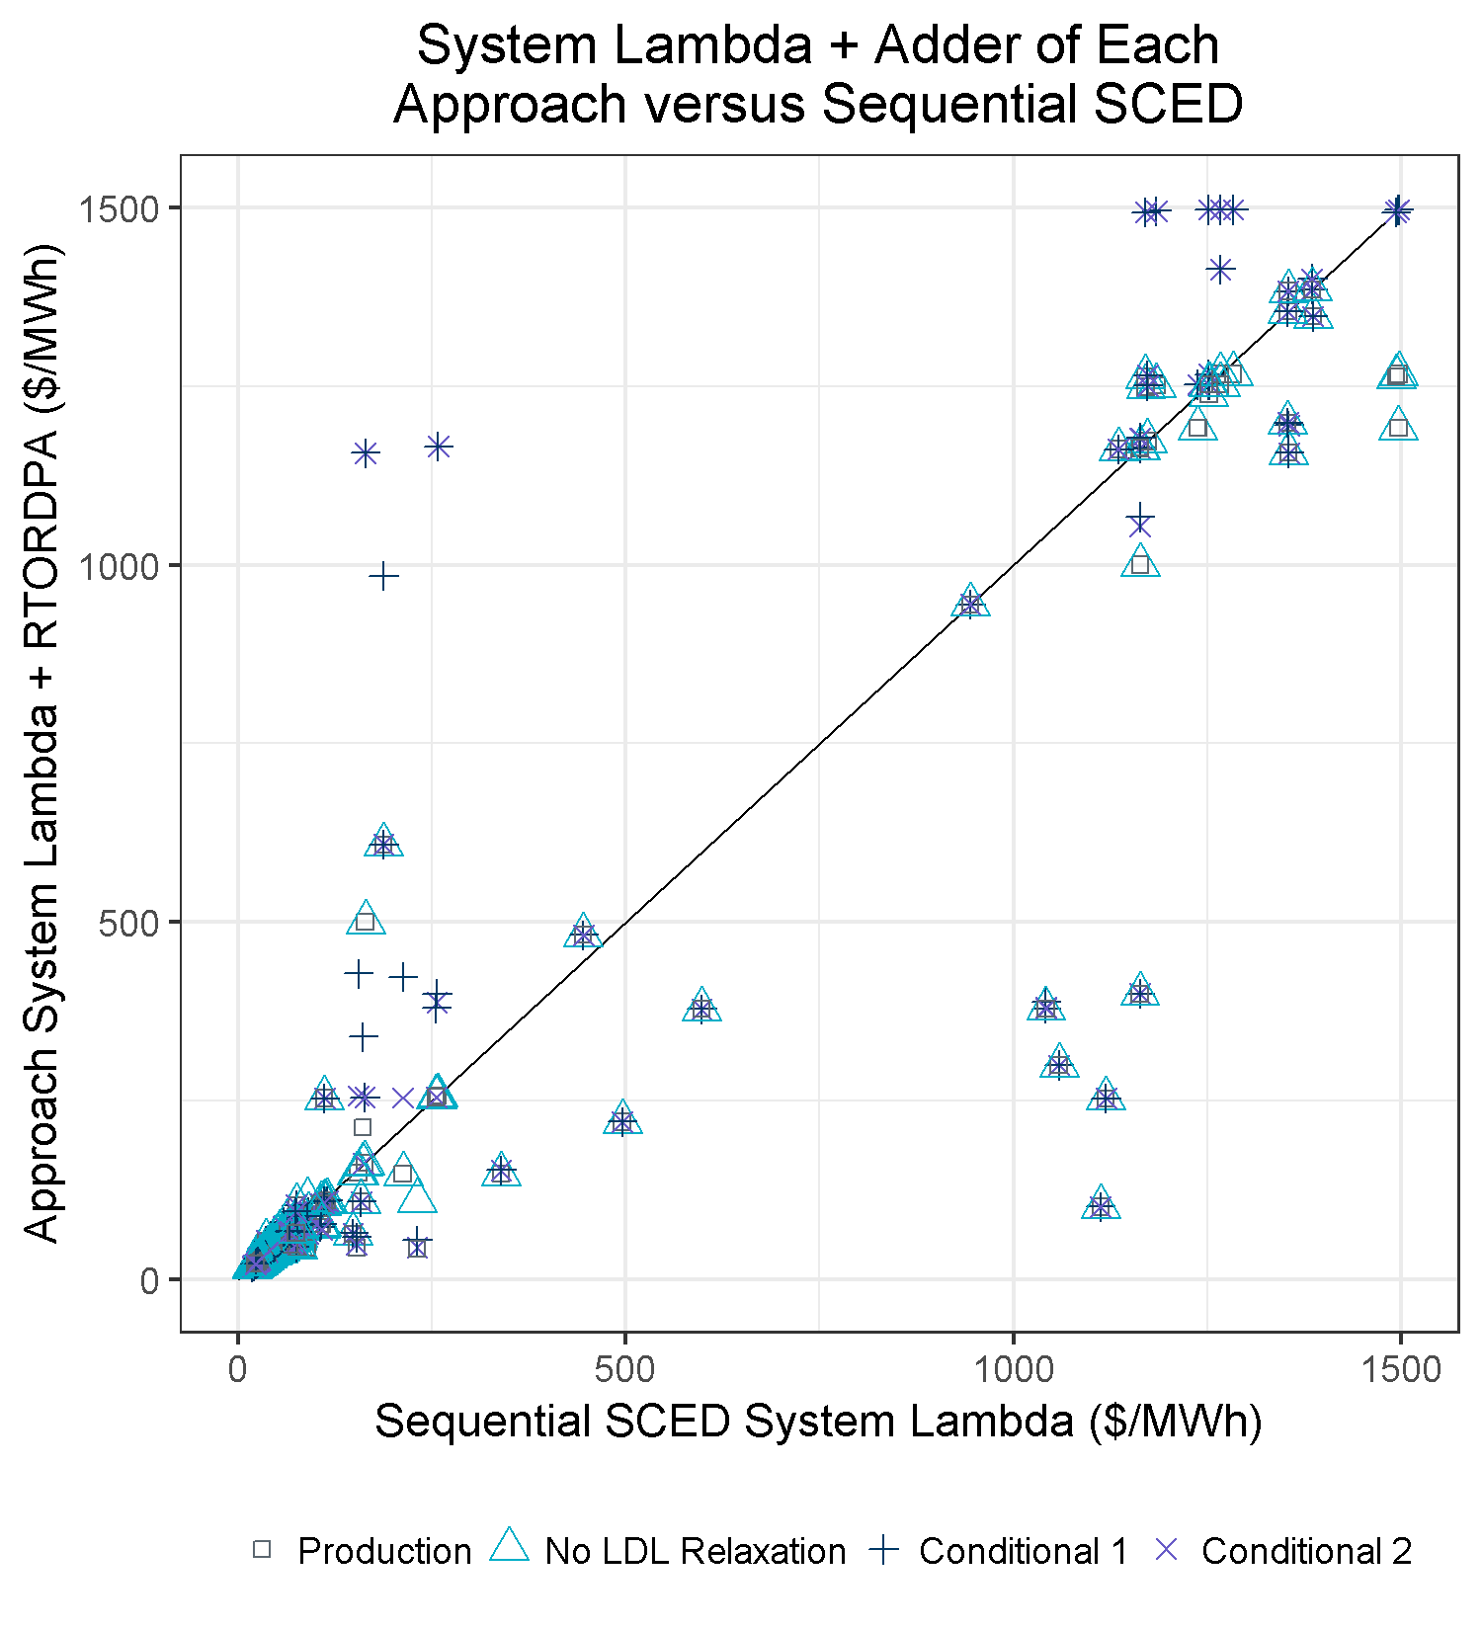
The Approaches vs. Sequential SCED
The graph shows each of the four approaches’ System Lambda + RTORDPA versus the Sequential SCED System Lambda, for the same SCED execution
Points on the line indicate good agreement between the approach and Sequential SCED
Points above and to the left of the line indicate the approach resulted in higher prices than Sequential SCED

Slide 11
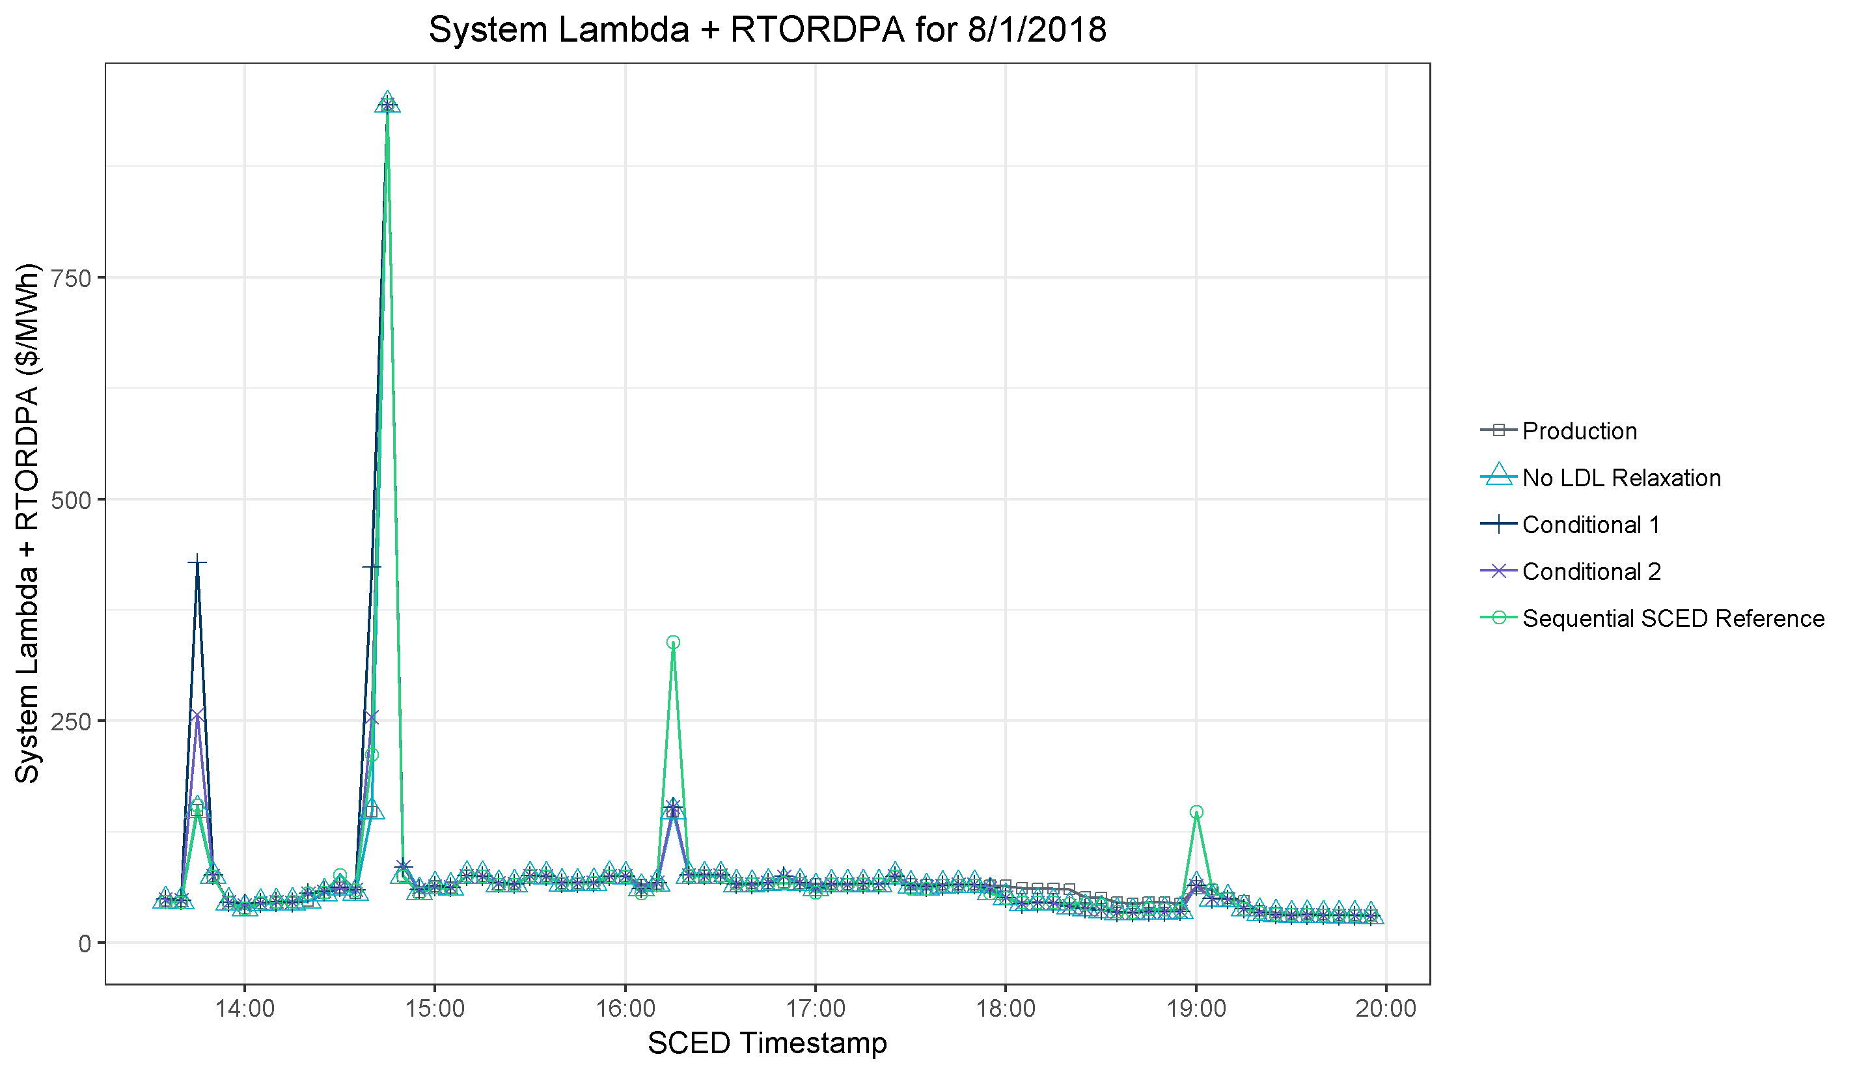
Results for 8/1/2018
Conditional 1 and 2 prices higher than Sequential SCED due to decreased HDL
Production approach produces price adders where the other approaches do not and Sequential SCED indicates adders are not appropriate. Ballpark 5 GW of capacity is ramp-limited in the dispatch run.
Sequential SCED prices higher than all approaches
For much of the time, all approaches are nearly identical.

Slide 12
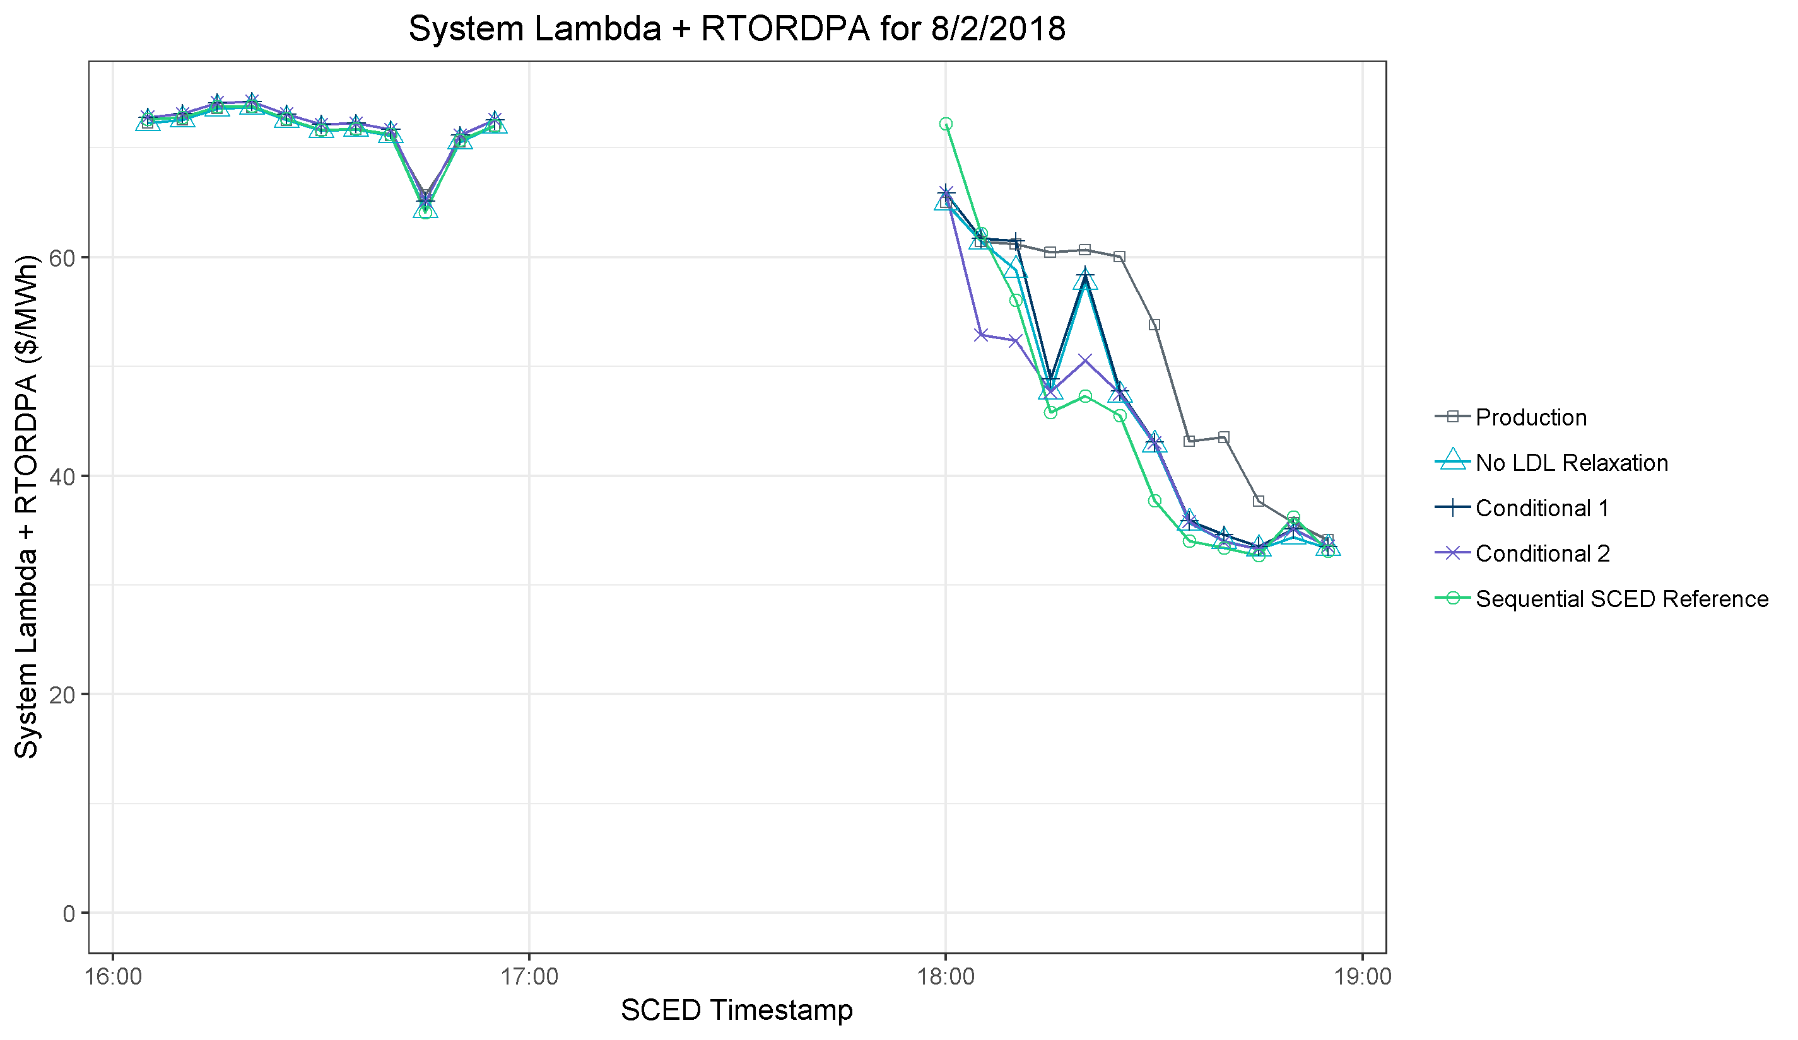
Results for 8/2/2018
All approaches nearly identical
Conditional 2 lower than others and Sequential SCED due to relaxation into AS capacity
No LDL Relaxation and Conditional 1 higher than Conditional 2 and Sequential SCED
Production approach produces price adders where the other approaches do not and Sequential SCED indicates adders are not appropriate.

Slide 13
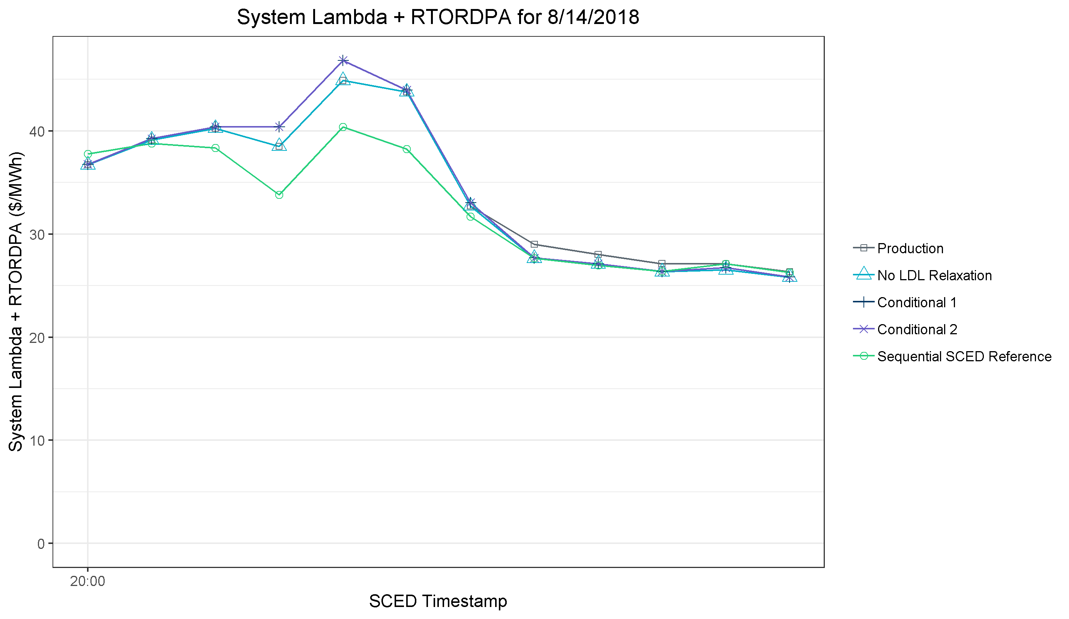
Results for 8/14/2018
Production approach produces price adders where the other approaches do not and Sequential SCED indicates adders are not appropriate.
Production and No LDL Relaxation are lower than both Conditional approaches
Sequential SCED is lower than all approaches

Slide 14
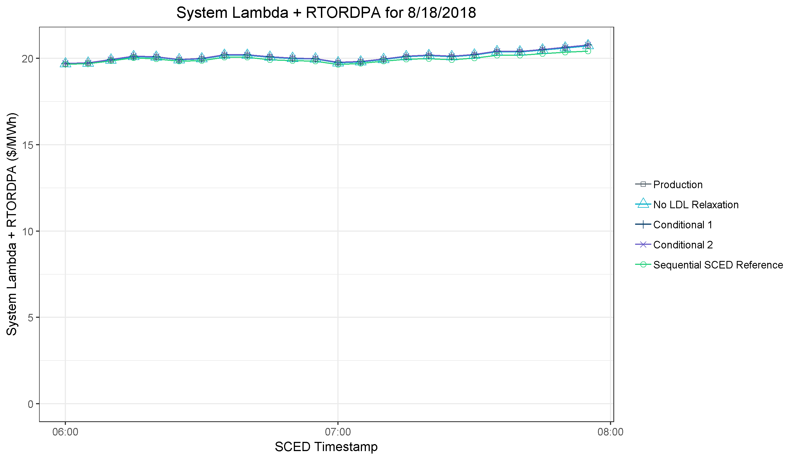
Results for 8/18/2018
All approaches are nearly identical

Slide 15
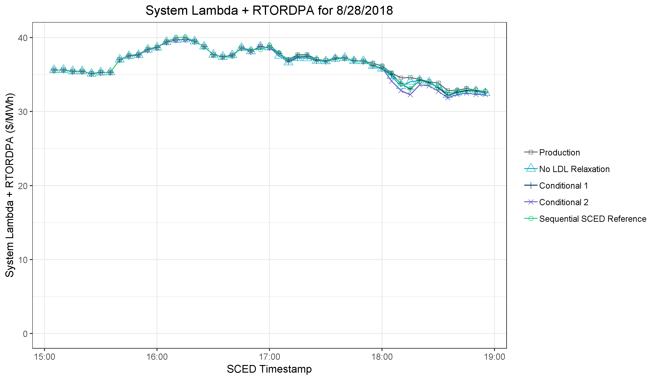
Results for 8/28/2018
Production approach produces price adders where the other approaches do not and Sequential SCED indicates adders are not appropriate.
All approaches are nearly identical for much of the RUC period
Conditional 1 has the closest match to Sequential SCED
Conditional 2 is below Sequential SCED due to relaxation into AS capacity

Slide 16
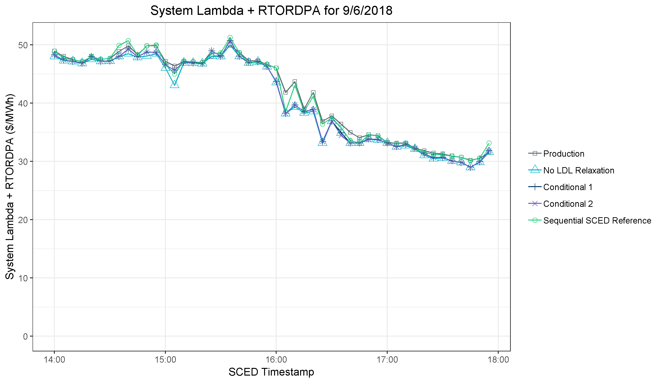
Results for 9/6/2018
Production has the closest match to Sequential SCED
No LDL Relaxation is lower due to HDL relaxation of ramp-constrained capacity
All approaches except Production are generally grouped together over the RUC period

Slide 17
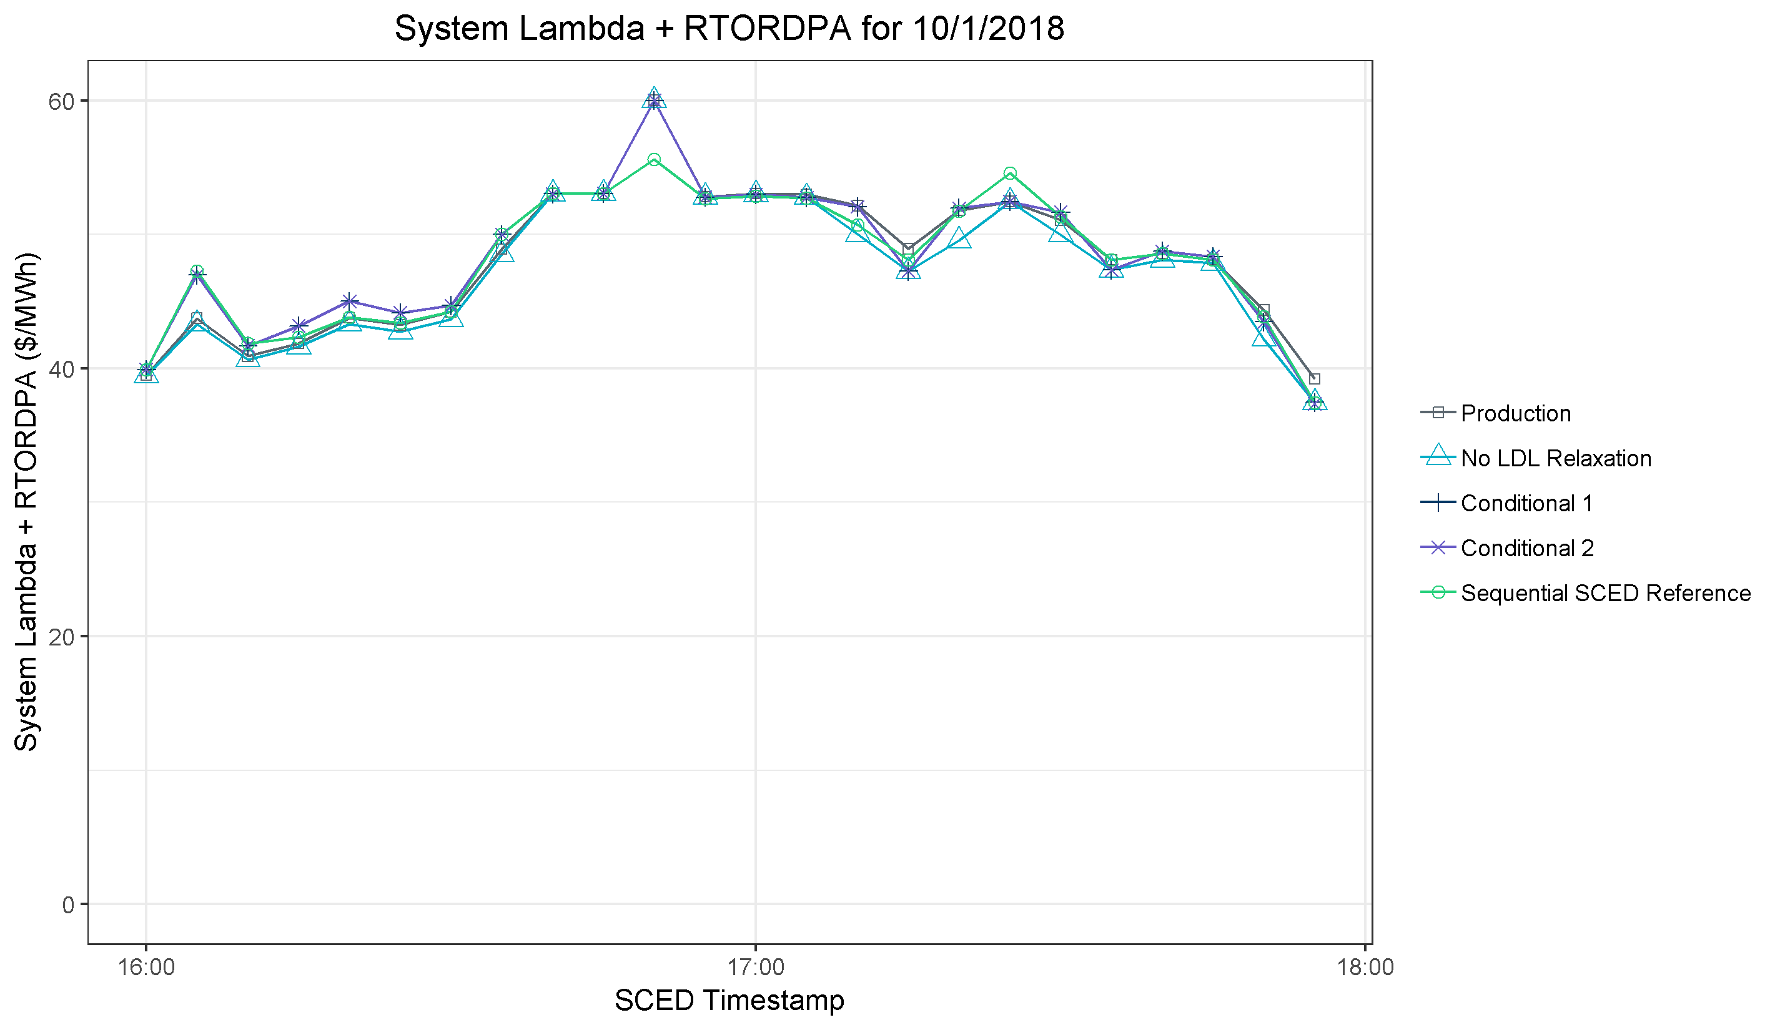
Results for 10/1/2018
All approaches have higher values than Sequential SCED
No LDL Relaxation prices are lower than the other approaches
Conditional approaches sometimes match Sequential SCED more closely, and other times Production or No LDL Relaxation match more closely

Slide 18
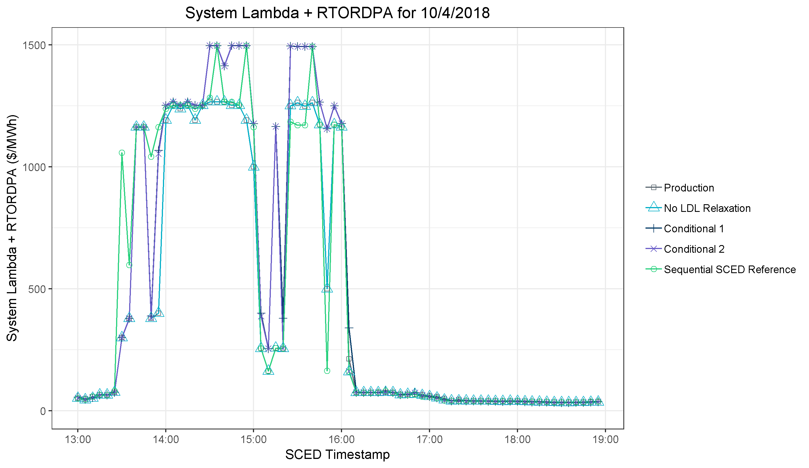
Results for 10/4/2018
Sequential SCED prices higher than all approaches
Conditional approaches have 9 intervals near $1,500/MWh whereas Sequential SCED has 3 and Production and No LDL Relaxation have zero
Conditional 1 and 2 prices higher than Sequential SCED
Production and No LDL Relaxation lower than Sequential SCED

Slide 19
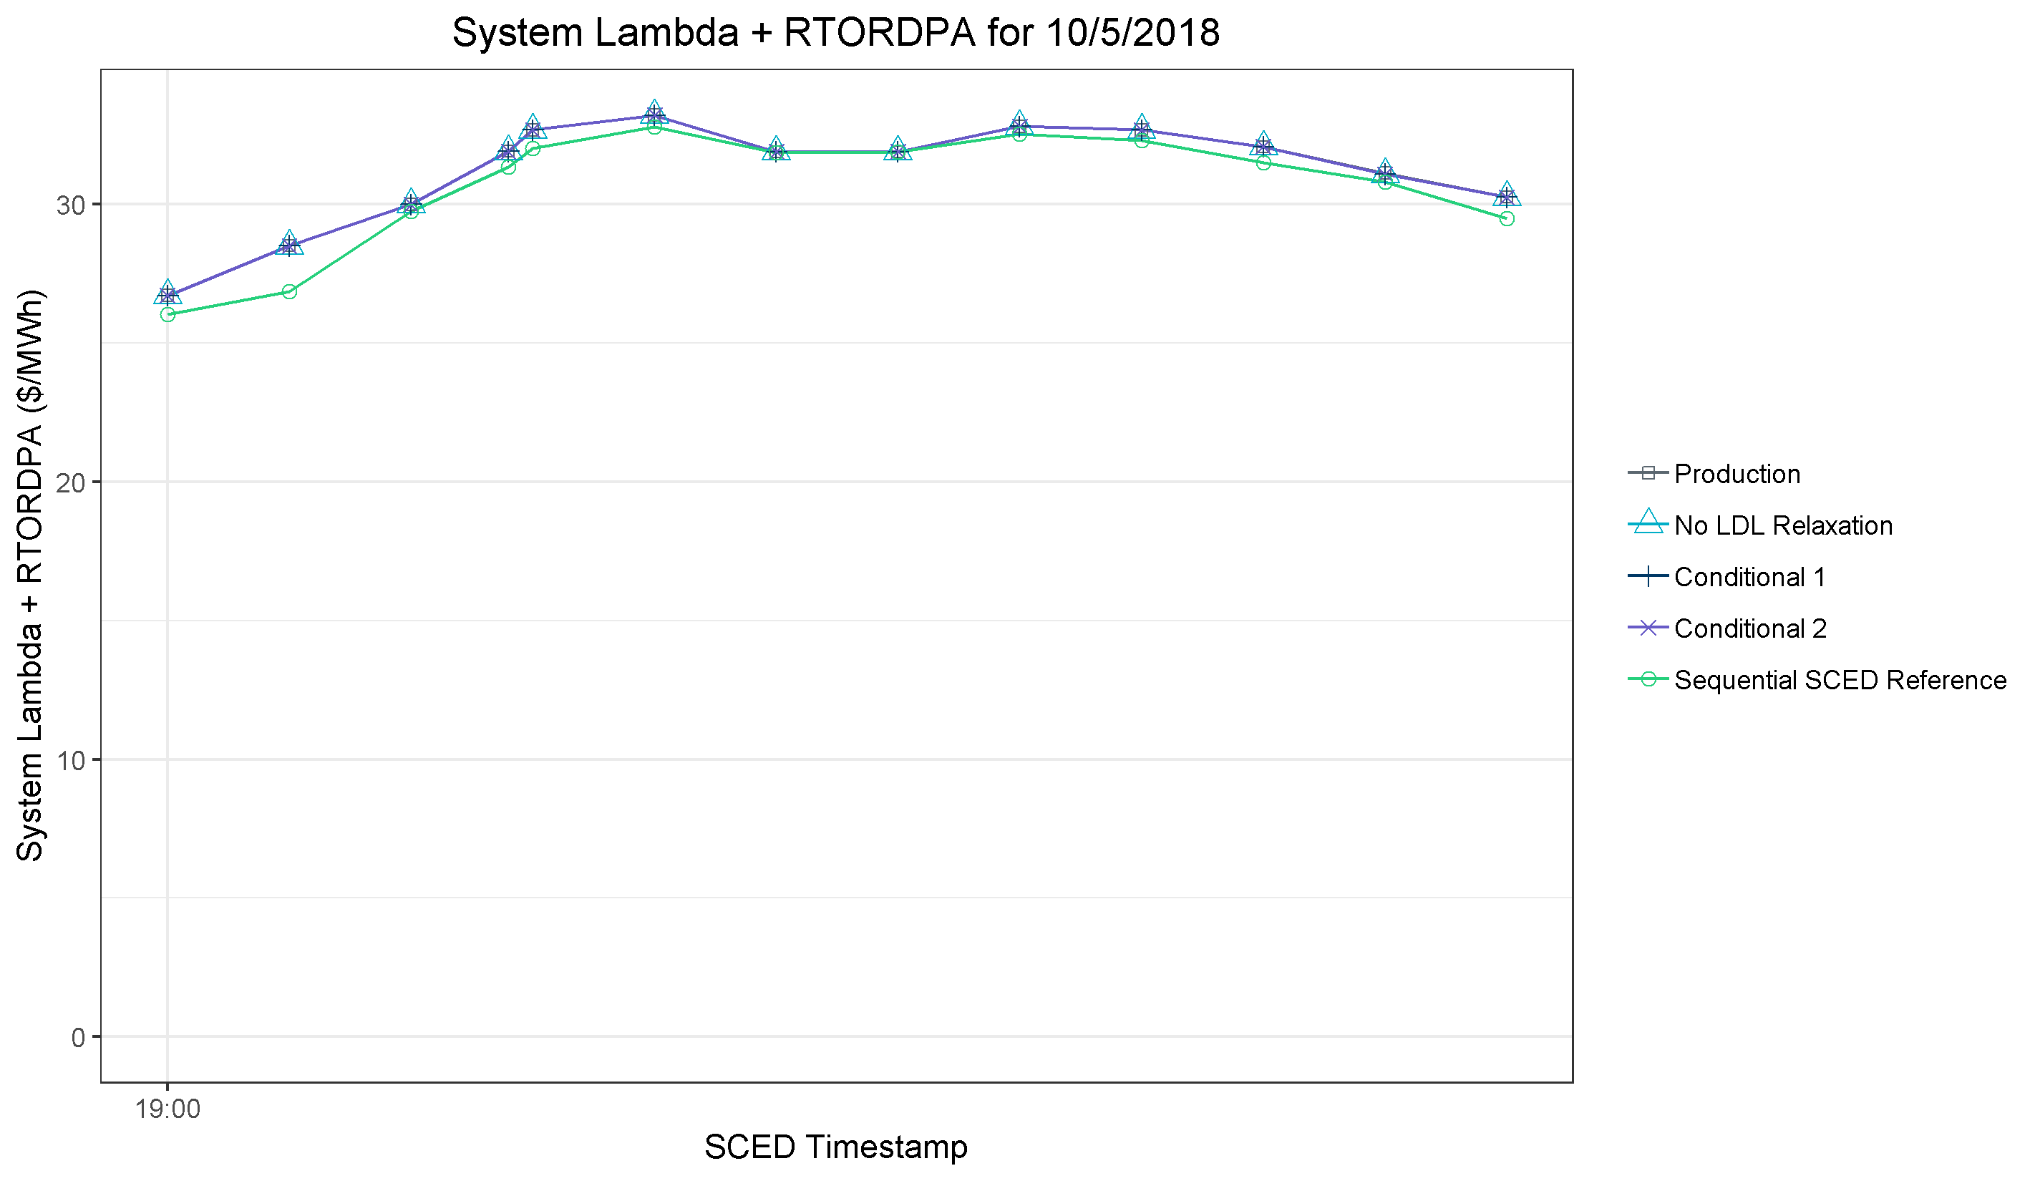
Results for 10/5/2018
All approaches are nearly identical

Slide 20
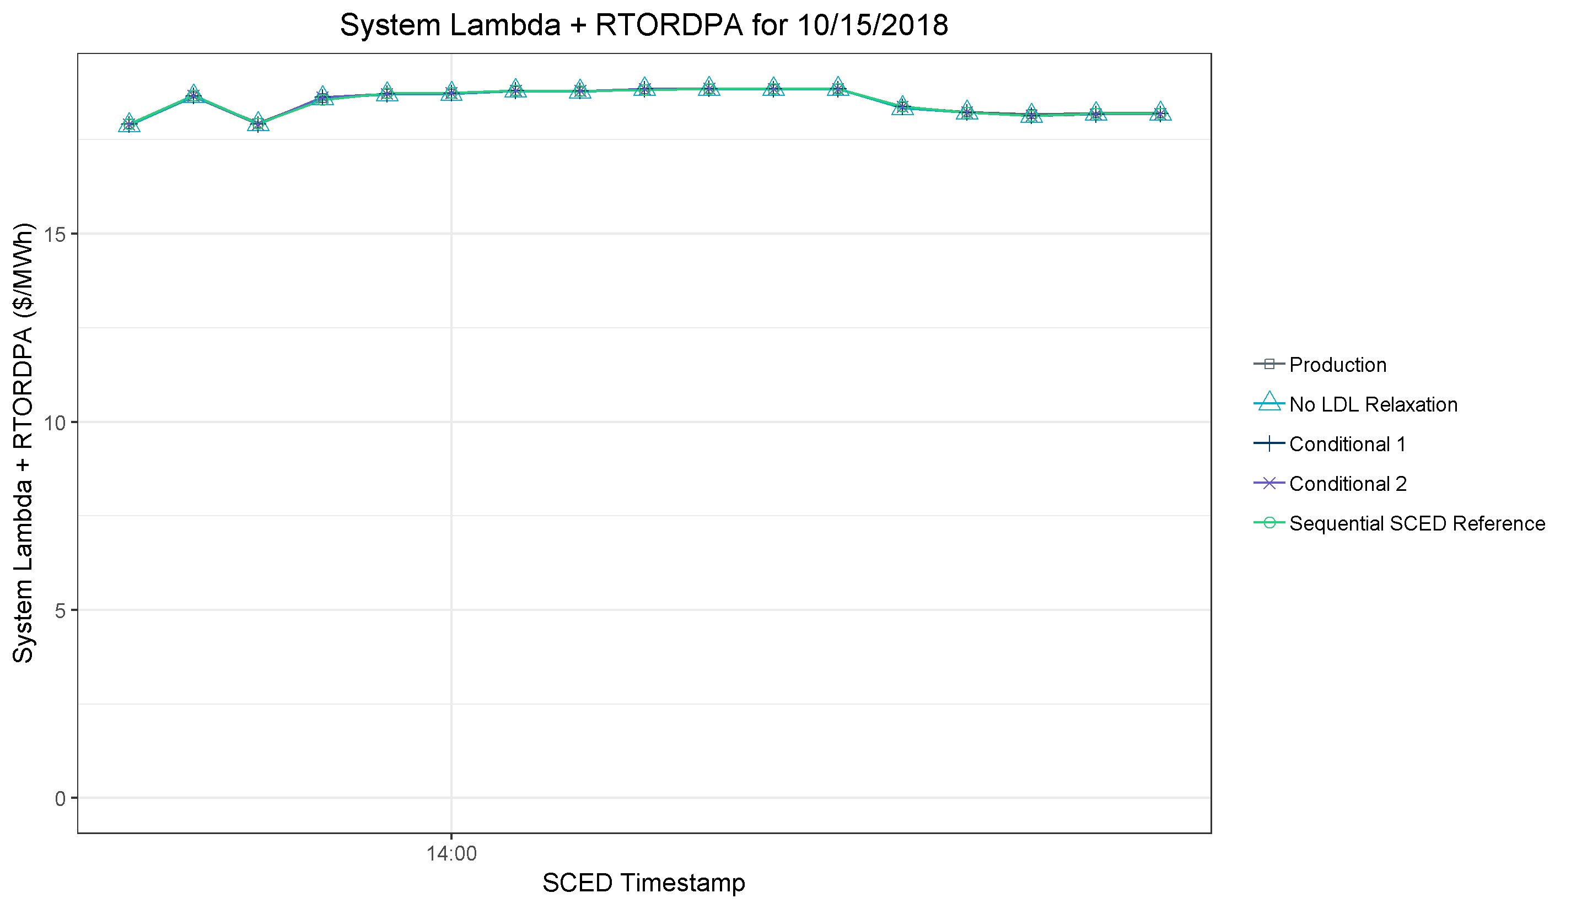
Results for 10/15/2018
All approaches are nearly identical

Slide 21
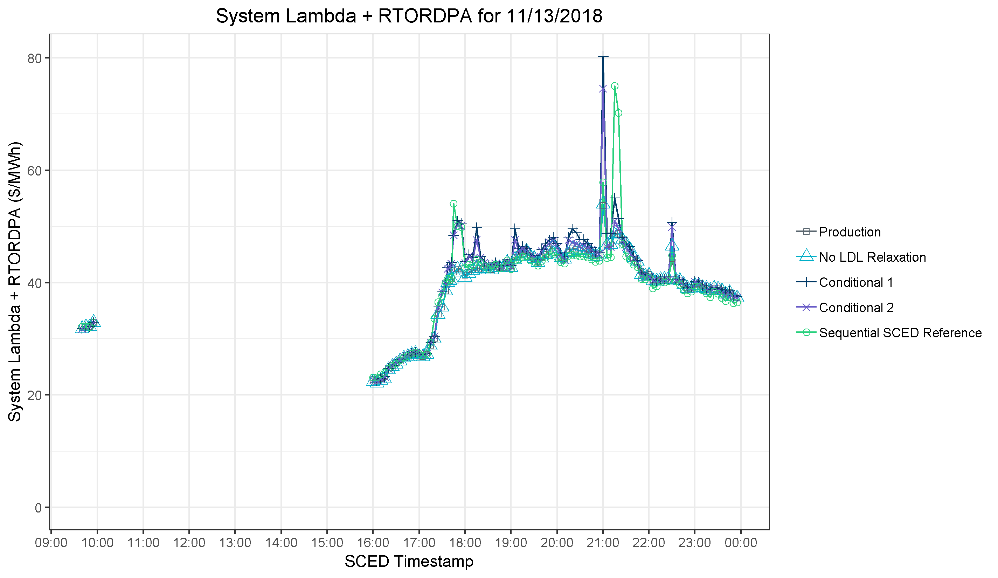
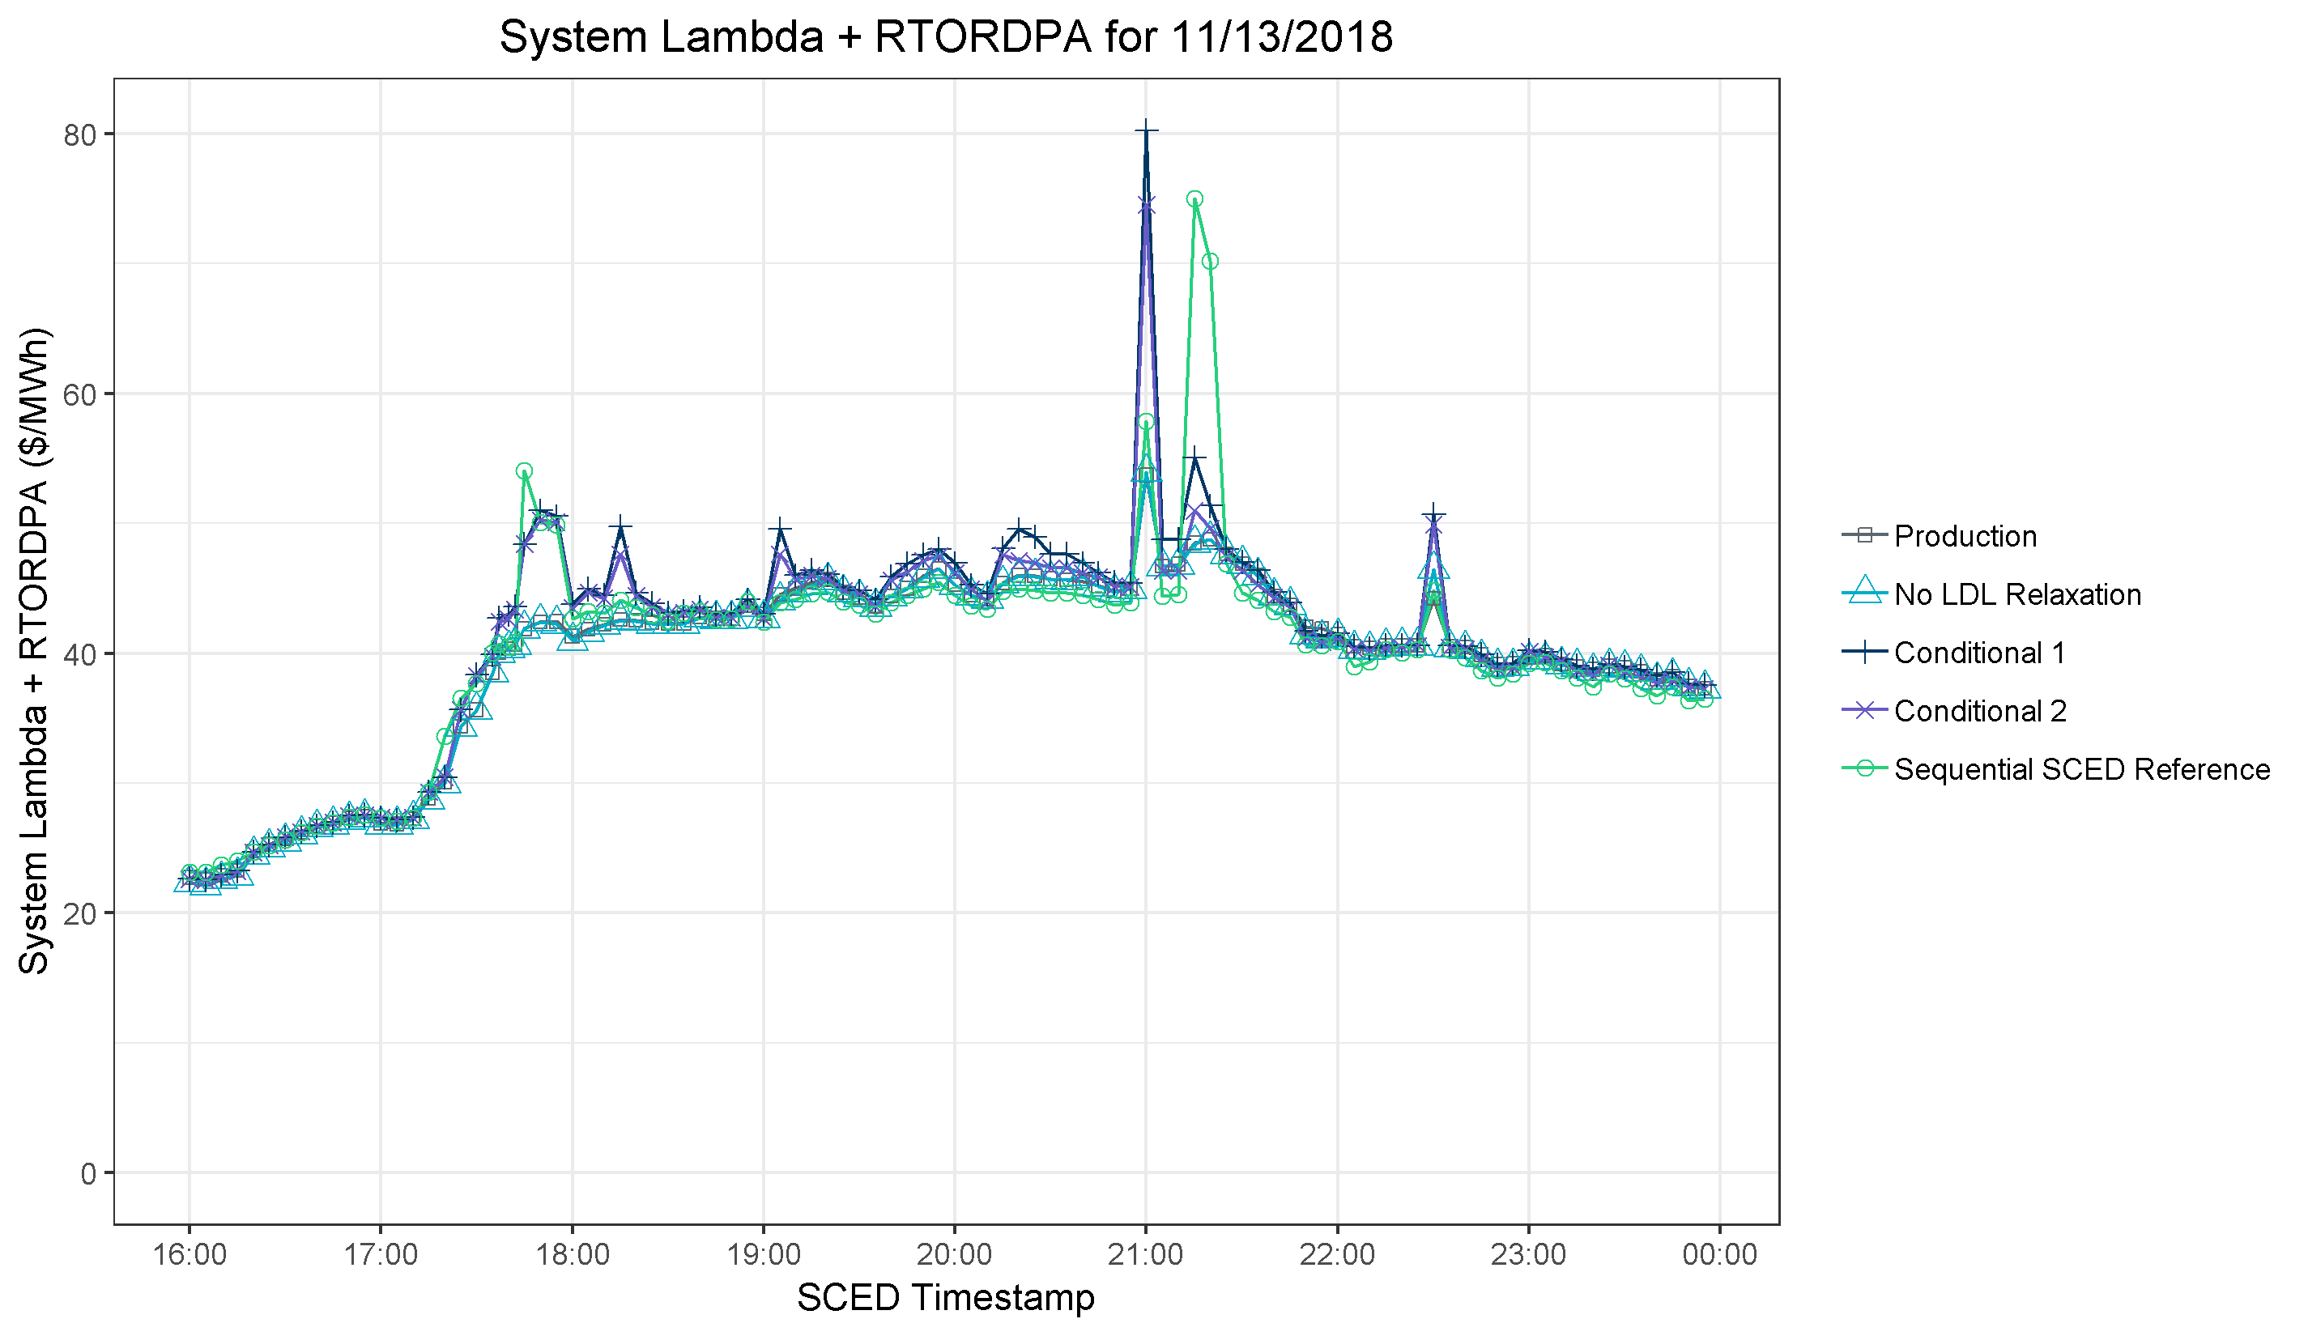
Results for 11/13/2018
Conditional 1 and 2 match Sequential SCED
Sequential SCED prices higher than all approaches
Conditional 1 prices highest throughout this period
Sequential SCED prices generally lower than all approaches
Sequential SCED prices generally lower than all approaches
All approaches nearly identical

Slide 22
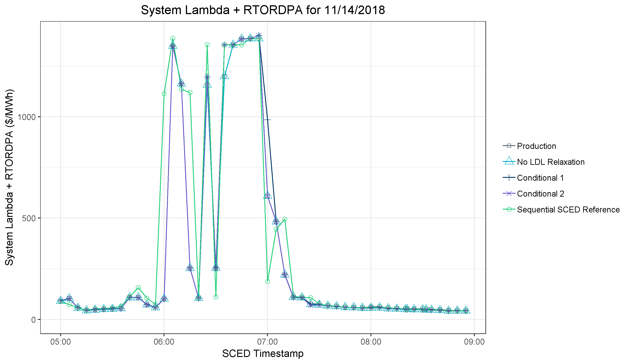
Results for 11/14/2018
Conditional 1 higher than other approaches and Sequential SCED
Sequential SCED prices higher than all approaches
Not visible: Production and Sequential SCED higher than other approaches
All approaches nearly identical

Slide 23
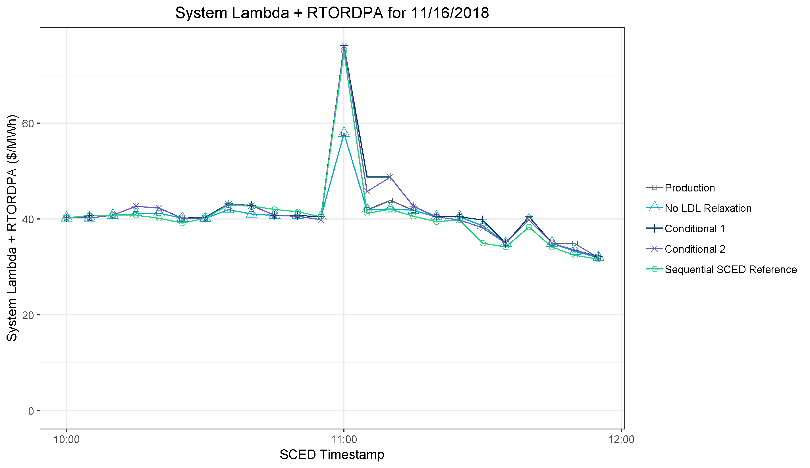
Results for 11/16/2018
Conditional 1 and 2 match Sequential SCED price spike. Production and No LDL Relaxation have lower spike.
All approaches similar

Slide 24
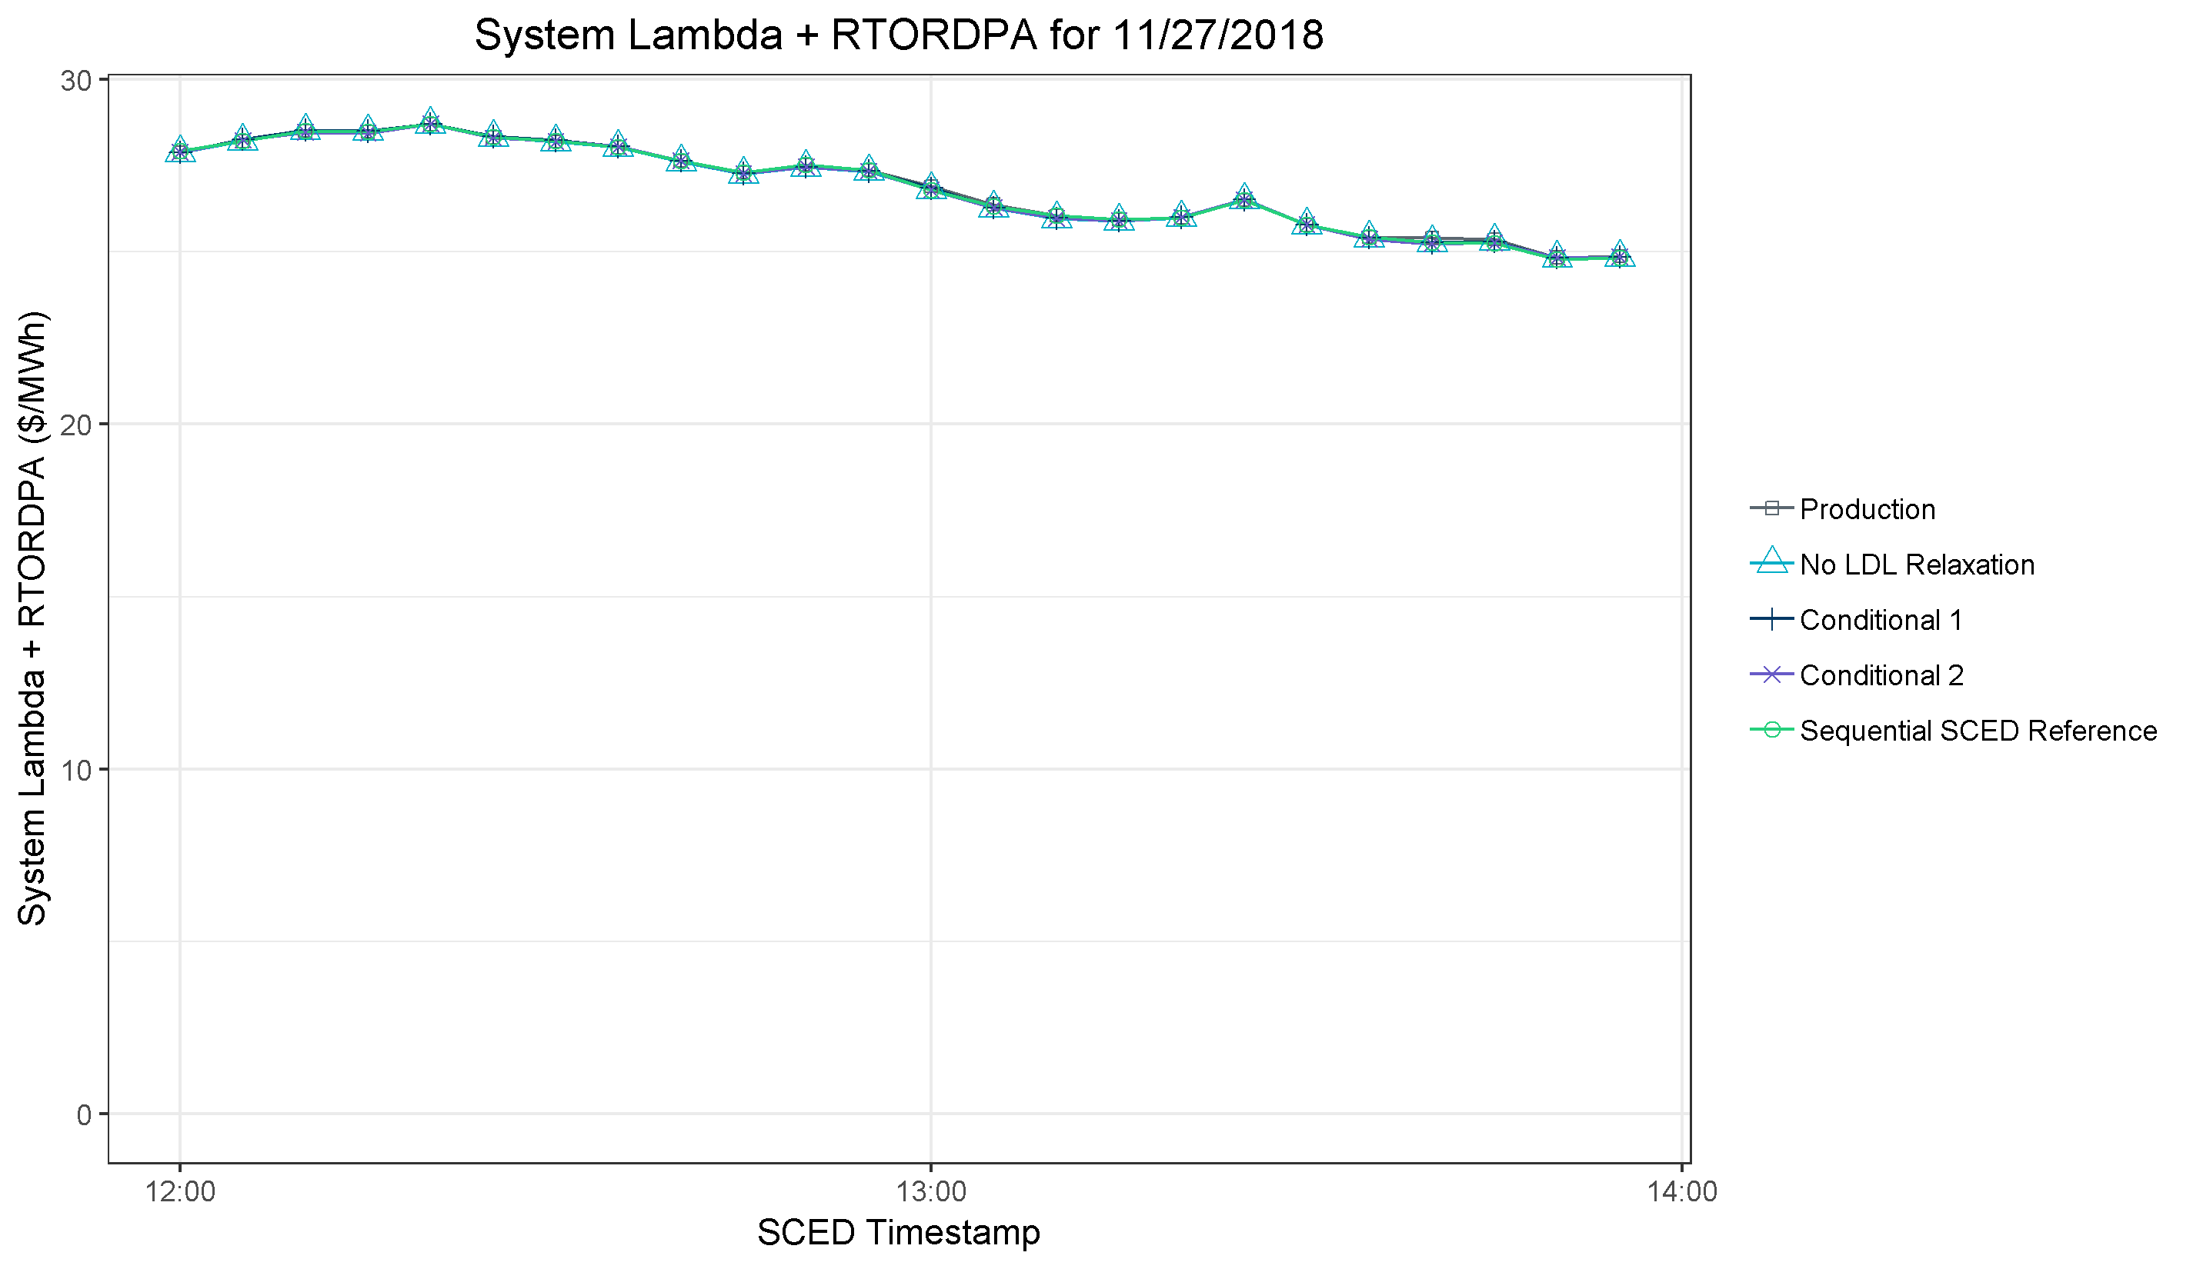
Results for 11/27/2018
All approaches are nearly identical

Slide 25
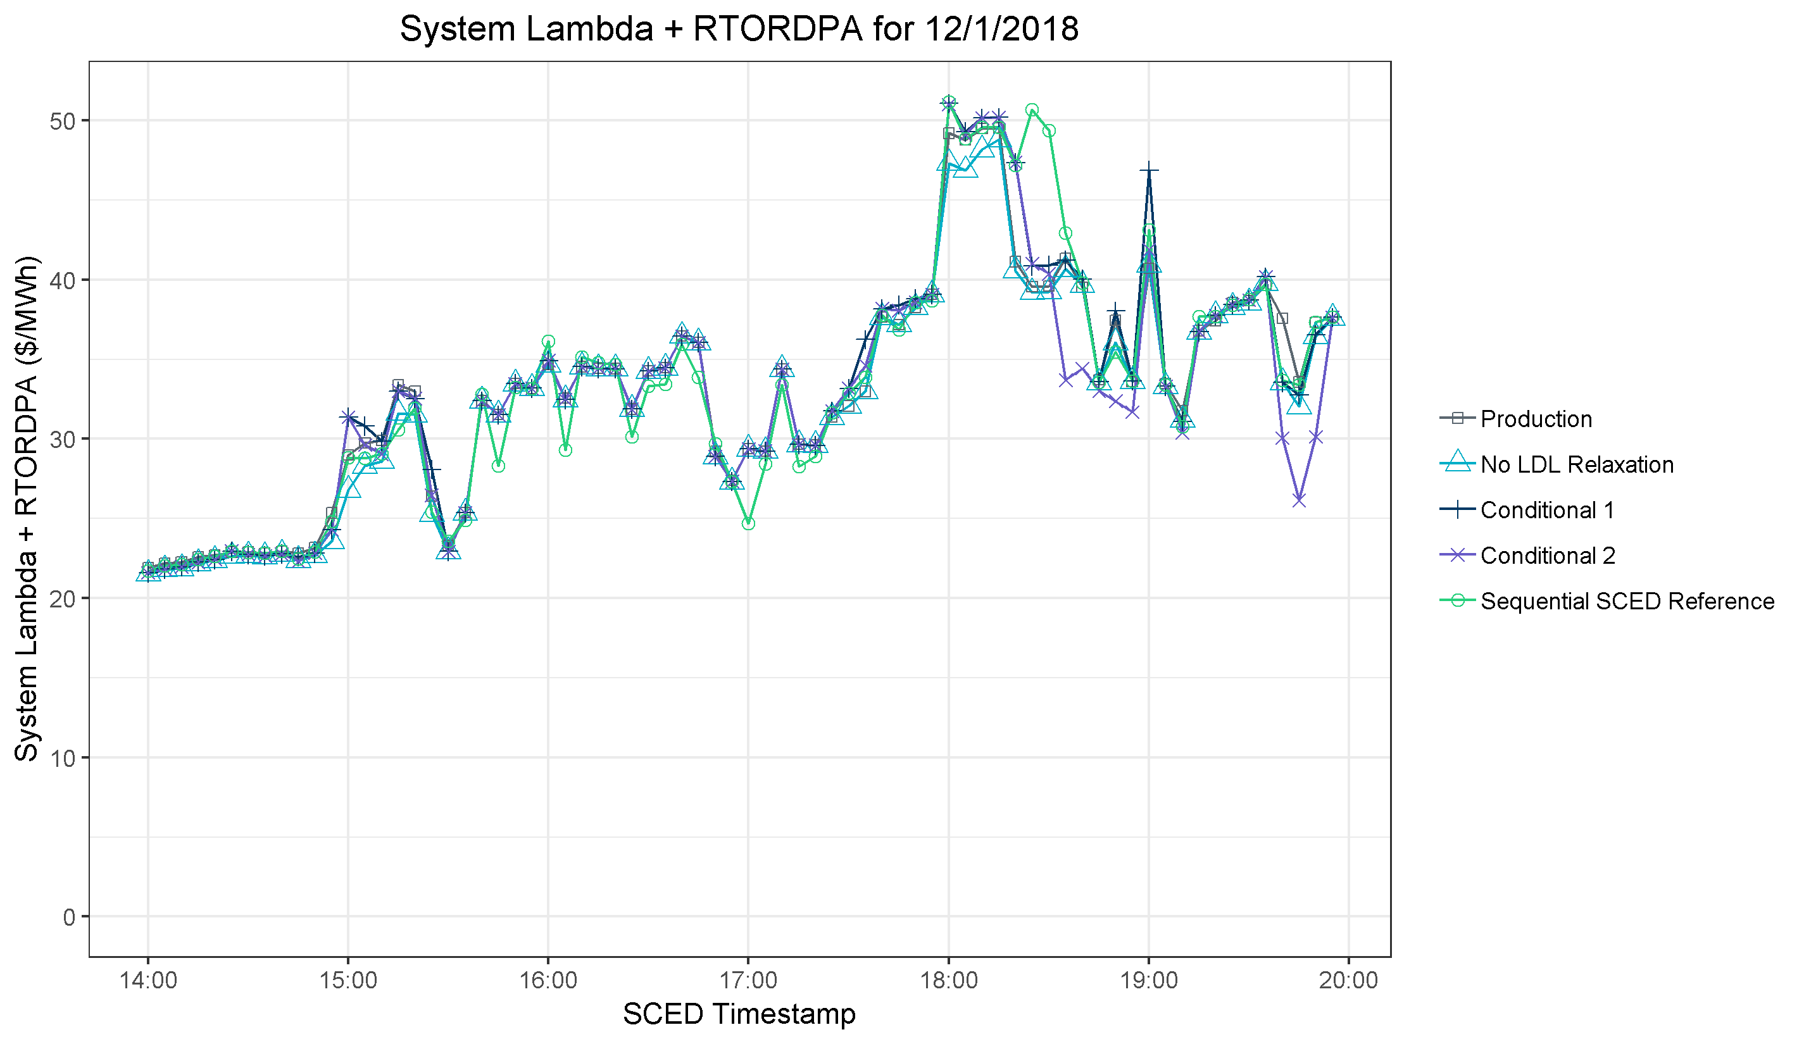
Results for 12/1/2018
No LDL Relaxation has lower values
Conditional 2 lower than others and Sequential SCED due to relaxation into AS capacity
All approaches similar

Slide 26
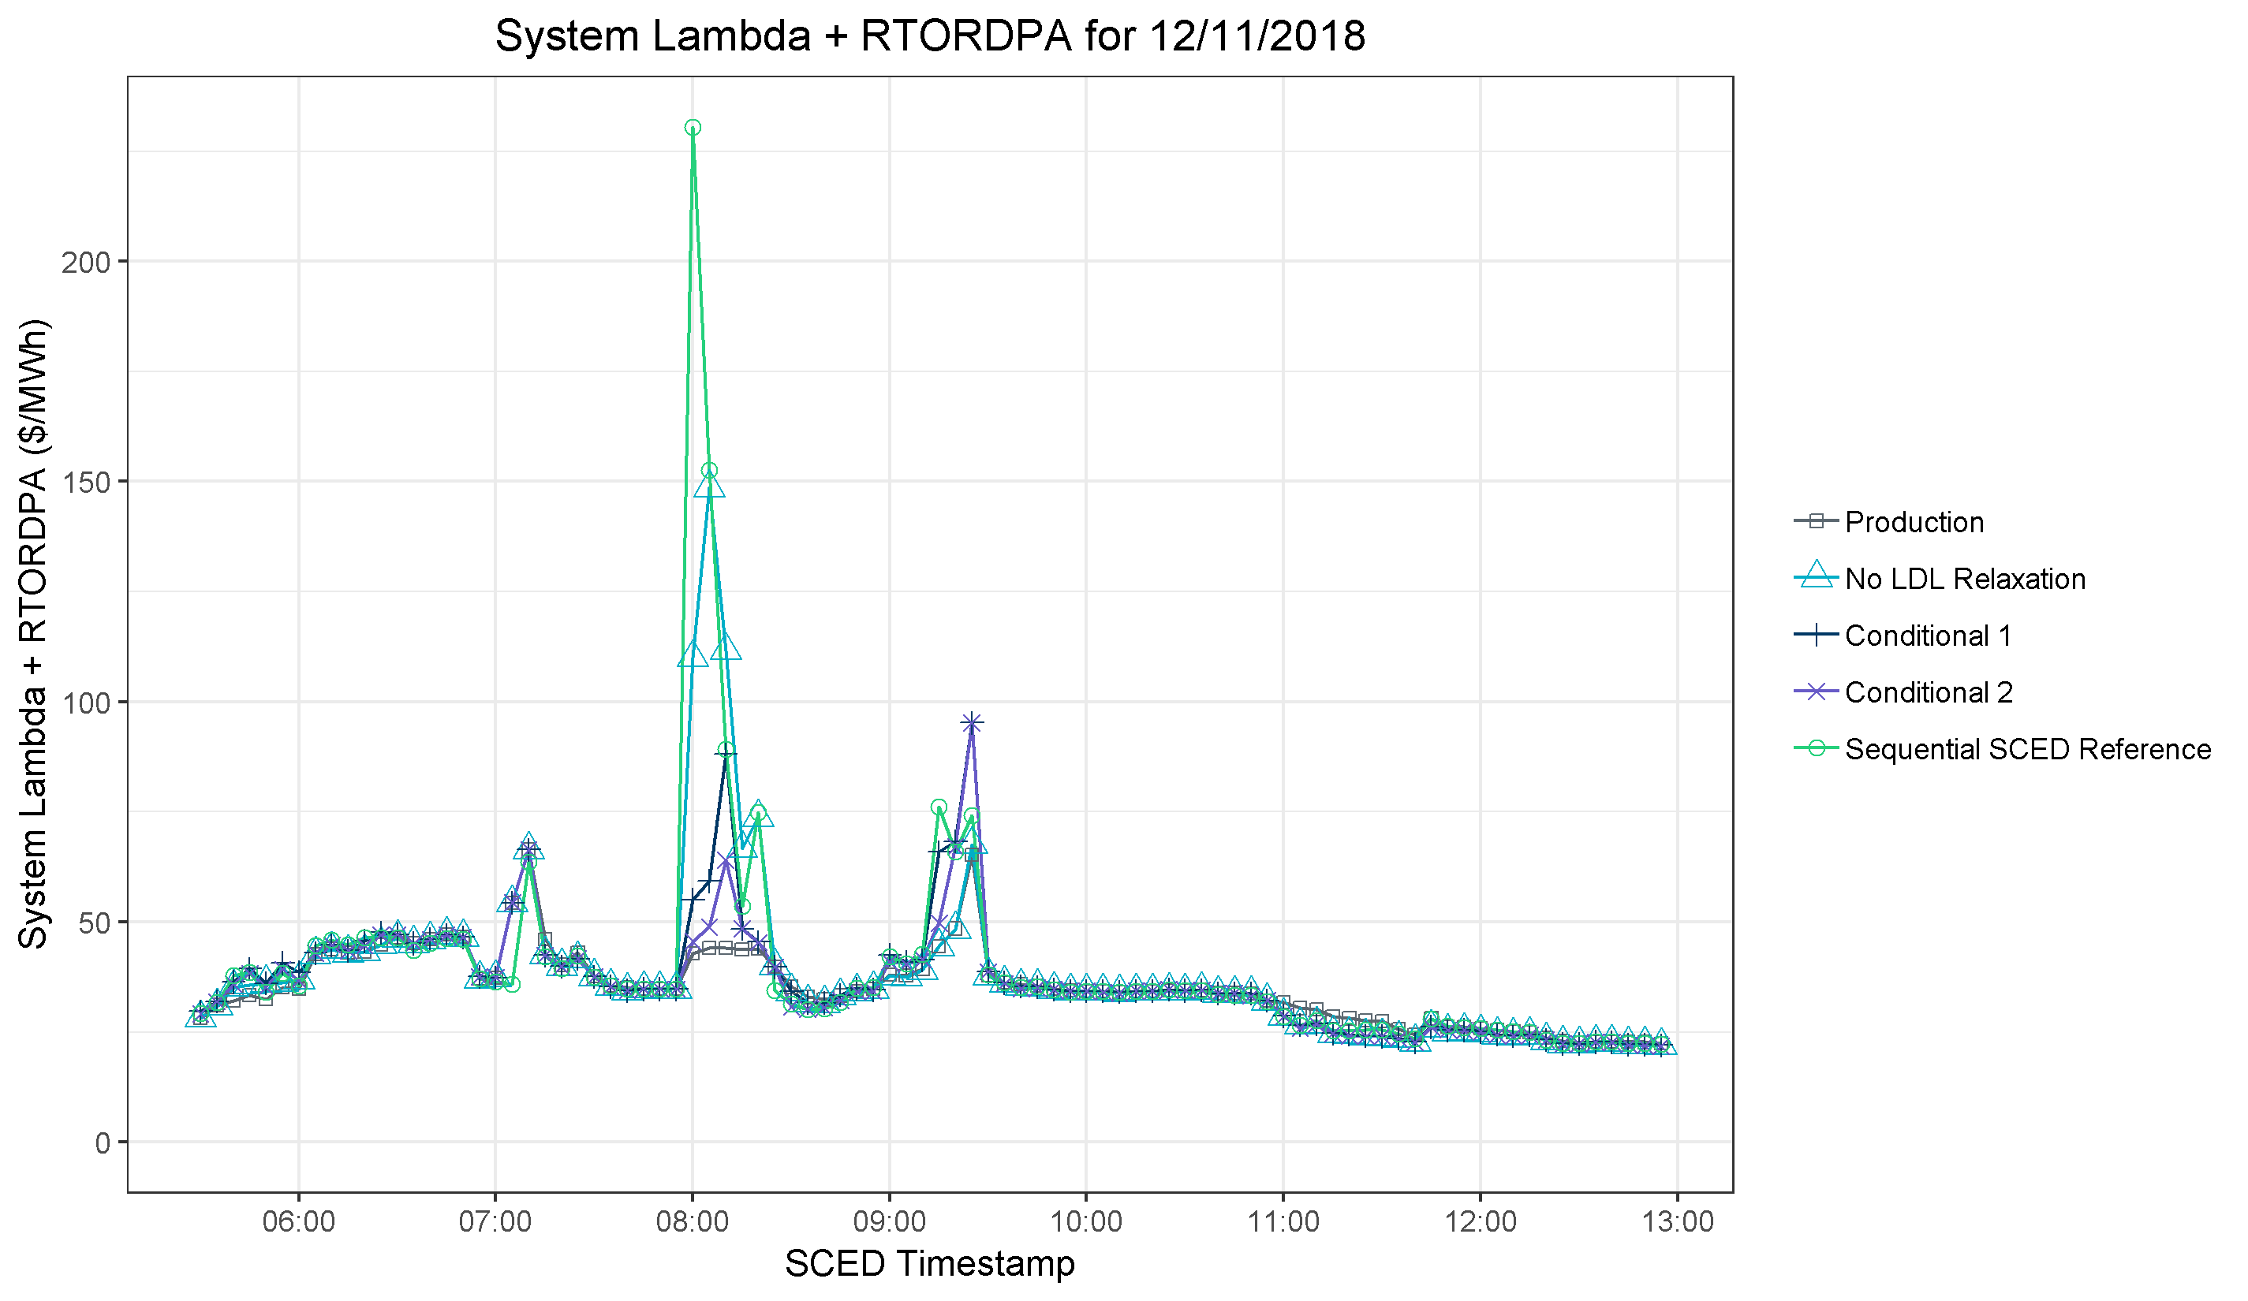
Results for 12/11/2018
No LDL Relaxation comes closest to matching Sequential SCED price spike. Conditional 1 has a small spike, and Production has no spike.
Production approach produces price adders where the other approaches do not and Sequential SCED indicates adders are not appropriate.
All approaches similar
All approaches similar
Production lower than Sequential SCED and all other approaches

Slide 27
Observations
All approaches are imperfect approximations to the alternative condition where the 0-LSL of ONRUC Resources is not price-taking (Sequential SCED)
The BP=LDL trigger for calculating the price adder rarely had a substantial impact, so adding this trigger may not be worth the added complexity
The No LDL Relaxation approach is designed to prevent price adders when there should not be, and it appears to do so, but it sometimes does not produce an adder when Sequential SCED suggests an adder is warranted
The Conditional 1 and 2 approaches are designed to create higher price adders when there should be and also prevent price adders when there should not be, and it appears to do so some of the time, but also produces higher or lower adders than Sequential SCED suggests are warranted

Slide 28
Observations
The Conditional 2 approach (relaxing HDL and LDL to HSL and LSL) results in the pricing run using capacity that is reserved behind HASL and LASL, which causes the pricing run to diverge further from the dispatch run in terms of physical meaning. This effect also resulted in lower adders than Sequential SCED suggests were warranted in a few cases.

Slide 29
Conclusions
After completing this analysis, and acknowledging that both approaches are imperfect approximations, ERCOT suggests moving ahead with either the No LDL Relaxation approach or the Conditional 1 approach.
However, ERCOT still has concerns with other aspects of NPRR904, as has previously been discussed
Concern for creating an incentive to schedule above advisory limits in order to trigger a price adder
Concern for capturing the information necessary to implement NPRR904
Other discussions related to alternatives to NPRR904 are ongoing
Treating DC tie exports more similarly to non-DC tie load

Slide 30
Conclusions
If stakeholders wish to move forward with a fix to the RTORDPA, ERCOT could submit a separate NPRR to separate the two issues
If stakeholders wish to pursue this path, ERCOT would request WMS vote on which of the two approaches to pursue (No LDL Relaxation or Conditional 1)

