Slide 1
PGDTF GIC Model Building Update
Eric Meier
Model Administration
4/11/2019

Slide 2
Agenda
Model Building and General Updates
Pass 1 Responses
How to use the GIC template
GIC Tool Updates
Discussion Items

Slide 3
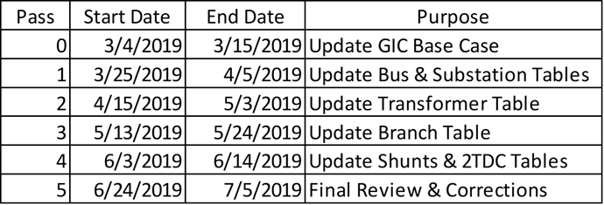
Model Building Schedule

Slide 4
General Update
Pass 1 concluded on 4/5/19
Pass 2 begins on 4/15/19 to update the transformer table
Updated Documents:
  Contact List
  GIC Modeling Expectations
    Ungrounded Station RG value, fixed missing branch table explanations, underground cables
Once Pass 2 is completed we will be able to run the GIC flows and distribute the results
New 6.9(2) generators and submitted Idevs have been incorporated
MIS GIC links have been updated

Slide 5
GIC Modeling Expectations Update
Added descriptions for branch RLNSHI and RLNSHJ fields which are in the provided template but did not exist in the GIC Modeling Expectations
Added how to model underground cables
Changed the substation RG value to be 99 and not 99999 when the station is ungrounded
The PSSE Version has been changed to version 34.5.1 per the request of ERCOT Planning.

Slide 6
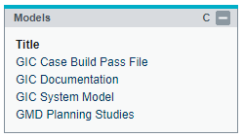
MIS Postings Updates
There is a new structure to the MIS Links for GIC Models and Planning Studies
GIC Case Build Pass File – Will contain all the information needed for each pass
GIC Documentation – Modeling Expectations, Contact List
GIC System Model – Completed GIC Models
GMD Planning Studies – GIC Study material (for ERCOT Planning)

Slide 7
Pass 1 Responses

Slide 8
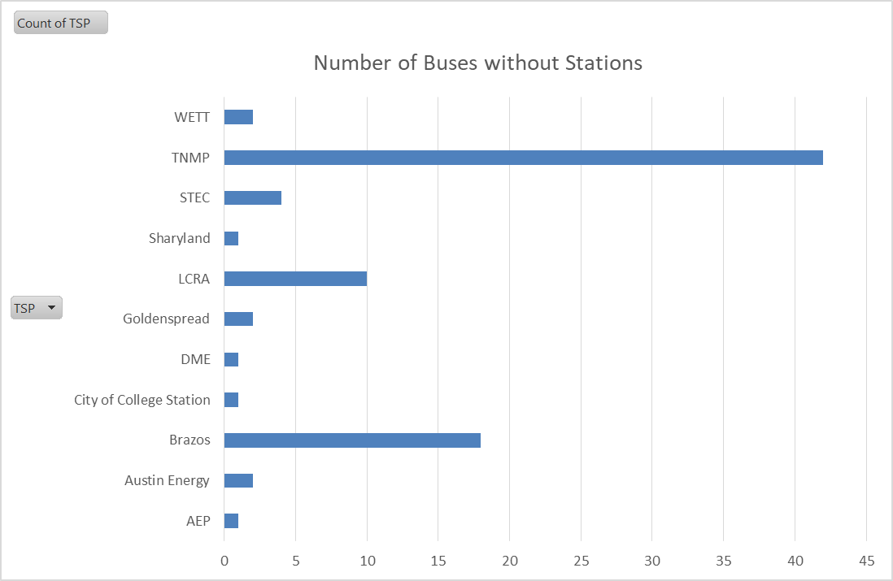
Remaining Data Issues From Pass 1
There are 84 buses without stations
  Some of these are due to imports which tried to duplicate buses
There is one set of duplicate stations
There are 14 buses with a station, but the station doesn’t exist

Slide 9
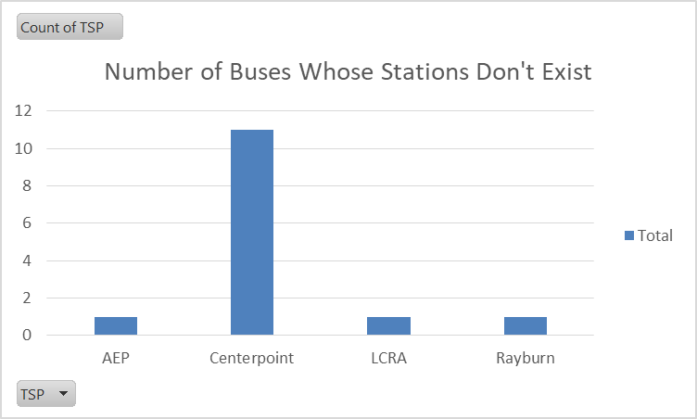
Remaining Data Issues From Pass 1 Cont.
Duplicate station: AEP
Buses whose stations don’t exist:

Slide 10
Thoughts on the model build so far?

Slide 12
How to use the GIC Template

Slide 13
Template Naming
The template provided has the following naming convention:
  Company_TSP_GIC_Template
Please rename it to this upon your submission:
  [Insert Company Name Here]_GIC_TSP_Template_PassX
  With X being the current pass number

Slide 14
Zip File Encryption
When submitting the templates, you may encrypt the Zip files
Do not encrypt the Excel file itself
Zip up the Excel file and then encrypt the zip file to avoid possible corruption of the Excel file
Send the password in a follow up email

Slide 15
Send all submissions to GMDData@ercot.com
For questions, please call or email Eric Meier:
  Eric.Meier@ercot.com
  512-248-6770

Slide 16
Using the Template to Change the DC Model
Here are some important notes for how to use the template.
All data in the following examples has been made up and does not represent any real information
If information in a record is not changing, then nothing needs to be changed for that row
The ID (ID1 for FixedShunt) column value is automatically generated by the database and should never be modified

Slide 17
Adding Elements to the DC Model
When adding elements:
There must be a 1 in the Modification Column
ID (ID1 for FixedShunts) must be blank
Set SUM = TRUE if the element is in the SUM case
Set MIN = TRUE if the element is in the MIN case
Set both SUM and MIN to TRUE if the element is in both cases

Slide 18
Modifying Elements in the DC Model
When modifying elements:
There must be a 1 in the Modification Column
ID (ID1 for FixedShunts) must be the ID (ID1) provided in the template
  This cannot be modified or edited
SUM and MIN should already be set otherwise:
  Set SUM = TRUE if the element is in the SUM case
  Set MIN = TRUE if the element is in the MIN case
  Set both SUM and MIN to TRUE if the element is in both cases

Slide 19
Deleting Elements to the DC Model
When Deleting elements:
There must be a Delete in the Delete Column
ID (ID1 for FixedShunts) must be the ID (ID1) provided in the template
  This cannot be modified or edited
No other info needs to change

Slide 20
Logic for Additions, Modifications, Deletions
If ID is blank and MOD = 1 then
  Element is added to the case
Elseif ID is populated and MOD = 1 then
  Element is modified based on submitted data
Elseif ID is populated and Delete = Delete
  Element is deleted

Slide 21
Other Template Info
Do not make changes to the Excel Sheet Names or delete any sheets
If there are no changes to be made on a particular sheet, all the data (except the column titles in Row 1) can be deleted before submission
You may modify the spreadsheet so it only contains changes from your company
  See the attached example template which only modifies the three substations on the sheet and nothing else

Slide 22
Review Example Template

Slide 24
GIC Tool Updates

Slide 25
GIC Tools Updates
Added code to prevent import of duplicate buses and stations
The log will say if the addition was an attempted duplicate
Job Log was updated to allow it to show the success or failure of an import
Validation is now possible to find duplicate buses and stations

Slide 26
Ungrounded Stations and Underground Lines
RG = 99 not 99999
The validation rule (RG = 99) conflicted with the modeling details for substations (RG = 99999)
For underground lines:
Set INDVP = 0
Set INDVQ = 0

Slide 27
Discussion Items

Slide 28
Transformers
For transformers that have an RE bus on one winding and a TSP bus on another winding
The respective TSP should model the transformer (fill out any necessary information)
If the respective TSP does not own the transformer, please notify the ERCOT Modeler at GMDData@ercot.com

Slide 29
Questions?
If you have any questions, please reach out to: Eric.Meier@ercot.com

