Slide 1
CRR Portfolios – Obligations only
Carrie Bivens
Manager, Forward Markets
April 18, 2019

Slide 2
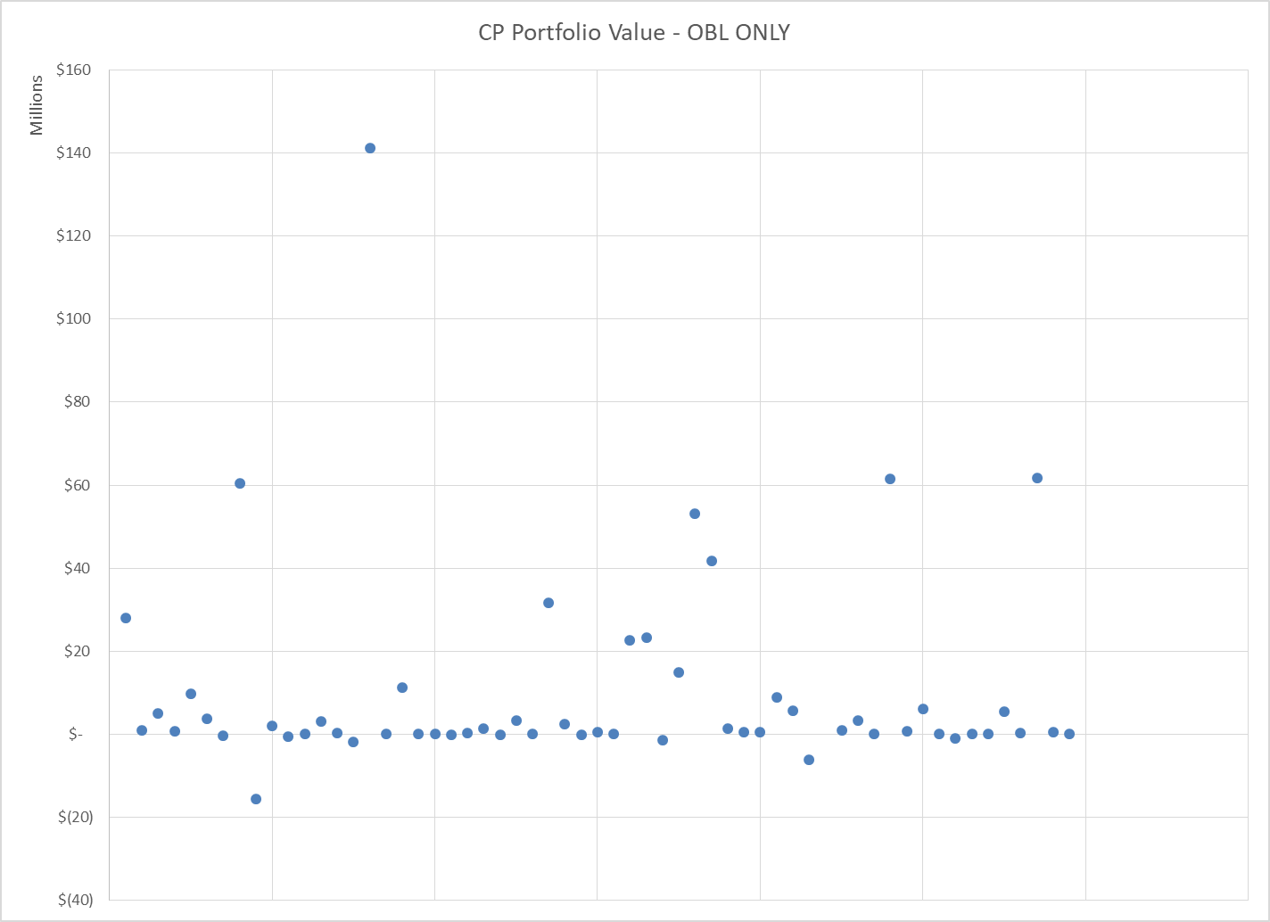
Scatter

Slide 3
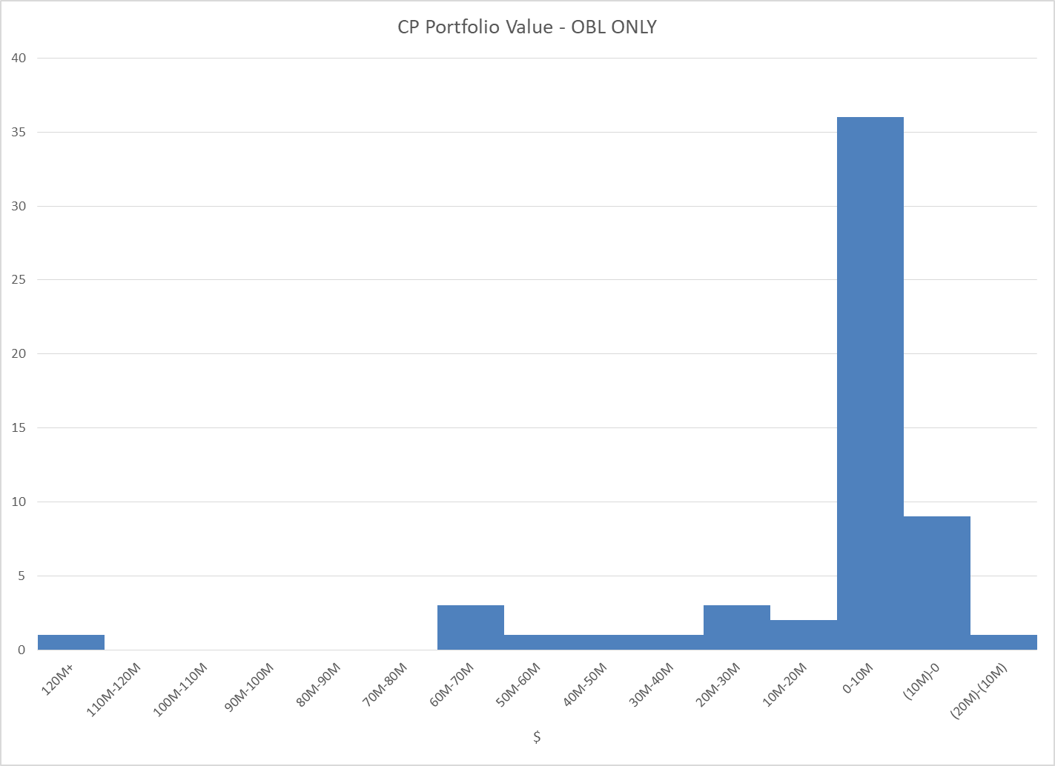
Histogram

Slide 4
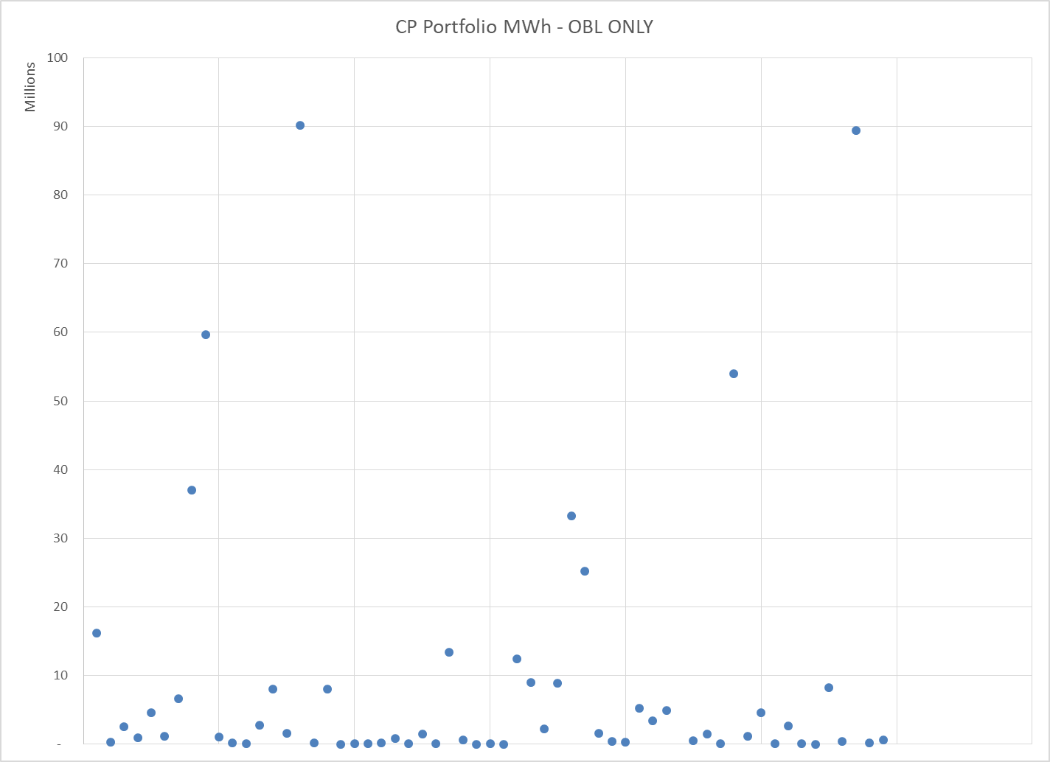
MWh Scatter

Slide 5
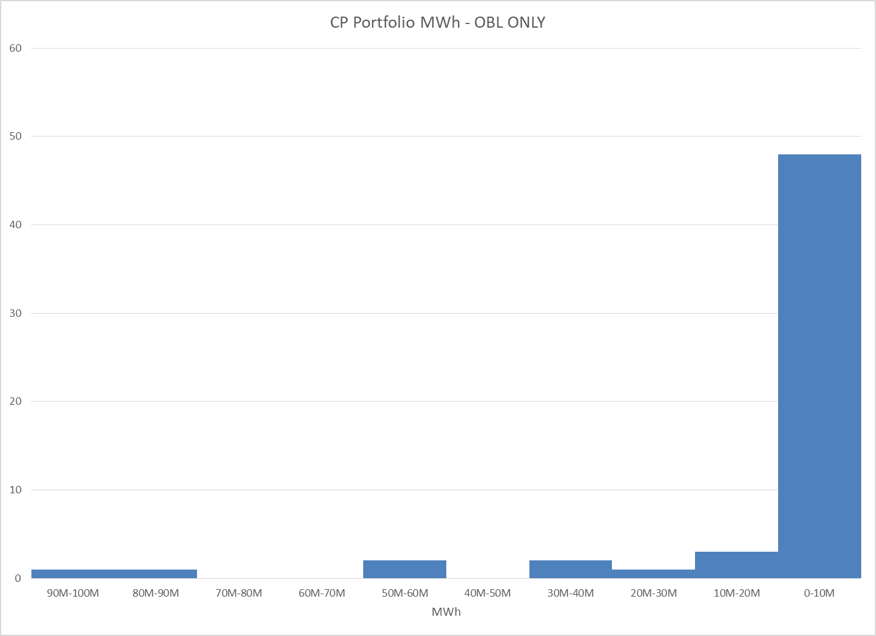
MWh Histogram

Slide 6
Appendix
Previously presented
March slides

Slide 7
Methodology
Based on CRR inventory as of 3/1/19
Value is based on the most recent auction clearing price available for each CRR
PCRRs that have been allocated but not yet priced were ignored
Aggregated to the CP level

Slide 8
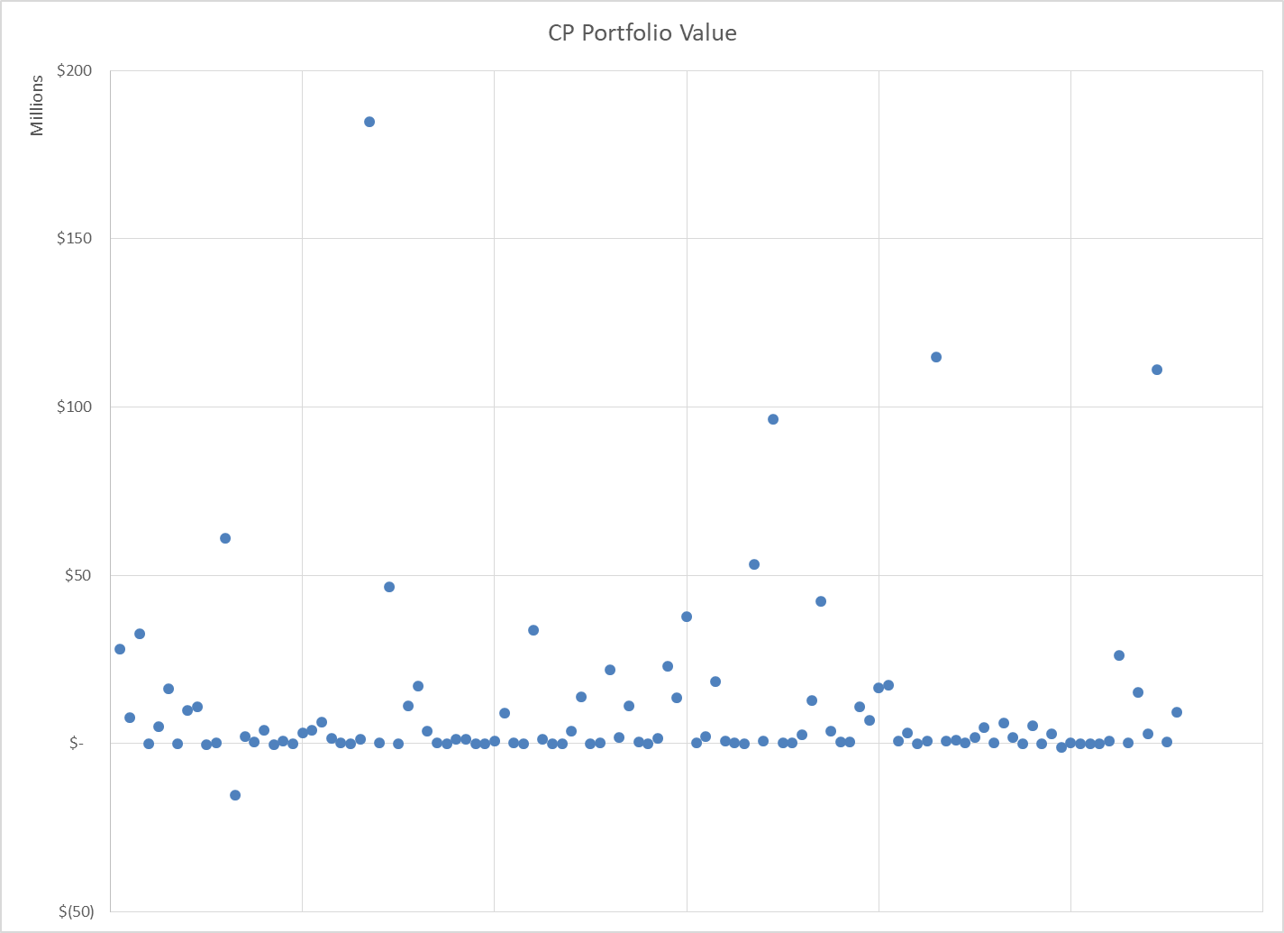
Scatter

Slide 9
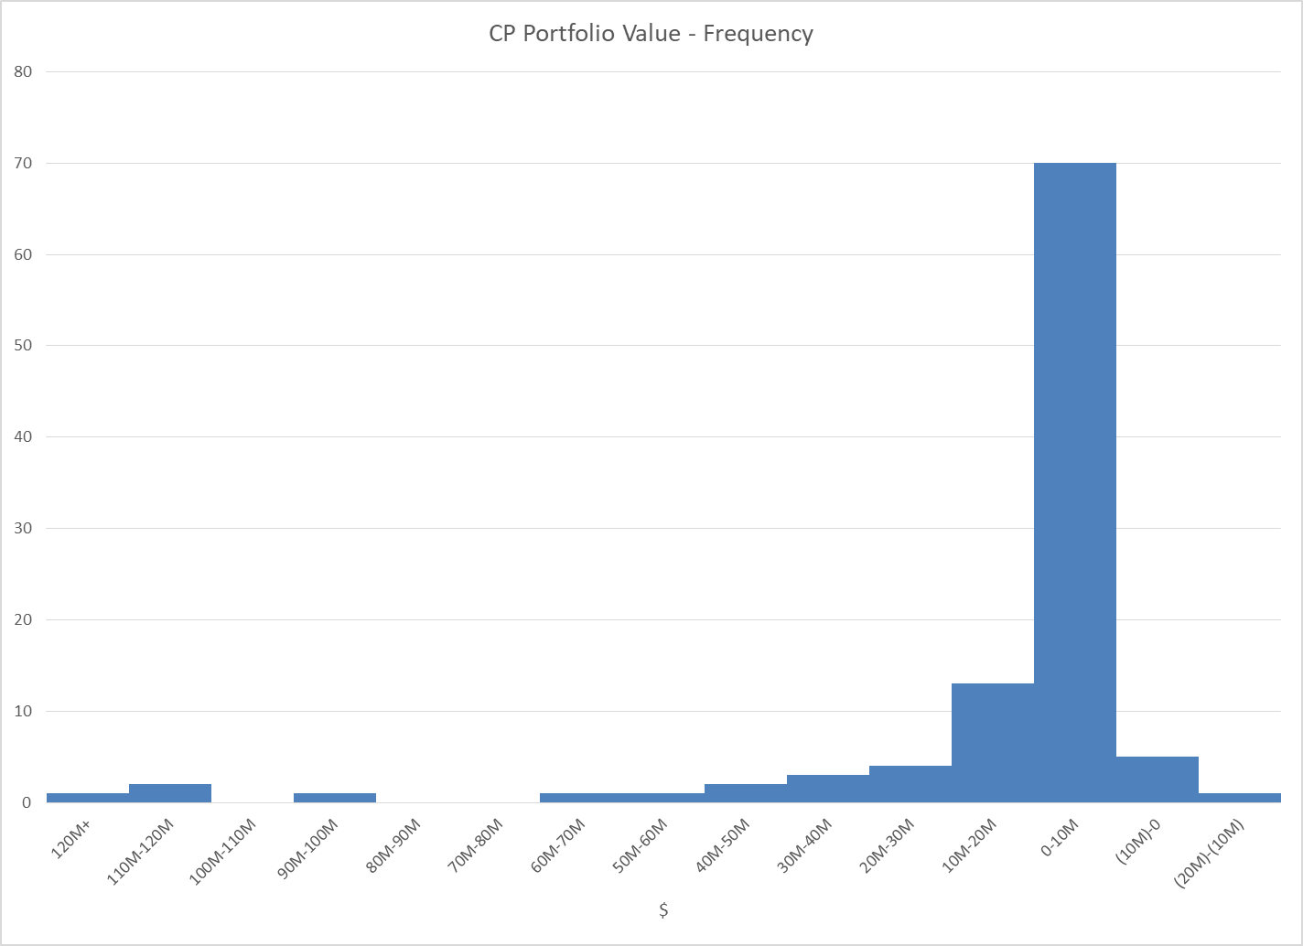
Histogram

Slide 10
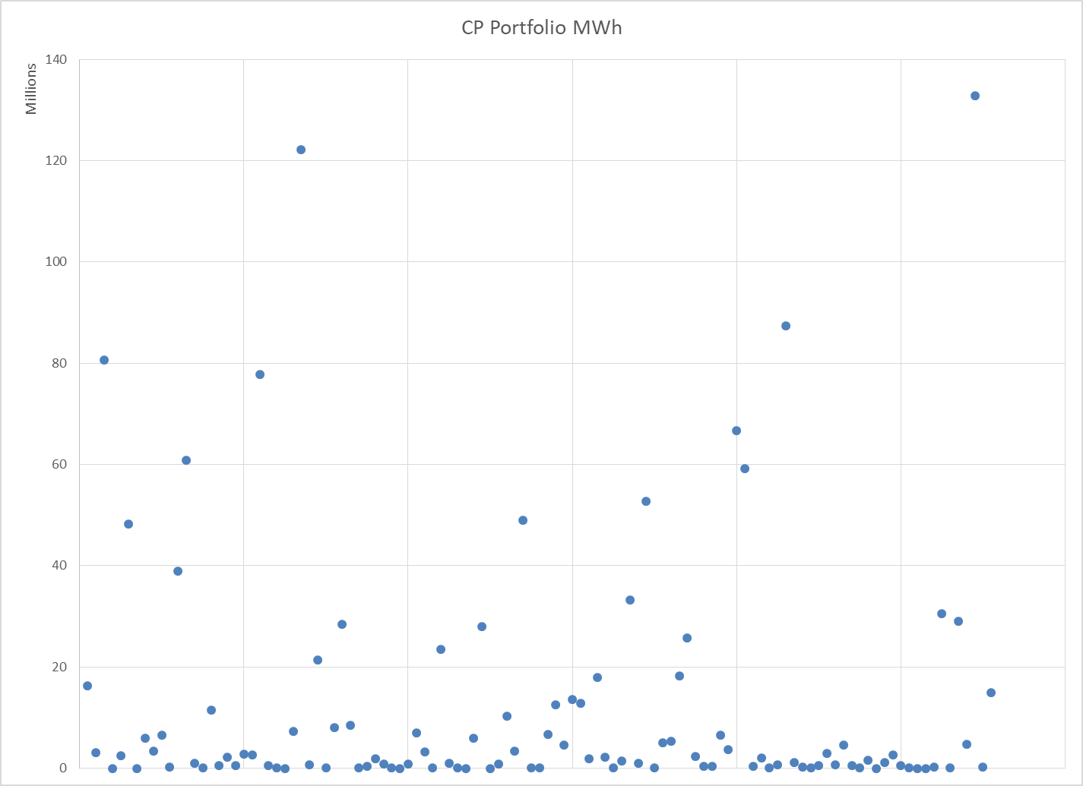
MWh Scatter

Slide 11
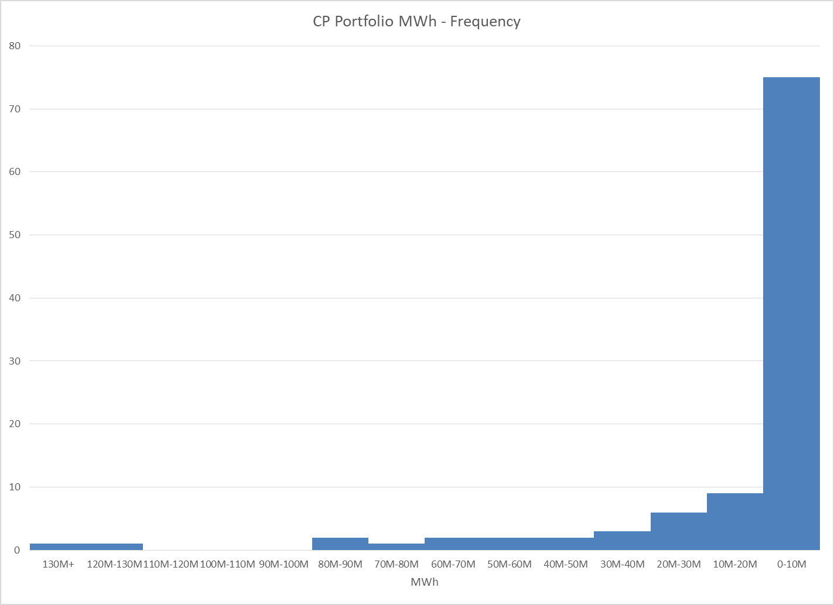
MWh Histogram

