Slide 1
Supply Analysis Working Group Meeting:
- NERC 2019 Reliability Assessment Schedule
- Distributed Generation in the CDR
Pete Warnken
Manager, Resource Adequacy
April 12, 2019

Slide 2
NERC Reliability Assessment Preparation Schedules for 2019

Slide 3
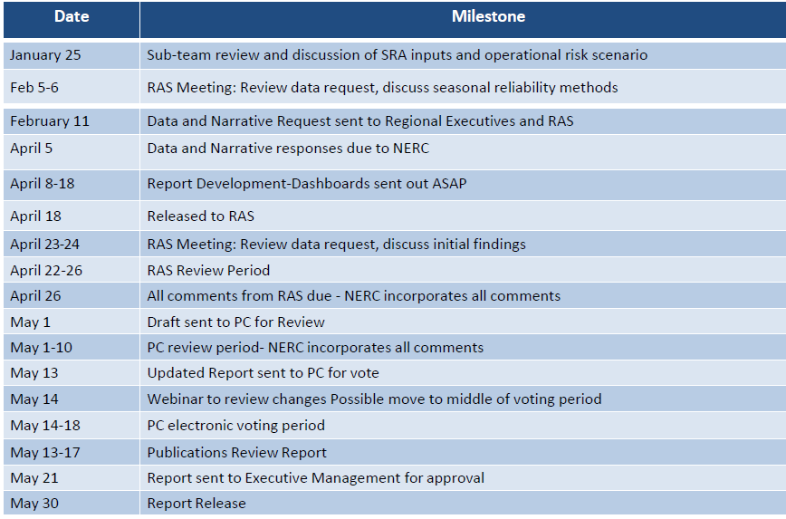
Summer Reliability Assessment
Next Milestone
Based on preliminary summer SARA report
Uses13.75% reference reserve margin
New feature − Incorporates “SARA-style” extreme scenarios

Slide 4
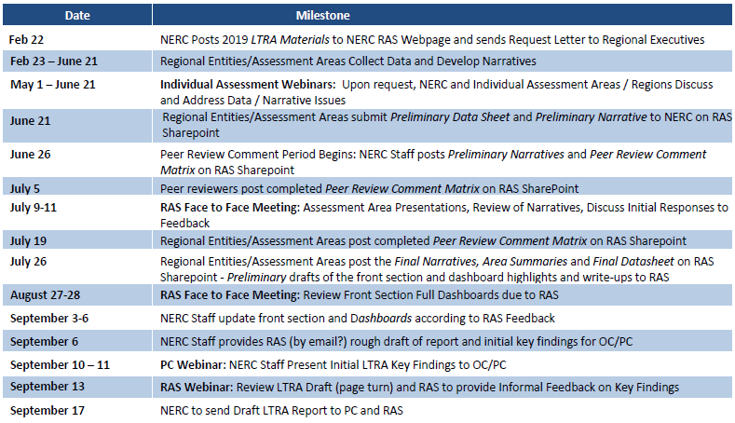
Long Term Reliability Assessment

Slide 5
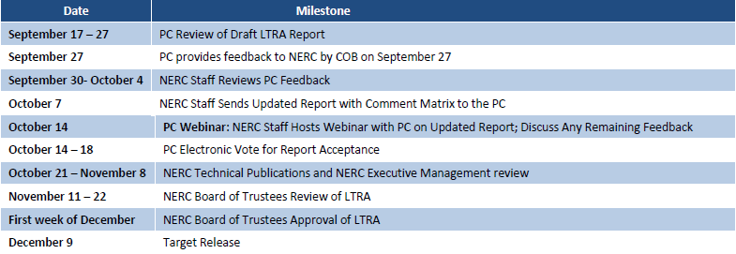
Long Term Reliability Assessment
Will be based on May CDR report with any significant post-release adjustments
Will use 13.75% reference reserve margin unless directed otherwise by the PUCT

Slide 6
Distributed Generation in the CDR

Slide 7
Treatment of DG in the CDR Report
DG currently in the CDR:
Registered renewables - itemized by unit like other Resources, and assigned the generic solar capacity contribution percentage
DG participating in ERS - not identified separately
Unregistered DG embedded in the Long Term Load Forecast (historical contribution plus growth based on 2013-2018 trend)
DG currently not in the CDR:
Registered fossil fuel DG; presumed to be used for emergency/standby service or has limited or no response to price
Unregistered DG growth expectations not factored into the Load Forecast

Slide 8
Issues for Discussion
CDR data organization approaches
Level of disaggregation in Summary and Capacity Details tabs
Naming conventions (NPRR889, Registered vs. Unregistered)
Forecasting of incremental DG capacity not captured in the Load Forecast
Point estimates vs. Supplemental tab scenarios
Reconcile with embedded amounts in the Load Forecast
Appropriate peak average capacity contributions for Registered fossil fuel DG and Unregistered DG (if broken out separately)
Scope of a new NPRR
Others?

