Slide 1
ERCOT Frequency Control Report
March 2019
ERCOT
Operations Planning
PDCWG | April 10, 2019

Slide 2
Summary of March 2019
CPS1: 173.12%
Current CPS1 12-Month Rolling Average: 174.64%
3 BAAL Exceedances
1 hourly CPS1 scores below 100%
BAAL-003 Events have updated through 2018
2018 BAAL-003 FRM Performance: -895.19
2019 RMS1 Statistics
Mean: 15.51 mHz
Min: 13.05 mHz
Max: 18.46 mHz
Energy Statistics
Total Energy: 27,806,530 MWh
Wind Energy: 6,058,318 MWh
Percent Energy from Wind Generation: 21.79%
Minimum System Inertia
Mean: 176,527
Max: 282,123 on March 5th
Min: 134,534 on March 27th

Slide 3
Frequency Control
CPS1, BAAL, & RMS1

Slide 4
Hourly CPS1 by Day
March-19 CPS1 (%): 173.12
Notes:
Outliers:
3/11/19 21:00 90.21%
Unit Loss and large manual offset. Large positive expected generation deviation. Non conforming load dropped by 200 MW while frequency was high. Load was decreasing.

Slide 5
BAAL Exceedances & Violations
There were 3 BAAL exceedances in March
March 2, 2019
Unit Trip at 03:18:53
Loss of 1224 MW
Less than 59.91 Hz for 1 minute
March 11, 2019
Unit Trip at 21:24:04
Loss of 610 MW
Less than 59.91 Hz for 2 minutes

Slide 6
15-Minute Average CPS1%
February-19 CPS1 (%): 173.12

Slide 7
12-Month Rolling Average CPS1
Current 12-Month Rolling Average: 174.64%

Slide 8
Daily RMS1 of ERCOT Frequency by Year
Notes:
Mean is 15.28 mHz

Slide 9
Daily RMS1 of ERCOT Frequency by Month

Slide 10
Daily RMS1 of ERCOT Frequency by Month
Notes:
Mean: 15.51 mHz
Min: 13.05 mHz
Max: 18.46 mHz

Slide 11
Frequency Profile Comparison

Slide 12
Frequency Profile Comparison

Slide 13
Frequency Profile Comparison

Slide 14
Time Error Correction

Slide 15
ERCOT Daily Time Error

Slide 16
Time Error Corrections Log Summary
There have been no time error corrections since December 2016

Slide 17
BAL-003 Performance

Slide 18
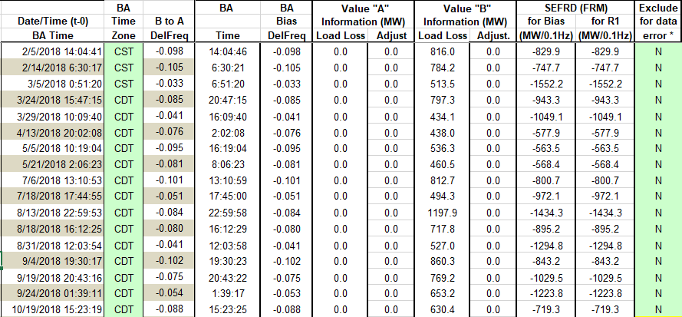
Op. Year 2018 BAL-003 Selected Events

Slide 19
Op. Year 2018 BAL-003 FRM Performance
Notes:
FRM Changed to -895 from -759 on April 1st at 10 AM

Slide 20
ERCOT Energy Statistics

Slide 21
Total Energy
Notes:
27,806,530 MWh

Slide 22
Total Energy from Wind Generation
Notes:
6,058,318 MWh

Slide 23
% Energy from Wind Generation
Notes:
21.79%

Slide 24
ERCOT System Inertia

Slide 25
Daily Minimum System Inertia
Notes:
Minimum Inertia = 128,759 MW*s on 11/3/2018.
Previous Minimum was 130,014 MW*s on 10/27/2017. This was also our record wind day.
Data:
Mean: 176,527
Max: 282,123 on March 5th
Min: 134,534 on March 27th

Slide 26
Questions?
Thank you!

