Slide 1
“Informal” Distributed Generation Review
Includes Registered and Unregistered DG
April 12, 2019

Slide 2
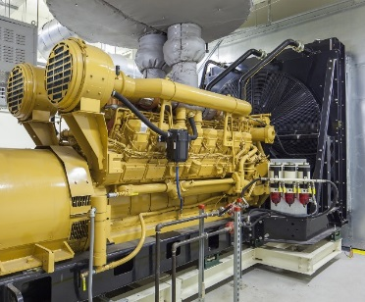
DER Awareness Issues in ERCOT
4 Different “Categories” of DG in ERCOT*
Distribution Generation Resource
A DG unit that has chosen to register as a Generation Resource to participate in the ERCOT Energy and Ancillary Services markets.
Settlement-Only Distribution Generator
DG units > 1 MW that export are required to register with ERCOT. QSEs representing these units are settled by ERCOT. (These units were previously referred to as “registered DG.”)
Unregistered Distributed Self-Generator
DG units > 1 MW that do not export and have registered as a Self-Generator with the PUC are not required to register with ERCOT.
Unregistered Distributed Generator
DG units < 1 MW are not required to register with ERCOT.
Registered DG
Unregistered DG
*NPRR889

Slide 3
Registered* DG in ERCOT
Distribution Generation Resources (DGR)
Full telemetry required
Dispatched by SCED
Full visibility in all systems
Settlement-Only Distribution Generator (SODG)
No telemetry
‘Self’ dispatched
Operational awareness only (DG mapping**)
*Registered with ERCOT
**NPRR866

Slide 4
Settlement-Only Distributed Generation in ERCOT 2010-2018
SODGs are:
<10 MW
If >1 MW and inject to grid, must register with ERCOT
If <1 MW, registration optional
Accumulated Count
Accumulated Count
Non-renewables
Renewables

Slide 5
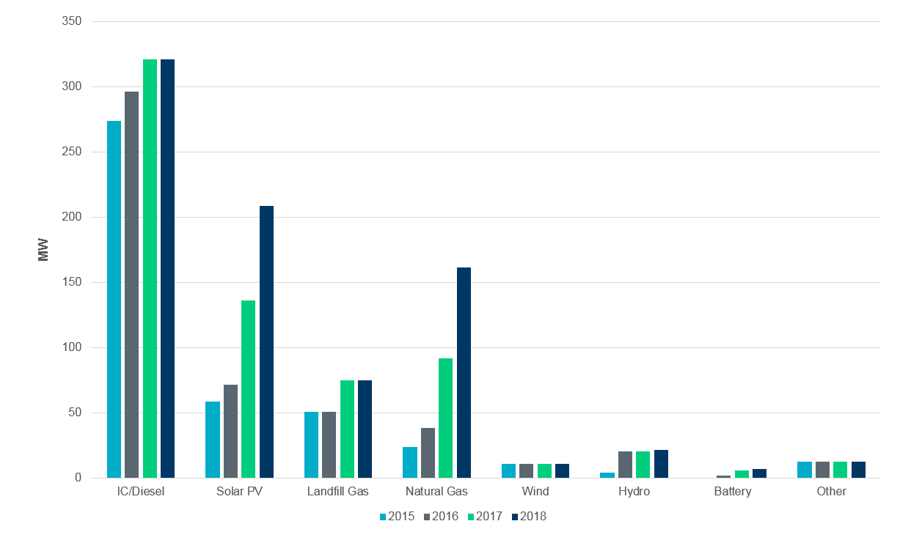
Registered DG Trends 2015-2018 (includes DGR)

Slide 6
Unregistered DG in ERCOT
Unregistered Distribution Self-Generator (> 1 MW that does not export)
TDSPs submit annual reports to PUC for all interconnections
ERCOT excludes information in the TDSP reports for backup and emergency generators that are not capable of paralleling with ERCOT
NOIEs submit quarterly reports to ERCOT for DG > 50 kW
Unregistered Distribution Generator (< 1 MW)
TDSPs submit multiple reports on DG interconnections
TDSPs submit annual reports to PUC for all interconnections
TDSPs submit updated ESI ID Profile Codes to ERCOT as DG is installed
Does not include DG installed at IDR Meter sites (> 700 kW)
NOIEs submit quarterly reports to ERCOT
For DG > 50 kW
Some NOIEs for DG < 50 kW starting in 2020*
*NPRR891

Slide 7
Q4 2018 NOIE Distributed Generation Survey
ERCOT surveyed municipalities and co-ops (NOIEs) representing the bulk of the NOIE Load to quantify the amount of DG
31 of 33 NOIEs surveyed responded
16 additional NOIEs responded
Solar PV > 50 kW ~70 MW
Wind > 50 kW ~1 MW
Solar PV < 50 kW ~210 MW
Wind <50 kW ~ 1 MW
Total NOIE unregistered DG ~ 282 MW total

Slide 8
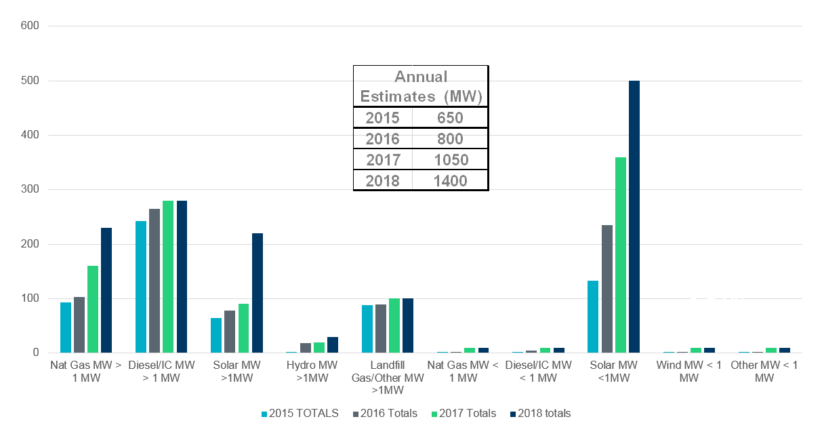
ERCOT Estimated Total DG Growth 2015-2018 (MW)
181%
26%
31%
Note: This estimate includes informal data reporting by many NOIEs and excludes generation data informally reported by investor-owned utilities for generation that would typically be considered backup or emergency generation.

Slide 9
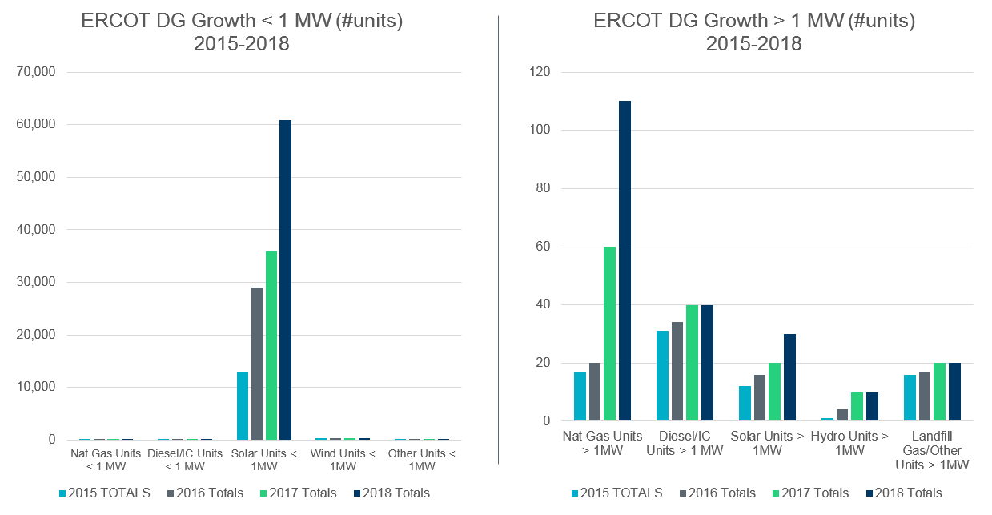
ERCOT Estimated Total DG Growth 2015-2018 (# Units)
Note: This estimate includes informal data reporting by many NOIEs and excludes generation data informally reported by investor-owned utilities for generation that would typically be considered backup or emergency generation.

