Slide 1
Resource Definition Task Force
Resources Framework Proposal
April 11, 2019

Slide 2
Agenda
Update on Energy Storage Framework
Proposed Definition
Proposed Framework for Energy Storage
Proposed overall resource framework
Proposal for Distributed Energy Sources
Proposed Overall Resource Framework

Slide 3
Proposed Energy Storage Definition
“Energy storage assets are capable of receiving electric
energy and storing it for later injection back into the
transmission or distribution system.”
It is acknowledged that, similar to the way different technologies are accommodated as Generation Resources, specific registration, qualification and requirements will be developed for the various technologies that would be registered as Energy Storage Resources by the appropriate working groups.

Slide 4
Existing Generation Nomenclature – should be similar to Energy Storage
Transmission Generation Resource (TGR) Transmission-connected Registered with ERCOT as GR Participates in the market SCED A/S Modeled in ERCOT systems Telemetry, etc. I |  | Settlement Only Transmission Generator (SOTG) Transmission-connected less than 10 MW Registered with ERCOT as SOG Settled for exported energy only Intermittent sources will typically export based on fuel availability. Self-dispatched may choose to export based on prices Modeled in ERCOT systems Reliability systems only Not scheduled/dispatchable II | Settlement Only Transmission Self-Generator (TSG) Transmission-connected Registered with PUC as a Self-Generator and registered with ERCOT as SOG May occasionally export, but does not generate with the intent to sell at wholesale If it exports, then settled for exported energy only Continuous exports will be re-evaluated for TGR Modeled in ERCOT systems Reliability systems only Not scheduled/dispatchable III
Distribution Generation Resource (DGR) Distribution connected Registered with ERCOT as GR >10 MW require to register as GR Participates in the market SCED A/S Pseudo-Modeled in ERCOT systems Future--Modeling light? Telemetry, etc. IV |  | Settlement Only Distribution Generator (SODG) Distribution connected but less than 10 MW Registered with ERCOT as SOG Settled for exported energy only Intermittent sources will typically export based on fuel availability. Self-dispatched may choose to export based on prices Mapped in ERCOT systems Not scheduled/dispatchable Telemetry not required V | Unregistered Distribution Self-Generator (UDSG) Distributed generation greater than 1 MW co-located with larger load, but smaller than minimum facility load. Registered with PUC as a Self-Generator but not registered with ERCOT May not export—otherwise must register with ERCOT as SODG. Neither Mapped nor modeled in ERCOT systems (future mapping?) VI | Unregistered Distributed Generator (UDG) Distribution connected less than 1 MW No requirement for registration Reported by DSP per PUCT 25.211(n) (competitive choice) Reported by NOIEs per ERCOT protocol 10.2.2.1.b(ii) for 50kW -1 MW Not reported by NOIEs for <50kW Neither Mapped nor modeled in ERCOT systems ERCOT settles as negative load in competitive choice areas once meter configuration updated to DG . VII

Slide 5
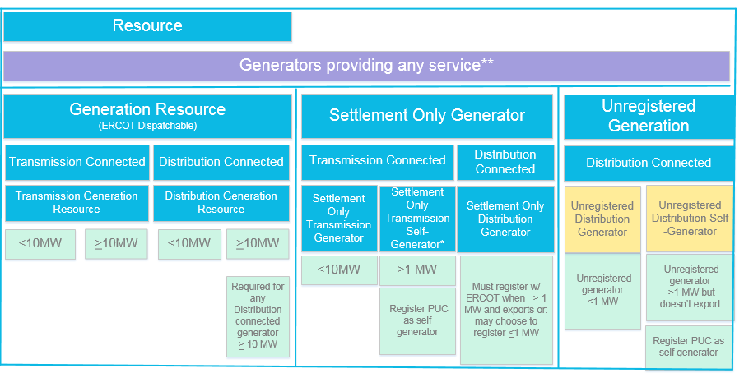
Existing Generation Framework (as of April 5, 2019)
**Service includes load reduction, 4CP response, exported energy, etc.

Slide 6
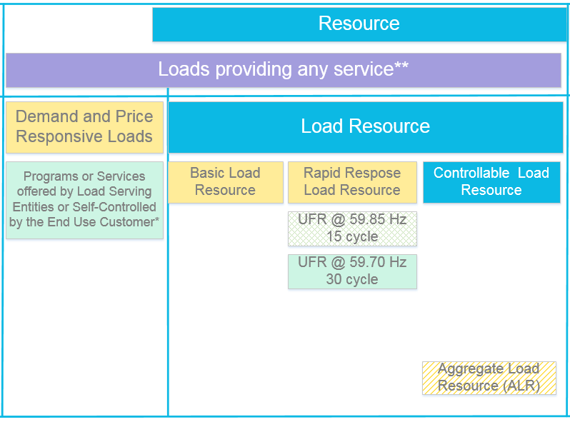
Accepted Load Framework (NPRR in process)
* Example: Remotely controlled thermostats, etc.
**Service includes load reduction, 4CP response, exported energy, etc.

Slide 7
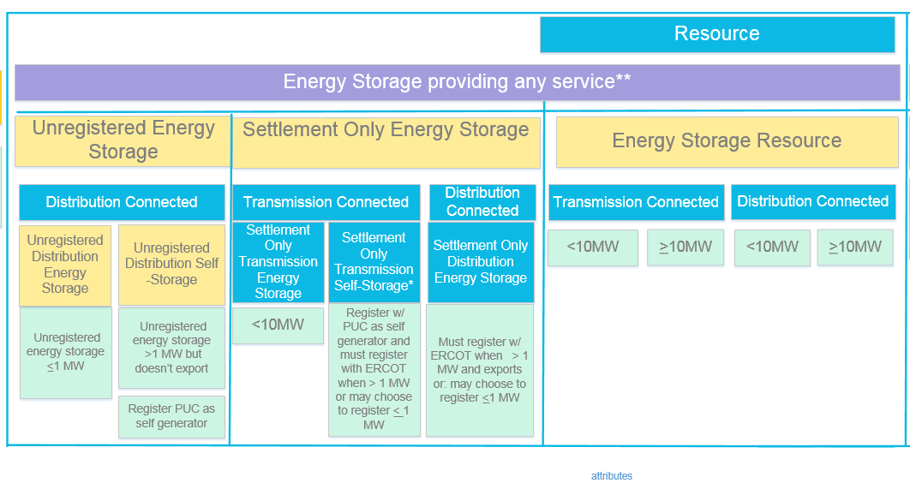
Proposed Energy Storage Framework
Primarily Residential/ Commercial Energy Storage “BTM”
Primarily Grid scale batteries not in A/S market
Primarily Grid scale batteries providing A/S
**Service includes load reduction, 4CP response, exported energy, etc.

Slide 8
Proposed Overall Framework
Energy Storage providing a service
Loads providing a service
Generators providing a service

Slide 9
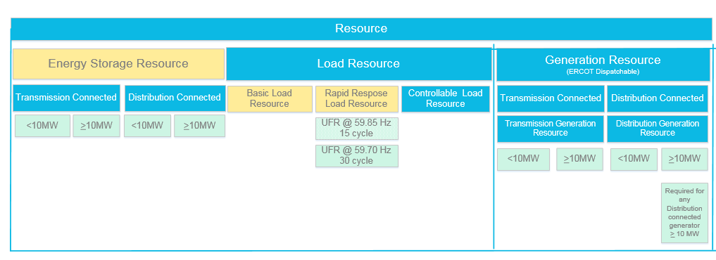
Reorganizing and Grouping - Resources
ERCOT Dispatchable Resources

Slide 10
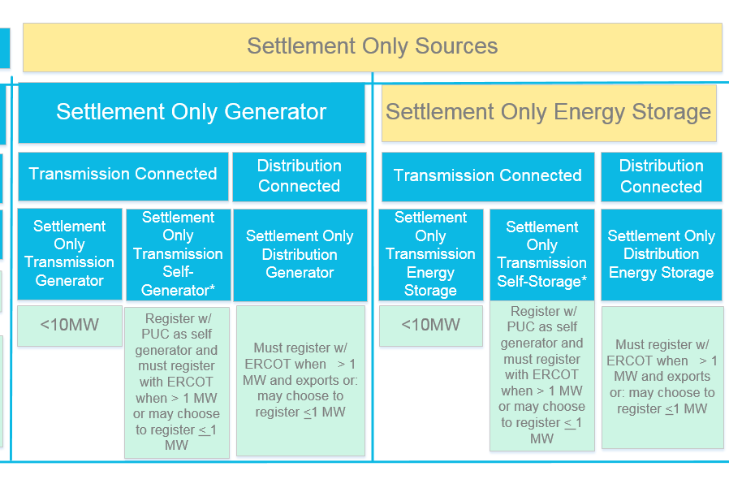
Reorganizing and Grouping- Settlement Only
ERCOT settled sources, non-dispatchable
**Settlement Only Sources cannot participate in the Ancillary Services Market, RUC, SCED or make energy offers.

Slide 11
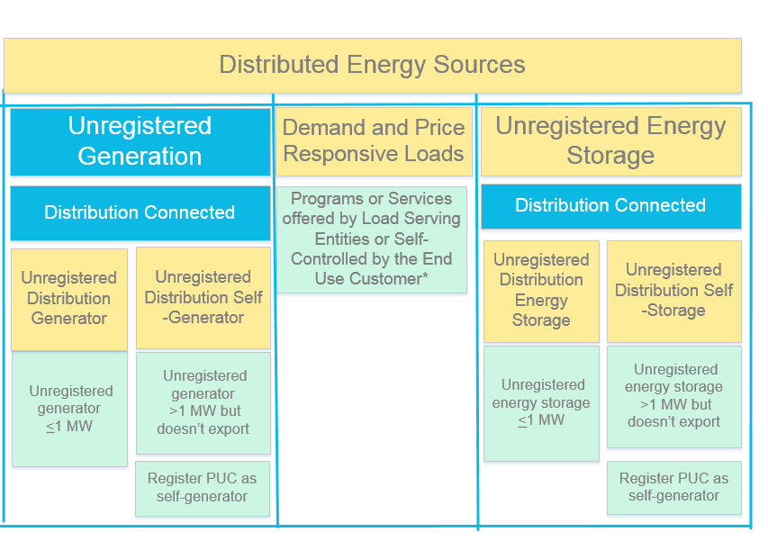
Reorganizing and Grouping- Distributed Energy Sources
“Behind the meter” sources

Slide 12
Putting it All together-- Entire Framework
Resources - ERCOT Dispatchable
ERCOT settled, Non-dispatchable
‘Behind-the-meter’
sources

