Slide 1
Market Credit Working Group update to the Wholesale Market Subcommittee
Bill Barnes NRG, Chair
Josephine Wan Austin Energy, Vice Chair
04/03/2019

Slide 2
MCWG update to WMS
General Update
March 28th Joint MCWG/CWG Meeting
5 NPRRS reviewed for their credit impacts
925NPRR Increasing Minimum Quantity for PTP Obligation Bids
885NPRR Must-Run Alternative (MRA) Details and Revisions Resulting from PUCT Project No. 46369, Rulemaking Relating to Reliability Must-Run Service
896NPRR Reliability Must-Run and Must-Run Alternative Evaluation Process
923NPRR Revision to Weather Responsiveness Determination Process
924NPRR Addition of Form to Section 23 – Independent Market Information System Registered Entity (IMRE) Application for Registration
All operational and without any credit impact.

Slide 3
MCWG update to WMS
Report of the Independent Consultants on the Greenhat Default
Summary of the Report Findings:
PJM did not have staff with the necessary training and credentials to successfully manage the financial risks posed by the numerous participants in its FTR markets. For a number of years prior to GreenHat, PJM’s FTR market participants self-regulated their conduct, and the market ran smoothly. GreenHat, however, provided a set of conditions for which the framework that PJM developed over time to manage risk was inadequate.
PJM made a decision not to terminate GreenHat’s trading rights when PJM initially understood the potential for a default. Instead PJM chose to manage the situation, which PJM believed could not get worse. As is discussed in detail in this report, PJM did not effectively manage the situation, which grew materially worse.
PJM personnel were naive about GreenHat’s assurances of creditworthiness and a future revenue stream pledged to PJM. What is more, they did not appreciate GreenHat’s determined ability to increase its position, and incur additional risk, thus expanding its losses well beyond anything PJM imagined could happen. PJM mistakenly believed it would contain and control GreenHat’s behavior and risk, which in the end it did not. If PJM were better prepared to monitor market participant behavior, and better measure risk, we believe it could have and would have responded more effectively to GreenHat’s empty assurances.
PJM was late to recognize GreenHat as a problem. Had PJM declared a default upon first recognizing the GreenHat problem, the amount of the loss would have been substantial but far less than what PJM must deal with today. In any case, we find that even if PJM had made such a default declaration, our recommendations would stand as set forth in this document.

Slide 4
MCWG update to WMS
Report of the Independent Consultants on the Greenhat Default
Recommendations:
Advance Credit/Collateral Best Practices into the Tariff
Use the mark to auction values established in the more frequent auctions
Retain the current 10¢/MWh minimum charge, in addition to purchase price, as a form of “original margin” until such time as more precise measurements become available to determine original margin.
Clarify the Role of PJM as Manager of Risk in Financial Markets
FERC and PJM’s stakeholders should sufficiently empower PJM, and PJM should acknowledge and take ownership of its important duties to provide a fair and orderly market that also protects market participants and other PJM members from risks that they are otherwise unable to manage for themselves.
Build a Customer Awareness Beyond Market Procedures & Rules (“Know Your Customer”)
Perform outsourced background checks for any member applicant, and should the applicant not be a public company, for the three most senior officers.
Perform due diligence by confirming that an applicant for membership actually employs the systems and processes for risk management as represented.
Provide explicit power for the rejection of a membership application should standards of good background and regulatory history not be met.
Update the financial qualifications of participant companies at least annually and clarify PJM’s rights to act on a member’s failure to meet those requirements.
Implement Technical Practices for Participant Risk Management
Clarify with the IMM any PJM expectations regarding participant risk management of (some) participant behaviors and reporting such with PJM.
Establish position limits for FTRs based on company capitalization and tenor.

Slide 5
MCWG update to WMS
Report of the Independent Consultants on the Greenhat Default
Recommendations:
Bring On-board and Develop New Expertise in Risk Management
Establish the position of Chief Risk Officer (CRO) over financial markets.
Create an independent committee of the Board.
Implement training for risk management.
Increase the Frequency of Long-term Auctions
Include Long Term FTRs in monthly or at least bi-monthly auctions.
Make Critical Organizational Changes
Identify the critical departmental components to the PJM financial markets business, from running auctions to managing risk, and bring them together in a well aligned organization.

Slide 6
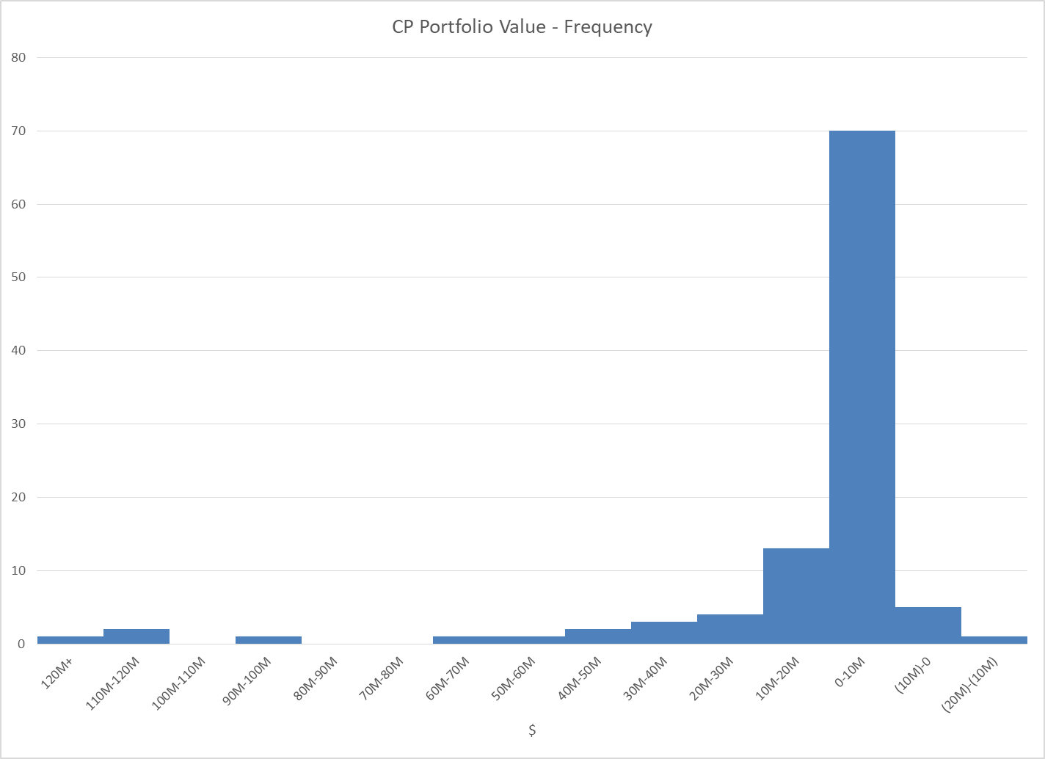
MCWG update to WMS
Review of ERCOT CRR Portfolio Valuation
Assess the risk of a large CRR portfolio default
Dollars

Slide 7
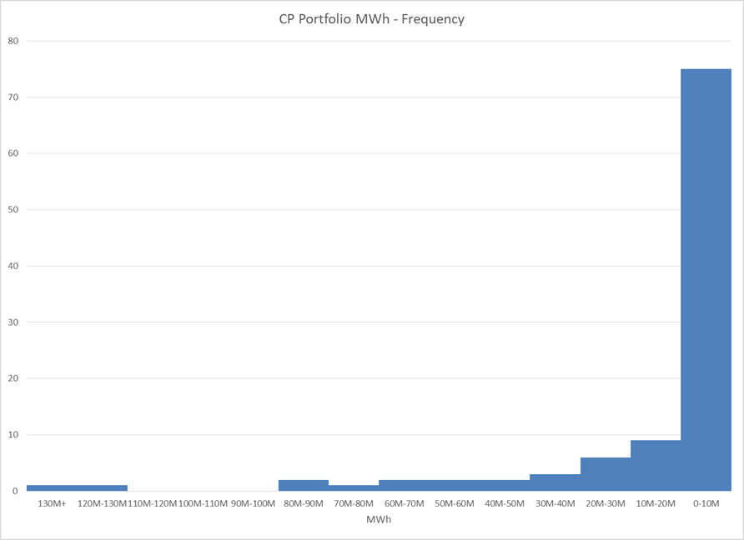
MCWG update to WMS
Review of ERCOT CRR Portfolio Valuation
Assess the risk of a large CRR portfolio default
MWh

Slide 8
MCWG update to WMS
Market Entry Qualifications Rules & Process
CWG/MCWG reviewed high-level summary of Market Participant Registration and Qualification rules.
Next Steps? WMS discussion and feedback.

Slide 9
MCWG update to WMS
ERCOT Credit Exposure Updates
Market-wide average TPE decreased from $330.5 million to $263.8 million
The drop in TPE is due to lower Forward Adjustment Factors in February
Discretionary Collateral is defined as Secured Collateral in excess of TPE,CRR Locked ACL and DAM Exposure.
Average Discretionary Collateral increased from $996.7 million to $ 1,034.8 million
The increase in Discretionary Collateral is largely due to decrease in TPE of Load and Generation entities
Number of active Counter-Parties increased from 228 to 233
No unusual collateral call activity

Slide 10
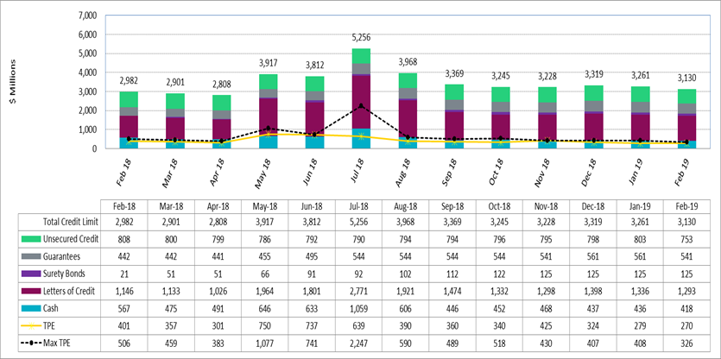
MCWG update to WMS

Slide 11
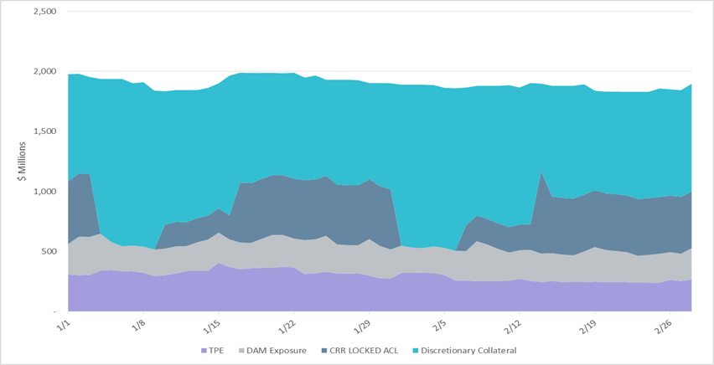
MCWG update to WMS

Slide 12
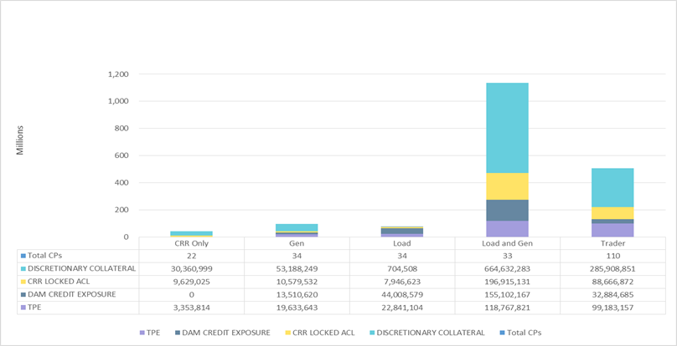
MCWG update to WMS

Slide 13
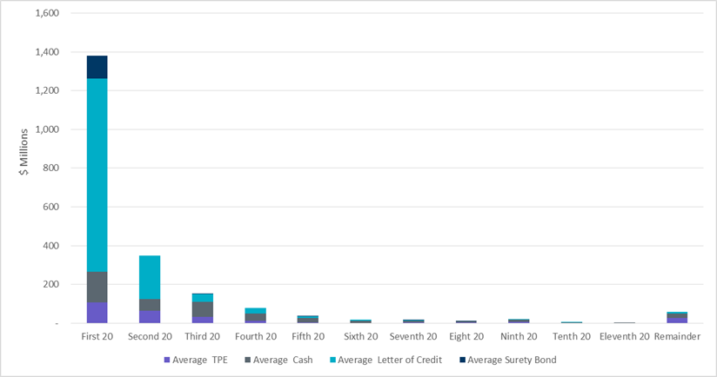
MCWG update to WMS

Slide 14
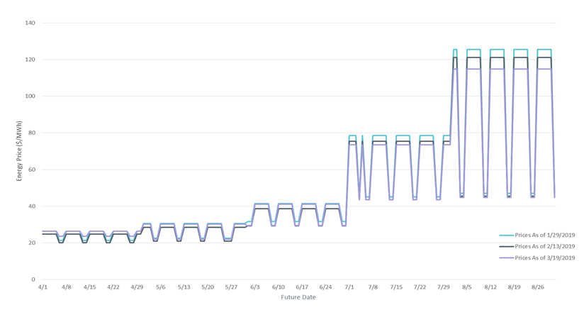
MCWG update to WMS

