Slide 1
Wholesale Market Working Group Report to WMS
David Detelich
April 3, 2019
From March 25 WMWG Meeting

Slide 2
Real-Time On-Line Reliability Deployment Price Adder
ERCOT presented results of analysis on changes to system wide RTORDPA
  4 approaches to relaxation
  2 triggers
  This is for the system wide adder
  Concept of sequential SCED used for evaluation of results to an expected adder for 10/4/2018
  ERCOT continuing analysis on more days
  WMWG will review results next meeting
Item not ready for vote by WMS

Slide 3
NPRR904, Revisions to Real-Time On-Line Reliability Deployment Price Adder for ERCOT-Directed Actions Related to DC Ties
Not ready for WMS vote; work will continue at next WMWG meeting
Shams noted that proposal for relaxation in his submitted comments are one of the cases that ERCOT is analyzing
Discussion on comments that DC Ties should be treated as load in regards to load shed
  RUC uses load forecast and DC ties export
  CDR and SARA count DC Ties as a resource
  Currently treatment of DC tie curtailment is not the same as load or generation
  ERCOT expressed concern that including DC Ties in RTORDPA could add troubling market outcomes, particularly as it relates to approval of schedules over the advisory limits
ERCOT Operations staff to attend next meeting to discuss DC Ties

Slide 4
Next Steps for NPRR664: Fuel Index Price for Resource Definition and Real-Time Make-Whole Payments for Exceptional Fuel Cost Events
Noted that NPRR 847 is in flight and this work reduces the cost of NPRR664
The remaining project impact is $150K to $200K
Agreement that project has zero benefit due to the voluntary language
There are issues with the use of the HSC index for mitigation and make whole but NPRR664 does not solve it
WMWG recommends that WMS vote on a motion to have ERCOT issue an NPRR that removes the grey box language of NPRR664

Slide 5
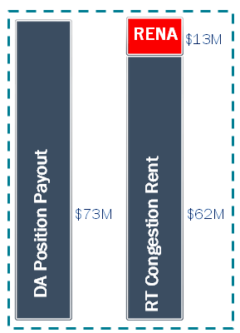
High Revenue Neutrality Allocation (RENA)
ERCOT presented a report on 2018 RENA by categories
  DAM Oversold
  PTPLO
  Others
Improving Load Distribution Factors is in progress
RAS Modeling updated
Noted that RENA is an artifact of congestion
WMWG work on this is complete

Slide 6
Other Business
NPRR903
  Not discussed as WMWG completed its recommendation in February
  At WMS
Question asked on NPRR826, Mitigated Offer Caps for RMR Resources
  On 7/20/17, PRS voted to table NPRR826
  participants requested tabling of NPRR826 pending Public Utility Commission of Texas (PUCT) direction on several issues, including local scarcity and RMR
  No action requested by WMWG
Next meeting April 22, 2019

