Slide 1
Review of Commercial Impacts of DC Tie Curtailments
WMWG
March 25, 2019
Market Analysis

Slide 2
DC Tie Tag Curtailments – January 2019
There was 1 DC tie tag curtailment event
  Due to local congestion
ERCOT posted a DC tie curtailment notice to MIS during this event

Slide 3
DC Tie Tag Curtailments – January 2019
Date | DC Tie | Curtailing Period | # of Tags Curtailed | Initiating Event | Curtailment Reason
01/25/2019 | DC-S | HE9, HE10 | 1 | SBEVASH8, loss of Asherton to Bevo 138 kV, overloads Hamilton to Maverick 138 kV | Local Congestion
Constraint was not activated in SCED due to no Resources having meaningful shift factors.

Slide 4
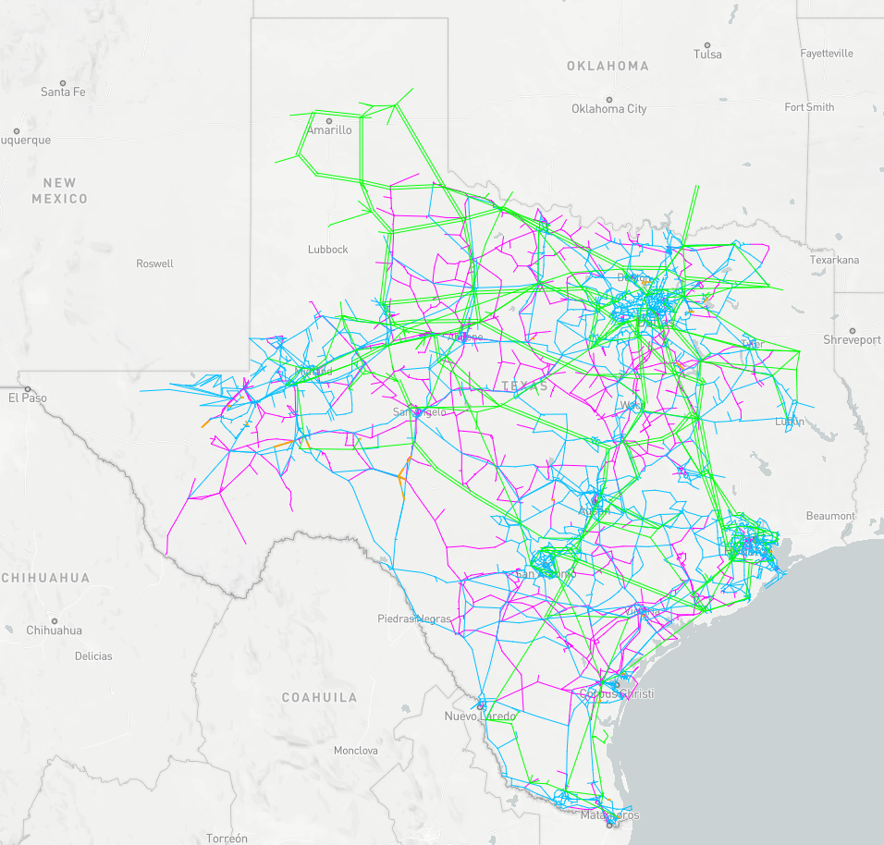
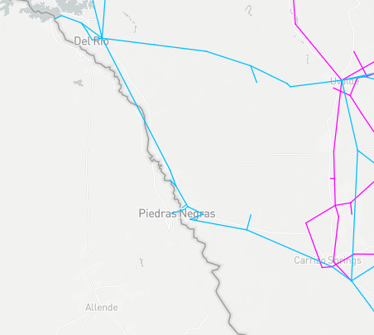
DC-S (Eagle Pass) and Constraint Locations
O
overloaded
element
DC-S
X
contingency

Slide 5
1/25/2019 Curtailment of DC-S

Slide 6
1/25/2019 LMPs Related to DC-S Curtailment

