Slide 1
PDCWG Report to ROS
Chair: Chad Mulholland, NRG
Vice Chair: Jimmy Jackson, CPS
ROS
April 4th, 2019

Slide 2
Report Overview & Notes
Report Overview
  Meeting Minutes
  BAL-001-TRE-1 FMEs & IMFR
    2 FMEs in the month of February
  Frequency Control Report

Slide 3
Meeting Minutes
PDCWG Meeting 3/13/19
  Overview of ERCOT Inertia Trends and Current Conditions
    ERCOT historical Inertia trends are roughly flat from 2013 to 2019, as increased combined cycle output (high inertia contribution) has offset increased renewable resource output (low inertia contribution)
    ERCOT began monitoring Interconnection Inertia in Real Time in 2016
    100 GWs is currently defined as the Critical Inertia threshold for ERCOT; operators may take action, including RUC, if Inertia falls below this level
    Lowest recorded Inertia to date is 128.8 GWs (11/03/2018)
  ERCOT Interconnection Frequency Response Models – Analysis from LCRA / Burns & McDonnell
    Analysis represents an attempt to replicate ERCOT frequency response models with limited model data
    Analysis concludes that some of ERCOT’s frequency response modeling (which dictates Ancillary Service Procurement, and has important reliability implications) could be significantly improved – particularly for combustion turbines (CTs)
    ERCOT contests some of the findings, but agrees that more collaboration between GOs, QSEs, and ERCOT could improve the modeling
  NPRR863 – Determining Bid/Offer RRS Limits: Procedure Review
    Draft calculation procedure presented by ERCOT. Questions for PDC input are 8 versus 10 event inclusion? Mean versus median performance calculation?
    Moderate concerns raised about setting limits based on historical events (which tend to cluster at 59.80 Hz) when RRS is designed to protect UFLS (59.30 Hz) – ideas to resolve?
  Regulation & Frequency Control Reports

Slide 4
Frequency Measurable Events Performance

Slide 5
Frequency Measurable Events
There was 2 FME in February
  2/26/2019 06:30:33
    Loss of 414 MW
    Interconnection Frequency Response: 713 MW/0.1 Hz
    10 of 48 Evaluated Generation Resources had less than 75% of their expected Initial Primary Frequency Response.
    7 of 48 Evaluated Generation Resources had less than 75% of their expected Sustained Primary Frequency Response.
  2/26/2019 19:21:55
    Loss of 658 MW
    Interconnection Frequency Response: 1,045 MW/0.1 Hz
    9 of 36 Evaluated Generation Resources had less than 75% of their expected Initial Primary Frequency Response.
    7 of 36 Evaluated Generation Resources had less than 75% of their expected Sustained Primary Frequency Response.

Slide 6
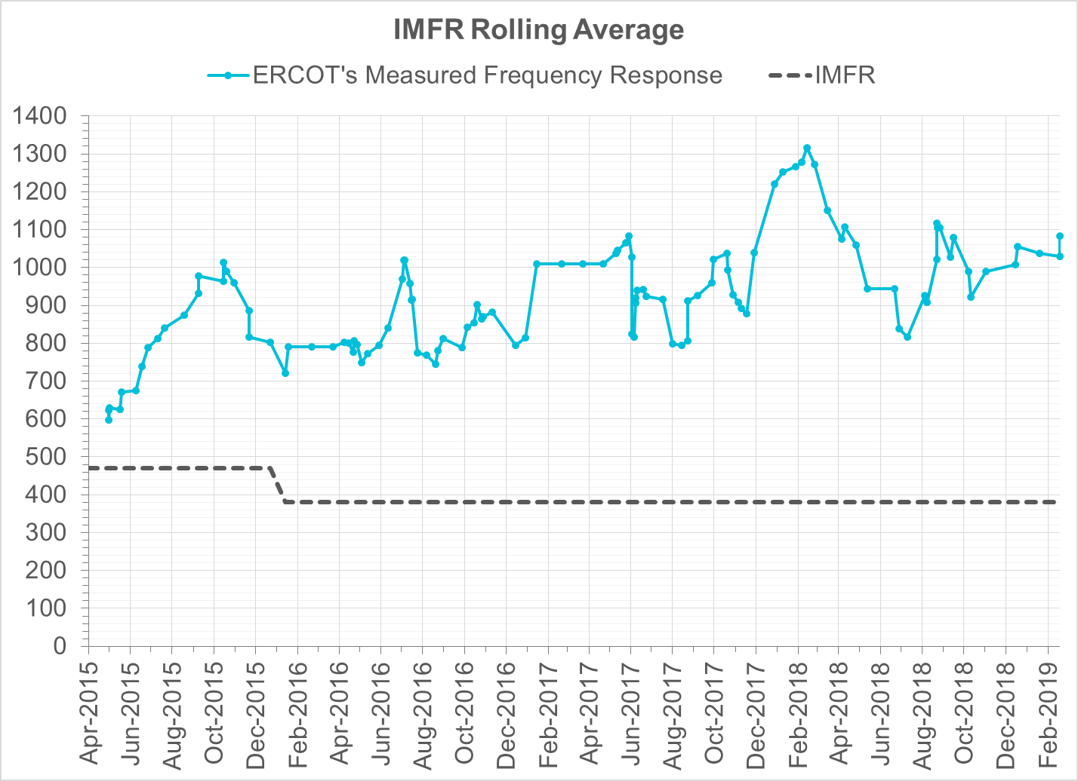
Interconnection Minimum Frequency Response (IMFR) Performance
IMFR Performance currently 1083.10 MW/0.1Hz
Frequency Response Obligation (FRO): 381 MW/0.1 Hz

Slide 7
Frequency Control Report
February 2019

Slide 8
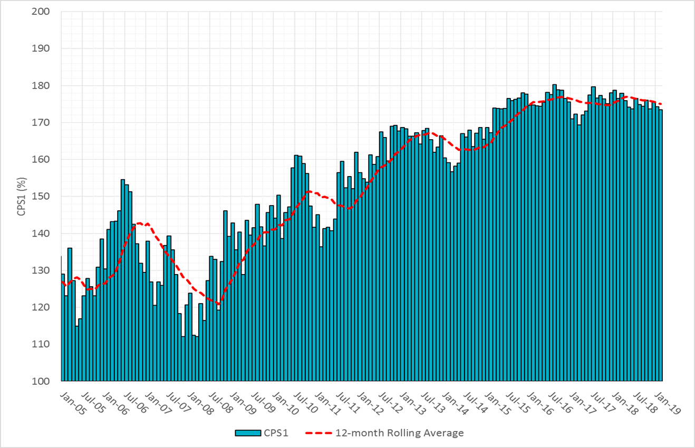

CPS1 Performance

Slide 9
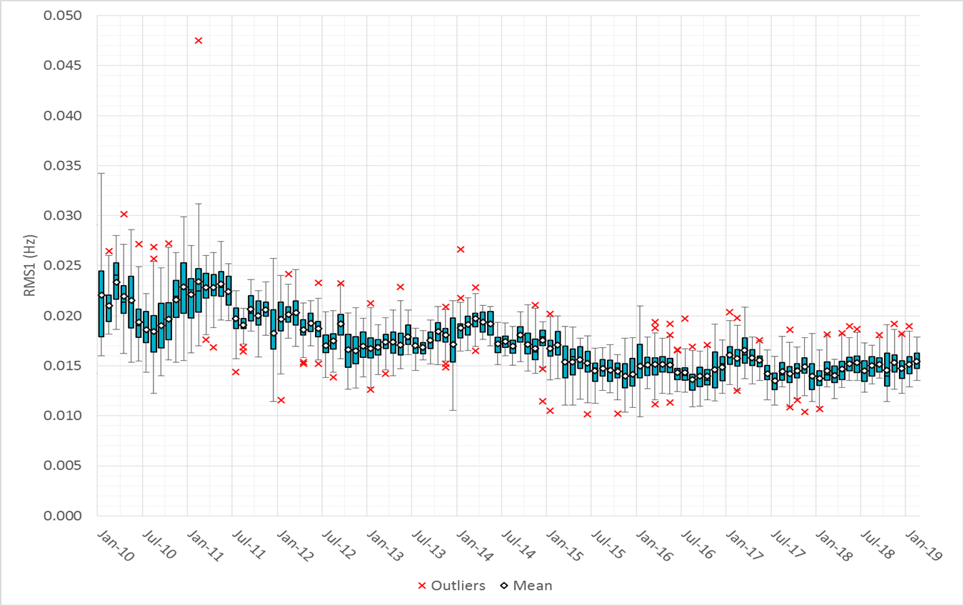
RMS1 Performance of ERCOT Frequency

Slide 10
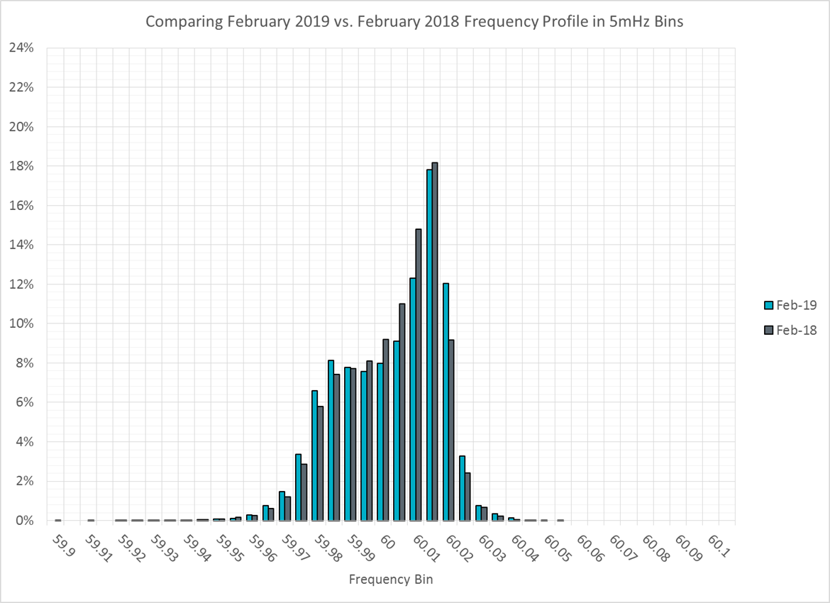
Frequency Profile Analysis

Slide 11
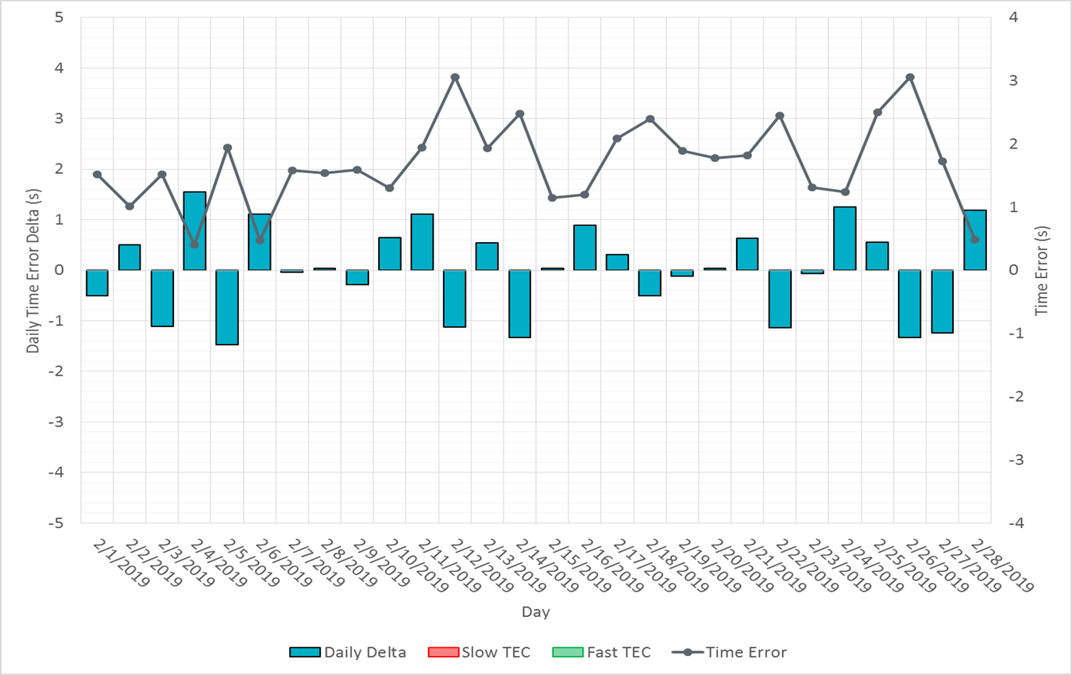
Time Error Corrections

Slide 12
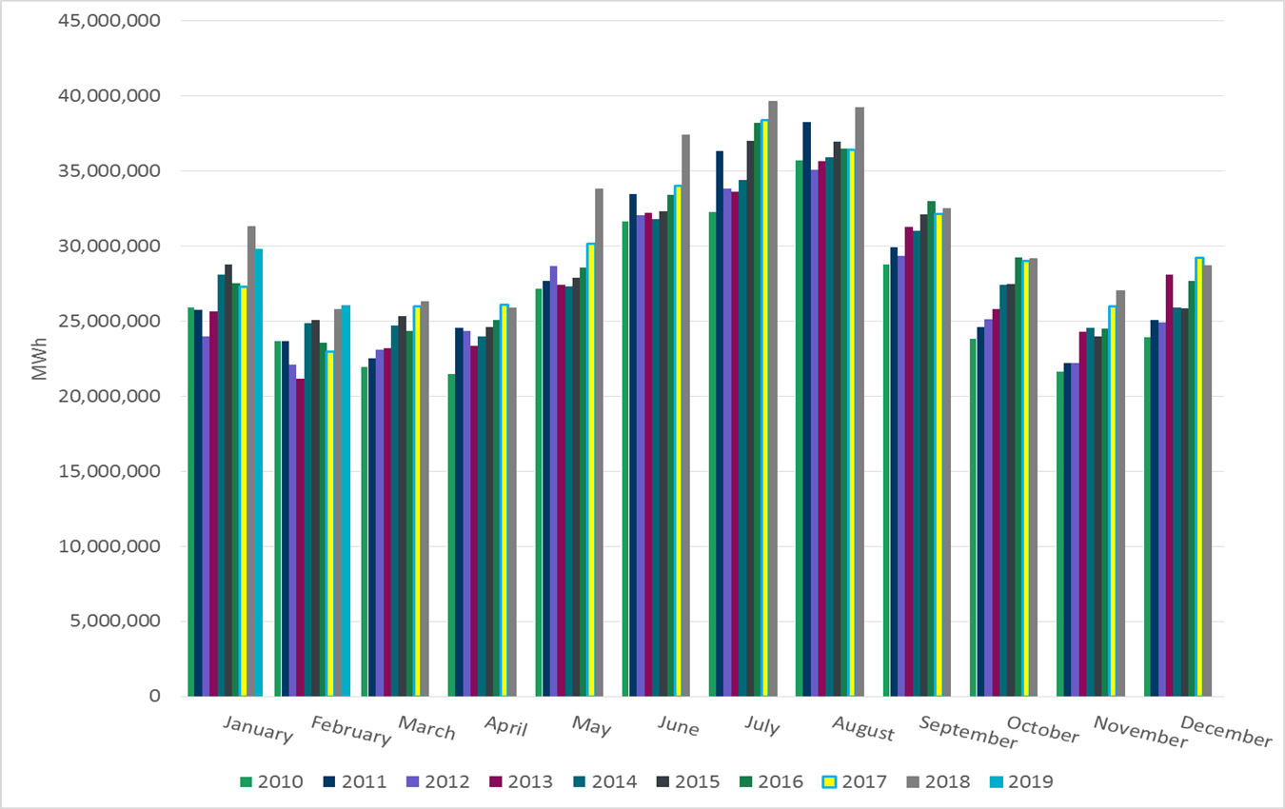
ERCOT Total Energy

Slide 13
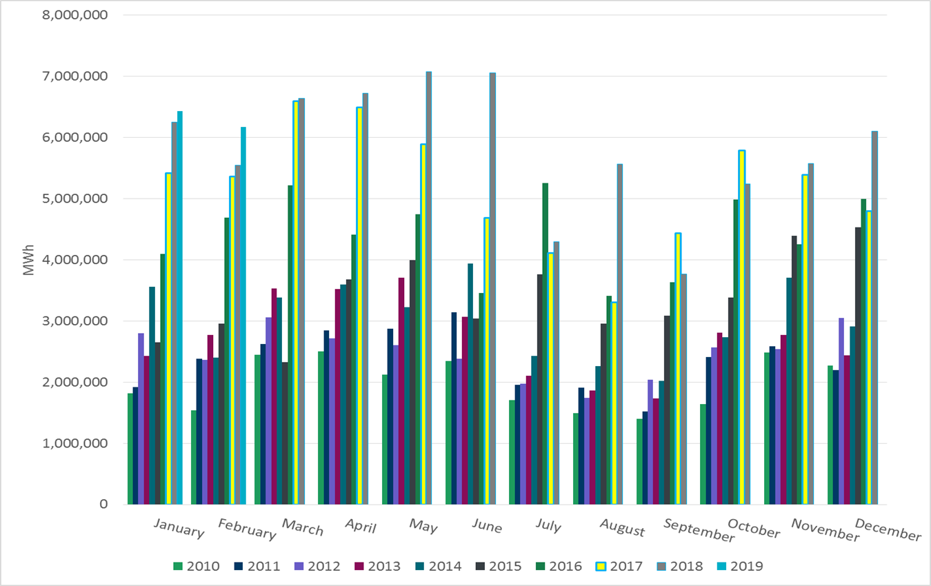
ERCOT Total Energy from Wind Generation

Slide 14
ERCOT % Energy from Wind Generation

Slide 15
Questions?

