Slide 1
Approval of Important Station Voltages for State Estimator Reporting
Aaron Rosenthal
Grid Applications Support
April 4, 2019

Slide 2
Objective
Approval of Important Buses as defined by the TAC-approved State Estimator Standards
“On 20 most important station voltages designated by ERCOT and approved by ROS; the telemetered voltage minus State Estimator voltage shall be within 2% of the telemetered voltage measurement involved for at least 95% of samples measured during a one month period.”

Slide 3
Important Station Voltages
Defines key buses to be monitored to ensure State Estimator accuracy
To be reviewed by the Network Data Support Working Group and approved by ROS

Slide 4
Determination of Important Buses
Major criteria for inclusion in important station voltage list:
Nuclear plant buses
Black Start synchronization point-related buses
IROL associated buses
345 KV stations with large power transfers

Slide 5
Bus List
STATION_NAME | VOLTAGE_LEVEL | OWNER_NAME
ALNSW | 345 | TONCOR
AUSTRO | 345 | TAEN
CALAVERS | 345 | TCPSE
CBY | 345 | TCNPE
CPSES | 345 | TONCOR
JEWET | 345 | TONCOR
LON_HILL | 345 | TAEPTC
MGSES | 345 | TONCOR
NEDIN | 345 | TAEPTC
PHR | 345 | TCNPE
RIOHONDO | 345 | TAEPTC
RNKSW | 345 | TONCOR
SSPSW | 345 | TONCOR
STP | 345 | TCNPE
THW | 345 | TCNPE
TMPSW | 345 | TONCOR
TULECNYN | 345 | TSHARL
VENSW | 345 | TONCOR
WLVEE | 345 | TONCOR
ZORN | 345 | TLCRA
Changes since previous update (2013)
Added TULECNYN station to represent the Panhandle region
Removed BNBSW station as Dallas is already well-represented by other buses

Slide 6
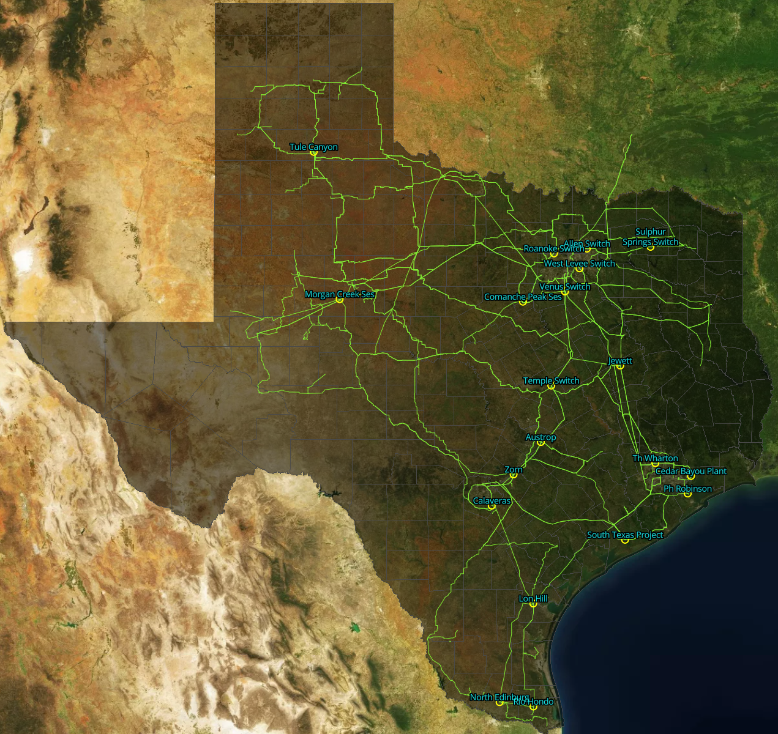
Bus List on Texas Map with 345 KV Lines

Slide 7
Conclusion
ERCOT SE report will monitor the telemetry vs. SE bus KV for the approved buses

