Slide 1
Natural Gas Use Study in Texas
Kevin Hanson
Lead Market Operations Analyst,
Wholesale Market Operations and Analysis
Gas Electric Working Group (GEWG)
March 29, 2019

Slide 2
Assumptions
Natural gas consumption in Texas is by sector: residential, commercial, industrial, and electric utility
Monthly consumption by sector can be found at EIA
In addition, LNG exports and exports via pipeline to Mexico are increasing significantly
This analysis attempts to show the risk of natural gas demand issues

Slide 3
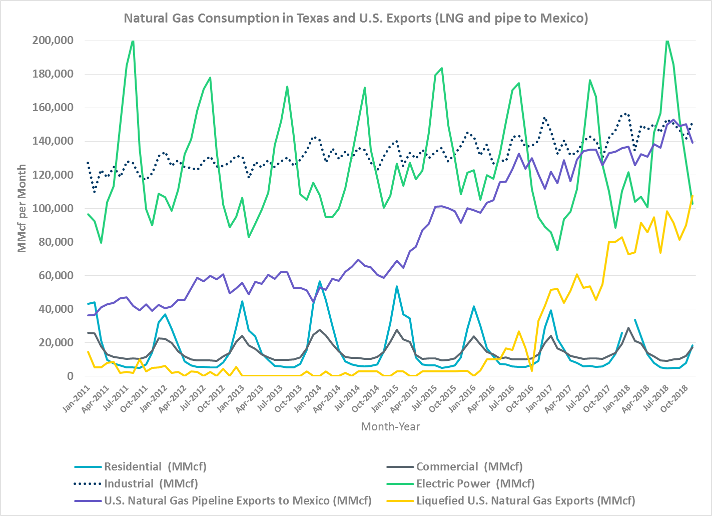
Monthly Natural Gas Consumption (EIA Data)
Exports to Mexico and LNG Exports have been increasing in addition to the natural gas power generation

Slide 4
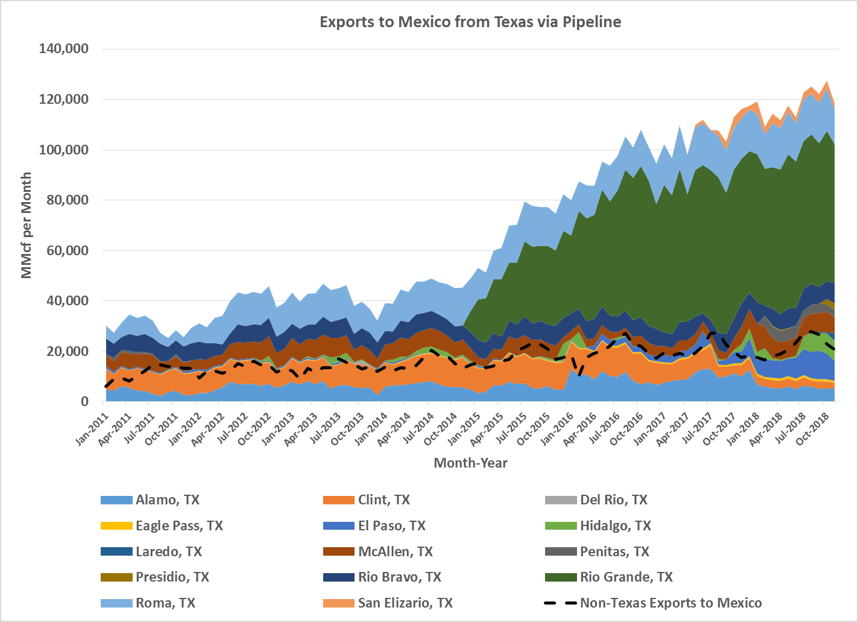
Monthly Pipeline Exports to Mexico (EIA Data)

Slide 5
Daily calculations
In order to calculate daily fuel burn in ERCOT, I have used a generic heat for each resource type
ERCOT generation heat rate assumptions is categorized as:
CCGT90 (7 MMBtu/MWh)
CCLE90 (7 MMBtu/MWh)
DSL (9 MMBtu/MWh)
GSNONR (12 MMBtu/MWh)
GSREH (12 MMBtu/MWh)
GSSUP (10 Mmbtu/MWh)
SCGT90 (10 MMBtu/MWh)
SCLE90 (10 MMBtu/MWh)

Slide 6
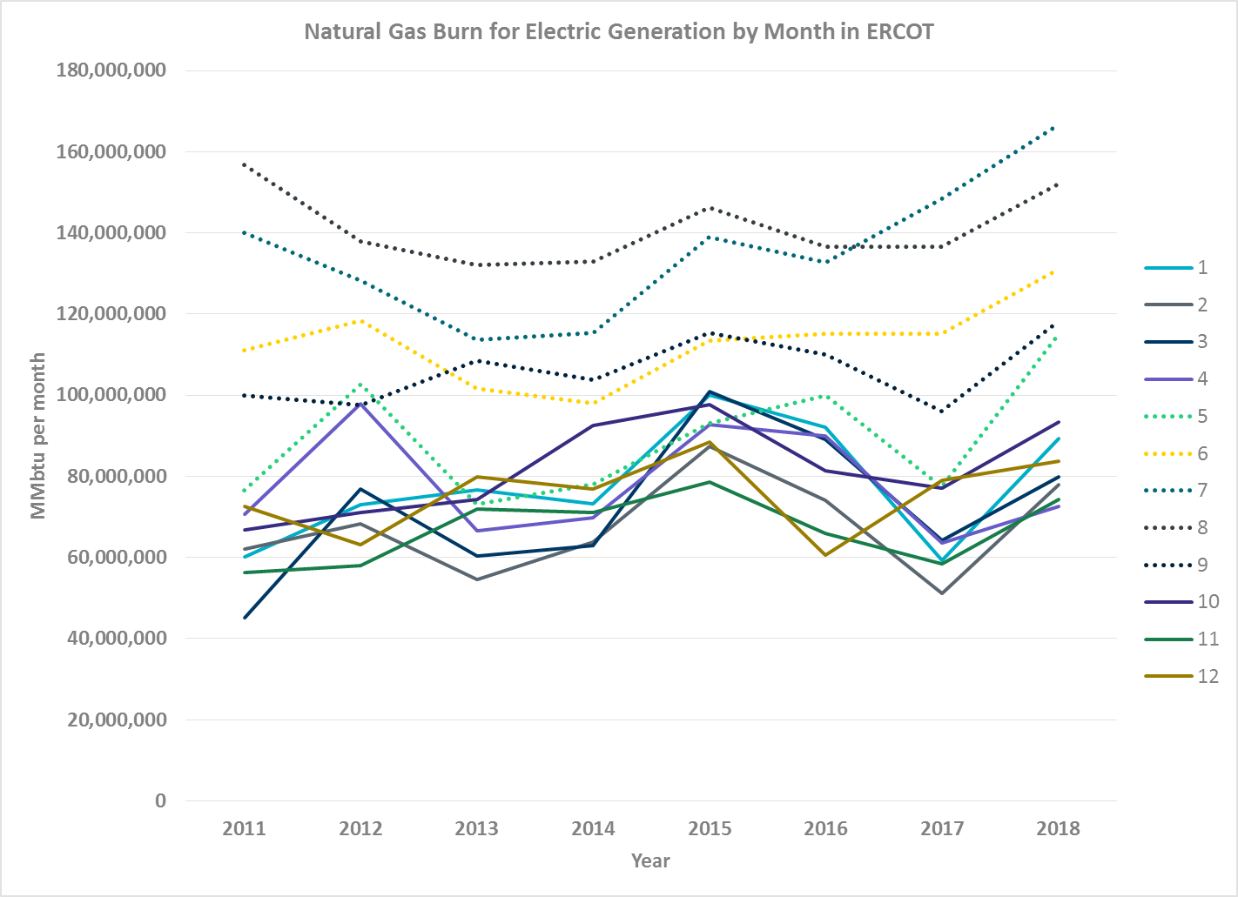
Monthly Natural Gas Burn for Generation
On average, most of the natural gas burn for electric generation in ERCOT is occurring in the summer months….

Slide 7
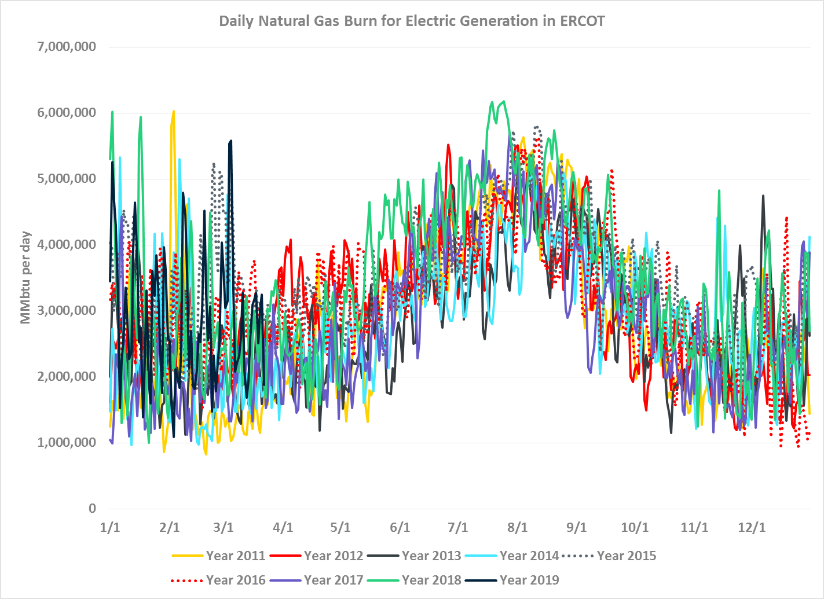
Daily Natural Gas Burn for Generation
… but when you look at it by Day, January and February have been challenging!

Slide 8
Takeaways
Daily natural gas supply and demand fundamentals could be just as large as ,if not more, challenging in the non-summer months as the summer months.
For pinch point locations and/or times of year, how likely are the electric generators going to be the first to be “curtailed”?

Slide 9
Questions?
Notes:
https://castaylor.ercot.com/owa/redir.aspx?C=oPhl4_Wz9UCI7oVqJkGdaM-P4-MvhtMIRAMJFZ7-K5eOg6lo6esBMUiebAbXd4c8z8FTPzV8g8A.&URL=https%3a%2f%2ftheconversation.com%2fwhen-will-rooftop-solar-be-cheaper-than-the-grid-heres-a-map-54789%3futm_source%3dtwitter%26utm_medium%3dreferral%26utm_campaign%3dUTAustinNews
http://www.vox.com/2015/6/19/8808545/wind-solar-grid-integration
http://greeningthegrid.org/quick-reads
https://ec.europa.eu/energy/intelligent/projects/en/projects/pv-grid
http://energy.gov/eere/sunshot/systems-integration

