Slide 1
ERCOT Reliability Deployment Examples
Blake Holt
03/29/2019

Slide 2
Reliability Deployment Analysis
ERCOT regularly reports on the pricing impacts of reliability actions in the following reports:
Operational Overview for the Board of Directors
Annual RUC TAC Report
ERCOT has also provided descriptions on how the pricing run works, detailed analysis on specific events, as well as, the specific methods and data points used to investigate those events:
WMWG 2/25/2019 – Study Reliability Deployment Adder Improvements
QMWG 12/03/2019 – Review of Reliability Deployment Price Adders on 10-04-18
WMS 10/10/2018 – 2018 Discussion on July and August RUC Activity
ERCOT has reporting mechanisms in line to regularly capture the impacts of future reliability deployments and their influence on pricing. Additionally, ERCOT has developed methods to use available data to give insight into specific events at the market’s request.

Slide 3
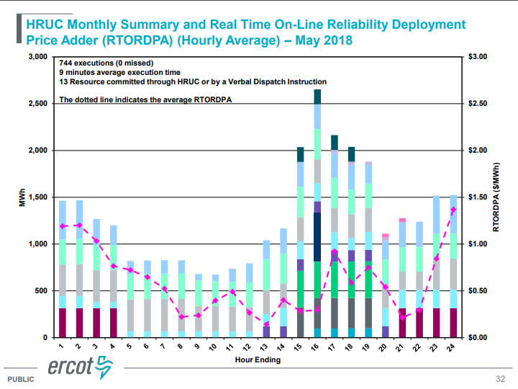
Report Example – Operational Overview

Slide 4
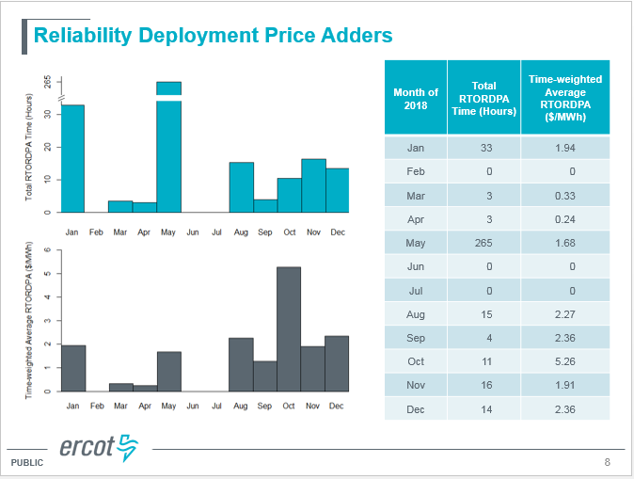
Report Example – Annual RUC TAC Report

Slide 5
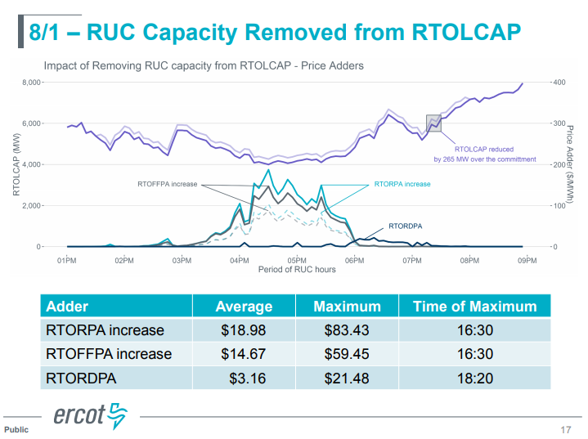
Ad hoc Analysis Example – Event driven review for WMS

Slide 6
Deployment Data- http://www.ercot.com/mktinfo/rtm
We currently produce and post historical and real-time deployment values along with corresponding RTORDPA values for the SCED run:
Historical Real-Time ORDC and Reliability Deployment Price Adders and Reserves
Real-Time ORDC and Reliability Deployment Price Adders and Reserves by SCED Interval

