Slide 1
Look-Ahead SCED Implementation and Performance
Andrew Reimers
Demand Side Working Group Meeting
29 March 2019

Slide 2
How does Look-Ahead SCED work and how is it used?
Look-Ahead SCED (LASCED) uses the following information to give an indication of prices an hour into the future:
  Short term load forecast
  Current wind and solar output
  Ramping constraints
  COP status
LASCED is non-binding but can give an indication of future prices for market participants
  Distinct from a multi-interval SCED

Slide 3
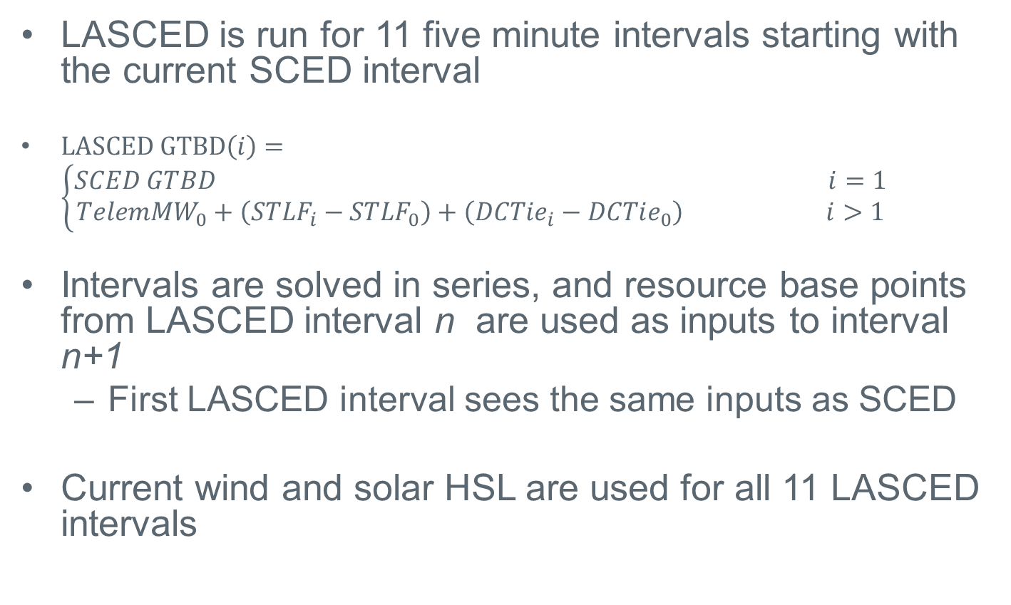
How does LASCED work?
LASCED is run for 11 five minute intervals starting with the current SCED interval
$LASCED GTBD\left(i\right)=\left\{\begin{aligned}SCED GTBD i=1 \\ TelemMW_{0}+\left(STLF_{i}−STLF_{0}\right)+\left(DCTie_{i}−DCTie_{0}\right) i>1\end{aligned}\right.$
Intervals are solved in series, and resource base points from LASCED interval n are used as inputs to interval n+1
  First LASCED interval sees the same inputs as SCED
Current wind and solar HSL are used for all 11 LASCED intervals

Slide 4
Sources of error for LASCED
Demand or wind/solar forecast error
Unit shutdown profile
  If a unit is shown as ON in the current hour and OFF in the next, the LASCED shutdown process forces the unit off in the first five mins of the next hour if it can be ramped down to its LSL at the hour boundary
  Otherwise, the unit is ramped down to its LSL and then shut down
  Sometimes units show OFF in the following hour but keep running through much of the hour, which can lead to a false price spike in LASCED
If a resource telemeters STARTUP, it is assumed to be ON for intervals in the next hour regardless of COP status
Unplanned outages can cause real-time price spikes that aren’t predicted in advance by LASCED
Transmission constraints persist through LASCED intervals

Slide 5
How well does LASCED perform?

Slide 6
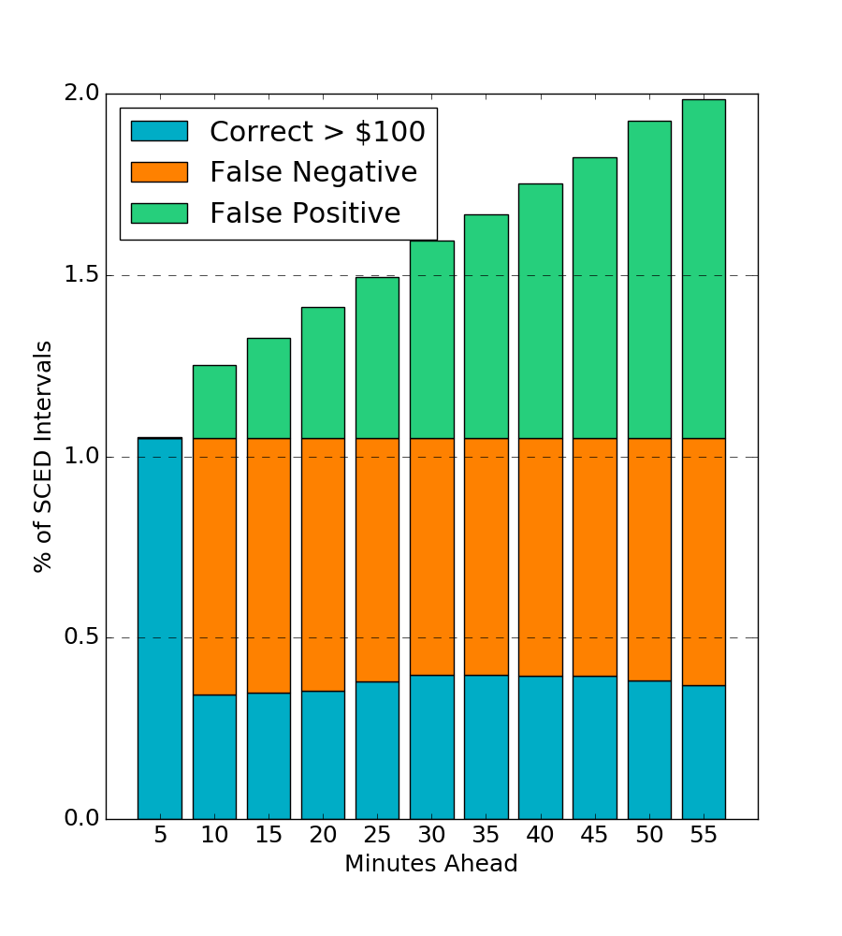
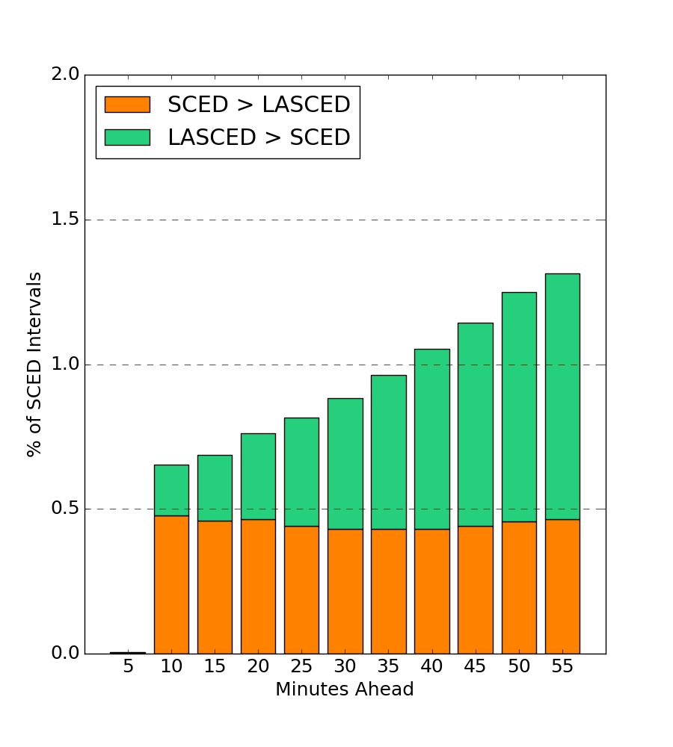
LASCED performance can be estimated based on how well it predicts price spikes or predicts prices within a certain range of SCED
Price spikes > $100
Price differences > $100
These figures use data from August 2018 to March 2019

Slide 7
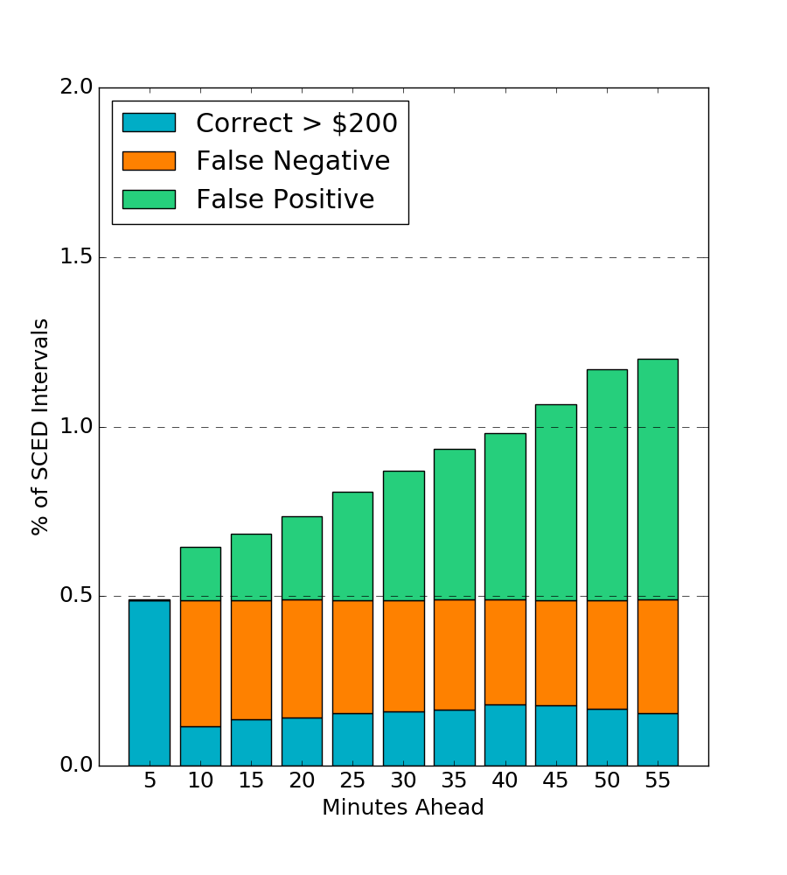
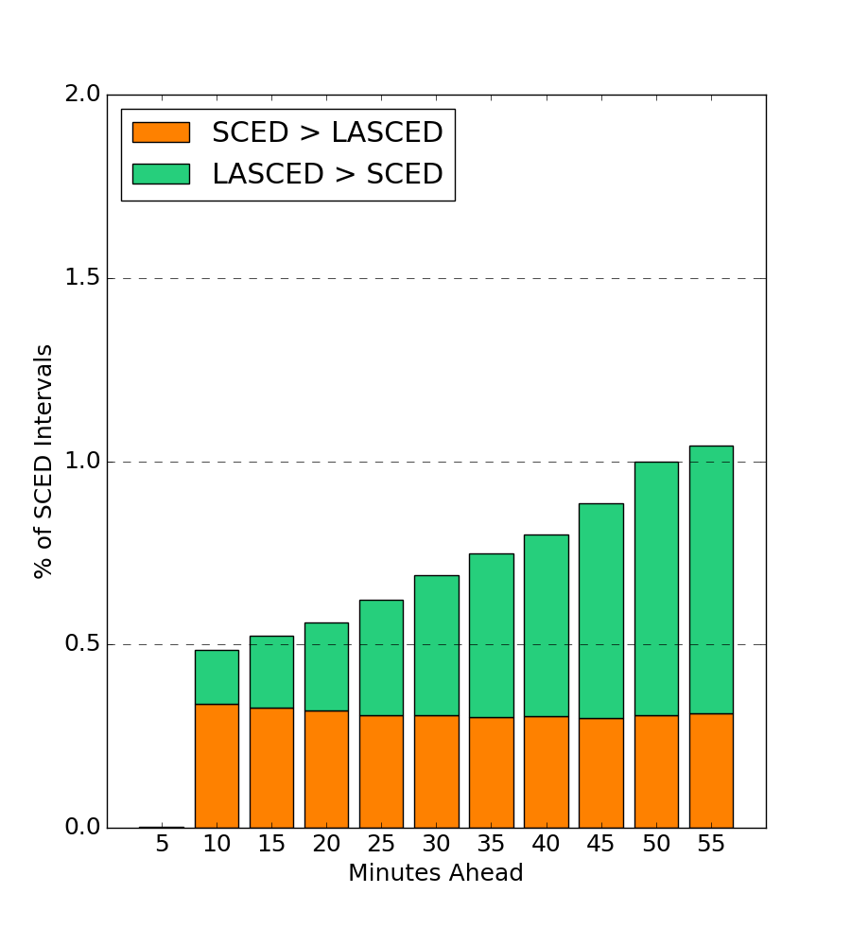
LASCED performance can be estimated based on how well it predicts price spikes or predicts prices within a certain range of SCED
Price spikes > $200
Price differences > $200
These figures use data from August 2018 to March 2019

Slide 8
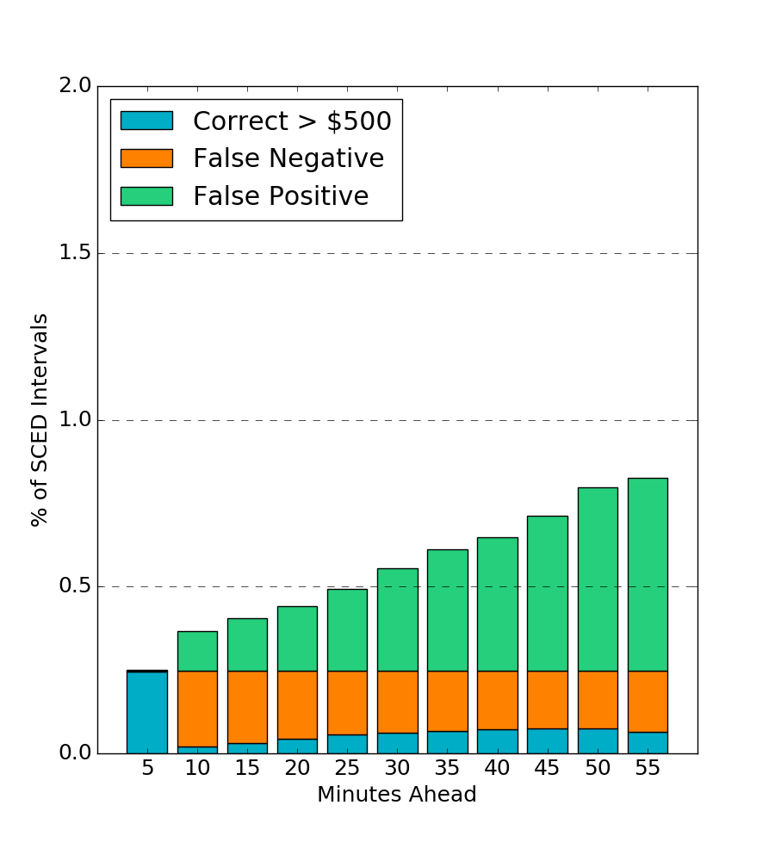
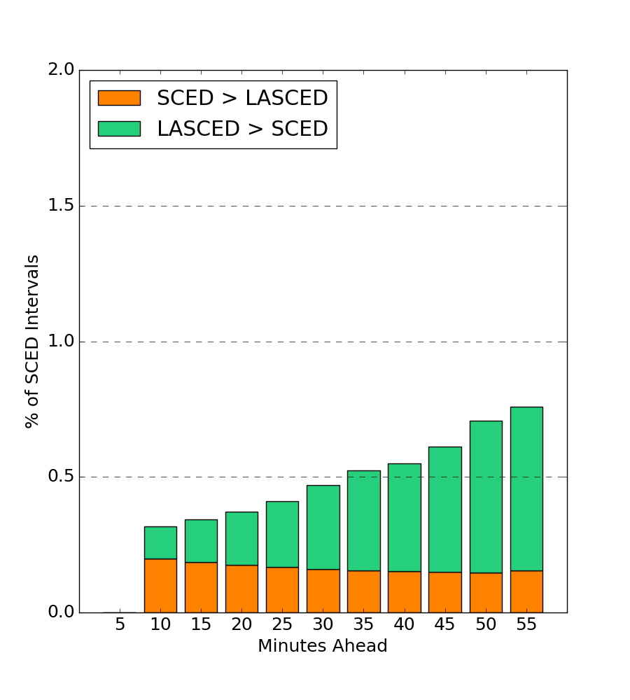
LASCED performance can be estimated based on how well it predicts price spikes or predicts prices within a certain range of SCED
Price spikes > $500
Price differences > $500
These figures use data from August 2018 to March 2019

Slide 9
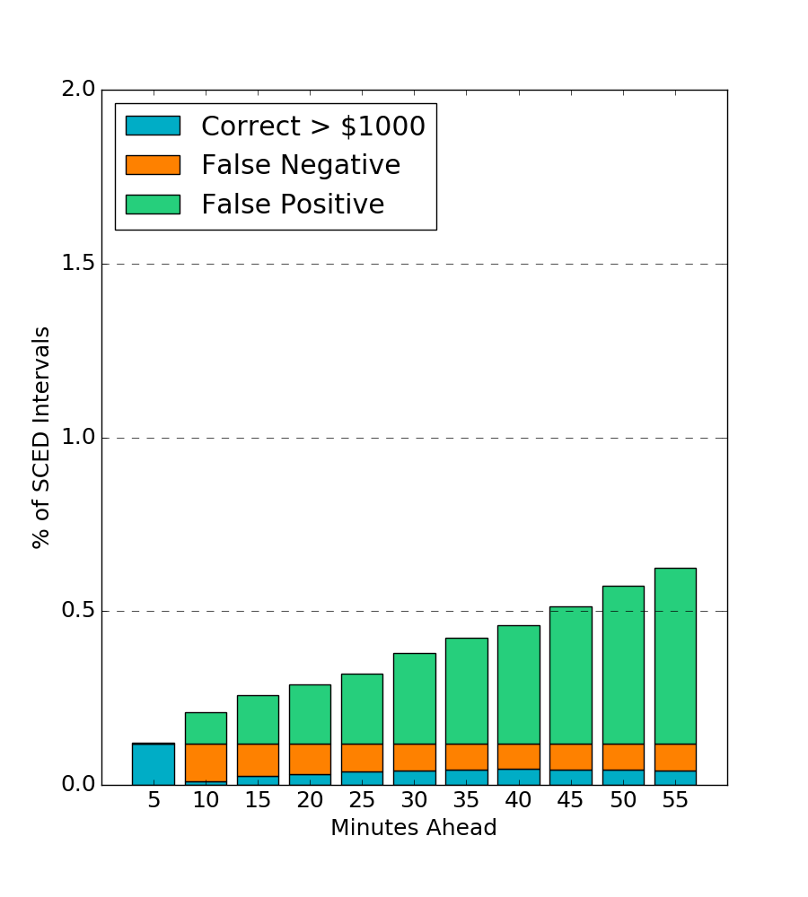
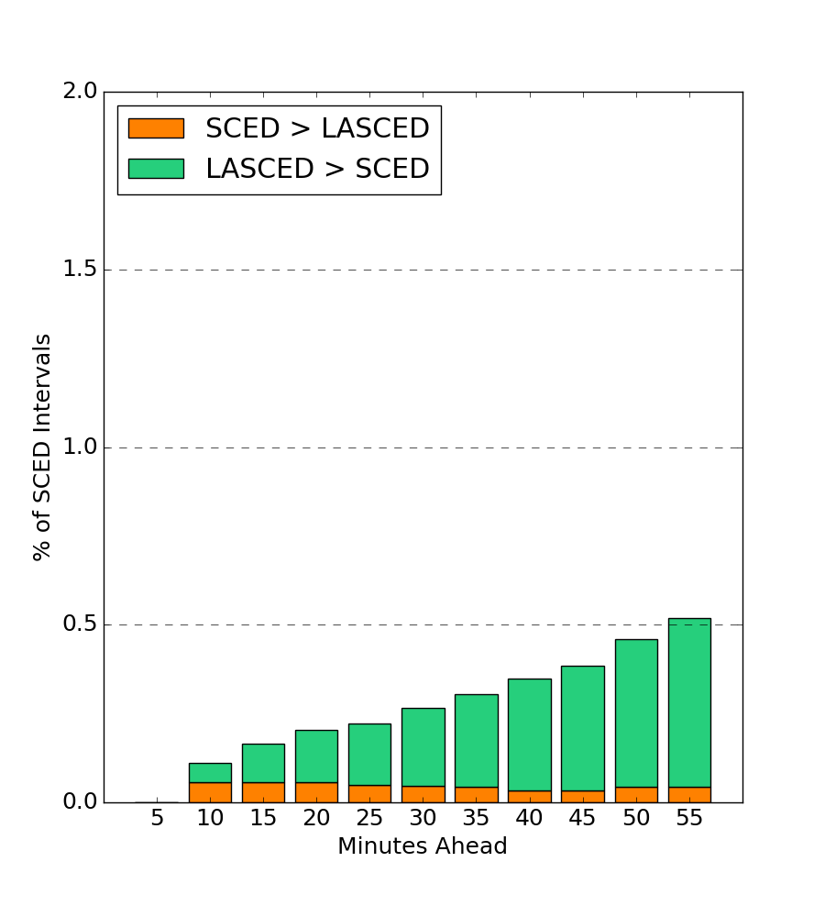
LASCED performance can be estimated based on how well it predicts price spikes or predicts prices within a certain range of SCED
Price spikes > $1000
Price differences > $1000
These figures use data from August 2018 to March 2019

Slide 10
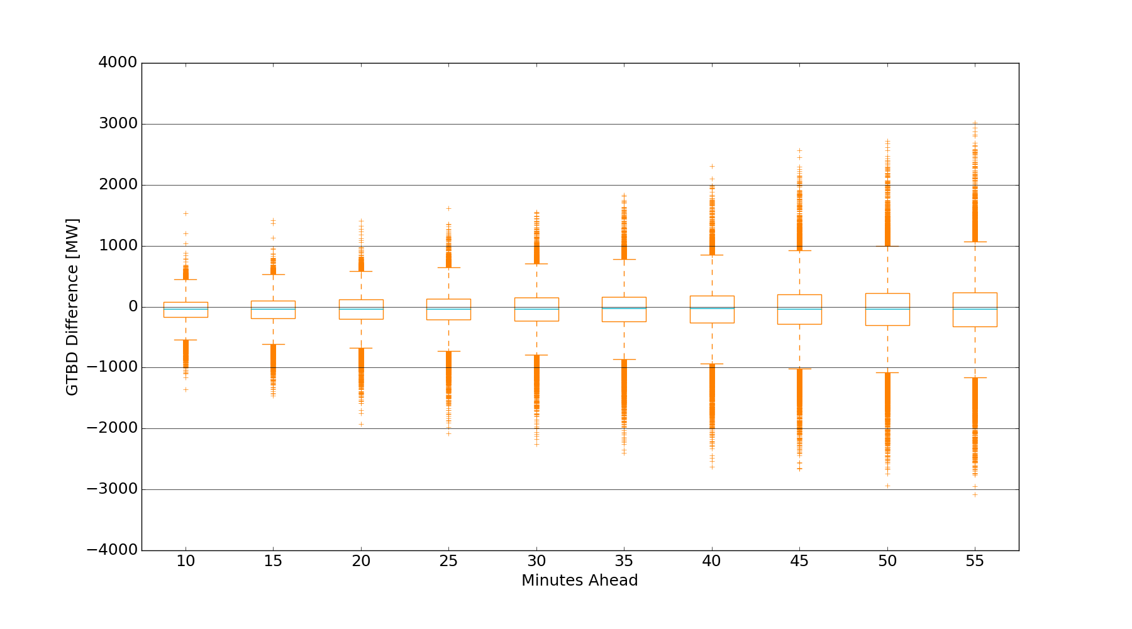
LASCED error as a function of minutes ahead can be partly explained by difference in GTBD
This figure uses data from August 2018 to March 2019

Slide 11
How does recent LASCED performance compare to prior implementation?

Slide 12
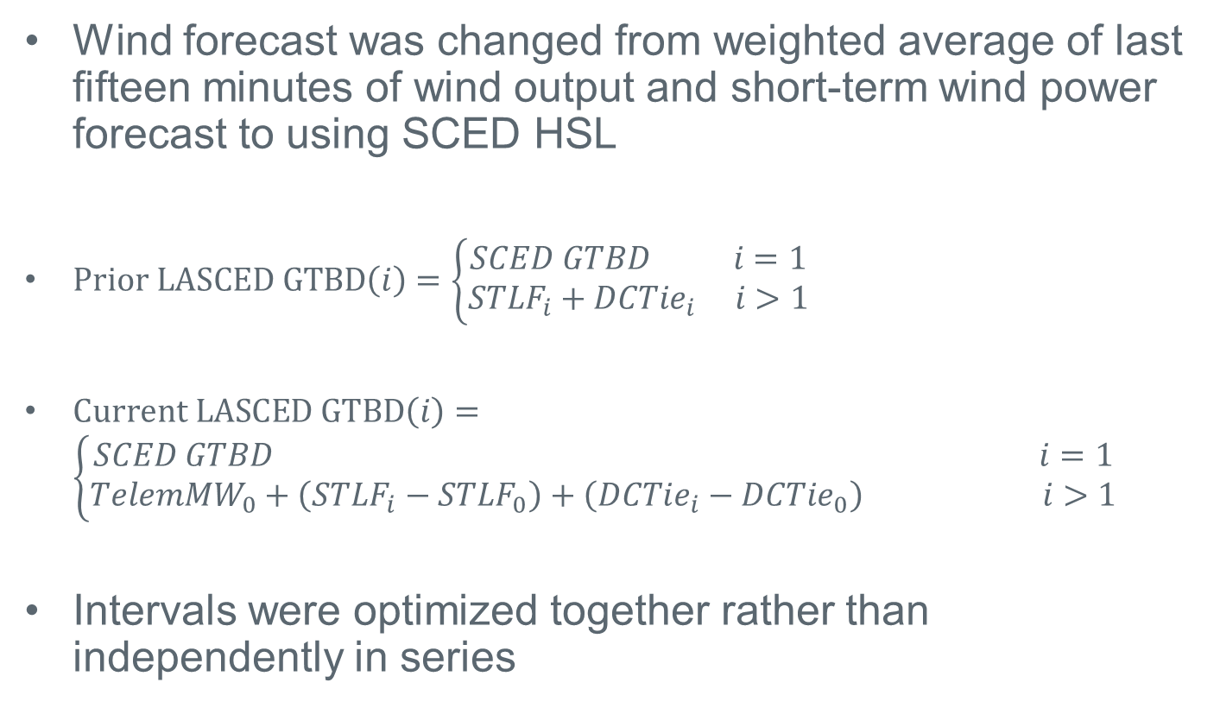
The following aspects of LASCED were changed in summer 2018
Wind forecast was changed from weighted average of last fifteen minutes of wind output and short-term wind power forecast to using SCED HSL
$Prior LASCED GTBD\left(i\right)=\left\{\begin{aligned}SCED GTBD i=1 \\ {STLF}_{i}+DCTie_{i} i>1\end{aligned}\right.$
$Current LASCED GTBD\left(i\right)=\left\{\begin{aligned}SCED GTBD i=1 \\ TelemMW_{0}+\left(STLF_{i}−STLF_{0}\right)+\left(DCTie_{i}−DCTie_{0}\right) i>1\end{aligned}\right.$
Intervals were optimized together rather than independently in series

Slide 13
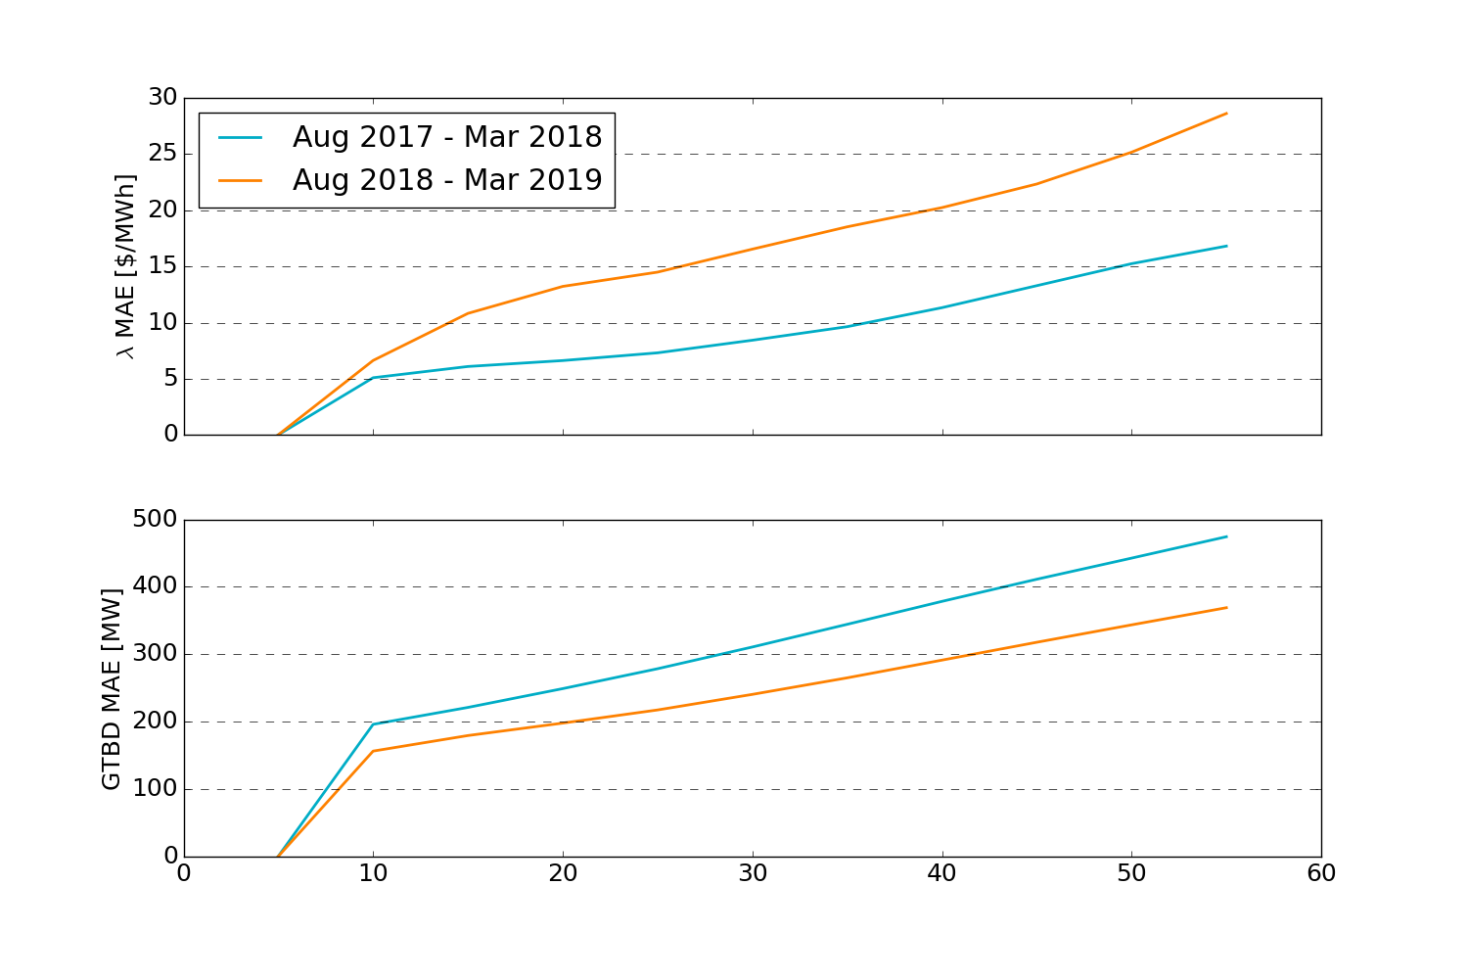
The mean absolute error (MAE) of LASCED GTBD has improved, but price predictions have not

Slide 14
A disproportionate amount of pricing errors are associated with the first SCED interval of the hour
Appx 3.5x more likely than random distribution
Shutdown logic could force units off earlier in LASCED than in real-time
Resource AS responsibilities for the next hour are based on COP and may differ from real-time

Slide 15
Conclusions
Efforts to improve LASCED have focused on inputs that we can control
  Improving GTBD forecast
  Using more realistic ramping constraints by solving LASCED intervals sequentially
Will evaluate whether short-term wind forecasts could improve performance
It’s unclear how to predict which constraints will be active in future intervals without adding new sources of error
We’re investigating common sources of prediction errors that can be effectively addressed

