Slide 1
Credit Exposure Update
Spoorthy Papudesi
Credit Work Group
ERCOT Public
March 28, 2019

Slide 2
Monthly Highlights Jan 2019- Feb 2019
Market-wide average TPE decreased from $330.5 million to $263.8 million
The drop in TPE is due to lower Forward Adjustment Factors in February
Discretionary Collateral is defined as Secured Collateral in excess of TPE,CRR Locked ACL and DAM Exposure.
Average Discretionary Collateral increased from $996.7 million to $ 1,034.8 million
The increase in Discretionary Collateral is largely due to decrease in TPE of Load and Generation entities
Number of active Counter-Parties increased from 228 to 233
No unusual collateral call activity

Slide 3
Settlement Invoice Charges/TPE Jan 2019- Feb 2019

Slide 4
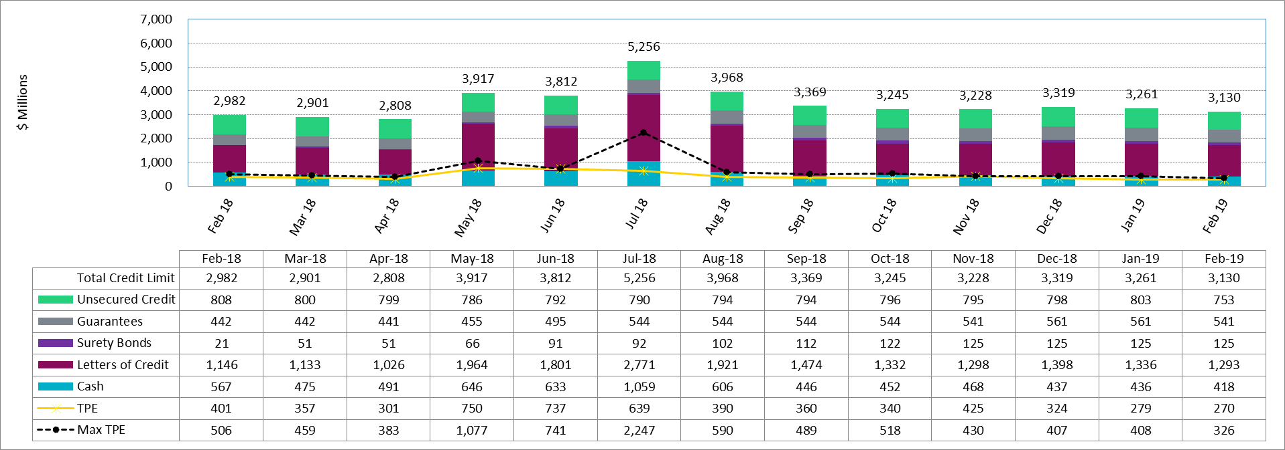
Available Credit by Type Compared to Total Potential Exposure (TPE)
*Numbers are as of month end except for Max TPE

Slide 5
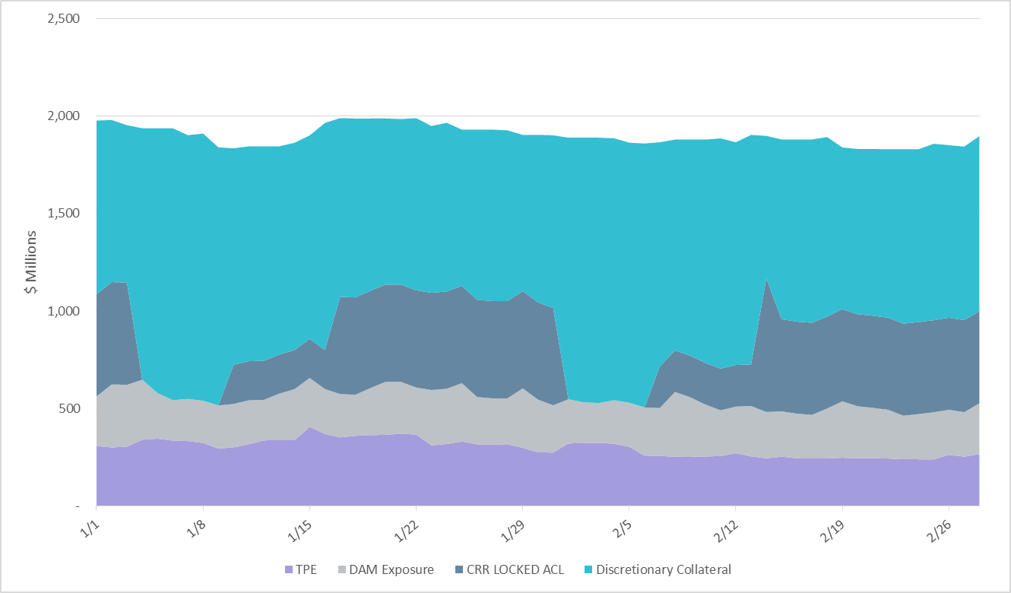
Discretionary Collateral Jan 2019- Feb 2019
At a Counter-Party level, no unusual changes were noted
Note: Discretionary collateral doesn’t include Unsecured Credit Limit or parent guarantees

Slide 6
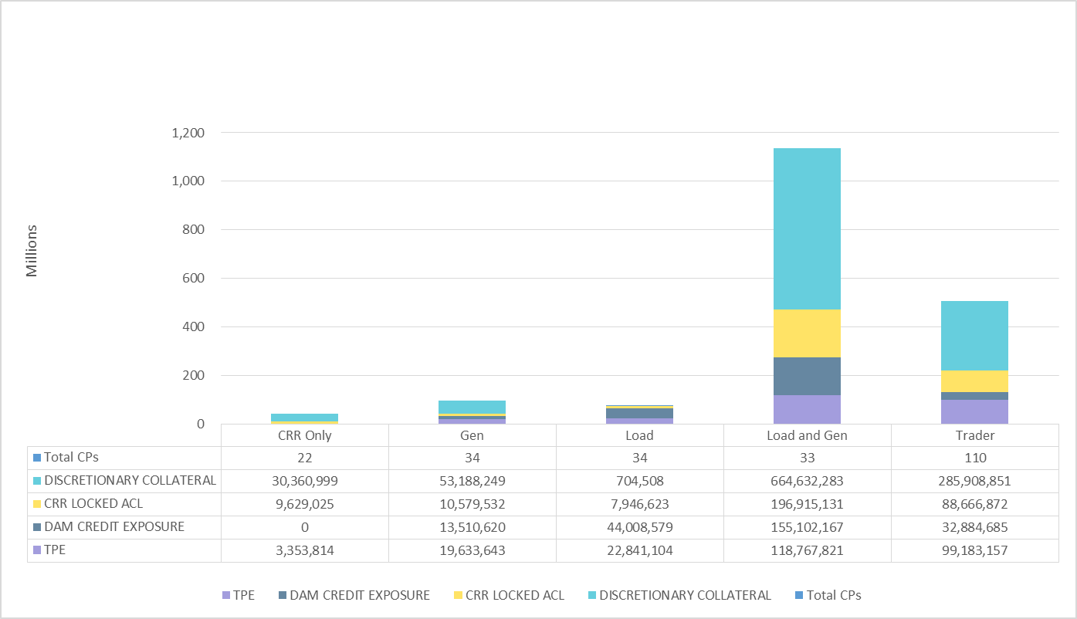
TPE and Discretionary Collateral by Market Segment- Feb 2019
Load and Generation entities accounted for the largest portion of discretionary collateral

Slide 7
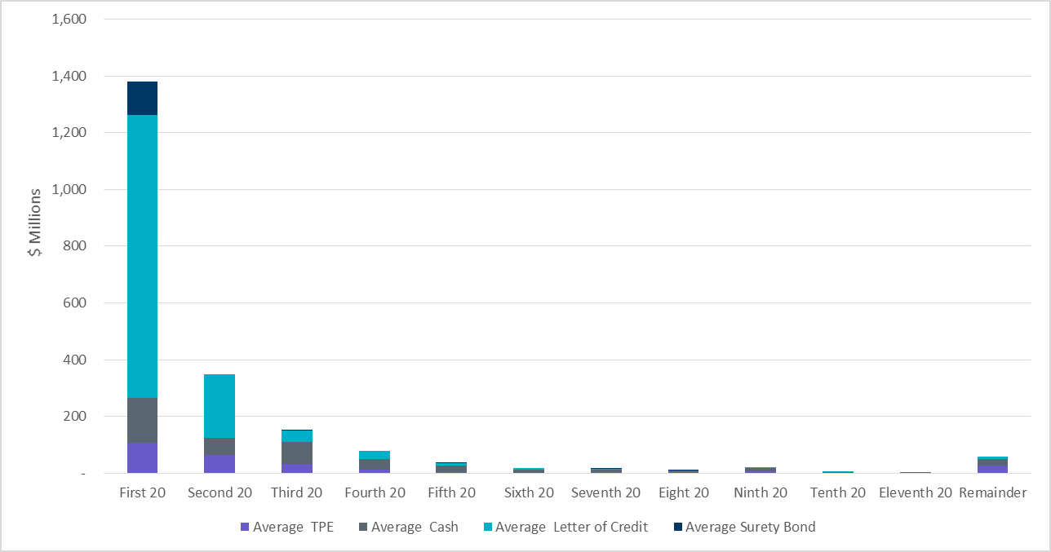
Secured collateral distribution/ TPE- Feb 2019
Posting of discretionary collateral is relatively concentrated.

Slide 8
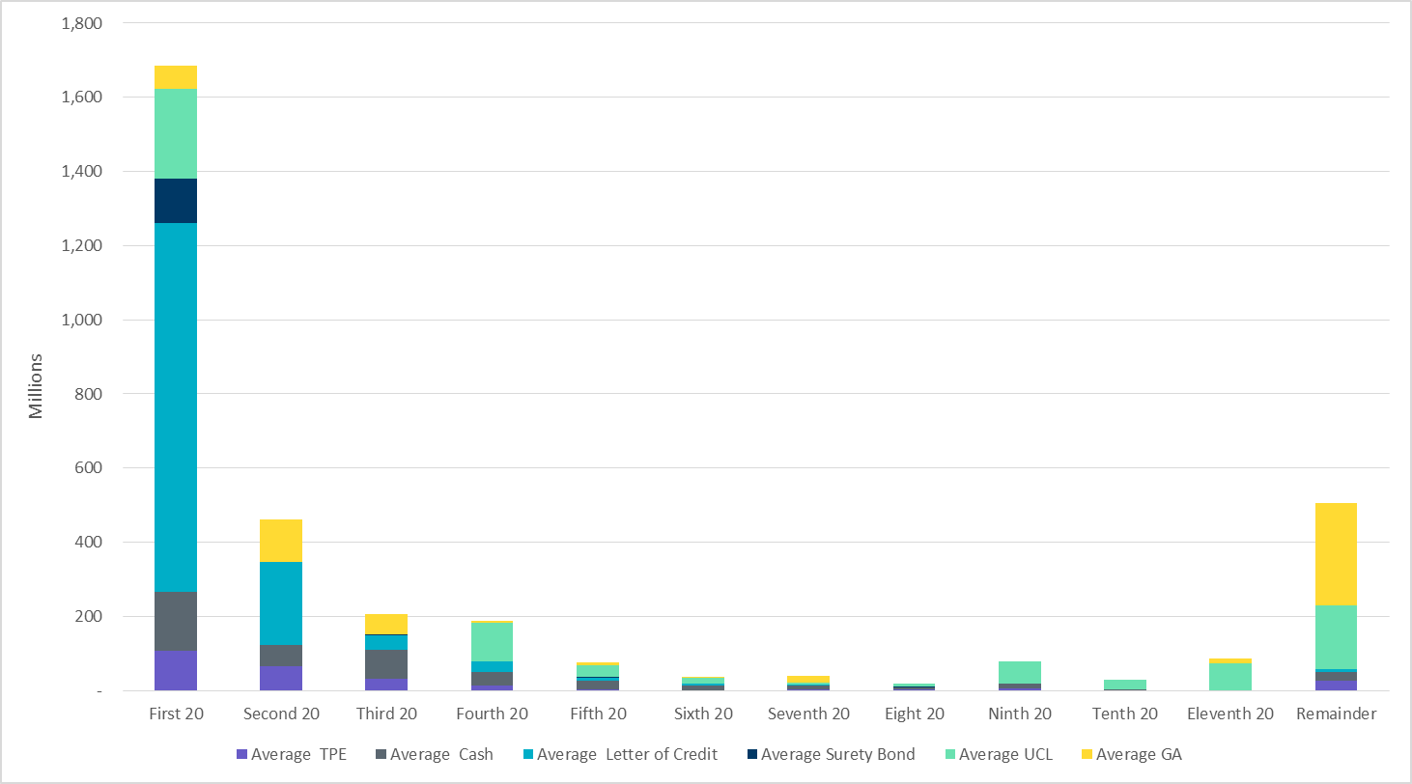
Secured collateral and Unsecured Credit Limit (UCL) distribution/ TPE- Feb 2019
TPE in the last bucket is covered by Guarantees and UCL

Slide 9
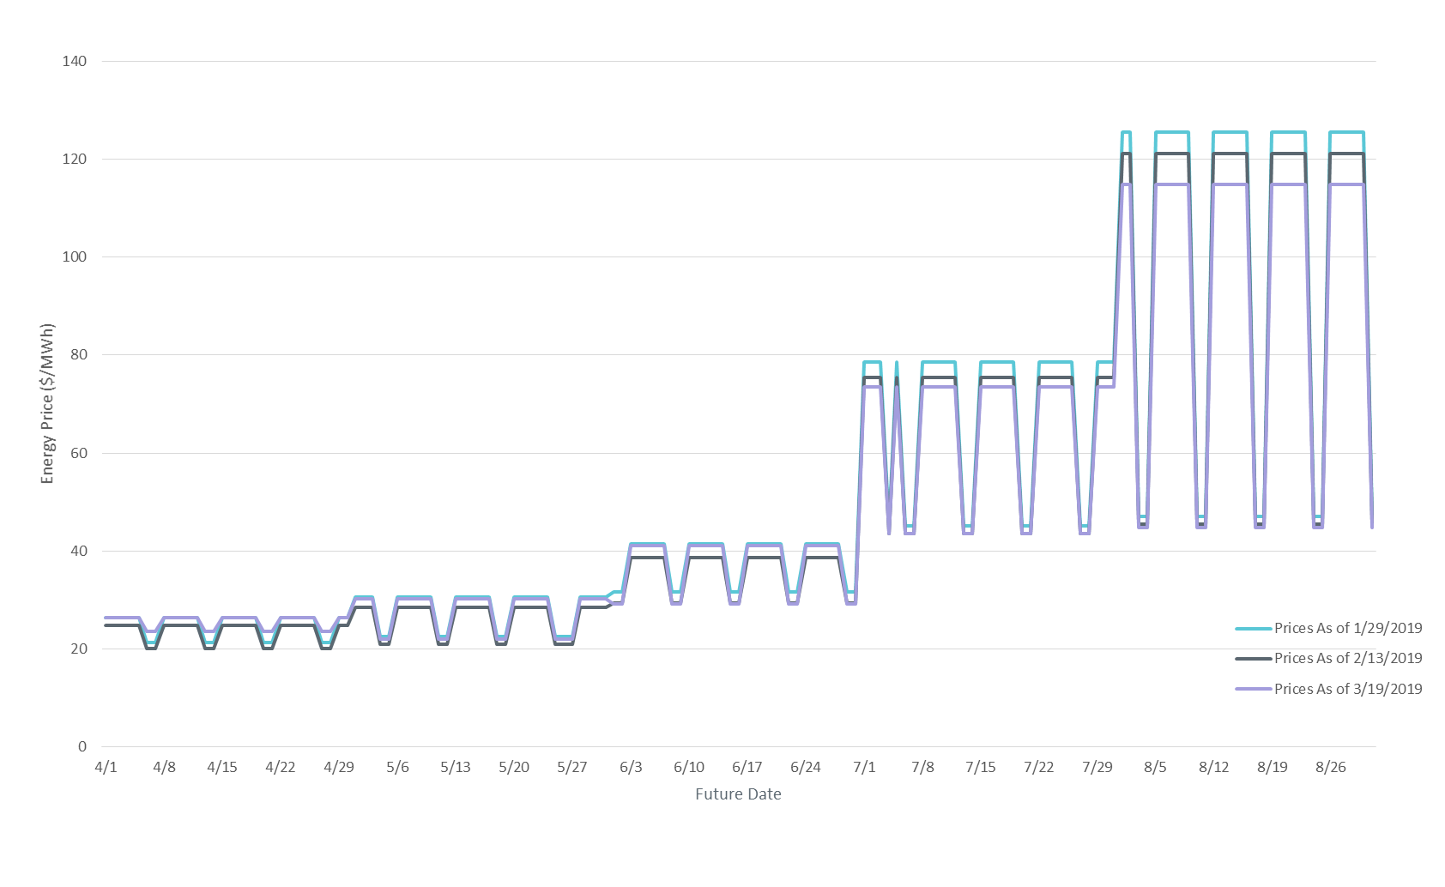
ICE Daily Average Prices April-August 2019
*Daily Average Price = (Peak price*16 +Off-Peak price*8)/24

Slide 10
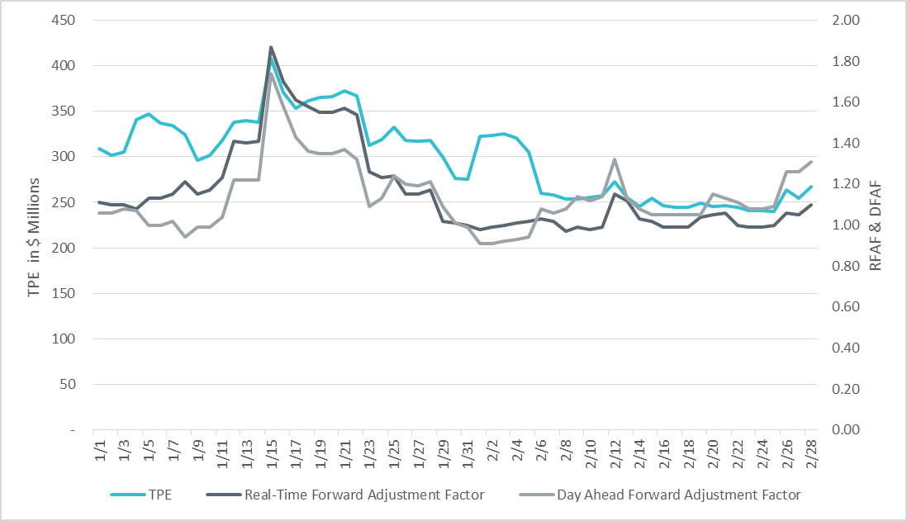
TPE and Forward Adjustment Factors Jan 2019- Feb 2019
TPE moved in conjunction with forward adjustment factors
The Real-Time (RFAF) and Day-Ahead (DFAF) forward adjustment factors capture the ratio of forward ERCOT North prices to actual prices.

Slide 11
Questions

