Slide 1
NPRR664 and Real-Time Mitigated Offer Cap Discussion Points
Ino González
Principal
Market Accounting and Settlements
WMWG
March 25, 2019

Slide 2
Issue A: NPRR664 TAC Vote
On 11/20/14, TAC unanimously voted to recommend approval of NPRR664.
Recommended priority of 2015 and a rank of 1400.
Requested that ERCOT revisit with TAC the rank and priority of NPRR664 prior to project initiation.

Slide 3
NPRR664 Summary
Introduces a Resource specific Fuel Index Price, based on:
Gas Daily’s Waha index price
Gas Daily Houston Ship Channel (HSC) index price (default index price)
Impacts the following sections:
Startup, Minimum Offer and Make-Whole Payment Caps
Startup and minimum Offer Costs for Make Whole Payment
Mitigated Offer Floor (changes with NPRR916)
RMR Payment for Energy
Minimum and Maximum Resource Prices
Real-Time Mitigation Offer Cap (MOC)
Introduces a Real-Time Mitigation Make-Whole Payment
For Exceptional fuel costs (Real-Time fuel purchases) – Changed with NPRR847 Exceptional Fuel Costs Included in the Mitigated Offer Cap

Slide 4
NPRR664 Summary – cont’d
Remaining changes in NPRR 664 not addressed with NPRR847
Impacts on (Based on Waha or Houston Ship Channel fuel prices)
Startup, Minimum Offer and Make-Whole Payment Caps
Startup and Minimum Offer Costs for Make-Whole Payment calculations
Mitigated Offer Cap
Mitigated Offer Floor (changes with NPRR916)
RMR Payment for Energy calculations, and
Minimum and Maximum Resource Prices
Original Impact Analysis (IA) for NPRR664
Between $200k and $300k
IA for NPRR847
Between $60k and $80k

Slide 5
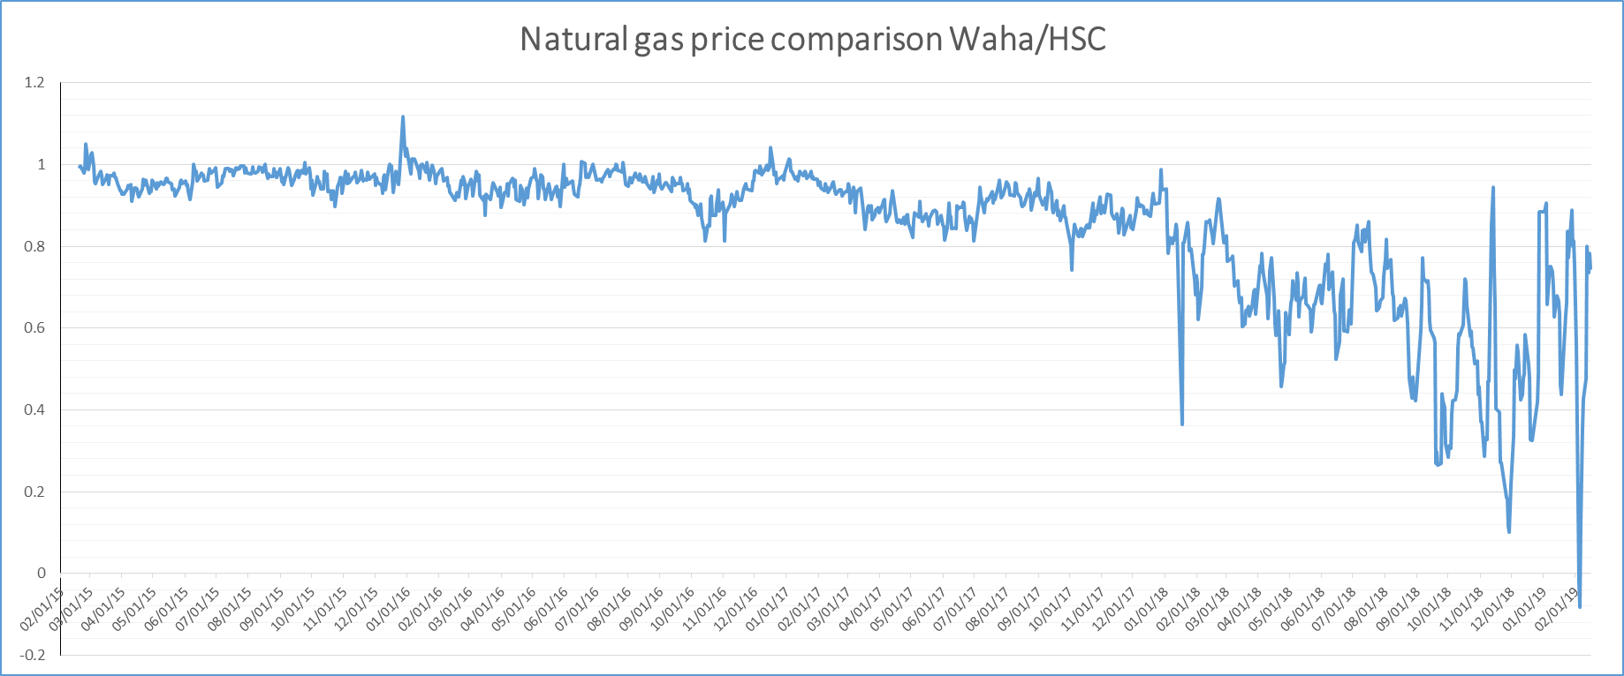
NPRR664 Summary – cont’d

Slide 6
Potential Considerations
Switching to Waha is not required but optional for Resources
If gray-boxed NPRR 664 language is implemented ERCOT may build systems that are never used
Prices in Waha could remain lower than HSC for some considerable time
If Resources do not switch to the appropriate index, the LMPs may not reflect correct fuel prices
WMS could broaden the scope of NPRR 664
Replace HSC with the Katy Index to reflect higher trading volume at Katy
ERCOT working with PUCT to change Subst. R. 25.505, Resource Adequacy in the Electric Reliability Council of Texas Power Region.
ERCOT will bring proposal to WMS for the switch to Katy.
Require use of Waha for Resources buying from Waha

Slide 7
Issue B: Mitigated Offer Cap (MOC) General Form
MOC = Max [ a, b ]
Where,
a = Generic Heat Rate (14.5 or 10.5) * FIP
b = [ IHR * Fuel Price¹ + OM ] * Multiplier (<=for Resources with VC)
IHR = Incremental Heat Rate curve
OM = Average Operations and Maintenance cost
¹ Fuel Price = (FIP * FIP % + FOP * FOP %) + Fuel Adder

Slide 8
Issue B: Capacity Factor Multiplier
b = [ IHR * Fuel Price¹ + OM ] * Multiplier
Capacity Factor (CF) | Multiplier
≥ 50% | 1.10
≥ 30% < 50% | 1.15
≥ 20% < 30% | 1.2
≥ 10% < 20% | 1.25
≥ 5% < 10% | 1.3
≥ 1% < 5% | 1.4
< 1% | 1.5
¹ Fuel Price = (FIP * FIP % + FOP * FOP %) + Fuel Adder

Slide 9
Issue B: Capacity Factor Multiplier (CFM)
b = [ IHR * Fuel Price¹ + OM ] * Multiplier
Impacts both total fuel cost plus OM.
Assumed multiplier included in MOC is to recover some fixed costs and/or to account for uncertainty in heat rates or other inputs.
There are no apparent fixed costs associated with fuel prices.
The OM value approved by ERCOT indirectly reflects the CF of Unit.
¹ Fuel Price = (FIP * FIP % + FOP * FOP %) + Fuel Adder

Slide 10
Issue B: Capacity Factor Multiplier (CFM)
b = [ IHR * Fuel Price¹ + OM ] * Multiplier
Changes made to MOC after Nodal-Go-Live:
Fuel Adder to recover transportation and storage costs.
ERCOT is using summer heat rates throughout the year
NPRR847 allows for Exceptional Fuel Costs, which are also increased by CF multiplier.
¹ Fuel Price = (FIP * FIP % + FOP * FOP %) + Fuel Adder

Slide 11
Issue B: Capacity Factor Multiplier (CFM)
b = [ IHR * Fuel Price¹ + OM ] * Multiplier
Impacts both total fuel cost plus OM.
Assumed multiplier included in MOC is to recover some fixed costs and/or to account for uncertainty in heat rates or other inputs.
There are no apparent fixed costs associated with fuel prices.
The OM value approved by ERCOT indirectly reflects the CF of Unit.
Changes made to MOC after Nodal-Go-Live:
Fuel Adder to recover transportation and storage costs.
ERCOT is using summer heat rates throughout the year
NPRR847 allows for Exceptional Fuel Costs, which are also increased by CF multiplier.
¹ Fuel Price = (FIP * FIP % + FOP * FOP %) + Fuel Adder

Slide 12
Issue B: Capacity Factor Multiplier
Questions for WMWG:
Is the MOC supposed to be a marginal cost curve?
Should the CFM apply to both the IHR and the OM?
Are the CFM values still appropriate?

Slide 13
Questions?
Notes:
https://castaylor.ercot.com/owa/redir.aspx?C=oPhl4_Wz9UCI7oVqJkGdaM-P4-MvhtMIRAMJFZ7-K5eOg6lo6esBMUiebAbXd4c8z8FTPzV8g8A.&URL=https%3a%2f%2ftheconversation.com%2fwhen-will-rooftop-solar-be-cheaper-than-the-grid-heres-a-map-54789%3futm_source%3dtwitter%26utm_medium%3dreferral%26utm_campaign%3dUTAustinNews
http://www.vox.com/2015/6/19/8808545/wind-solar-grid-integration
http://greeningthegrid.org/quick-reads
https://ec.europa.eu/energy/intelligent/projects/en/projects/pv-grid
http://energy.gov/eere/sunshot/systems-integration

