Slide 1
CRR Portfolios
Carrie Bivens
Manager, Forward Markets
March 28, 2019

Slide 2
Methodology
Based on CRR inventory as of 3/1/19
Value is based on the most recent auction clearing price available for each CRR
PCRRs that have been allocated but not yet priced were ignored
Aggregated to the CP level

Slide 3
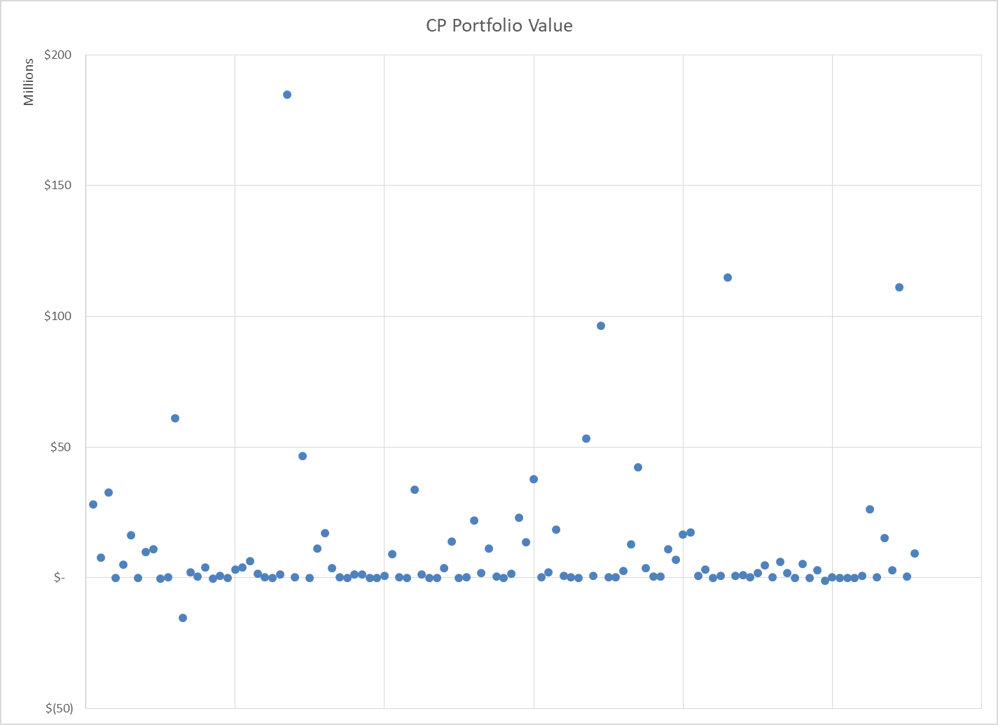
Scatter

Slide 4
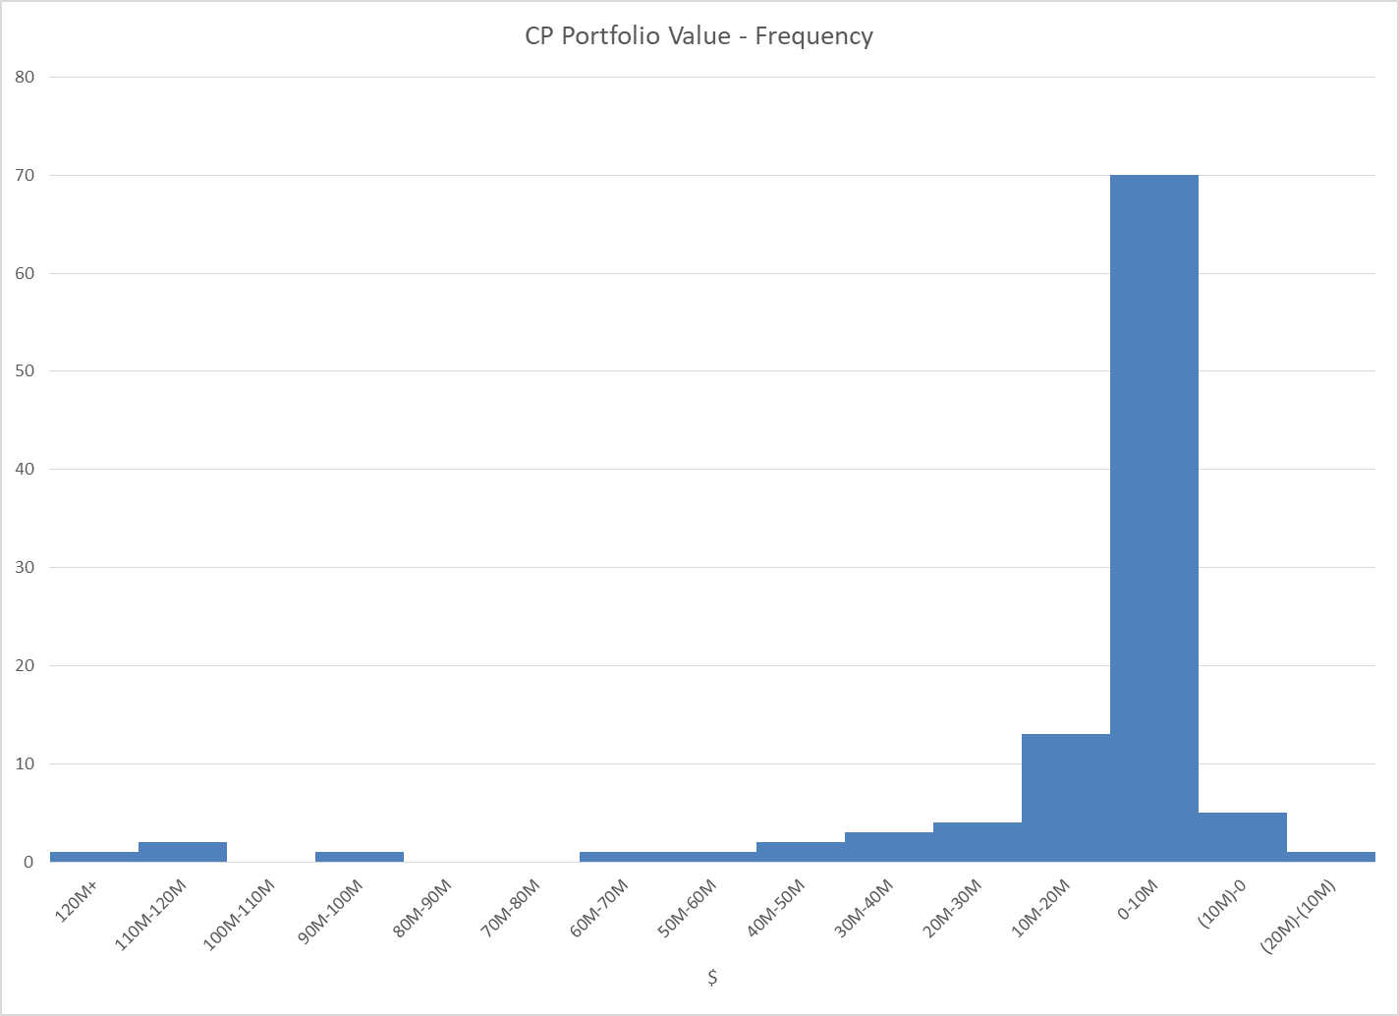
Histogram

Slide 5
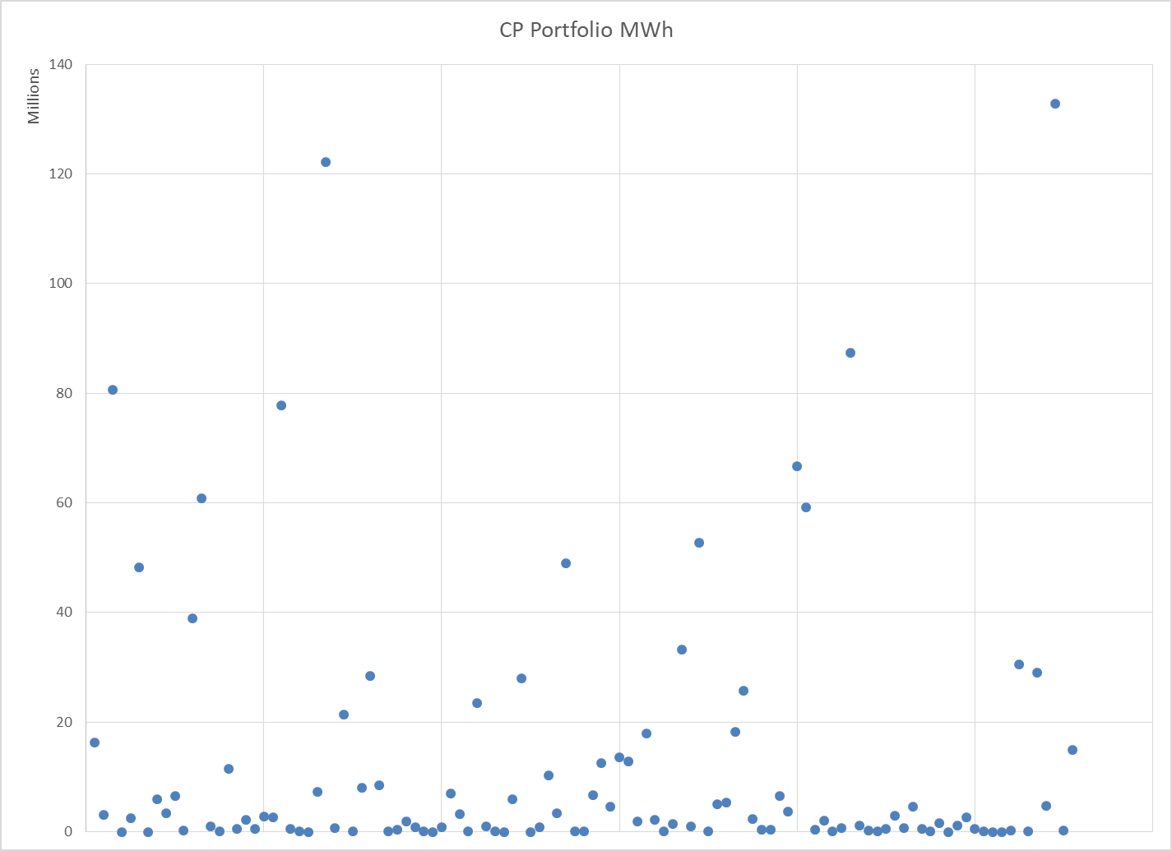
MWh Scatter

Slide 6
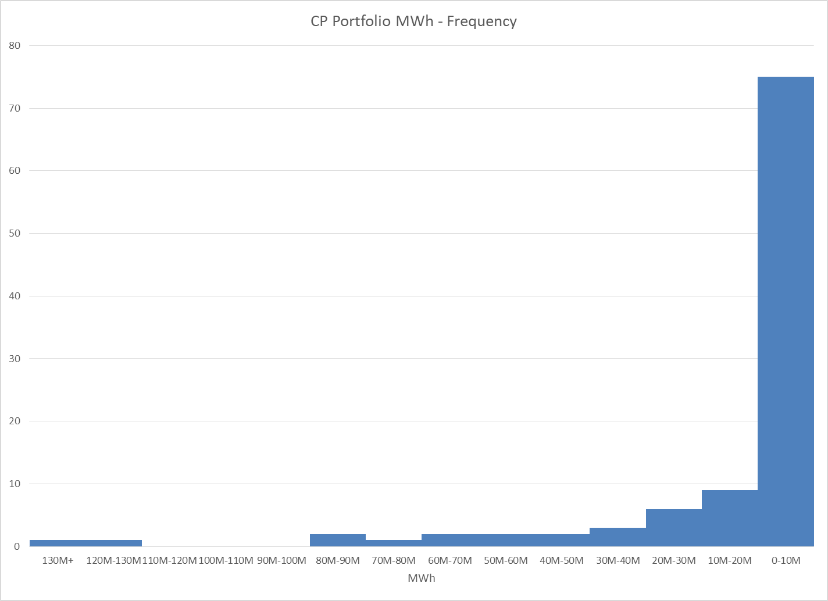
MWh Histogram

