Slide 1
Intra-Hour Wind Forecast Accuracy Updates (Mar. 2019)
WMWG
Operations Analysis
March 25, 2019

Slide 2
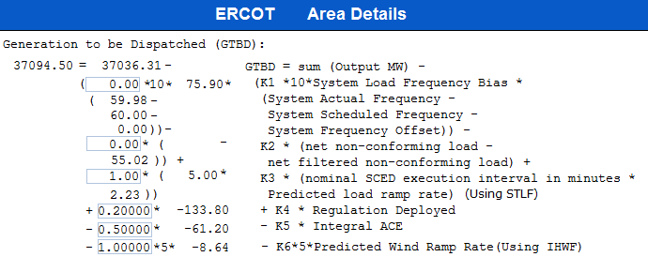
Current GTBD Parameters
Historical K factor tuning events:
12/4/18 10:05 AM – K6 Changed from 0 to 0.5
2/12/19 2:15 PM – K6 changed from 0.5 to 1.0
3/12/19 2:10 PM – PWRR Max/Min Threshold from 10 MW/min to 15 MW/min
3/19/19 2:15 PM – PWRR Max/Min Threshold from 15 MW/min to 20 MW/min
Notes:
3/12/18 – Integral ACE Time Constant Changed from 60 min to 45 min
5/17/18 – K4 Changed from 0.3 to 0.2 and K5 Changed from 0.4 to 0.5
12/4/18 – 10:05 AM – K6 Changed from 0 to 0.5
2/12/19 – 2:15 PM – K6 changed from 0.5 to 1.0
3/12/19 – 2:10 PM – PWRR Threshold from 10 to 15 MW/min
3/19/19 – 2:15 PM – PWRR Threshold from 15 to 20 MW/min

Slide 3
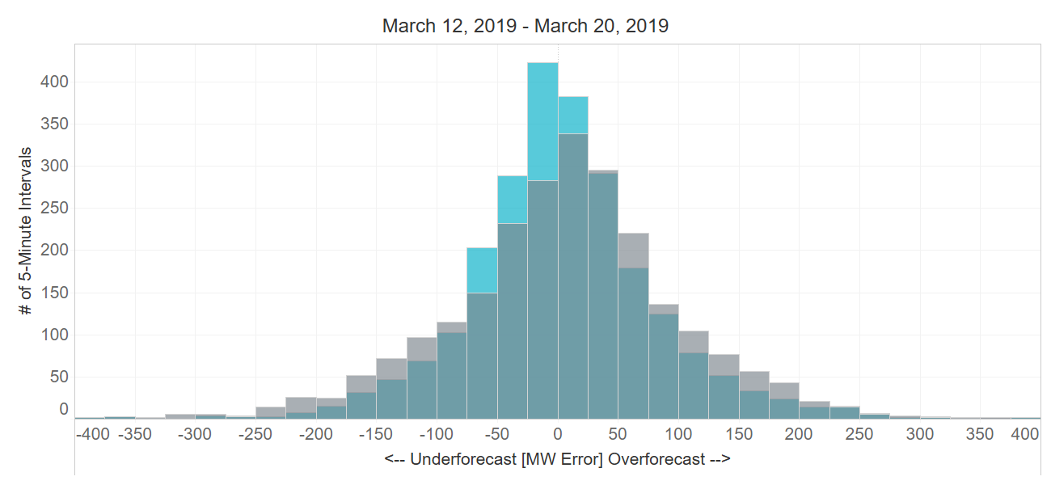
Projected Wind Ramp Rate (PWRR) Error
Performance Metric | SCED PWRR (12/4 – 3/12) | Persistence Ramp* (12/4 – 3/12) | SCED PWRR (3/12 – 2/20) | Persistence Ramp* (3/12 – 2/20)
Monthly MAE (MW) | 68 | 76 | 60 | 74
Monthly MAE when 5-Min. Wind Ramp > 100 MW | 142 | 163 | 123 | 164
SCED PWRR
Persistence Ramp*
* Persistence Ramp assumes using a 0 MW wind ramp in PWRR

Slide 4
Appendix The following slides were presented at March PDCWG

Slide 5
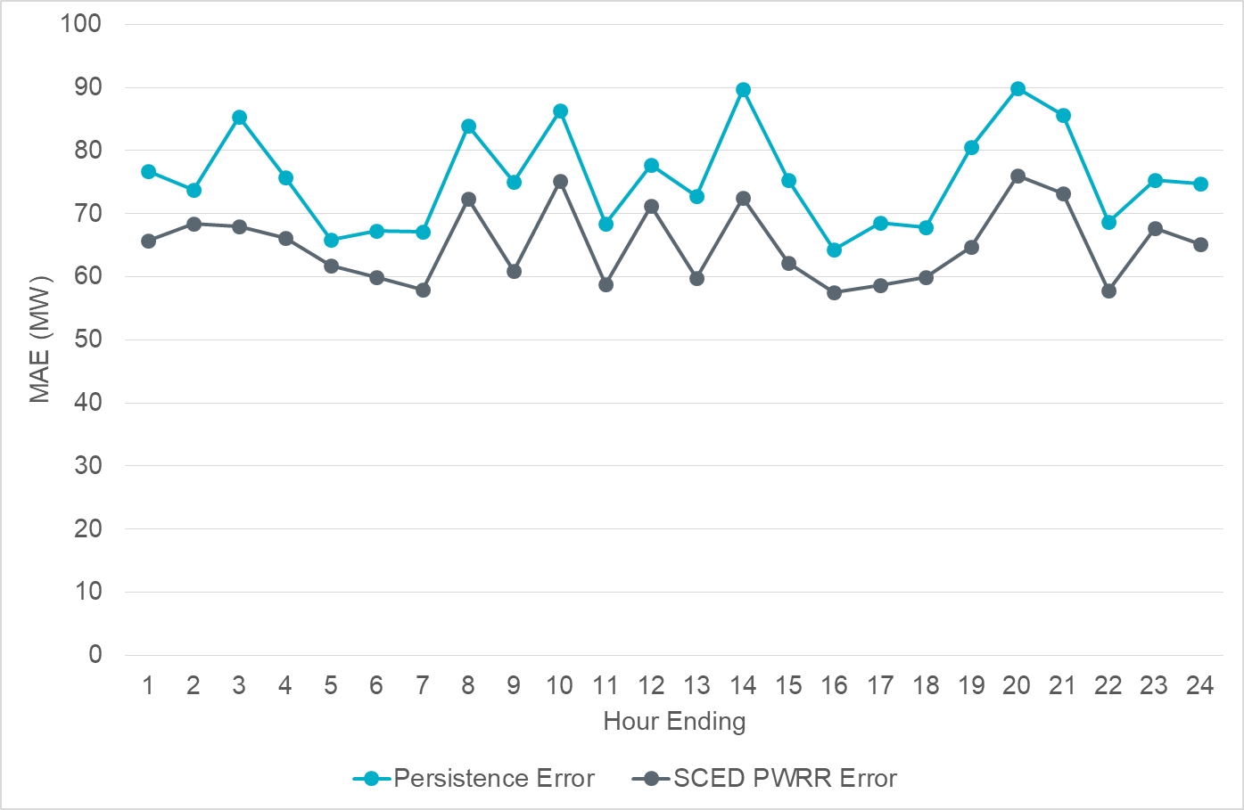
Intra-Hour Wind Ramp Forecast Error (February 2019)

Slide 6
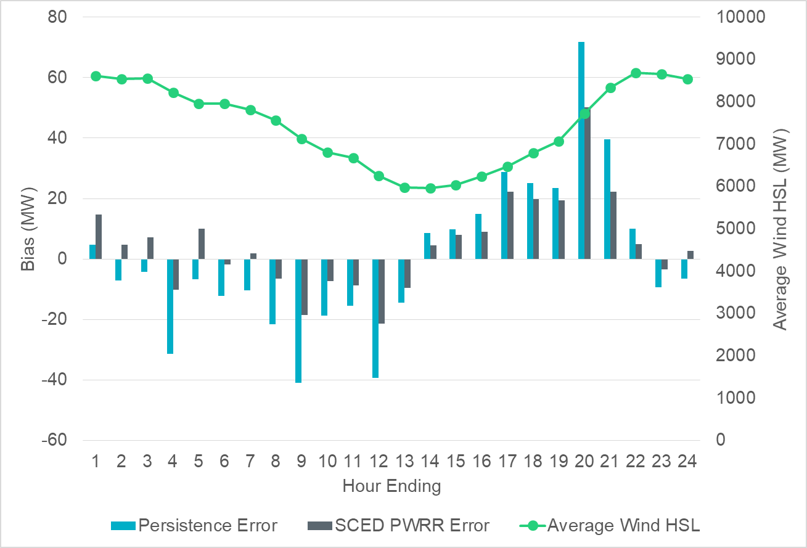
Intra-Hour Wind Ramp Forecast Error (February 2019)

