Slide 1
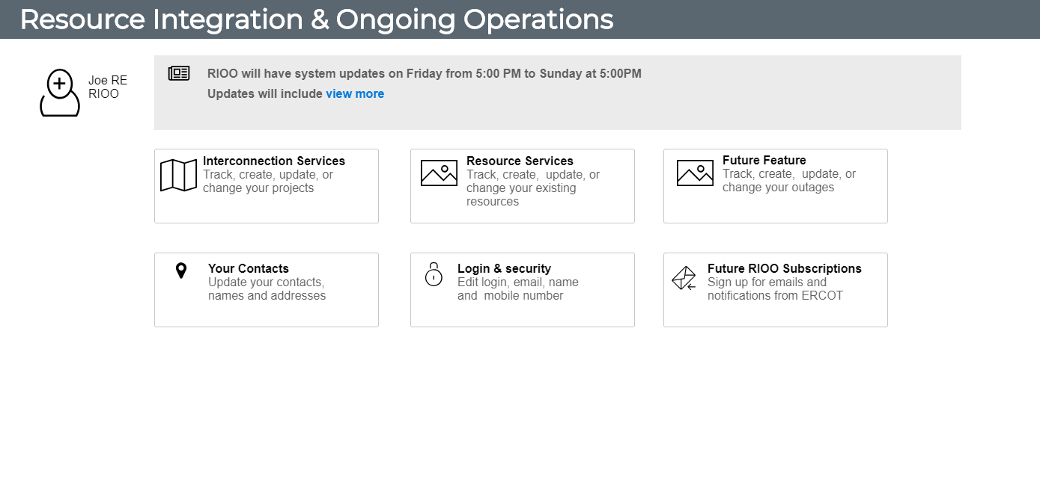
ERCOT RIOO - Springboard

Slide 2
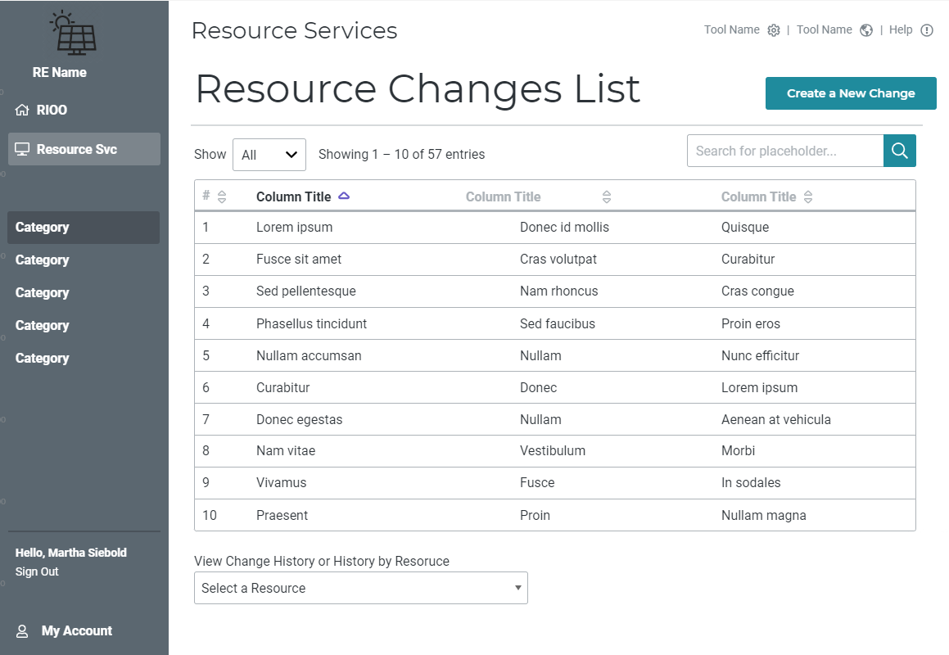
ERCOT RIOO – Resource Changes List

Slide 3
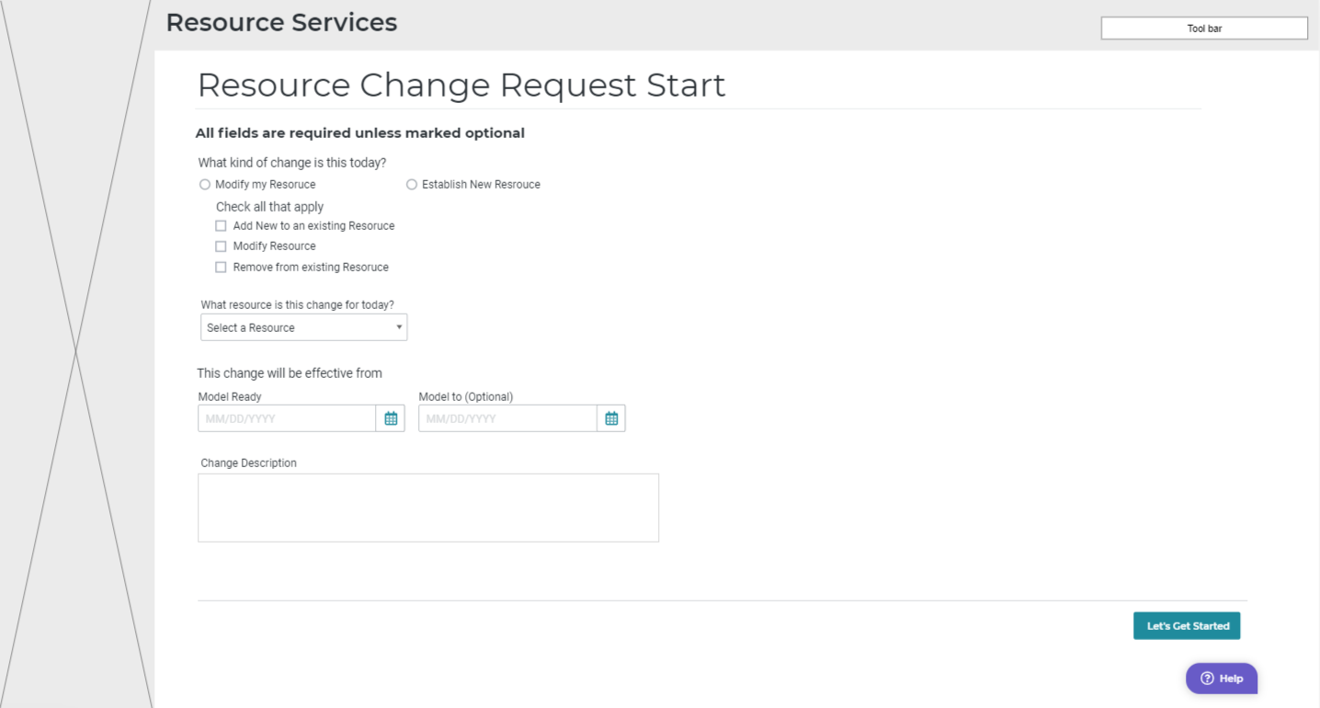
ERCOT RIOO – Resource Change Request Start

Slide 4
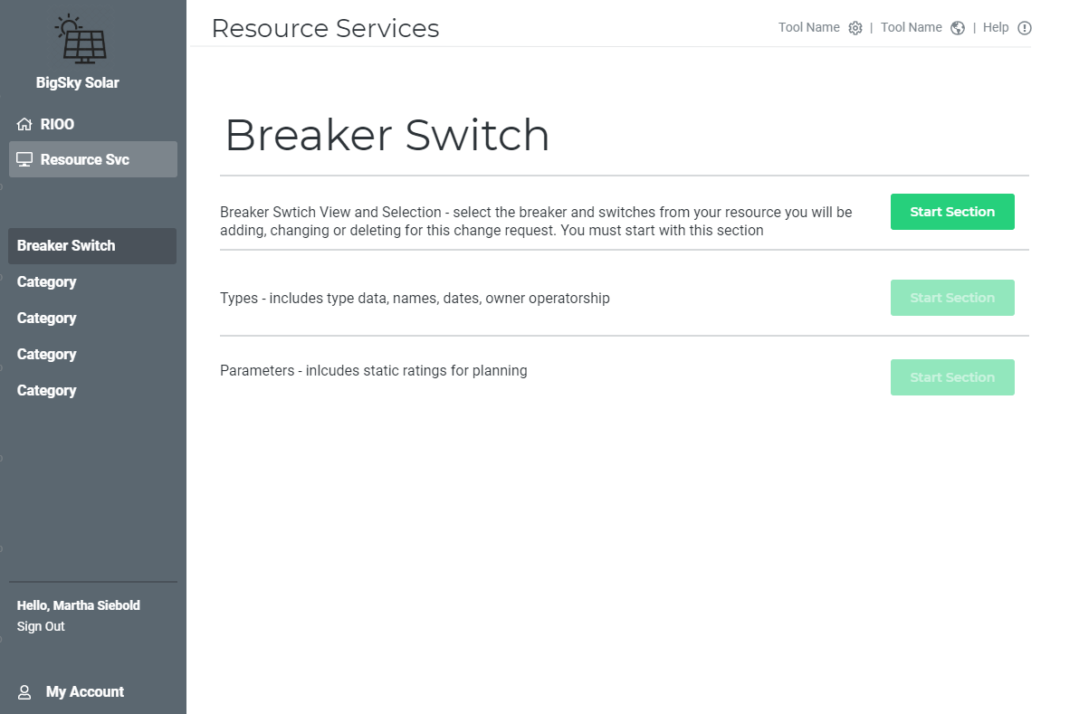
ERCOT RIOO – Breaker Switch List

Slide 5
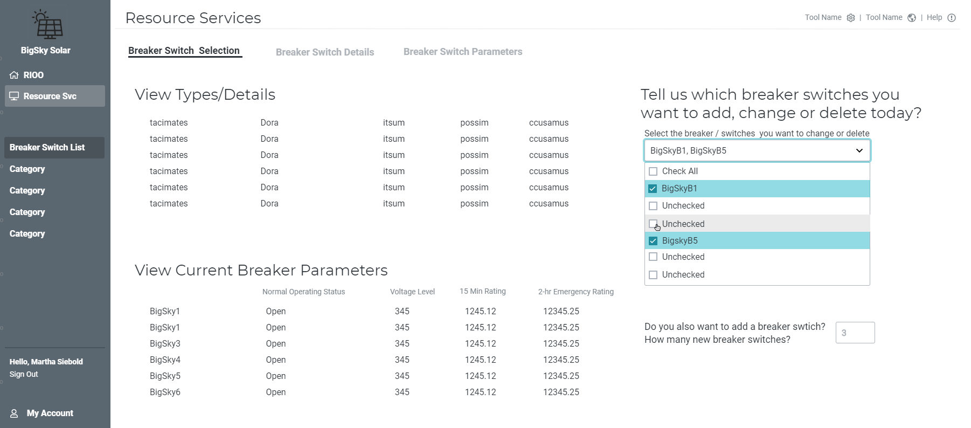
ERCOT RIOO – Breaker Switch View and Selection

Slide 6
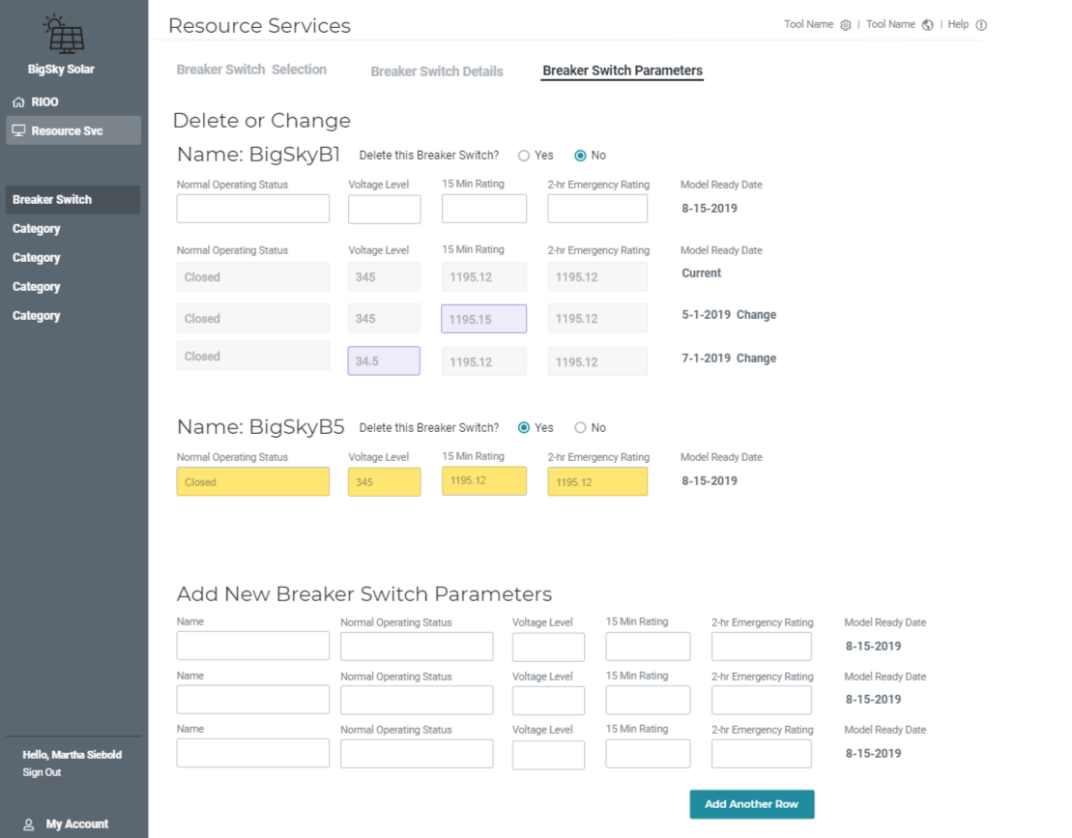
ERCOT RIOO
Breaker
Switch
Update

Slide 7
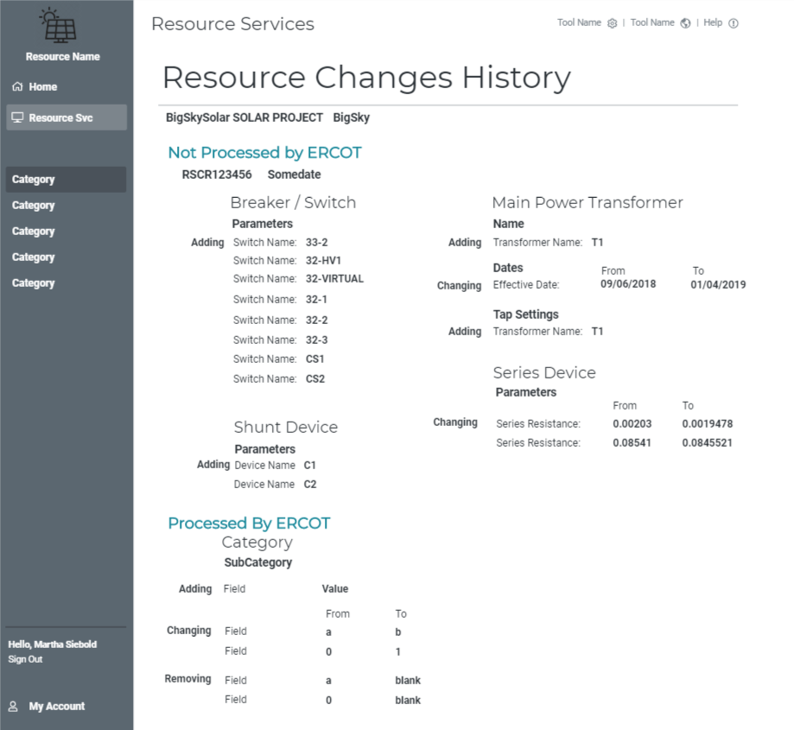
History
Example

