Slide 1
NPRR 849 Problem Statements and Solutions
Stephen Solis
OWG Meeting
March 21, 2019

Slide 2
Purpose
This set of slides presents two primary paths forward with NPRR 849.
  Make modifications to the current draft of NPRR 849
  Move forward with smaller set of changes for NPRR 849 and follow up with additional NPRRs
Options are provided to address the two primary concerns raised at ROS on the current draft of NPRR 849.
Options are provided to break out NPRR 849 into smaller set of changes to address ROS directive.
Decide on which path forward and options have most consensus to report back to ROS.

Slide 3
Options modifying the current draft of NPRR 849
Achieves original objective of NPRR 849
Addresses all of the noted problems (#1-14)
Improves clarity of reactive power requirements

Slide 4

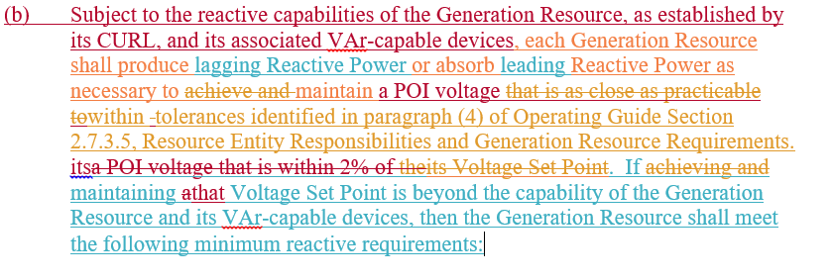

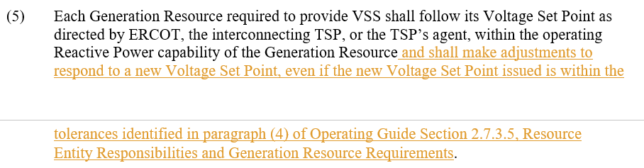
Options modifying the current draft of NPRR 849 - Option 1 – Address “as close as practicable”
Maintains progress made with current language which addresses most of the problems (#1-13).
Addresses the primary issue with the “as close as practicable” language discussed at February ROS
Addresses clarity that GRs must adjust voltage for a new Voltage Set Point Instruction even if the instruction is within the tolerances.
Allows for separate discussion of NOGRR to adjust the tolerances in Section 2.7.3.5 of the Operating Guides.

Slide 5
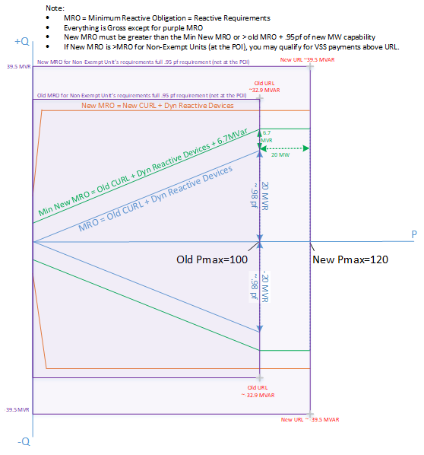
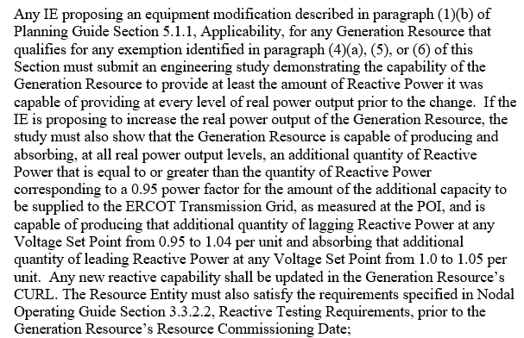
Options modifying the current draft of NPRR 849
Option 2 – Option 1 + MP submits comments for repower
ERCOT still prefers that grandfathered GRs undergoing a substantial equipment modification should come into compliance with current grid code
ERCOT would not oppose if majority of stakeholders support the below language preserving grandfathering for these GRs (Problem #14).
Maintains exemption but requires that the additional MW capacity is accompanied with a minimum amount of additional dynamic MVAr capacity at a .95 pf.
Any new dynamic MVAr capability must be made available and reflected in its CURL or subsequent dynamic device model.
Problem (ERCOT): Generators that were grandfathered from 0.95 power factor (“rectangle”) reactive requirement are being repowered with modern technology that should be capable of providing 0.95 power factor requirement but are not providing 0.95 power factor.

Slide 6
Options with multiple NPRRs to address Problems
Achieves original objective of NPRR 849
Addresses some of the noted problems
These separate NPRRs would generally address the same sections, which could result in confusion as to the ultimate impact to the Protocol language if they move through stakeholder process simultaneously; yet waiting to address each issue in series would take a number of years to provided needed clarifications.

Slide 7
List of Problems and Solutions addressed by Option 3
Problem (ERCOT): Section 3.15 does not explicitly state the range of voltages within which a Generation Resource must have the required reactive capability.
  Option 3
Problem (NRG): ERCOT’s enforced range of voltages between .95 and 1.05 pu for the full .95 pf is unnecessary/inefficient in some areas (lagging requirements at higher voltages and leading requirements in lower voltages.)
  Option 3
Problem (ERCOT): Clarifying the range of applicable voltages would raise the question whether a generator can be instructed to provide voltage support outside of the stated range.
  Option 3
Problem (NRG, Invenergy): Set point ranges are unnecessarily broad;
  Option 3
Problem (OWG/Oncor): Language doesn’t explicitly require generators to provide all reactive capability when the Voltage Set Point is outside the established voltage ranges.
  Option 3

Slide 8
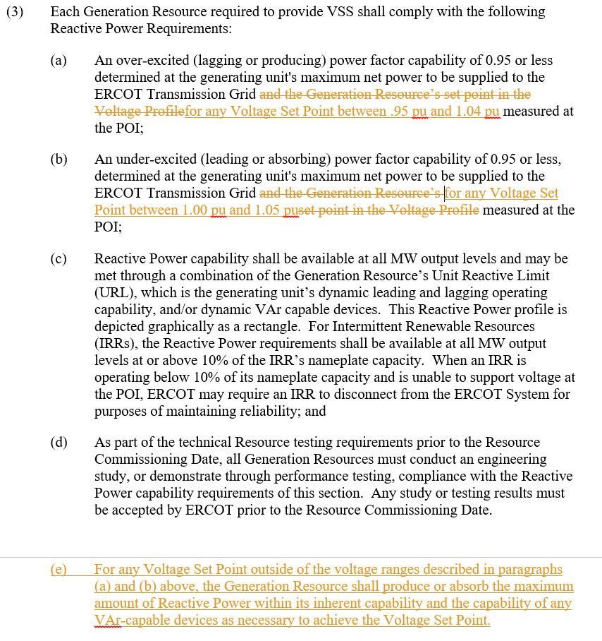
Options with multiple NPRRs to address Problems
Option 3 – Just address Problems #1, #2, #3, #6 and #12.
Focuses on original objective of NPRR 849
Addresses multiple issues with fewer language changes
Adds clarity that Voltage Set Points can vary within operating ranges avoiding confusion at time of Reactive Study review
Lowers minimum Reactive Requirements from current .95 pu to 1.05 pu range of Voltage Set Points for new Generation Resources
Does not alter grandfathering provisions
Does not address whether duty to comply with Voltage Set Point is limited by capability
Does not distinguish between real-time obligation and demonstration of capability in study, as some MPs desired
May not be supported by entities with Generation Resources that did not design their units to meet the current .95 to 1.05 voltage range

Slide 9
List of Problems and Solutions addressed by other options.
Problem (ERCOT): Section 3.15 does not explicitly recognize TSP’s authority to instruct an IRR operating below 10% output to operate VAr-capable devices or to disconnect from ERCOT System.
  Option 4
Problem (ERCOT): Some generators are not always moving to newly assigned Voltage Set Points when the new Voltage Set Point is within 2% of the current Voltage Set Point.
  Option 5
Problem (ERCOT): Option 6: Provisions in paragraph (3) of 3.15 should be arranged in chronological order to provide maximum clarity (i.e., interconnection study requirement in paragraph (c) should precede real-time operational requirements) (ERCOT 10/28/18 comments)
  ERCOT Option 6
Problem (ERCOT): Generators that were grandfathered from 0.95 power factor (“rectangle”) reactive requirement are being repowered with modern technology that should be capable of providing 0.95 power factor requirement but are not providing 0.95 power factor.
  Option 2 *language looks different if done in independent NPRR*:

Slide 10
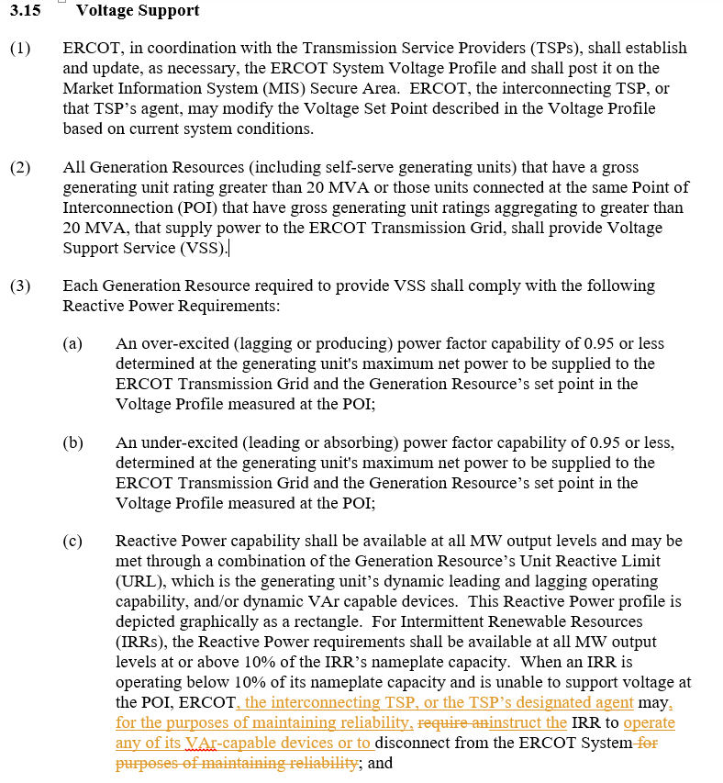
Options with multiple NPRRs to address Problems
Option 4 – Separate NPRR to address Problem #5.
If Option 3 is selected for NPRR 849, then this separate NPRR would address a smaller issue to minimize changes to NPRR 849
Clarifies ability for ERCOT and TSPs to instruct IRRs to operate VAR-capable devices for reliability reasons (e.g. address System Operating Limit exceedances, avoid voltage collapse, avoid load shed, etc.).
Recognizes that some IRRs and its VAR capable devices are available at output levels below 10%.

Slide 11
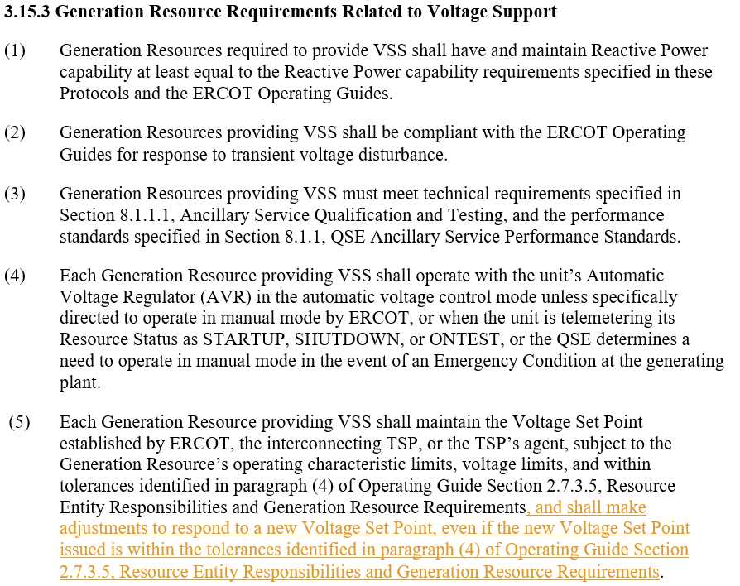
Options with multiple NPRRs to address Problems
Option 5 – Separate NPRR to address Problem #9.
If Option 3 is selected for NPRR 849, then this separate NPRR would address a smaller issue to minimize changes to NPRR 849
Clarifies expectation for Generation Resources to make adjustments for a new Voltage Set Point even if they are currently within the tolerance band.
While a majority of Generation Resources do not have an issue adjusting to new Voltage Set Points, the existing language clarity for newer MPs can be confusing and has led to some Generation Resources not adjusting when within the tolerance band.

Slide 12
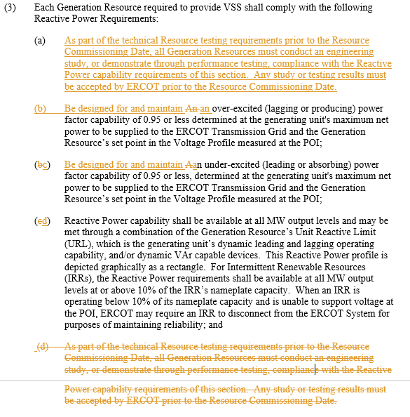
Options with multiple NPRRs to address Problems
Option 6 – Separate NPRR to address Problem #10.
If Option 3 is selected for NPRR 849, then this separate NPRR would address a smaller issue to minimize changes to NPRR 849
Allows requirements to be arranged chronologically.

Slide 13
List of Problems without proposed breakout options.
Problem (ERCOT): Section 3.15 doesn’t clearly define obligation of generators to meet Voltage Set Point and does not explain how this relates to the duty to have 0.95 power factor capability within the defined range.
  Language separating design vs performance is included in current 012219 ERCOT Comments to address this issue, and any language to separate into an independent NPRR would be substantial.
Problem (Invenergy): Establishing set point ranges may create compliance risk for generators that designed to a narrower range.
  Additional grandfathering provisions is a non-starter, performance based language is included in current 012219 ERCOT Comments to address this issue, and any language to make performance based in an independent NPRR would be substantial.
Problem (NRG, Invenergy): Protocols do not explicitly recognize 2% tolerance band stated in Operating Guide 2.7.3.5.
  Section 3.15.3 makes reference to the tolerances in the Nodal Operating Guides.
Problem (ERCOT): Language imposing reactive requirements may be difficult to conceptualize, even with additional clarifications.
  Graphs will be located in alternative location than the Protocols.
Problem (Invenergy/ERCOT): Graphs may misrepresent the literal requirement.
  Graphs will be located in alternative location than the Protocols.

Slide 14
Questions?

