Slide 1
Resource Integration Workshop
ERCOT
Jay Teixeira
March 21, 2019

Slide 2
Quarterly Stability Assessment (QSA)
Planning Guide 5.9
Next Deadline for QSA
If a GINR is not included in QSA, its Initial Synchronization date will be automatically delayed to the next quarter
All-Inclusive Generation Resource Initial Synchronization Date | Last Day for an IE to meet prerequisites as listed in paragraph (4) below | Completion of Quarterly Stability Assessment
Upcoming January, February, March | Prior August 1 | End of October
Upcoming April, May, June | Prior November 1 | End of January
Upcoming July, August, September | Prior February 1 | End of April
Upcoming October, November, December | Prior May 1 | End of July

Slide 3
Quarterly Stability Assessment (QSA)
Planning Guide 5.9, Quarterly Stability Assessment
Issue’s seen in the QSA that had May 1, 2018 deadline
  10 day comment period for FIS
    Needs to be complete before QSA deadline
    TSPs need to plan for it
  Dynamic data validation
    Dependent on FIS Stability study
    Need to meet PG 6.9 15 to 30 days prior to QSA deadline

Slide 4
RIOO-IS Application
Go-Live

Slide 5
TSPs with RIOO accounts
TDSP Name | Number of Accounts
AEP TEXAS INC (TDSP) | 8
BRAZOS ELECTRIC POWER CO OP INC (TDSP) | 3
CENTERPOINT ENERGY HOUSTON ELECTRIC LLC (TDSP) | 19
CITY OF AUSTIN DBA AUSTIN ENERGY (TDSP) | 7
CITY OF GARLAND (TDSP) | 1
CPS ENERGY (TDSP) | 5
CROSS TEXAS TRANSMISSION LLC (TSP) | 2
LCRA TRANSMISSION SERVICES CORPORATION (TDSP) | 4
LONE STAR TRANSMISSION LLC (TSP) | 4
ONCOR ELECTRIC DELIVERY COMPANY LLC (TDSP) | 13
RAYBURN COUNTRY CO OP DBA RAYBURN ELECTRIC (TDSP) | 4
SHARYLAND UTILITIES LP (TDSP) | 2
SOUTH TEXAS ELECTRIC CO OP INC (TDSP) | 2
WIND ENERGY TRANSMISSION TEXAS LLC (TSP) | 3

Slide 6
TSPs without RIOO accounts
TDSP Name | Lead TSP Projects
ELECTRIC TRANSMISSION TEXAS LLC (TDSP) | 3
TEXAS-NEW MEXICO POWER CO (TDSP) | 6

Slide 7
Importance of TSP RIOO Account
At some point in the future...
TRANSMISSIONOWNERSGENINTERCONNECT@LISTS.ERCOT.COM will be decommissioned
All notices will go out via RIOO
Timeline TBD

Slide 8
PGRR Language Review
This Workshop

Slide 9
Miscellaneous Updates
5.1.1 Applicability
  (b)
    (ii) Change the inverter, wind turbine generator, or power converter associated with an All-Inclusive Generation Resource of ten MW or greater, unless the replacement is in-kind; or

Slide 10
Miscellaneous Updates
5.4 Study Processes and Procedures
  5.4.1
(4) Upon completion of the Security Screening Study, ERCOT will present the IE with a preliminary report indicating future transmission additions or enhancements that may be required to accommodate the proposed additional generation or Generation Resource modification at the specified in-service year. This report that is meant to inform the IE about any additional transmission improvements estimated to be required for the continued security and reliability of the ERCOT System. the potential transfer limits at the POI for the proposed MW amount. This report does not imply any commitment by ERCOT or any TSP to recommend or construct these transmission additions or enhancements. The report will also contain a description of the SSR assessment performed as part of the Security Screening Study and any conclusions resulting from the SSR assessment.

Slide 11
Under Discussion
This Workshop

Slide 12
NPRR776 Voltage Set Point Communication
Requires TSPs to telemeter kV measurement of designated POI bus to be utilized to determine compliance with Voltage Set Point instructions to ERCOT. This point is called kVM.
  Modify to match any Verbal Voltage Set Point
Also requires TSP to telemeter the Real-Time Voltage Set Point to ERCOT. This point is called kVT.
ERCOT will make these measurements available to the QSE
The QSE will provide to the Generation Resources it represents
Must be done before Resource can synchronize above 20 MVA.

Slide 13
PG 6.9 Addition of Proposed Generation to the Planning Models
(1) (d) ERCOT receives one of the following:
  (i) A signed Standard Generation Interconnection Agreement (SGIA) from the Transmission Service Provider (TSP) and a written notice from the TSP that the IE has provided:
    (A) A notice to proceed with the construction of the interconnection; and
    (B) The financial security required to fund the interconnection facilities; or
  (ii) A public, financially binding agreement between the IE and the TSP under which the interconnection for the applicable generation will be constructed along with:
    (A) A written notice from the TSP that the IE has provided notice to proceed with the construction of the interconnection; and
    (B) The required financial security; or

Slide 14
Up Next
Discussion next Workshop

Slide 15
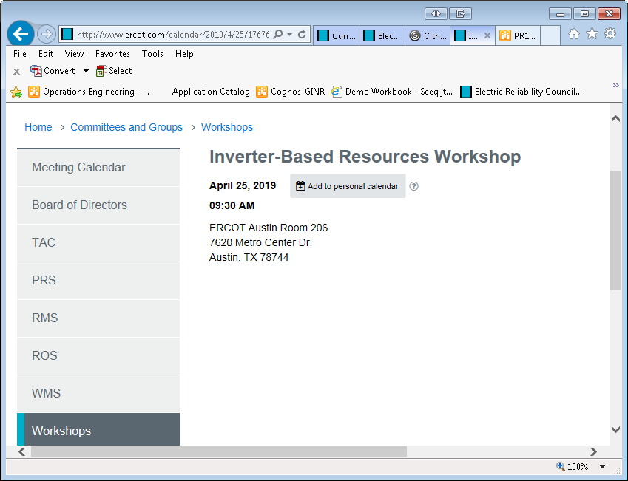
April RI Workshop Cancelled
Inverter-Based Resource Workshop
NERC IRPTF Reliability Recommendation Document
Vendors Welcome

Slide 16
Active PGRR’s

Slide 17
Active PGRR’s
PGRR062 - Updates to Generation Interconnection or Change Request (GINR) Process – Implementing last grey box language on 3/26/2019
PGRR066 - Interconnection Request Cancellation and Creation of Inactive Status – BOD approved December 11. Waiting implementation. Project Priority = 2019, Rank = 2580, will have reduced scope

Slide 18
Back Log

Slide 19
Possible Changes to Interconnection Process
Propose Fee Increase for Project Determination
Screening Study Advanced. This option consists of:
  appropriate case(s)
  one POI will be studied
  a set of transmission projects to allow full output will be determined
  current fee schedule price + $4,000
  completed in 90 days
  Normal Tracking and Coordination
Need ERCOT advice on how to proceed

Slide 20
Possible Changes to Interconnection Process
Projects must have a unique name
Interconnection requests must include a name that is not in use anywhere else in the ERCOT system and not too similar to any other name
  Use ERCOT Planning Data Dictionary and GIS Report
  ERCOT Operations uses NMMS model name but REs and TSPs may use different name. It is critical that equipment names are unique, easy to spell, and pronounce, and used by all
  Once a project name is acceptable to ERCOT it will not be changed

Slide 21
Other contact information
ResourceIntegrationDepartment@ercot.com is distribution list for Resource Integration department

Slide 22

Questions?
Thank you!

Slide 23
The following are old slides for reference only

Slide 24
MW Output of Proposed Resources
The MW size that is proposed by a new All-Inclusive Generation Resource is at the generator terminals entering the low side of the gsu/main transformer. – 5.1.1(a)
The change in MW size that triggers GINR applicability should be based on Seasonal Net Max Sustainable Rating in latest RARF – 5.1.1(b)(i)

Slide 25
Possible Changes to Interconnection Process
Miscellaneous
IE/TSP agreement on FIS scope - Clock starts ticking towards 60 day deadline at FIS Kickoff Meeting - 5.4.2.1 (6)
Minimum COD date to accept in a GINR application
  18 to 24 months typical time frame to go from application to commissioning – 5.2.1(4), changed to 15 months
Alter PG section 5.9 Quarterly Stability Assessment
  Add new deadline to meet PG 6.9 Addition of Proposed Generation to the Planning Models so that models can be validated prior to last day to meet prerequisites – 5.9(4)(a) and 5.9(4)(c) – changed to provided data

Slide 26
Possible Changes to Interconnection Process
Projects cannot be split
Aug 30: Developers will no longer be able to sub-divide projects into phases with same or different synchronization dates
  Projects can be decreased in size
  Additional projects can be submitted at the same POI
  The current practice causes confusion and time-consuming documentation and reporting problems
  Dec 18: Comment: Not liked by IE’s as they divide due to power purchase agreements.
  Further comment: Can split but need to pay fees for all INR’s created by split

Slide 27
Continued from previous slide
Splitting One INR into multiple INRs
When an INR is split, the original INR MW size is modified to show the amount that continues to use original INR number with a COD.
  FIS study will complete all studies using new MW amount and COD if not already done. If done, TSP certifies new studies are not required
  SSR study (if required and not done) will be done for new MW size and COD
  New Screening Study Fee not needed for this INR
  TSP charges for all FIS work done before and after split
  New NTP and Financial Security needed, changed to not needed

Slide 28
Continued from previous slide
Splitting One INR into multiple INRs
A new INR number will be created for each remaining piece with designated MW size and COD.
  Screening Study Fee will need to cover difference of original single INR fee that was paid versus cost of all new INRs created by split
  FIS Fee will not be needed if paid in original INR
  FIS study will be done using new MW Size and COD or TSP certifies not needed
  SSR study (if required) will be done for each new INR created by split
  TSP charges for additional work for each INR created by split
  New NTP and Financial Security needed for each INR created by split
  Must be done at the same time, no MWs left over for future use
  MW’s not used in split will be lost

Slide 29
Continued from previous slide
Splitting One INR into multiple INRs
ERCOT Security Screening Study (Not Refundable) | NA | A preliminary study of the impacts of a proposed generation plant conducted by ERCOT staff - $5,000 (less than or equal to 150MW) $7,000 (greater than 150MW)
200
100
100
+
$7000
$5000
+
$5000
=
$10000
Splitting a 200 MW INR into 2 100 MW INRs will cost an additional $3000

Slide 30
TBD Status
  ERCOT will move INR with no communication to a new status, tentatively called TBD Status.
  INR in TBD Status will be calculated separately in GIS Reports.
  INR in TBD Status will have to pay INR fees again to move forward, keeping the INR number
    FIS studies may have to be updated or redone
    RARF data may have to be updated
  INR in TBD Status can cancel their request for no cost
  INR in TBD Status for 60 days will follow cancellation process
  PGRR to define this in 2018

Slide 31
Possible Changes to Interconnection Process
Sale of project before commercial operation
Seller informs ERCOT of sale, identifies buyer, and provides contact information
ERCOT asks buyer to confirm by submitting an updated RARF including contacts.
ERCOT places project into TBD status until RARF confirmation received.
ERCOT will cancel any project left in TBD status for more than 60 days.
Project clock continues to click while in TBD status

Slide 32
Possible Changes to Interconnection Process
Developers must reply to ERCOT requests
When ERCOT staff request additional or updated information about a project, the developer shall either answer in full or acknowledge the request within 10 days and commit to answering by a future date. PG 5.3.2(1). This request will be done by email for documentation purposes.
INR will be put in TBD Status after 10 days
ERCOT will cancel any project left in TBD status for more than 60 days.

Slide 33
Possible Changes to Interconnection Process
Biannual Attestations as Proof of Life and Communication
Bi-Annual RARF attestations are required by PG 5.3.2 (3)
  There are numerous INR projects that have not had action in years
  These INRs need to be cancelled to keep project list reflective of active projects
  Attestations will alert ERCOT to projects not active or where communication avenues (email, phone) are not correct
  New GINR app will provide attestation (slide 21).
  Separate attestation from RARF submittal
  Move GINR that has missed an attestation to TBD status if communication attempts fail

Slide 34
Possible Changes to Interconnection Process
Temporary and Permanent POI in same INR
Aug 30: No longer allow temporary POI and permanent POI studies in same INR. These will be submitted as separate INRs. Currently allowed by PG 5.4.2.2 (2) if agreed by IE and TSP
  Different POI quite often have very different power flow results
  Leads to situation where a GTC is not needed for temporary POI but is needed for permanent POI
  Comment: need for Temp POI not known until FIS underway
Dec 18: For further discussion: Temp and Perm POI at the same physical location can be in same INR if at the same location.
  If not at same location, then separate into two INRs and temp POI must have breakers and built to possibly be permanent.
  Temp and perm POI in same INR, 16.5 requirements must be met for entire INR (both temp and perm POI) to synchronize at temp POI

Slide 35
Continued from Previous Slide
Temporary and Permanent POI in same INR
Having one INR number refer to different POI’s and/or different COD’s is not practical and difficult to track
Once a Temporary POI is decided upon, a new INR number will be created using “xxxx” = “9zzz” (format yrINRxxxx) where “zzz” is the last three digits of original INR number
  Remainder of activity only for temporary POI and its corresponding COD.
  FIS study will complete short circuit and stability studies using only temp POI
  SSR study (if required) will only be for temp POI
  TSP charges for this portion of FIS
  Facility, NTP and Financial Security needed to cover both temporary and permanent POI
  Temp POI use will be granted for up to 26 months
    Extensions only granted for TSP requests

Slide 36
Continued from Previous Slide
Temporary and Permanent POI in same INR
Having one INR number refer to different POI and/or different COD is not practical and difficult to track
The original INR number will be used for the Permanent POI and its corresponding COD.
  Screening Study Fee will not be needed if already paid
  FIS Fee will not be needed if already paid
  FIS study will complete all FIS studies required by TSP using only perm POI and COD not already completed
  SSR study (if required) will be done for perm POI
  TSP can charge for additional work for this part of FIS

Slide 37
Continued from Previous Slide
Temporary and Permanent POI in same INR
ERCOT expressly reserves the right to withdraw its approval of continued operations at the temporary Point of Interconnection or take other appropriate action at any time in the future, should ERCOT determine, in its sole discretion, that the temporary Point of Interconnection is negatively impacting reliability of the ERCOT system or is in violation of any of ERCOT’s operational standards.

Slide 38
Re-Power GINR
5.1.1 Applicability
(1) The requirements in this Section 5, Generation Resource Interconnection or Change Request, are applicable, to the following:
(a) Any Entity proposing a new All-Inclusive Generation Resource, including a storage device, with an aggregate power output (gross Generation Resource output minus auxiliary Load directly related to the Generation Resource) of ten MW or greater, planning to interconnect to transmission in the ERCOT System; or
(b) Resource Entities that are seeking to:
(i) Upgrade the summer or winter Net Dependable Capability of an All-Inclusive Generation Resource by ten MW or greater within a single year;
(ii) Re-power an All-Inclusive Generation Resource of ten MW or greater; or
(iii) Change or add a Point of Interconnection (POI) of an All-Inclusive Generation Resource of ten MW or greater

Slide 39
Re-Power GINR
  ERCOT has seen many of these in 2017
  The term “Re-Power” in PG not related to “Repowering” or “Repowered Facility” definitions in ERCOT Protocols or PUCT rules
  GINR must be submitted
    Screening Study required if MW increase is 10 MW or more
    Additional information for reactive, SSR, and VRT capability compared with pre re-power equipment helpful to determine which FIS studies need to be done
    Stability model submission or detailed comparison with pre re-power equipment model necessary to determine if FIS stability study needs to be done
    Part 2 and Part 3 necessary although facility has already synchronized
      Need to check model and PFC, Voltage Control, Reactive Capability and AVR
  PGRR to clarify this information in 2018
Notes:
Part 2 necessary to check model (may need to re-aggregate if wind) and telemetry and inform PMU requirements

Slide 40
INR Cancellation Process
Current Process
    ERCOT sets COD back 1 year when it determines current COD is unlikely given current status and notifies IE
      Occasionally, IE gets caught up and COD can move back toward original COD
      IE gives ERCOT new COD date further in the future
      IE notifies ERCOT to cancel the request
    If there is no response from an IE after an ERCOT request, INR cancellation will be initiated
ERCOT will initiate PGRR to define a formal cancellation process in 2018

Slide 41
Possible Changes to Interconnection Process
Temporary Taps Not Allowed
POIs consisting of a non-breakered tap to an existing line will not be accepted in future FIS reports
  Change will apply to all projects where the FIS has not been approved by ERCOT effective May 31, 2018
  Going forward, ERCOT will not approve FIS reports for this type of configuration
  Need for exit strategies will be determined for existing non-breakered POIs with Resource Commissioning Date after January 1, 2013

Slide 42
Possible Changes to Interconnection Process
Temporary Taps Not Allowed, Market Notice sent June 14, 2018

Slide 43
Possible Changes to Interconnection Process
Temporary Taps Not Allowed, Market Notice sent June 14, 2018

Slide 44
Possible Changes to Interconnection Process
Temporary Taps Not Allowed, Market Notice sent June 14, 2018

Slide 45
Possible Changes to Interconnection Process
Temporary Taps Not Allowed, Market Notice sent June 14, 2018

Slide 46
Possible Changes to Interconnection Process
Temporary Taps Not Allowed, Additional Information
Any planned FIS containing a hard tap that was submitted and approved before May 31, 2018, but isn’t energized, can proceed with the hard tap plan, but still needs to have an exit strategy

Slide 47
Possible Changes to Interconnection Process
Miscellaneous
Language to require IE submit Reactive Study prior to TSP start of FIS Stability Study
  IE need SC info from TSP to do reactive study
  TSP do VRT first and need reactive study
  Reactive Study can be done at same time as steady state study
  How can TSPs provide SC info
    Provide after study scope agreement is signed

Slide 48
Possible Changes to Interconnection Process
Miscellaneous
Tightening of timeline for TSP to complete FIS studies
  Dependent on IE submittal of necessary data for each stage of FIS
    Many data problems
    TSP put timeline in study scope
    TSP report minimum 180 days under ideal conditions
Alter PG section 5.4.8 (8) from “before meeting Section 6.9” to “before Initial Synchronization”.
  Removed from PGRR062, added to PGRR066

Slide 49
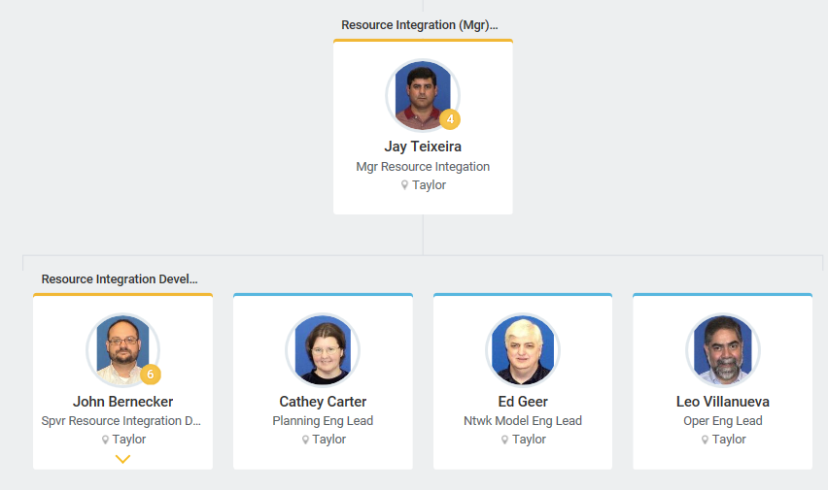
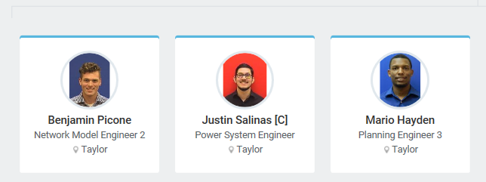
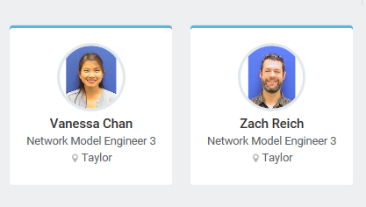
Screening Studies
Screening Study Responsibility to RI group
Mario Hayden to RI group
+2 Contractors
+ 2 contractors to do SS

Slide 50
Possible Changes to Interconnection Process
Propose new fee structure
Propose a new fee structure to make sure that INRs are serious propositions and not fishing.
  Overloads ERCOT staff with extraneous studies
  More attention needs to be paid to screening study results where generation deliverability is shown to affected
  Graduated scale (inc) for subsequent INR requests?
  Higher fee for INR to voltage less than 345 kV since studies are more involved and lines more congested?
  Non-responsive INR’s moved to TBD status must pay fee to move forward from that status
  Reduced Screening Study scope options

Slide 51
Possible Changes to Interconnection Process
New reduction of Screening Study Scope
Screening Study Basic. This option consists of:
  appropriate case(s) will be used
  one POI will be studied
  no transmission projects to allow full output will be studied
  current fee schedule price
  completed in 90 business days
  Normal Tracking and Coordination
Effective will all screening studies submitted after 7/31
SS will only use generation meeting PG 6.9(1)
No loop stations will be created for study

