Slide 1
Regulation Bias Analysis Post SCR-773
February 2019
ERCOT
Operations Planning
PDCWG | March 13th, 2019

Slide 2
Discussion Points
Current GTBD Parameters & References
Metric to measure Regulation bias and performance
Regulation Deployed comparison for last three months.
Total Regulation (net) Deployed Comparison
Regulation Deployed 15-minute interval comparison by each hour for 2016, 2017, and 2018 months
Regulation Exhaustion Rate
Regulation bias for consecutive 5-min SCED intervals
Time Error & Contributing Factors
Summary

Slide 3
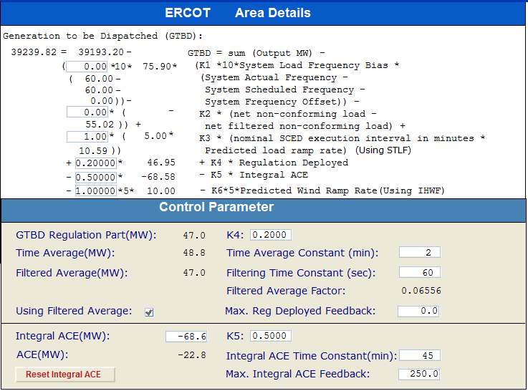
Current GTBD Parameters
Notes:
3/12/18 – Integral ACE Time Constant Changed from 60 min to 45 min
5/17/18 - K4 Changed from 0.3 to 0.2 and K5 Changed from 0.4 to 0.5
12/4/18 - K6 Changed from 0 to 0.5
2/12/19 - K6 Changed from 0.5 to 1

Slide 4
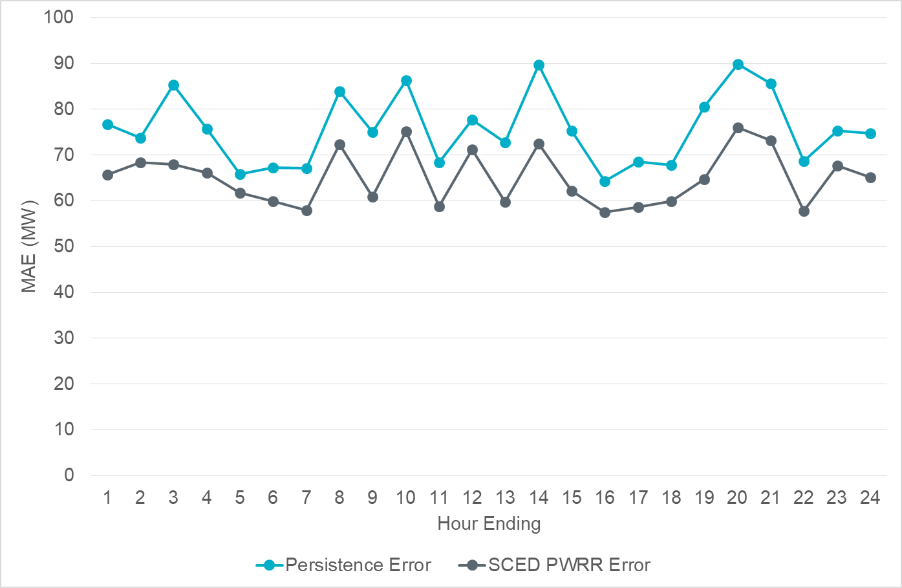
Projected Wind Ramp Rate MAE

Slide 5
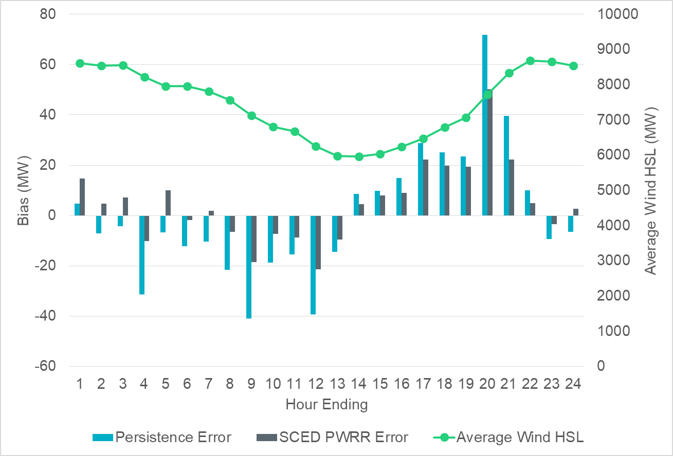
Projected Wind Ramp Rate Error

Slide 6
References

Slide 7
Metrics to Measure SCR-773 Performance
Trend and monitor the regulation deployed by hour.
Set target of 50 MW for total regulation deployed by hour for peak hours.
Set target of 85% for the number of intervals where regulation deployment was both up and down for peak hours.
Track the Regulation exhaustion rate for all hours (not to exceed 5%).
Using a 50MW filter, target 15 occurrences or less per month for regulation bias of six or more consecutive 5 minute intervals for peak hours.

Slide 8
Total Regulation Deployed Comparison
Total regulation deployed for the last three months.

Slide 9
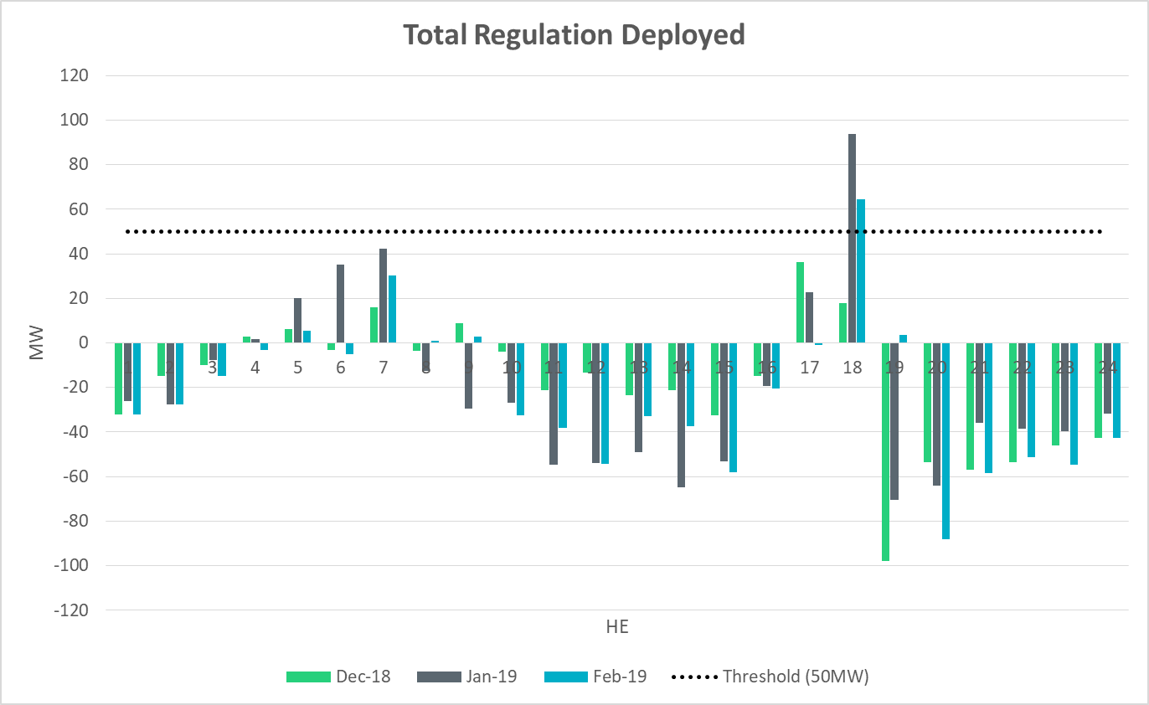
Total Regulation Deployed Comparison - Monthly

Slide 10
Metric 1: Regulation Deployed Comparisons
Trend and monitor the regulation deployed by hour.

Slide 11
Regulation Deployed Comparison

Slide 12
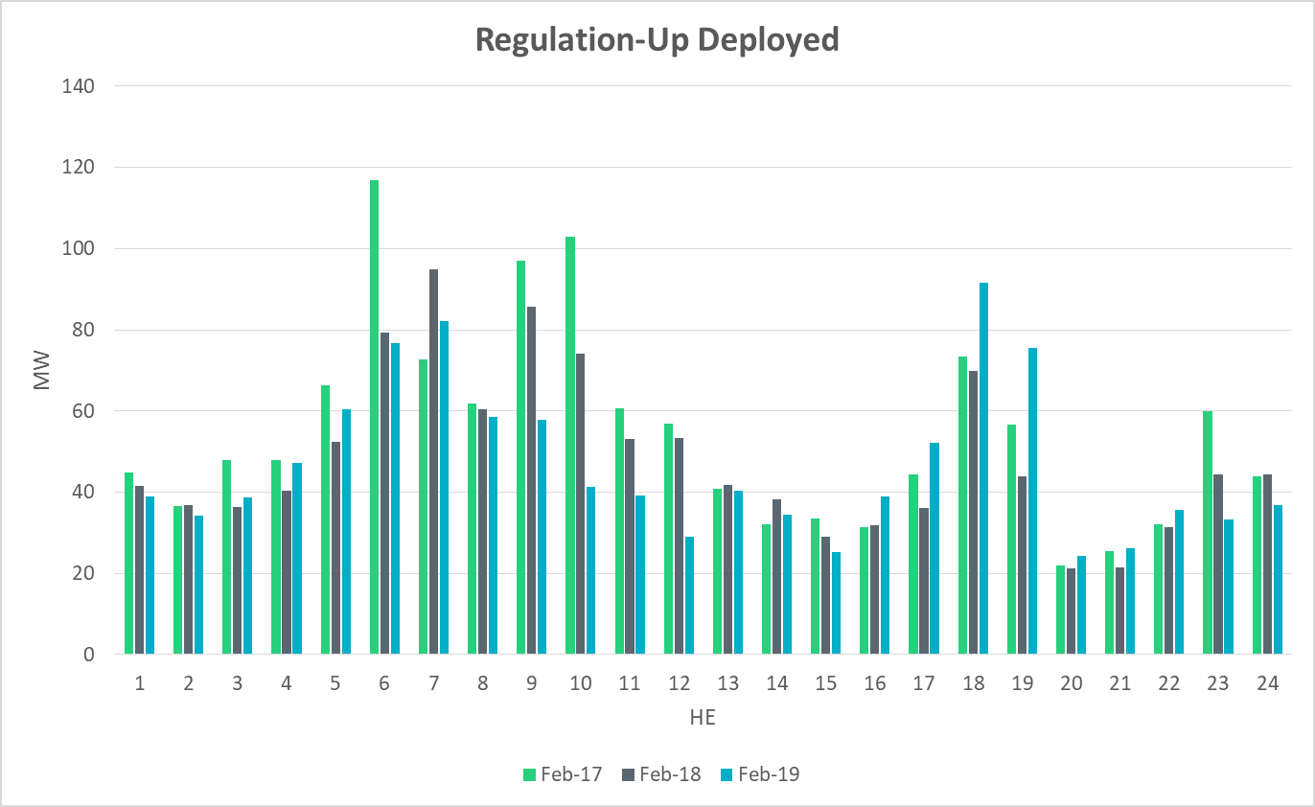
Regulation Deployed Comparison

Slide 13
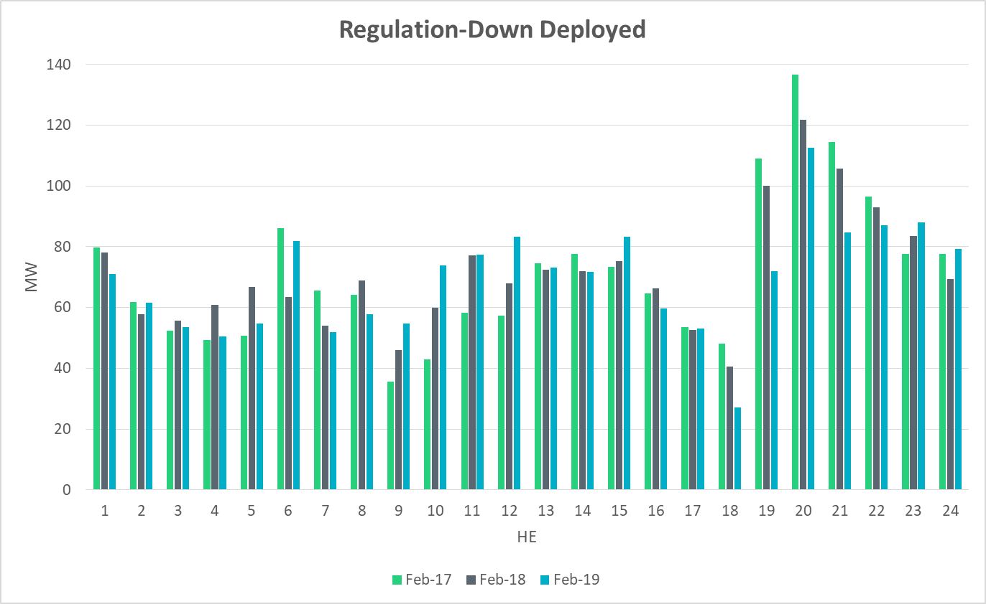
Regulation Deployed Comparison

Slide 14
Metric 2: Total Regulation Deployed Comparisons
Set target of 50MW for total regulation deployed by hour for peak hours.

Slide 15
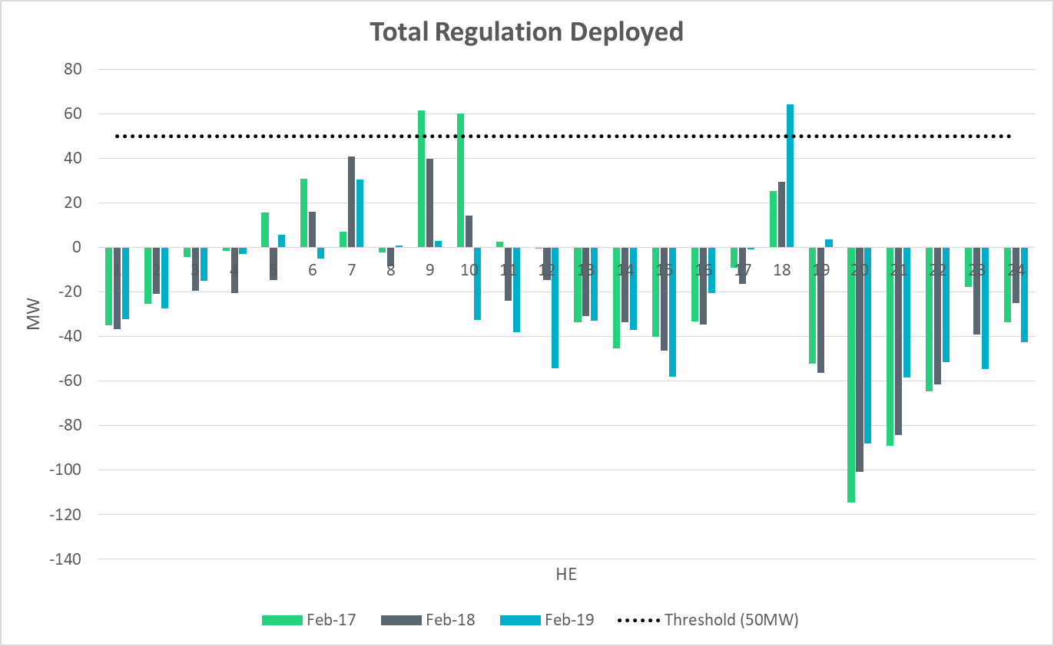
Total Regulation Deployed Comparison

Slide 16
Metric 3: 15-min Intervals Where Both REGUP/REGDN Were Deployed
Set target of 85% for the number of intervals where regulation deployment was both up and down.

Slide 17
“Zero” Crossing Regulation

Slide 18
“Zero” Crossing Regulation

Slide 19
Metric 4: Regulation Exhaustion Rate
Track the regulation exhaustion rate for all hours (not to exceed 5%.)

Slide 20
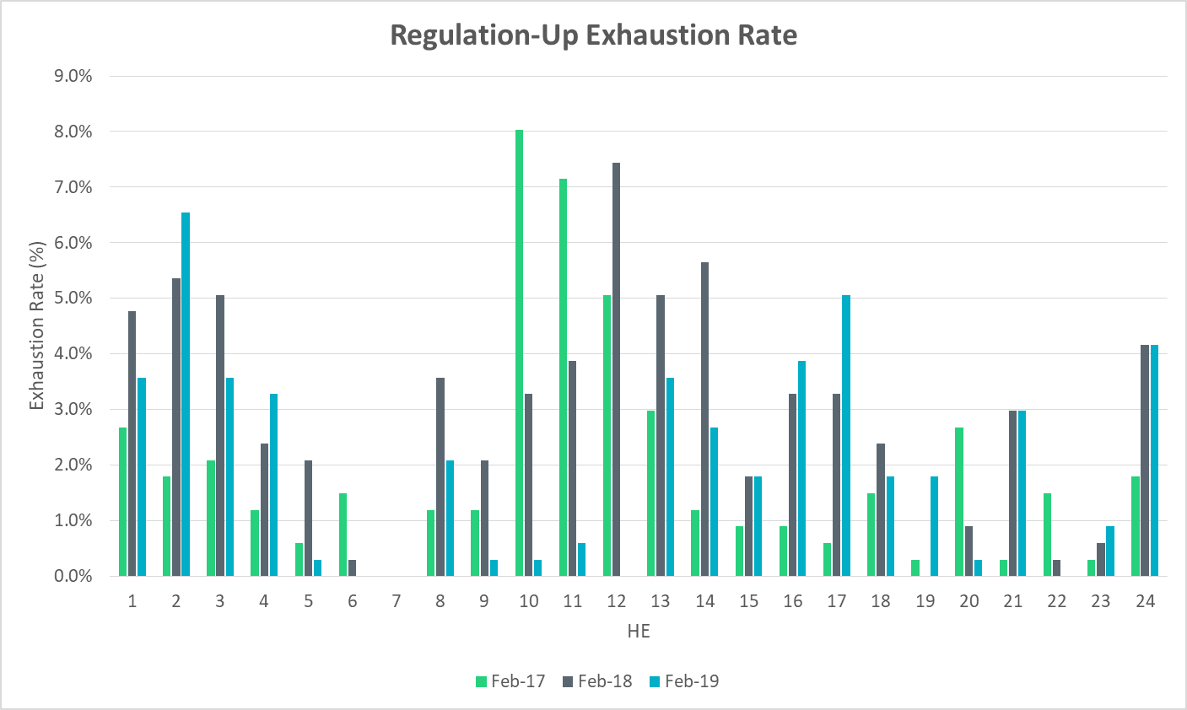
Regulation Exhaustion Rate

Slide 21
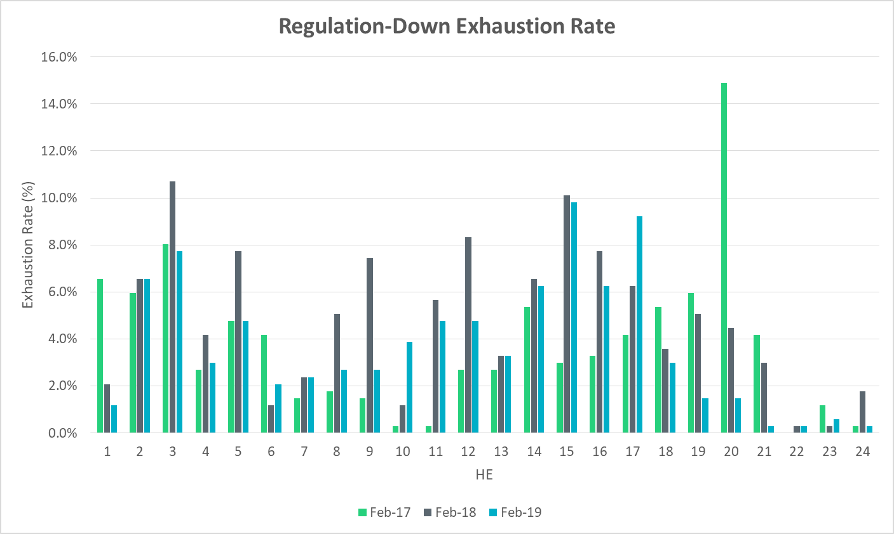
Regulation Exhaustion Rate

Slide 22
Metric 5: Stats on REGUP Bias for Consecutive 5-min Intervals
Using a 50MW filter, target 15 occurrences or less per month for regulation bias of six or more consecutive 5-minute intervals for peak hours.

Slide 23
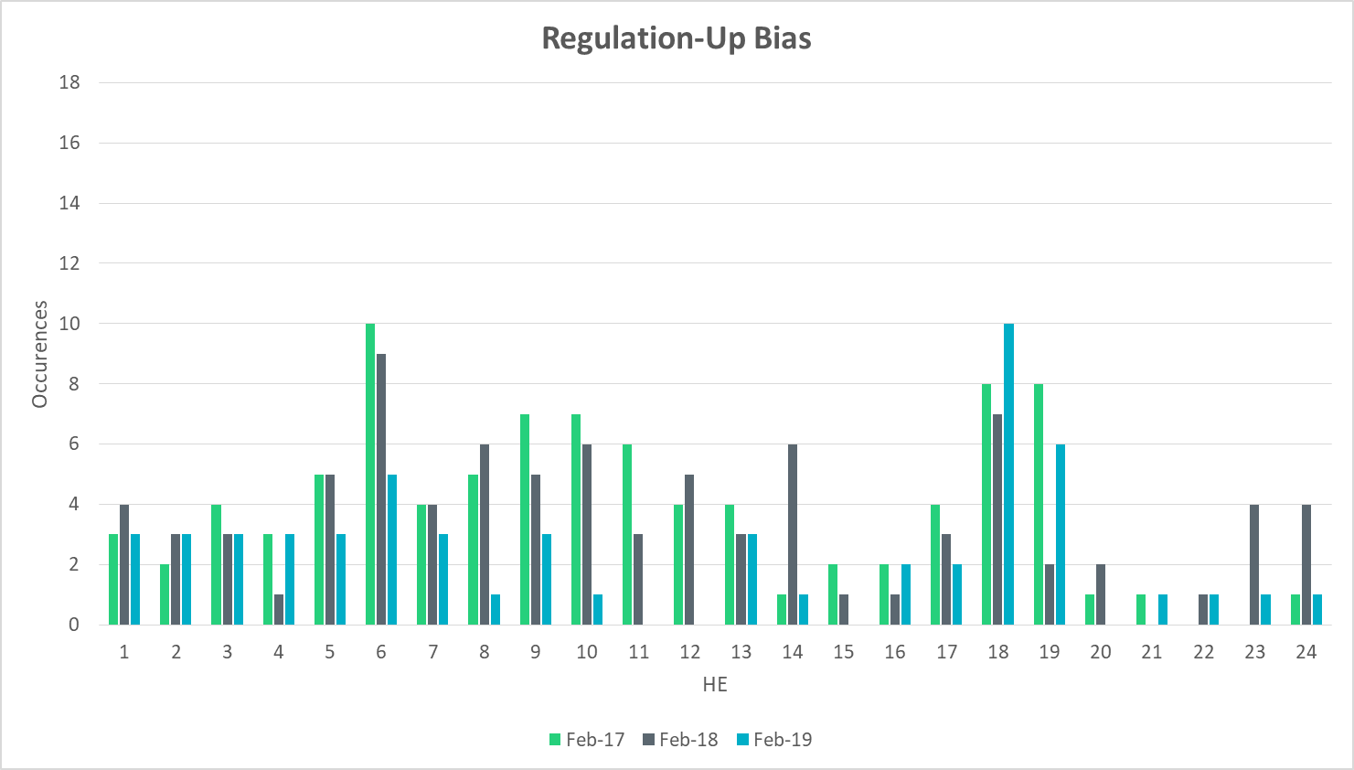
Regulation Bias for Consecutive SCED Intervals

Slide 24
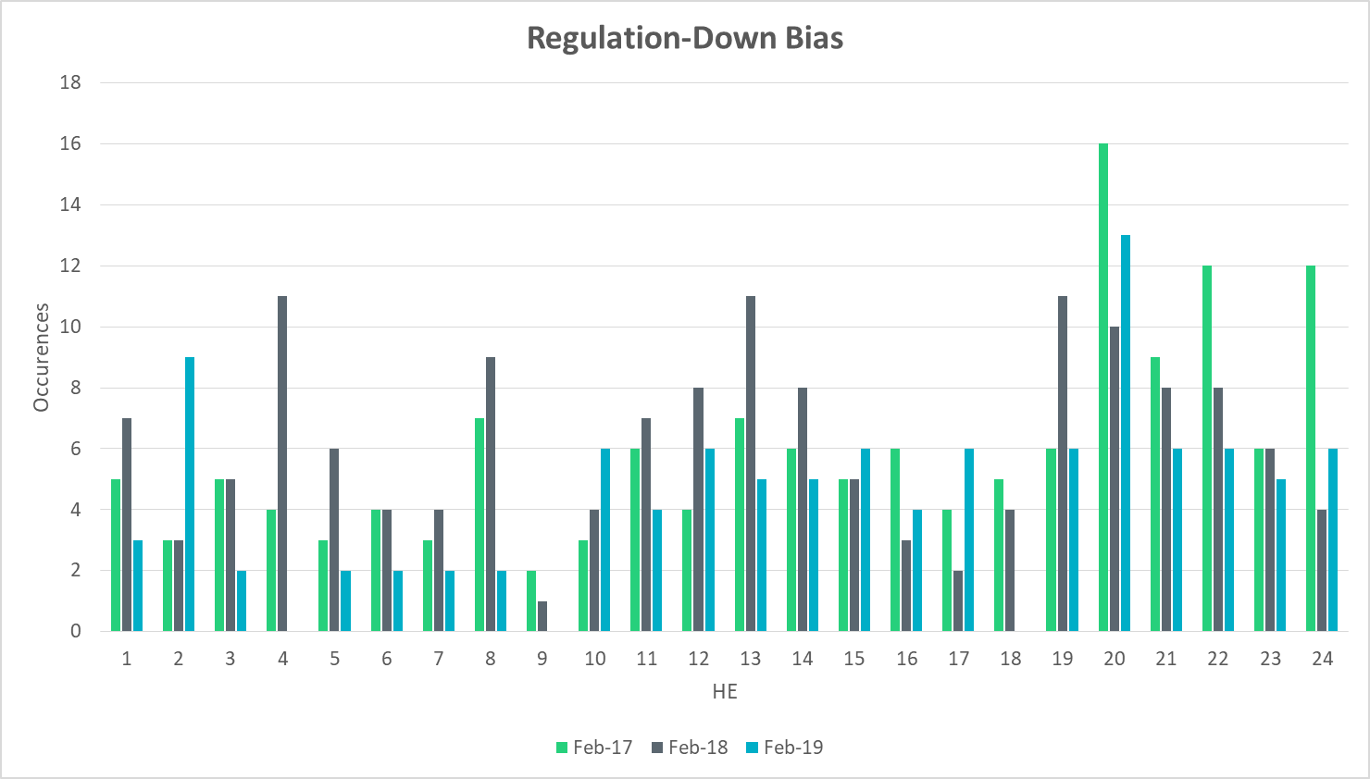
Regulation Bias for Consecutive SCED Intervals

Slide 25
Time Error and Contributing Factors
Accumulated Time Error, Load and Wind Ramp, PWRR Error, Start-Up/Shut-Down Hours, STLF Error, and Expected Generation Deviation.

Slide 26
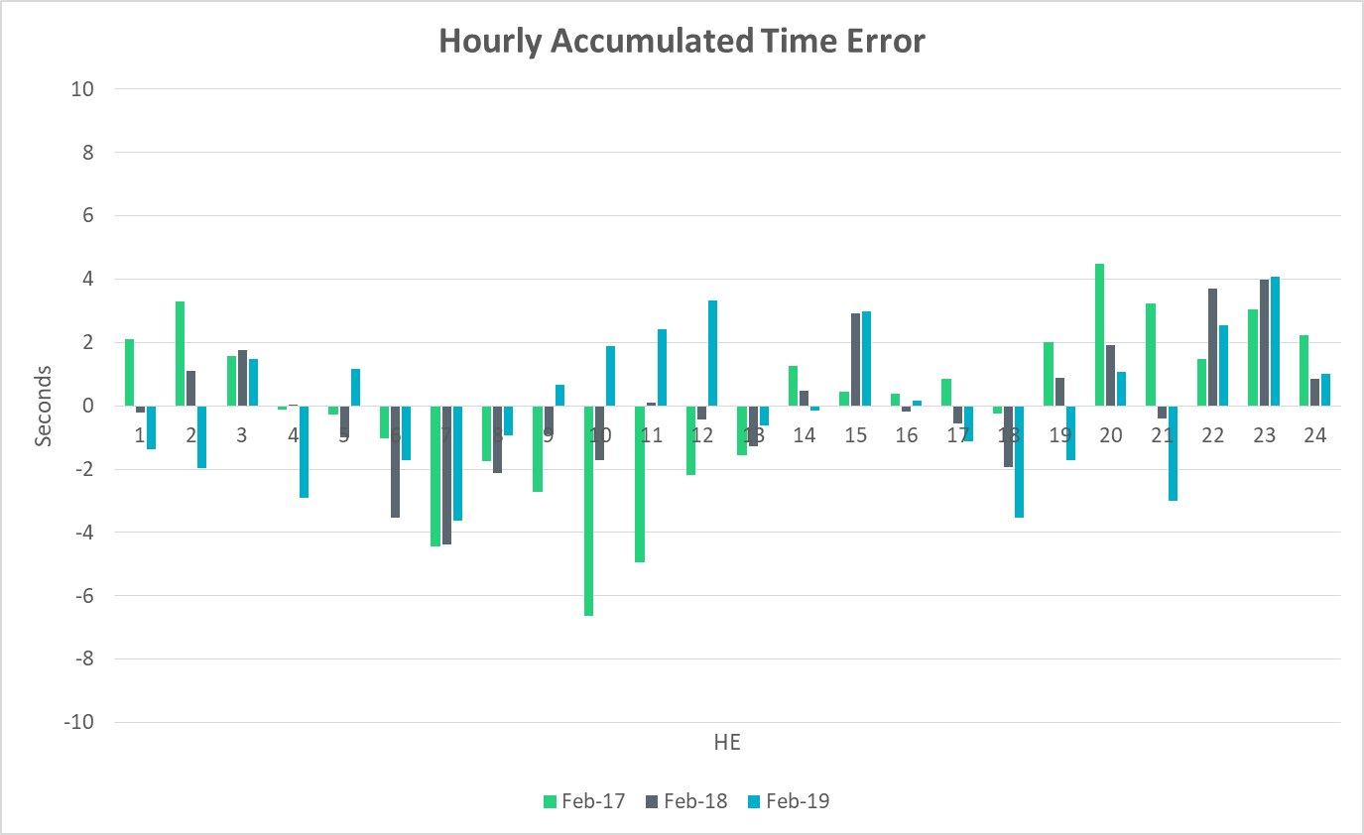
Time Error Accumulation

Slide 27
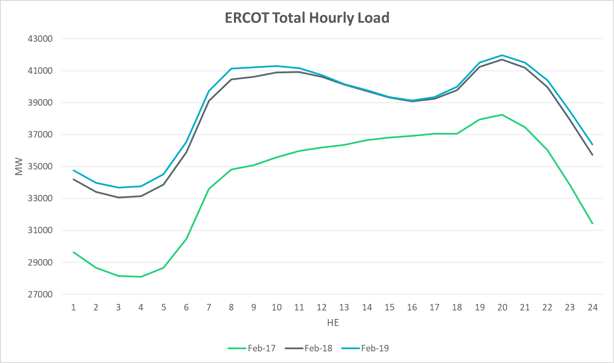
Load Profile

Slide 28
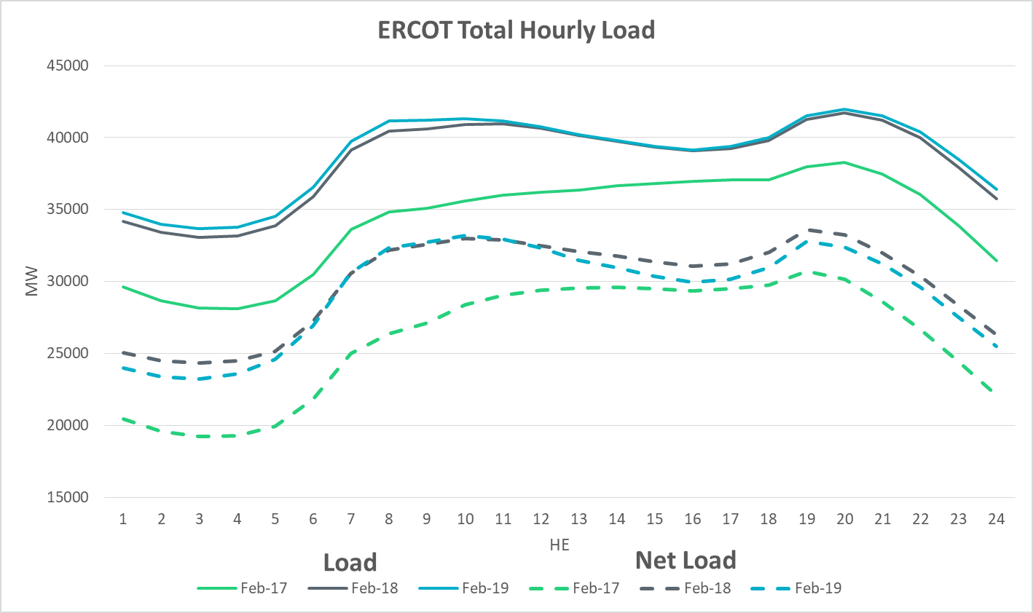
Net Load Profile

Slide 29
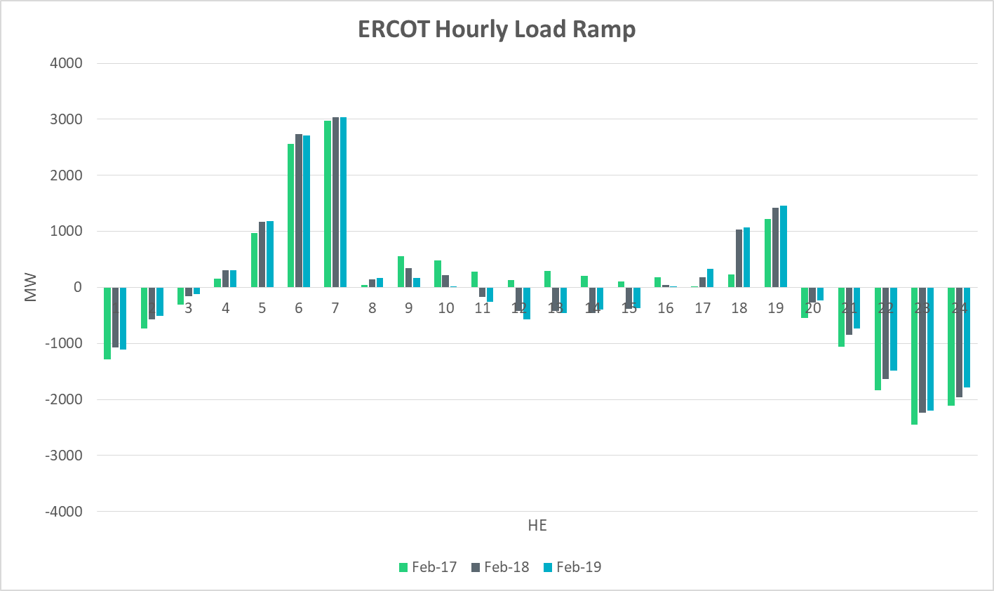
Load Ramp

Slide 30
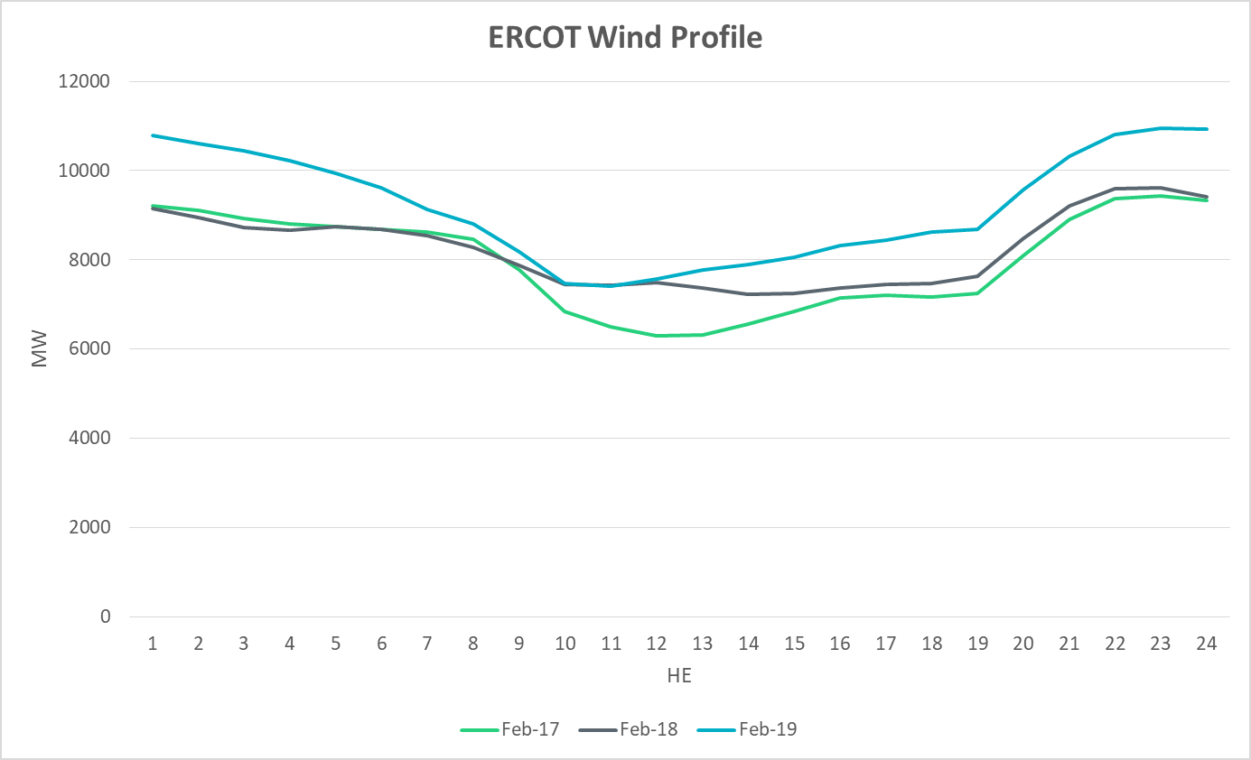
Wind Profile

Slide 31
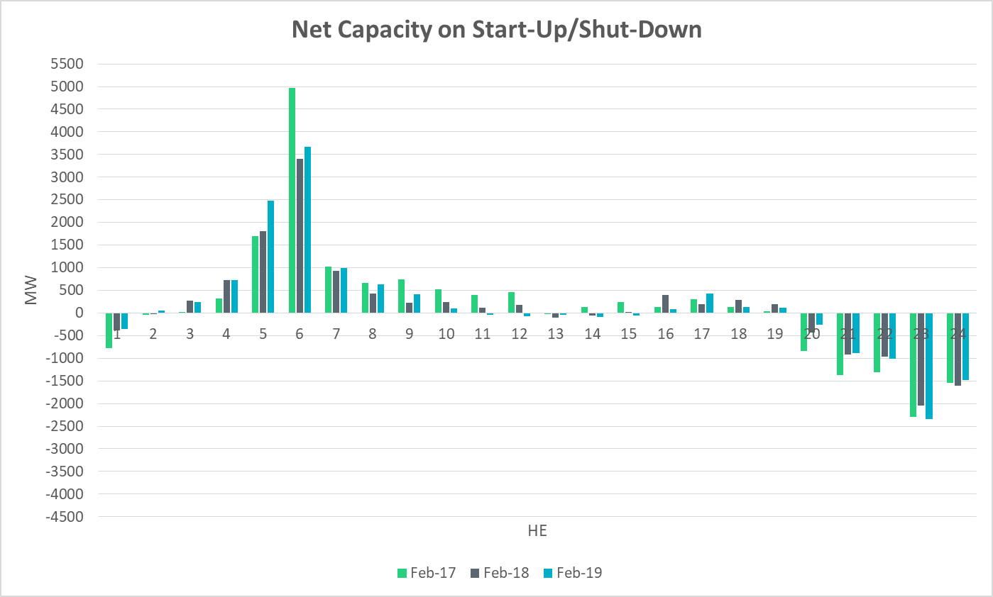
Start-Up & Shut-Down Hours

Slide 32
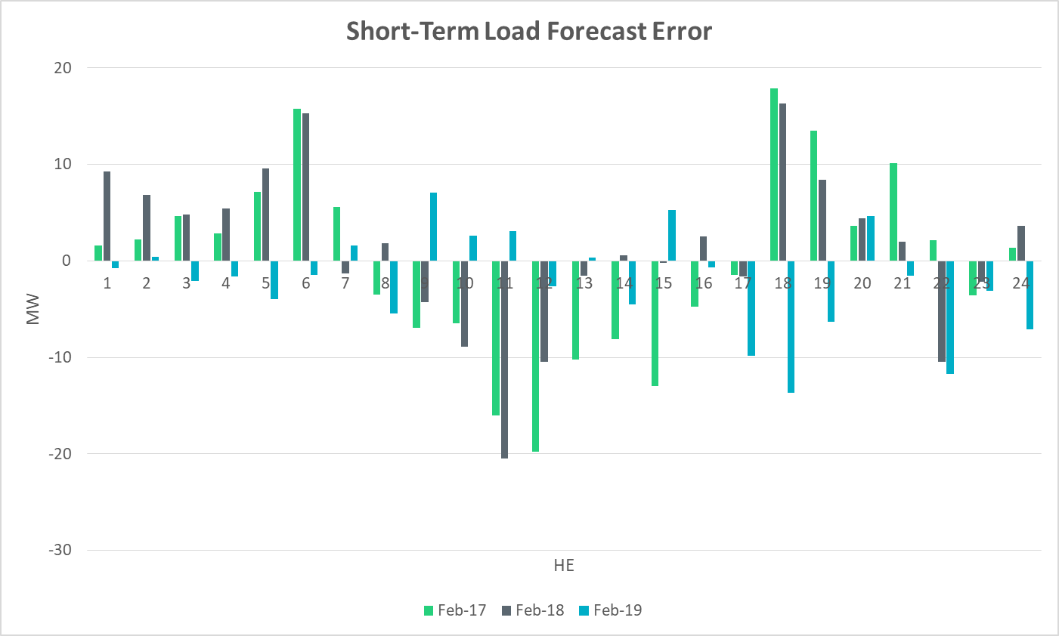
Short-Term Load Forecast Error

Slide 33
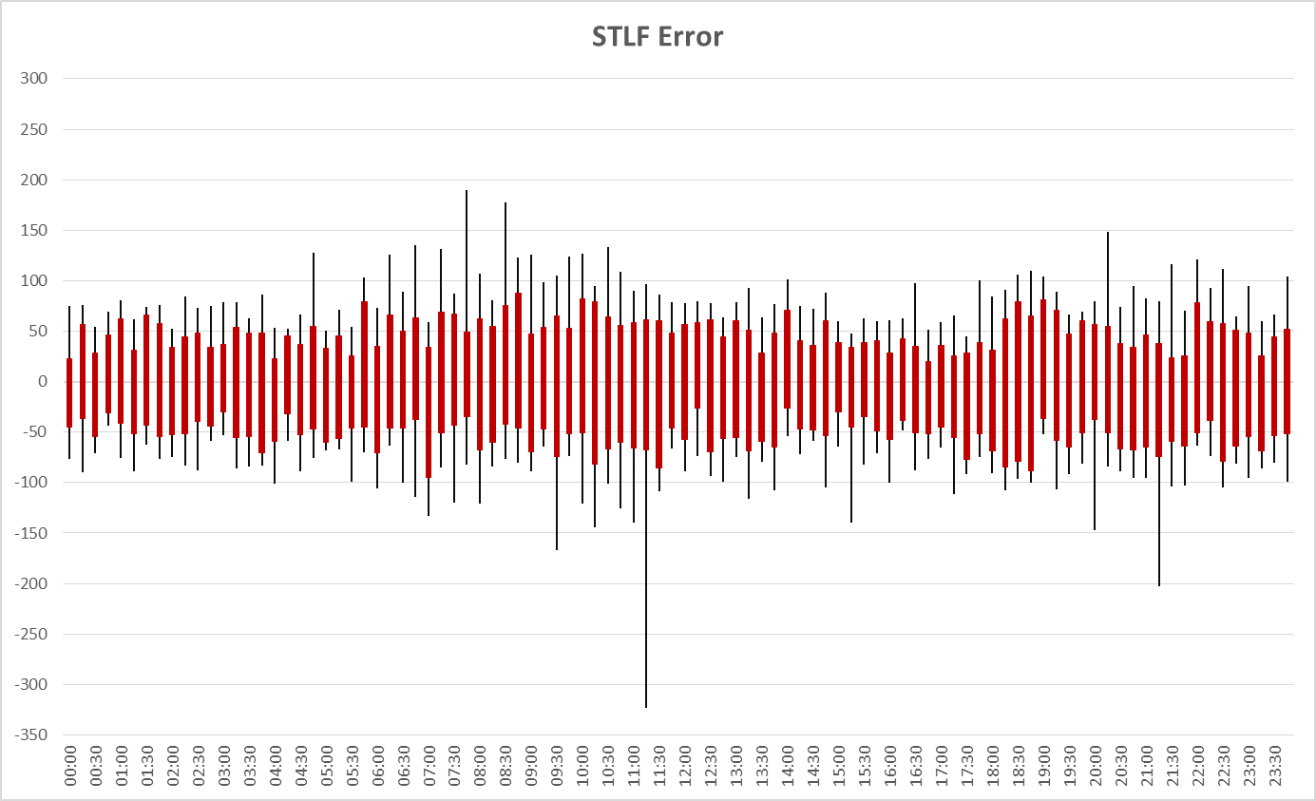
STLF Error Chart
Notes:
Min,Max, 10th, 90th percentile
15 minute intervals

Slide 34
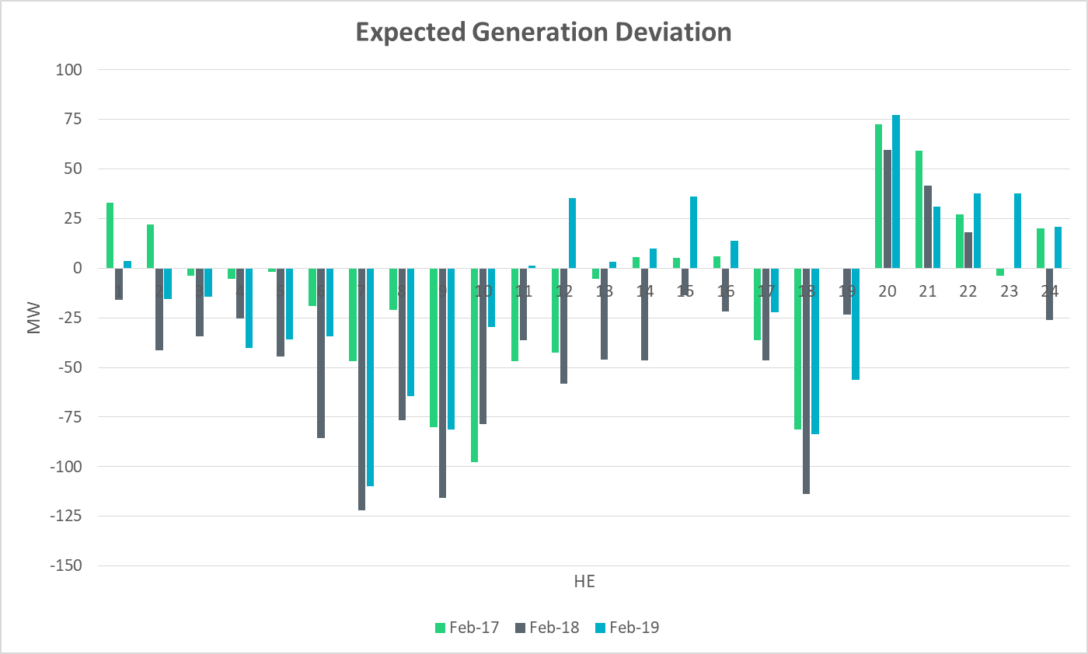
Expected Generation Deviation

Slide 35
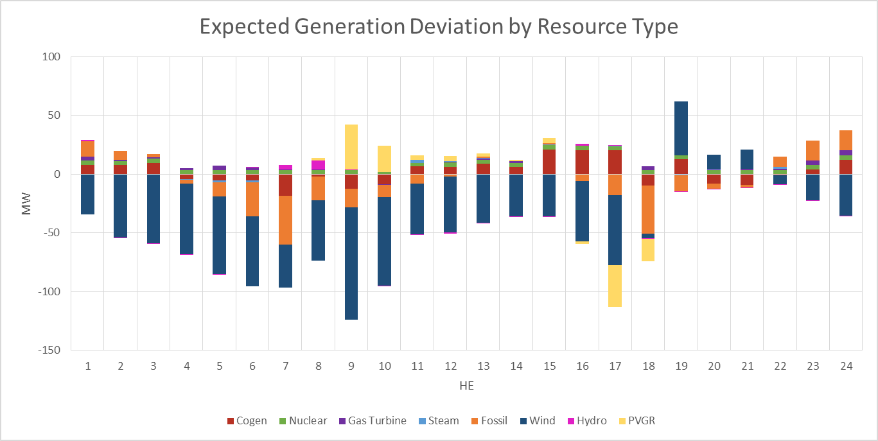
Expected Generation Deviation

Slide 36
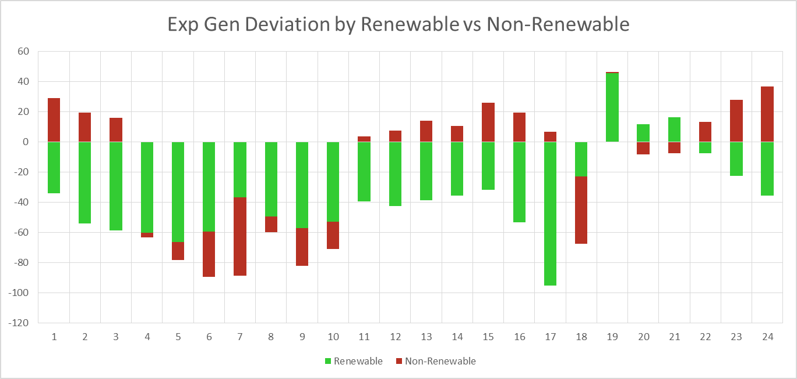
Expected Generation Deviation

Slide 37
Questions?
Thank you!

