Slide 1
Resource Definition Task Force
Load Resources Review
Mar 2019

Slide 2
Agenda
Updated Load Resource Framework
Proposed Definitions
Proposed Composite Framework

Slide 3
Current Protocol Load Resource Framework
Load Resources
Non-Controllable Load Resources*
Controllable Load Resources
UFR @ 59.7 Hz Required
Single Site
Aggregate Load Resource (ALR)
Distribution Connected Loads Only
* Also referred to in the Protocols as Load Resource controlled by high-set under-frequency relay, Load Resource other than Controllable Load, and other variations
Each site < 10 MWs of Demand Response Capability and all sites located in same Load Zone

Slide 4
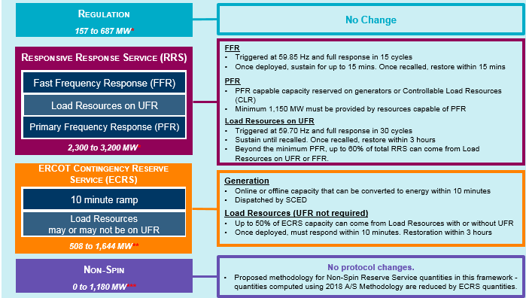
NPRR 863 Framework
Controllable Load Resource providing FRRS
Controllable Load Resource w/ Gov Resp & LFC base points
UFR** Load Resource (15 cycle)
Auto Dispatch Controllable Load Resource (15 cycle)
Controllable Load Resource w/ Gov Resp & LFC basepoints
UFR** Load Resource (30 cycle)
Auto Dispatch Controllable Load Resource (30 cycle)
Controllable Load Resource (SCED Dispatched)
Basic Load Resource (Manual 10 Minute Response)
UFR* Load Resource (30 cycle)
Controllable Load Resource (SCED Dispatched)
Real-Time Energy Market
Aggregate Load Resource (SCED Dispatched)
SCED Qualified Controllable Load Resource
Existing Load Resource Type
New Load Resource Type

Slide 5
Updated Proposed Load Resource Framework
Load Resource
Basic Load Resource
Rapid Response Load Resource
Controllable Load Resource
Fast Response Regulation Service
ECRS
Responsive Reserve Service
FFR
UFR
Regulation Service
Primary Frequency Response
ECRS
ECRS
Non Spin (SCED Qualified)
Real-Time Energy Market (SCED qualified)
Register as a Basic Load Resource and deployed through Verbal Dispatch Only to provide ECRS,
Register as a RRLR Load Resource with either a 15 cycle (FFR) or 30 cycle(UFR) response time and may qualify to provide ECRS or Responsive Reserve Service.
Register as a Controllable Load Resource to qualify to provide one or more of the following: FRRS, Regulation Service, Primary Frequency Response, ECRS, Non-Spin, and Real-Time Energy Market. May be an aggregation for providing Non-Spin only.

Slide 6
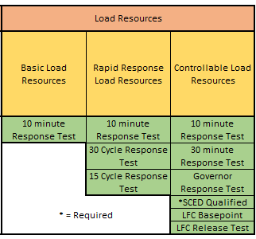
Merit Badge Load Resources Framework

Slide 7
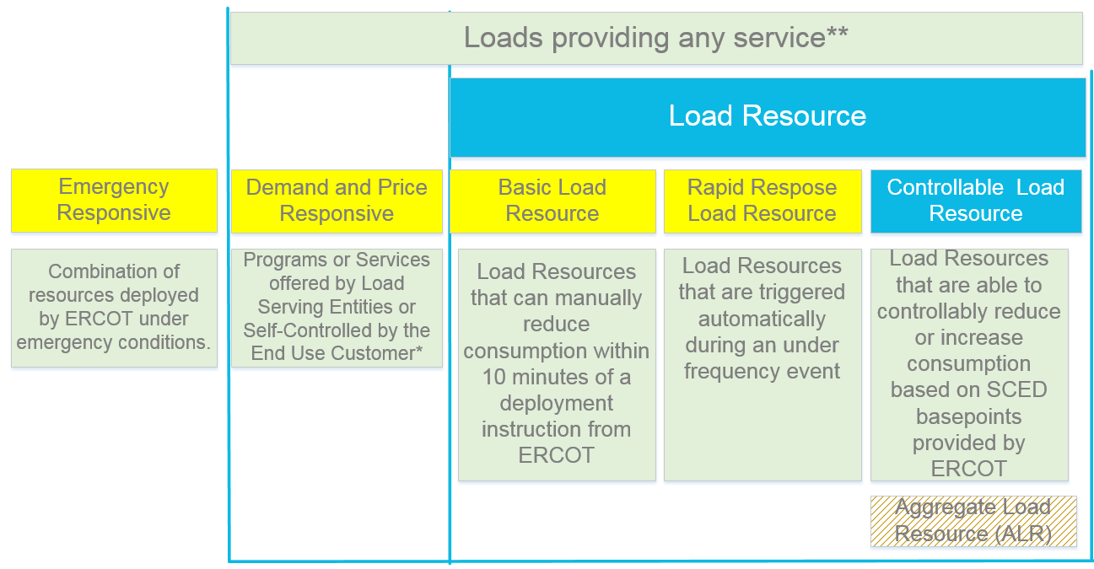
Proposed Framework for Loads providing any kind of service

Slide 8
Proposed Combined Framework

