Slide 1
Frequency Response Study
03/13/2019

Slide 2
LCRA retained Burns & McDonnell to verify and validate prior ERCOT analysis
This was in response to:
An ERCOT study to determine 2018 RRS amounts on September 30, 2017 ^{[1]}
A presentation at the January 12, 2018 PDCWG meeting^{[3]}
A presentation at the February 1, 2018 ROS meeting ^{[4]}
LCRA charged Burns and McDonnell with the following tasks:
Benchmark their model to the ERCOT RRS Study^{[1]} , along with details shown in the presentations^{[2] [3]}
Compare historical loss-of-generation events to the results from the ERCOT RRS Study
Develop a model that closely mirrors actual system events
Identify the value that hydro generation adds to the ERCOT system

Slide 3
We recommend performing a more detailed and extended term simulation of large loss-of-generation events
This recommendation is based on the following observations and conclusions…
Current governor models do not include thermal ramp rate limitations present on large CTs
Simulated response from governor models do not match actual behavior seen during large frequency excursions
Key results from the recent ERCOT RRS study are substantially different from a large event in 2003

Slide 4
Current governor models do not include thermal ramp rate limitations present on large CTs
Exhaust temperature ramp limitations override or squelch governor action
During large frequency events this results in an actual MW output increase lower than what the governor requests and simulations produce
Our documentation from Siemens and GE validate this limitation
The NERC guideline on Primary Frequency Control from November 2018 provides caution about this, and other, limitations.
Typical models, including the one present in the tool used by ERCOT, do not account for this ramp rate limitation during governor response
Notes:
OEM Ramp limits: The OEM’s are using this conservative terms because there are many things that will restrict a unit’s output. The typical response observed is then unit output will saturate at the stated MW/min and will not increase until the next minute interval. This is simply throttling the thermal energy to prevent exceeding the thermal limits of internal materials.

Slide 5
Burns & McDonnell Study Approach
Burns & McDonnell conducted transient stability analysis based on the power flow cases provided by ERCOT to LCRA
Burns & McDonnell created the entire stability model database based on LCRA generating units test reports and industry standard models^{[5]} for various types of units
The cases were tuned to provide the adequate PFR response (1150 MW)
Detailed Hydro models of LCRA were included in the analysis
Two of the lowest inertia cases (130 GWs & 150 GWs) out of ERCOT’s nine different power flow cases with different system inertia conditions were duplicated in the study

Slide 6
Burns & McDonnell Study Validation
Simulated the loss of two STP units and compared the results against the results produced by ERCOT
Same study assumptions were used by Burns & McDonnell
Baseline results were similar in regard to the frequency characteristics (nadir and recovery)
Full ERCOT network model was used
Assumptions were made where data was unavailable.

Slide 7
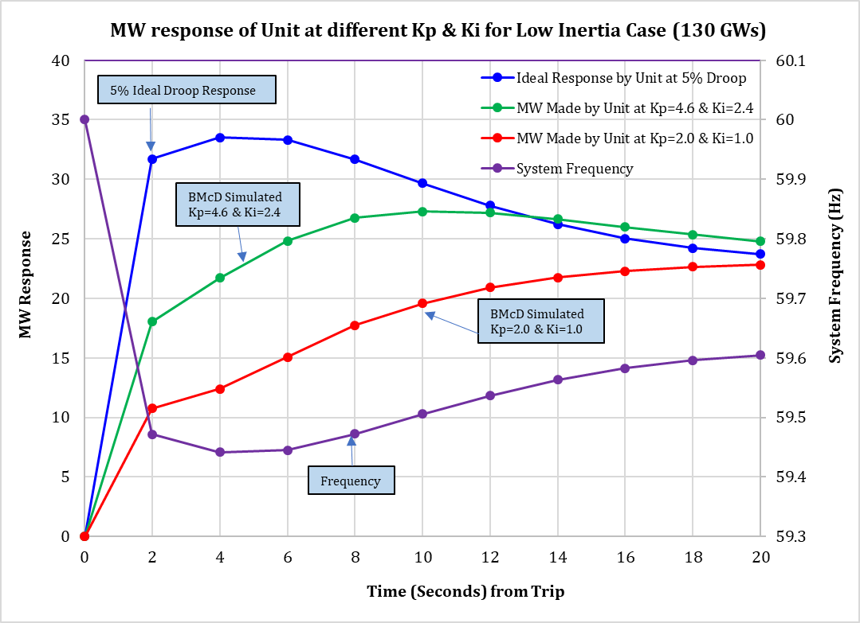
Burns & McDonnell Governor Modeling
Existing GGOV1 models do not capture realistic turbine generator performance under low frequency conditions
Observing Combined Cycle outputs indicate that measured values are much different from expected
One way to model this behavior under low frequency event is to adjust PI gains in the GGOV1 model
Burns & McDonnell simulation used the gains that result in much more conservative output that is close to observed reality

Slide 8
Current governor models do not include thermal ramp rate limitations present on large CTs
** 1/26/16 Event
Notes:
OEM Ramp limits: The OEM’s are using this conservative terms because there are many things that will restrict a unit’s output. The typical response observed is then unit output will saturate at the stated MW/min and will not increase until the next minute interval. This is simply throttling the thermal energy to prevent exceeding the thermal limits of internal materials.

Slide 9
We recommend performing a more detailed and longer study of large loss-of-generation events
This recommendation is based on the following observations and conclusions…
Current governor models do not include thermal ramp rate limitations present on large CTs
Simulated response from most governor models do not match actual behavior seen during large frequency excursions
Key results from the recent ERCOT RRS study are substantially different from a large event in 2003

Slide 10
Simulated response from most governor models do not match actual behavior seen during large frequency excursions:
LCRA and Burns & McDonnell believe the market participant-supplied information to ERCOT for this type of simulation can be incorrect.
Guidance for parameter setting and unit testing focuses on development of parameters used for deviations between 0.15-0.25 Hz
Vast majority of uses/users in the world focus on this range of deviation – ERCOT is a substantially different grid
This range is typically used for transmission planning studies and transient stability studies.
Notes:
Typically used for transmission planning studies to verify faults on the system can be cleared while allowing generators to sustain a stable swing without tripping.
Only is accurate for frequency events that result in deviations between 0.15-0.25 Hz because the actual tests are made with small step changes….so not to trip the unit off-line.
Overestimated natural gas units’ output by more than 50% especially when the frequency deviations are large (2-14 seconds after the event)

Slide 11
Simulated response from most governor models do not match actual behavior seen during large frequency excursions:
** 1/26/16 Event
Notes:
Typically used for transmission planning studies to verify faults on the system can be cleared while allowing generators to sustain a stable swing without tripping.
Only is accurate for frequency events that result in deviations between 0.15-0.25 Hz because the actual tests are made with small step changes….so not to trip the unit off-line.
Overestimated natural gas units’ output by more than 50% especially when the frequency deviations are large (2-14 seconds after the event)

Slide 12
We recommend performing a more detailed and longer study of large loss-of-generation events
This recommendation is based on the following observations and conclusions…
Current governor models do not include thermal ramp rate limitations present on large CTs
Simulated response from most governor models do not match actual behavior seen during large frequency excursions
Key results from the recent ERCOT RRS study are substantially different from a large event in 2003

Slide 13
Key results from the recent ERCOT RRS study are substantially different from a large event in 2003 ^{[6]}
 | 2017 ERCOT RRS study | 2003 actual event | Predicted severity of study compared to actual
Generation | 29,008 MW | 27,823 MW | About the same
Generation Loss | 2,750 MW | 2,275 MW | Worse than actual
Inertia | 150 GW-s | 218 GW-s | Worse than actual
PFR | 1,150 MW | 1,617 MW | Worse than actual
Frequency Nadir | 59.34 Hz | 59.305 Hz | About the same
Initial Freq. Recovery | 59.68 Hz | 59.53 Hz | Better than actual
Freq. Recovery Rate | From an actual 2017 event with similar conditions 0.02 Hz/min | 0.06 Hz/min | Estimated Recovery Worse than 2003 historical event

Slide 14
Frequency Recovery
Frequency Recovery is related to spinning/PRC and Inertia
3/15/17 FME,
Inertia 154 GW-s
Spinning/PFR=6736/4591MWs
Frequency recovery rate
2003 – 0.06 Hz/min
2017 – 0.02 Hz/min
Study – Similar grid conditions to 2017 event/similar recovery expected
ERCOT Model Response
Inertia = 150 GW-s
Spinning/PRC=1150/1150 MWs
3/15/17 event and ERCOT model have similar inertia; model has less spinning therefore recovery could take longer than event.
Secondary Trip
5/15/03 FME,
Inertia = 218 GW-s
Spinning/PRC=13,675/1617 MWs
2003 event has twice the spinning of 2017 event and therefore recovery is faster than 2017 event
ERCOT model & 2003 event have similar Nadirs even though model simulates a worse condition than 2003 (i.e. less inertia, less PFR & less generation lost) indicating the model may overstate performance
Sympathy trips are a bigger risk with low inertia and slow recovery.
2017 event and 2003 events experienced sympathy trips
43 sec

Slide 15
Recommendation
Perform a more detailed and extended term simulation of a large loss-of-generation event with revised models
Seek or develop expertise and modify existing large CT and CC governor models to account for additional restrictions described by both GE, Siemens and others
Include governor response actions in addition to inertia/first response actions (run longer)
Form a joint task force between PDCWG and the Dynamics Working Group to help:
Guide / seek guidance to ensure dynamic model parameters supplied by market participants are valid and correct for large frequency excursions and longer simulation times
Compare results using updated models and parameters to multiple historic responses and identify differences and the cause of such difference
Evaluate benchmarked results and change market requirements, if necessary

Slide 16
Appendix

Slide 17
References
[1] ERCOT, “2017 Responsive Reserve Service (RRS) Study for Determining 2018 Ancillary Service RRS Requirements”, September 30, 2017
[2] NERC, “BAL-003-1.1 — Frequency Response and Frequency Bias Setting”
[3] ERCOT, “Continued Evaluation of Overall RRS Requirement in our Changing Grid”, January 12, 2018
[4] ERCOT, “Incremental Adjustment to Responsive Reserve Services Requirements”, February 1, 2018
[5] IEEE Power & Energy Society, “Dynamic Models for Turbine-Governors in Power System Studies,” Technical Report PES-TR1, January 2013
[6] IEEE Power & Energy Society, “Interconnected Power System Response to Generation Governing: Present Practice and Outstanding Concerns”, Technical Report PES-TR13, May 2007
[7] John Undrill, “LBNL’s Frequency Response Study for FERC” (Presentation to ERCOT ROS), May 3, 2018
[8] ERCOT, System Protection Working Group (SPWG), “Review of Under Frequency Relay Performance During May 15, 2003 Load Shed Event
[9] M. Henry, “May 15, 2003 Event Review”, Twenty-First Annual ERCOT Operations Seminar
[10] Siemens, “Siemens Response on W501FD Limitations”, Feb 18, 2018
[11] NERC, “BAL-001-TRE-1 — Primary Frequency Response in the ERCOT Region”
[12] 2017 Assessment of Reliability Performance of the Texas RE Region, By Texas Reliability Entity, Inc., April 2018
[13] Inertia: Basic Concepts and Impacts on the ERCOT Grid, April 4, 2018
[14] 09._180503_LBNL_FR_for_ERCOT_ROS_final, John Undrill, Sydney Niemeyer, May 3,2018

