Slide 1
ERCOT Frequency Control Report
February 2019
ERCOT
Operations Planning
PDCWG | March 13th, 2019

Slide 2
Summary of February 2019
CPS1: 173.46%
Current CPS1 12-Month Rolling Average: 175.04%
0 BAAL Exceedances
1 hourly CPS1 scores below 100%
BAAL-003 Events have updated through 2018
2018 BAAL-003 FRM Performance: -895.19
2019 RMS1 Statistics
Mean: 15.42 mHz
Min: 13.52 mHz
Max: 17.90 mHz
Energy Statistics
Total Energy: 26,060,591 MWh
Wind Energy: 6,174,568 MWh
Percent Energy from Wind Generation: 23.69%
Minimum System Inertia
Mean: 177,451
Max: 243,101 on February 9th
Min: 138,761 on February 3rd

Slide 3
Frequency Control
CPS1, BAAL, & RMS1

Slide 4
Hourly CPS1 by Day
February-19 CPS1 (%): 173.46
Notes:
Outliers:
2/5/19 16:00 98.96%
Wind decreased by 2,000 MW throughout the hour. Solar decreased by 200 MW. Large expected generation deviation. DC Tie schedule change. Reg Up exhausted the majority of the hour.

Slide 5
BAAL Exceedances & Violations
There were no BAAL exceedances in February

Slide 6
15-Minute Average CPS1%
February-19 CPS1 (%): 173.46

Slide 7
12-Month Rolling Average CPS1
Current 12-Month Rolling Average: 175.04%

Slide 8
Daily RMS1 of ERCOT Frequency by Year
Notes:
Mean is 15.28 mHz

Slide 9
Daily RMS1 of ERCOT Frequency by Month

Slide 10
Daily RMS1 of ERCOT Frequency by Month
Notes:
Mean: 15.42 mHz
Min: 13.52 mHz
Max: 17.90 mHz

Slide 11
Frequency Profile Comparison

Slide 12
Frequency Profile Comparison

Slide 13
Frequency Profile Comparison

Slide 14
Time Error Correction

Slide 15
ERCOT Daily Time Error

Slide 16
Time Error Corrections Log Summary
There have been no time error corrections since December 2016

Slide 17
BAL-003 Performance

Slide 18
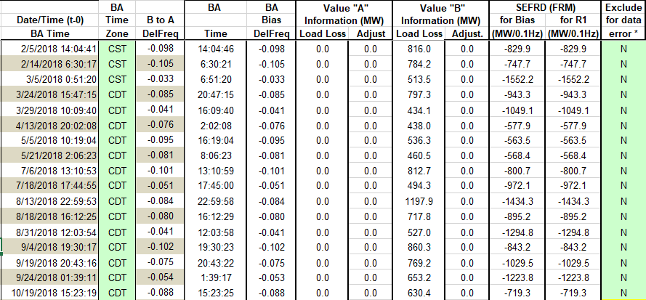
Op. Year 2018 BAL-003 Selected Events

Slide 19
Op. Year 2018 BAL-003 FRM Performance

Slide 20
ERCOT Energy Statistics

Slide 21
Total Energy
Notes:
26,060,591 MWh

Slide 22
Total Energy from Wind Generation
Notes:
6,174,568 MWh

Slide 23
% Energy from Wind Generation
Notes:
23.69%

Slide 24
ERCOT System Inertia

Slide 25
Daily Minimum System Inertia
Notes:
Minimum Inertia = 128,759 MW*s on 11/3/2018.
Previous Minimum was 130,014 MW*s on 10/27/2017. This was also our record wind day.
Data:
Mean: 177,451
Max: 243,101 on February 9th
Min: 138,761 on February 3rd

Slide 26
Questions?
Thank you!

