Slide 1
AEPSC LRGV Import Transmission Project – ERCOT Independent Review Update
Regional Planning Group
March 12, 2019

Slide 2
Background
AEPSC submitted Lower Rio Grande Valley (LRGV) Import Project for Regional Planning Group review in January 2018.
AEPSC’s proposed RPG upgrades are in two stages to address the Native LRGV load growth and the addition of potential LNG load
Stage 1 Upgrades (Proposed for 2021)
Lon Hill – Bessel 138kV line rebuild, dynamic reactive support, and shunt capacitor bank addition
Estimated cost is approximately $73 million
Stage 2 Upgrades (Proposed for potential LNG load)
New 345kV BOLD transmission line from Corpus Christi area to Valley
Estimated cost is approximately $357 million

Slide 3
Status of AEPSC Lower Rio Grande Valley (LRGV) Import Project
ERCOT presented the study scope in the March 2018 RPG
http://www.ercot.com/content/wcm/key_documents_lists/138680/AEPSC_LRGV_Import_Scope_March2018-RPG.pdf
An update was provided to RPG in May 2018
http://www.ercot.com/content/wcm/key_documents_lists/138688/08_AEPSC_LRGV_Import_Update_May2018-RPG.pdf

Slide 4
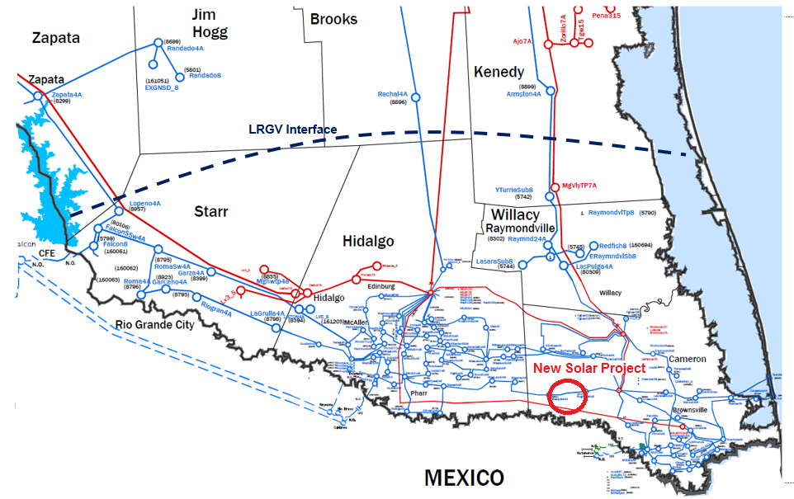
Updates Since Last RPG Update
Dynamic Load model review with TSP
150 MW Solar in Cameron County recently met PG 6.9 and added to the case – COD 12/31/2020
Dispatched at 74% (111 MW)

Slide 5
Preliminary Results
New solar project increased the Valley Load Serving Capability by 100 MW
Primary need for Valley continues to be additional reactive support under G1G1 conditions
Contingency Type | Dynamic Stability Limit (MW) |  | Limiting Condition
 | Without Solar | With Solar
G1-G1 | 2850 | 2950 | UVLS

Slide 6
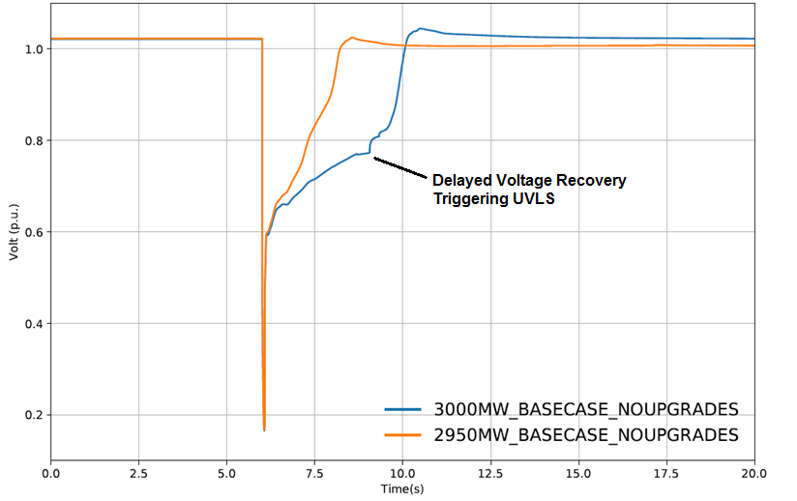
UVLS Triggered under G1G1 Conditions

Slide 7
Current Reactive Compensation Inside Valley
Total Static Compensation
~1000 MVAR
Total Dynamic Compensation
750 MVAR
Includes two, 300 MVAR each, STATCOMs recommended in 2016

Slide 8
Additional Reactive Compensation Sensitivity
Continuously increasing dynamic reactive support has diminishing returns
DRD Added (MVAR) | Limit (MW) | Incremental MVAR | Incremental MW | MW/MVAR Ratio
0 | 2950 | 0 | 0 | NA
150 | 3100 | 150 | 150 | 1.00
300 | 3200 | 150 | 100 | 0.67
600 | 3300 | 300 | 100 | 0.33
900 | 3400 | 300 | 100 | 0.33

Slide 9
Next Steps
Determine project alternatives to reliably serve the LRGV load
Load model sensitivity considerations

Slide 10
QUESTIONS?

Slide 11
APPENDIX

Slide 12
LRGV Load Forecast
LRGV is defined to include four counties: Cameron, Willacy, Hidalgo, and Starr
LRGV load is composed of load in zones 610, 615, 800, 829, 875, and 876
Year | ERCOT 90th Percentile Summer Peak Forecast (MW)
2019 | 2666
2020 | 2729
2021 | 2792
2022 | 2867
2023 | 2941
2024 | 3005
2025 | 3065
2026 | 3133
2027 | 3200

