Slide 1
Market Credit Working Group update to the Wholesale Market Subcommittee
Bill Barnes NRG, Chair
Josephine Wan Austin Energy, Vice Chair
03/06/2019

Slide 2
MCWG update to WMS
General Update
February 20th Joint MCWG/CWG Meeting
7 NPRRS reviewed for their credit impacts
891NPRR Removal of NOIE Capacity Reporting Threshold for the Unregistered Distributed Generation Report
900NPRR Protocol Section 14 Language Review
908NPRR Revisions to Mass Transition Processes
912NPRR Settlement of Switchable Generation Resources (SWGRs) Instructed to Switch to ERCOT
920NPRR Change to Ramp Rate Calculation in Resource Limit Calculator
921NPRR RTF-2 Elimination of the Terms All-Inclusive Generation Resource and All-Inclusive Resource
922NPRR Modifications to DC Tie Import Forecast Method
6 without any credit impact. NPRR908 improves notice and transparency of mass transition events and is expected to have a positive impact on credit

Slide 3
MCWG update to WMS
Market Entry Qualifications/CRR Portfolio Liquidation Process
Continued discussion of lessons learned from PJM Greenhat default. What changes should be adopted in ERCOT?
Following the GreenHat Energy LLC default in the PJM market, many prompted discussion on further credit diligence on Market Participant (MP) background check
Discussion over whether ERCOT should have more discretion to suspend/liquidate or do MP’s have to make additional representations?
Protocols say if there’s an instance of default ERCOT can hold a one-time auction of MP’s CRR’s
Additional background checks are currently only performed by PJM and ISO-NE, ERCOT will inquire how they perform these checks and identify this to the PUCT as a possible issue of concern.
What is the level of discretion ERCOT (and PJM/other ISO’s) would have to deny someone entrance into Market?
Looking into company officers’ criminal backgrounds. Coordinate with other ISOs?
CRR portfolio liquidation: all or nothing? Tranche disposition?
ERCOT staff is going to bring back recommendations to a future Credit Working Group meeting.

Slide 4
MCWG update to WMS
Summer 2019 Preparation
Mass Transition Drill – Implications for credit?
Acquisition Transfer Contract List – Be sure contact info is up-to-date
Credit Training – April?

Slide 5
MCWG update to WMS
ERCOT Credit Exposure Updates
Market-wide average TPE decreased from $338.6 million to $330.5 million
The decrease in TPE is due to change in Real Time and Day Ahead settlement point prices.
Discretionary collateral is defined as Secured Collateral in excess of TPE,CRR Locked ACL and DAM Exposure.
Average Discretionary collateral decreased from $ 1,071.7 million to $996.7 million.
The decrease in discretionary collateral is due to the number of days of CRR auctions.
Number of active Counter-Parties remained flat at 228
No unusual collateral call activity

Slide 6
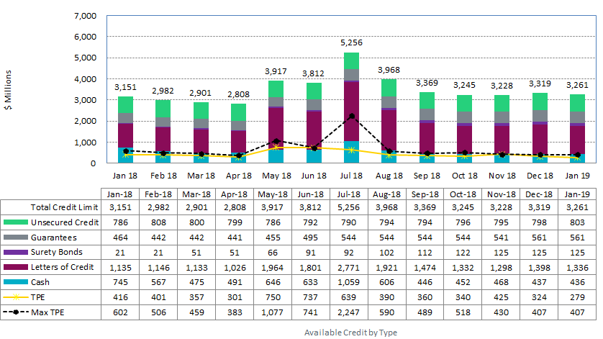
MCWG update to WMS

Slide 7
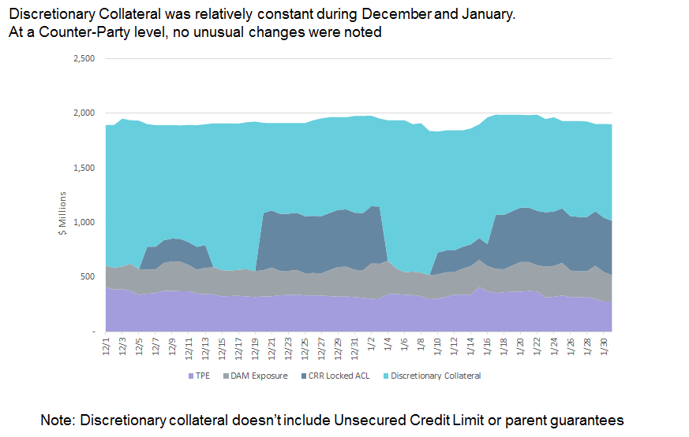
MCWG update to WMS

Slide 8
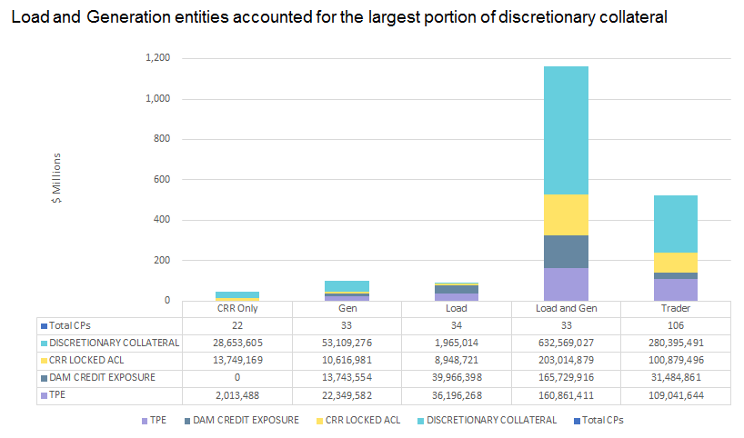
MCWG update to WMS

Slide 9
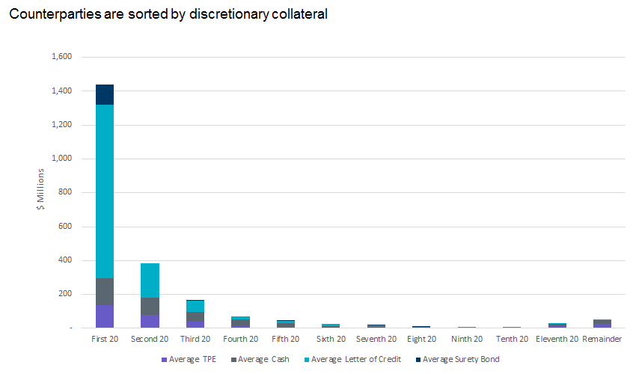
MCWG update to WMS

Slide 10
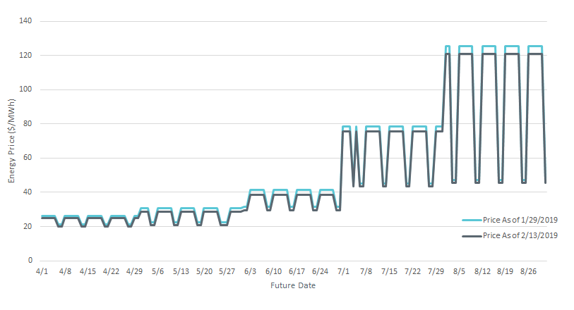
MCWG update to WMS

