Slide 1
GIC Modeling Expectations
Eric Meier
Model Administration
2/26/2019

Slide 2
Agenda
Model Building Contact List Review
GIC Modeling Expectations Review
Modeling Discussion Items
GIC Modeling Building Overview

Slide 3
Model Building Contact List
ERCOT updated the contact list for those involved with PGDTF Model Building
It will be posted on MIS
Would the task force want it released on either the restricted or public mailing list?

Slide 4
GIC Modeling Expectations
The purpose of the GIC Modeling Expectations document is to lay out standards that the GIC System Models should adhere to
It is not a ROS approved document like the Procedure Manual
We will now go over some highlights before reviewing the document itself

Slide 5
Shunt Devices
All shunt reactors, either bus or line connected must be modeled
NOT just in-service reactors.
  In-service and out of service reactors must be modeled
ERCOT Planning will modify the GIC file to switch shunts as needed for the vulnerability assessment
Series capacitors are have a negative impedance – status is read in from the AC case

Slide 6
Transformers
The I, J, K buses do not reflect voltages
They must match what is in the AC case
Some new transformers will be modeled:
  Load serving power transformers with a high side winding of 200kV or greater
  There are 35 loads in operations connected to the 345kV system
  8 are RE loads and will be ERCOTs responsibility to model
  Full modeling in both the GIC and AC case will be needed

Slide 7
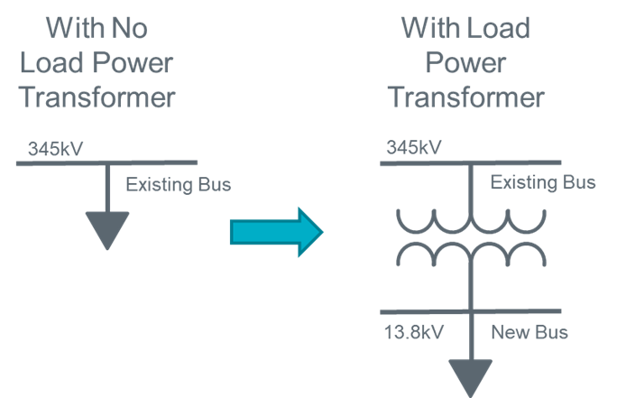
Transformers
HVDC converter transformers are included in the 2TDC model
However reactive losses are not calculated
K-Factors will be found or assumed for the transformers to calculate reactive losses by hand for the DC ties

Slide 8
Validation Rules
The validation rules were taken from the GIC System Model User Guide created by PGDTF
These are only applied to data that is added or modified, not everything in the database
  If the submission fails validation, the submission is not accepted
Each rule is assigned an id, e.g. 5A
  The Expectations and validation log ids are correlated
Inactive Rules:
  Latitude and longitude, flag if:
    # of digits is less than 4 significant digits (after decimal)
  For branch data, flag if:
    Branch mileage > 160 km (found in branch GIC output)

Slide 10
PTI Responses to ERCOT Questions
Auto transformer Series and Common winding designation is done based on Winding voltage, not how you enter data.
PSSE does not require transfomer winding buses to be any voltage order. There is HV, LV bus designations in PSSE. As data is entered 1st bus is Winding 1 Bus, 2nd bus is Winding 2 bus etc.
Series capacitor branches defined in PSSE Case data are automatically ignored (open circuit) in GIC. You do not need to provide 1 Mohm Rdc for these lines.

Slide 11
Substation Groupings
How are buses in a station being aggregated?
Are there any differences due to voltage levels, the grounding grid, or reasons due to the software?

Slide 12
Combined Reactor and Shunt Modeling
In PSSE, some separate reactors and caps that share a bus may be modeled as a single switched shunt
The reactor component is significant for GIC flows
Any thoughts on modeling?

Slide 13
SVC/Statcom Modeling
Reactive devices capable of providing both positive and negative VARs
Shunt reactors offer a flow for GICs while shunt caps block GICs
SVC/STATCOMs are mostly (but not all), machines in the PSSE planning cases
Any thoughts on modeling?
  They could be modeled as switched shunts but it then becomes a combined cap and reactor model

Slide 14
GIC Model Building Process
Eric Meier
Model Administration
2/26/2019

Slide 15
Case Building Timeline

Slide 16
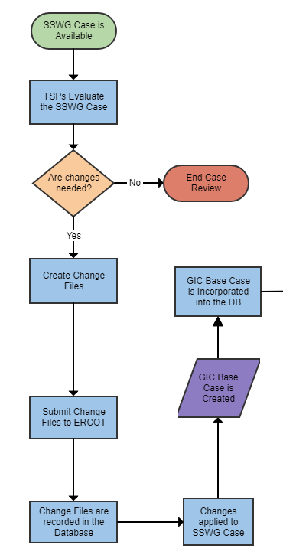
Flowchart Part One
Setting up the initial case and templates

Slide 17
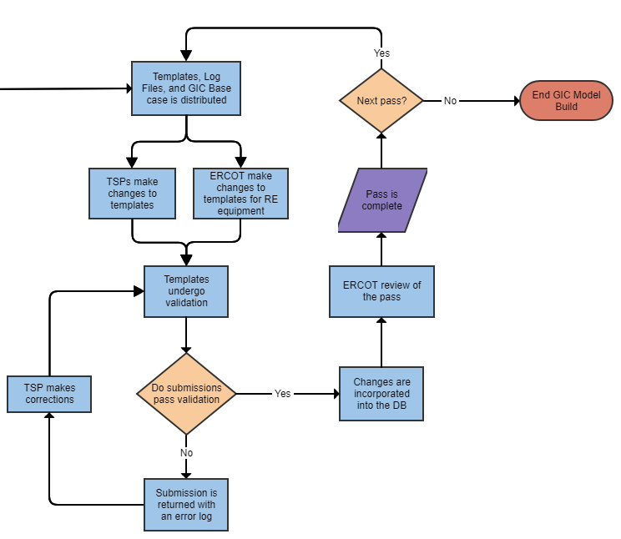
Flowchart Part Two
Submitting changes to the GIC DC Model

Slide 18
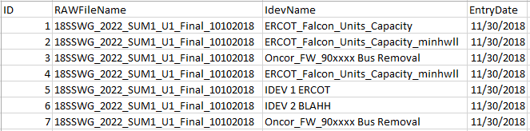
Starting Files
When beginning the model build, the following files will be available
  GIC Template
  Job Log
  RAW File Change Log
  Idev Log
  GIC AC Model
The Idev log shows which Idevs have been applied to the GIC AC Model

Slide 19
How to Submit
Use the ERCOT supplied template to submit changes
Email the ERCOT Modeler with the modified template
Two Options:
  Modify the provided template
  Delete all info from the template except the headers and then make all the changes
  Either option works and depends on user preference

Slide 20
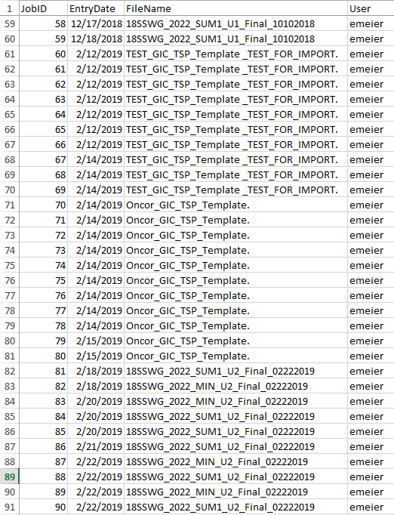
Job Log
Shows what file is associated with a job
The log will be cleaned prior to the case build
Shows both RAW file imports and TSP/ERCOT changes

Slide 21
Adding New Data
To add new data, add the new record on its respective sheet
Leave the ID or ID1 (Fixed Shunts) column blank (always the column in A)
Input data for the new record
Put a 1 in the Modification column

Slide 22
Modifying Data
When modifying data, edit the existing data on its respective sheet
DO NOT modify the ID or ID1 (Fixed Shunts) column blank (always the column in A)
Input the new data
Put a 1 in the Modification column

Slide 23
Deleting Data
When deleting data, make the following changes:
Put Delete in the Delete column
No other modifications are needed
  The ID or ID1 (Fixed Shunts) column must NOT be modified

Slide 24
Change Log
For each successful submission, there is a change log
It shows what was entries were added, modified, and deleted by the template that was submitted

Slide 25
Template Naming
Before returning the modified template to ERCOT, rename the file to include the company at the front and pass number at the end.
Example:
[Company]_GIC_TSP_Template_ -> ERCOT_GIC_TSP_Template_Pass2
Cannot put letters in fields meant for numbers
Null values are not permitted in the template name
Add in PassX (Ex. Pass2)
For company names, use the names in Appendix A

Slide 26
Data Submission
If a secure data transmission method is need, use the following:
Submit templates in an encrypted ZIP file.
The zip file should then be encrypted, not the Excel template.
  By encrypting the zip file and not the template, corruption of the template is less likely.
The encrypted zip file should then be emailed to the ERCOT modeler.
The password should follow in a separate, second email to the ERCOT modeler.

Slide 27
Import Validation
Each import undergoes validation
Validation rules are the ones approved by PGDTF
Output: A spreadsheet that details what elements failed validation and the specific rule that was failed
  Sheet Code: Example 5A refers to a specific validation rule in the GIC Modeling Expectations

Slide 28
Full Database Validation
Validation rules are only run on new submissions
However it was also expanded to run on the entire database
Elements in the database fail to meet the following rules 1A, 4A, 4D, 4E, 5B_Fixed, 5B_Switched, 6A
Excluding Lat and Long Issues there are 444 validation issues of existing data

Slide 29
New Earth Model Regions Boundaries
At the NERC GMDTF meeting, EPRI presented on a new report
  Use of Magnetotelluric Measurement Data to Validate/Improve Existing Earth Conductivity Models
In the report is a map of updated 1D regional boundaries for the United States earth model
The boundaries near and in Texas have changed a bit
This is not in the GIC Modeling Expectations

Slide 30
Questions?

