Slide 1
CRR Activity Calendar Update
Donald House
Supervisor, CRR
WMS
March 6, 2019

Slide 2
CRR activity calendar - overview
NPRR852 requires ERCOT to post an updated calendar no later than April 1 of each calendar year
Each calendar includes auction activity dates for the remainder of the current calendar year and for the two subsequent calendar years
Calendar was shared with CMWG on February 25, 2019
No revisions requested
Seeking final approval today from WMS

Slide 3
CRR activity calendar – description of changes
Current calendar
Dates from the currently approved calendar remain unchanged (through the 2021.MAR.Monthly.Auction)
Added dates to cover CRR activity through 2021
Applied the same patterns to assign the dates as have been used for previous calendars to maintain Protocol requirements and consistency

Slide 4
CRR activity calendar – description of changes
Plan to delay posting auction results around the New Year’s Day holiday weekend leading into 2022
Current approved calendar does the same leading into 2021
2023.1st6.AnnualAuction.Seq3
Post results on Tuesday, 1/4/2022 (usually post results on a Thursday)
Will result in invoices being posted and credit released on Wednesday, 1/5/2022
Avoids staffing issues around the holiday weekend for ERCOT and market participants
Credit locked for longer period but no overlap with other auctions

Slide 5
CRR activity calendar – description of changes
PCRR annual nomination process dates have been adjusted to hold the process as late in the summer as possible while still respecting the protocol requirements for receiving nominations and posting allocation results
PCRR-eligible NOIEs are encouraged to view the dates on the “PCRRs” tab of the calendar

Slide 6
CRR activity calendar – general reminders
The model build process begins 2 weeks prior to the model posting date (get outages and Common Information Model snapshot)
We hold a monthly auction and a long-term auction every month of the year
Typical pattern is monthly auction bid window in the first half of the month followed by the long-term auction bid window the very next week (occasionally, there will be a one-week gap to avoid holidays)
Monthly auction results are posted one week after the bid window closes; long-term auction results are posted two weeks after the bid window closes
Monthly auction credit is usually released 1 day after the long-term auction credit is locked

Slide 7
CRR activity calendar – general reminders
There are two additional tabs on the calendar
“Calendar Protocol References” includes any references to protocol sections relating to the selection of dates
“PCRRs” gives activity dates and protocol sections related to the annual PCRR allocation process
Note that the changes associated with NPRR808, Three Year CRR Auction, moved the annual allocation process into July/August of each year

Slide 8
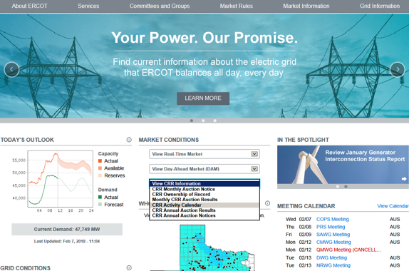
CRR activity calendar – next steps
ERCOT is seeking final approval today from WMS
Once approved, the new version of the calendar will be posted on the ERCOT public site by April 1, 2019

