Slide 1
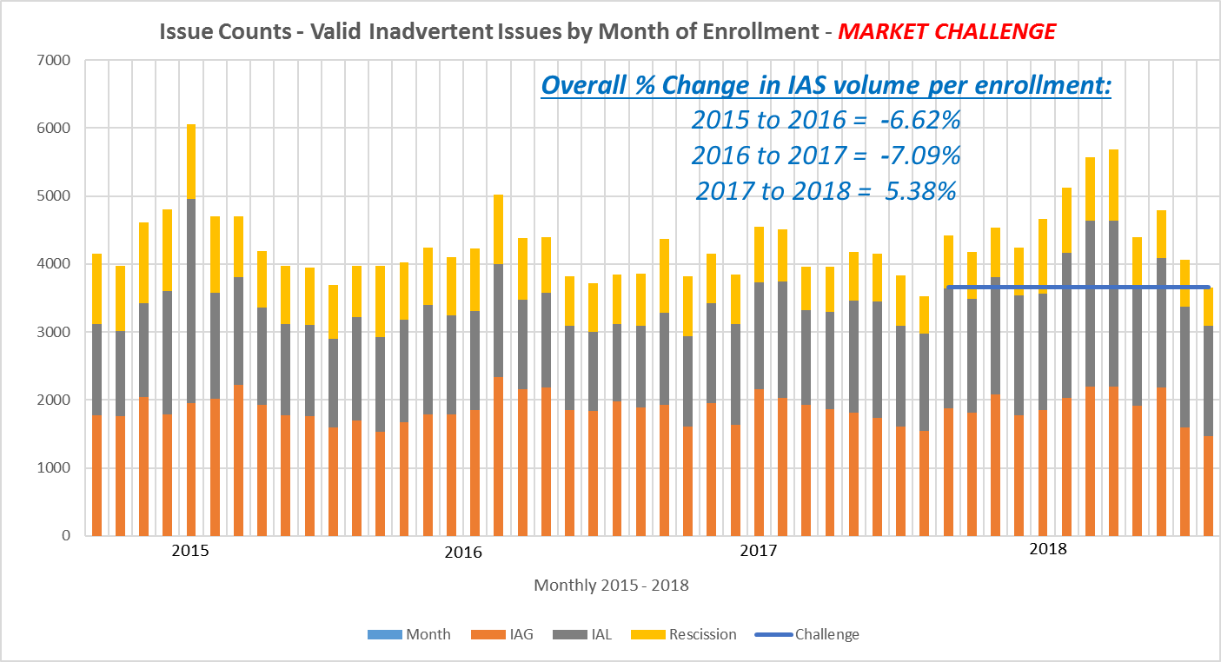
IAG Market Challenge - Volumes
CHALLENGE:
Reduce the total volume by another 10%!!
Drive % volume to below 1.5% !!

Slide 2
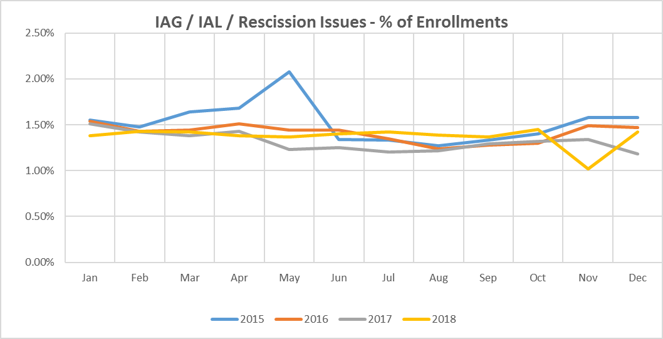
IAS Market Challenge - % of Enrollments

Slide 3
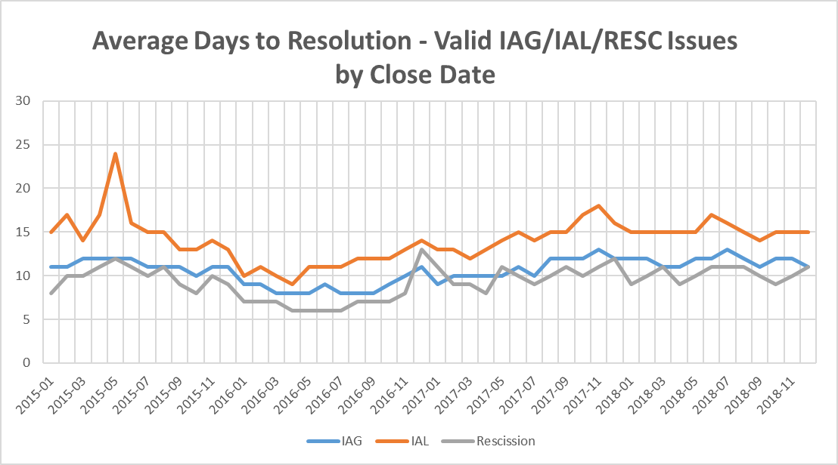
IAS Market Challenge – Resolution Days

