Slide 1
Final GIC Flow Summary for Benchmark GMD Event
March 2019
ROS Meeting

Slide 2
Benchmark GMD Event Description
NERC TPL-007-1 Standard defines the benchmark Geomagnetic Disturbance (GMD) event as composed of the following four elements.
a reference peak geoelectrical field amplitude of 8 V/km derived from statistical analysis of historical magnetometer data
scaling factors to account for local geomagnetic latitude
scaling factors to account for local earth conductivity
a reference geomagnetic field time series or waveshape to facilitate time-domain analysis of GMD impact on equipment
“The frequency of occurrence of this benchmark GMD event is estimated to be approximately 1 in 100 years”^{[1]}.
[1]https://www.nerc.com/comm/PC/Geomagnetic%20Disturbance%20Task%20Force%20GMDTF%202013/Benchmark_GMD_Event_Dec5_clean.pdf
[1]

Slide 3
GIC Flow Posting Status
Preliminary transformer Geomagnetically Induced Currents (GIC) results for Benchmark GMD event were posted in the MIS Secure area of the ERCOT website on 7/2/2018.
Final transformer GIC results for Benchmark GMD event to meet NERC TPL-007-1 Requirement 5 were posted in the MIS Secure area of the ERCOT website on 10/29/2018 after addressing comments received after the preliminary GIC flows were posted.
[1]

Slide 4
Final GIC Flow Summary
None of the transformers’ maximum effective GIC flow value exceeded the 75 A per phase threshold described in NERC TPL-007-1 R6.
Three transformers’ maximum effective GIC flow value were above 50 A per phase.
The majority of the transformers’ maximum effective GIC flow value were below 10 A per phase.

Slide 5
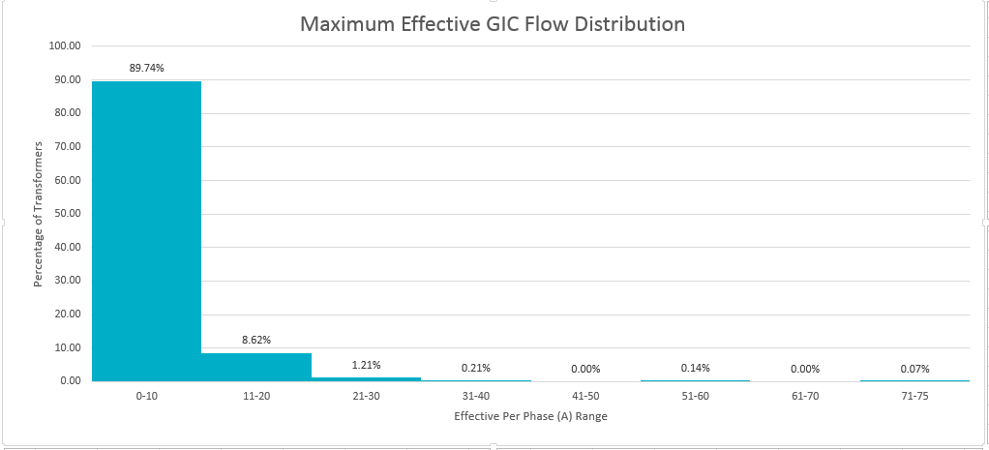
Maximum Effective GIC Flows Distribution for 2021 Summer Peak Case
The numbers in the chart reflect the percentage of transformers whose GIC flow are in the specified range among 1403 transformers.

Slide 6
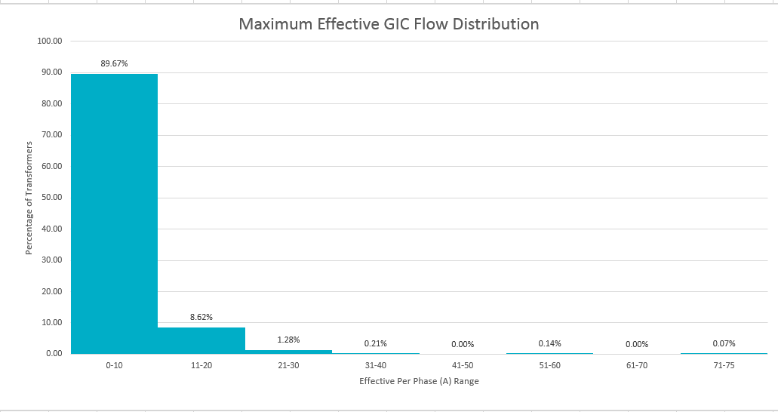
Maximum Effective GIC Flows Distribution for 2021 Minimum Load Case
The numbers in the chart reflect the percentage of transformers whose GIC flow are in the specified range among 1403 transformers.

Slide 7
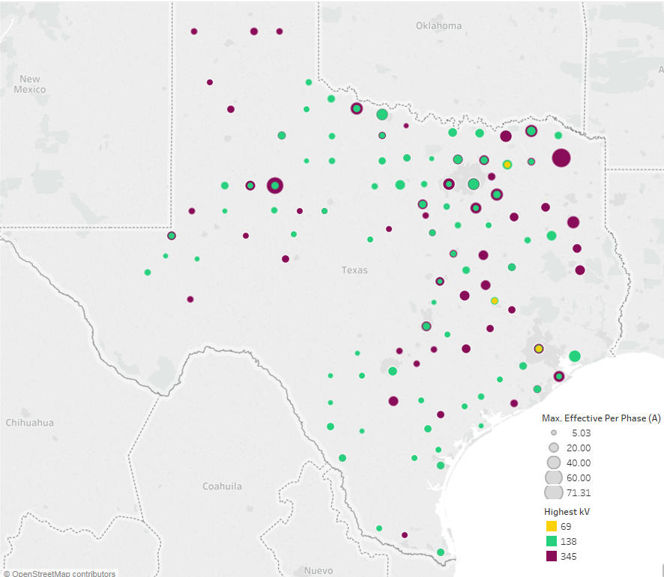
Maximum Effective GIC flows for 2021 Summer Peak (Geographic distribution) (>4 Amps)

Slide 8
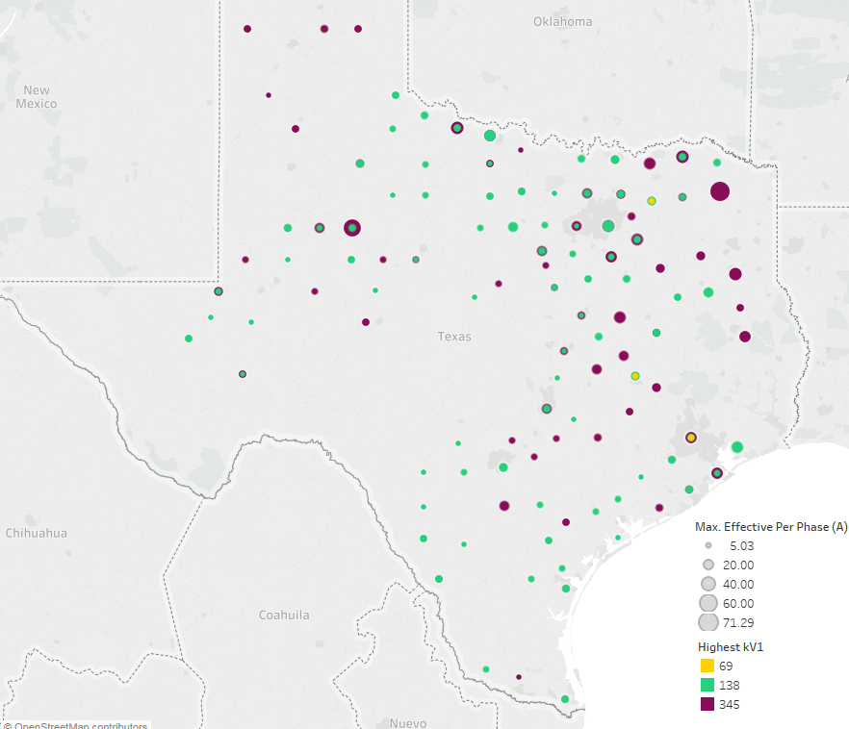
Maximum Effective GIC flows for 2021 Off-Peak (Geographic distribution) (>4 Amps)

Slide 9
Question
?

