Slide 1
Defining Solar Regions
In ERCOT
ROS
Sean Chang
Sandip Sharma
Operations Planning
March 7, 2019

Slide 2
Objective
Similar to how ERCOT has defined wind regions, seek to understand solar irradiance and variability in Texas
ERCOT worked with solar forecasting vendor to group regions in Texas by similar irradiance and variability patterns
Define solar regions

Slide 3
Utility Scale Solar Generation Capacity – January 2019
The data presented here is based upon the latest registration data provided to ERCOT by the resource owners and can change without notice. Any capacity changes will be reflected in current and subsequent years' totals. Scheduling delays will also be reflected in the planned projects as that information is received. This chart reflects planned units in the calendar year of submission rather than installations by peak of year shown.
As of January 31, 2019

Slide 4
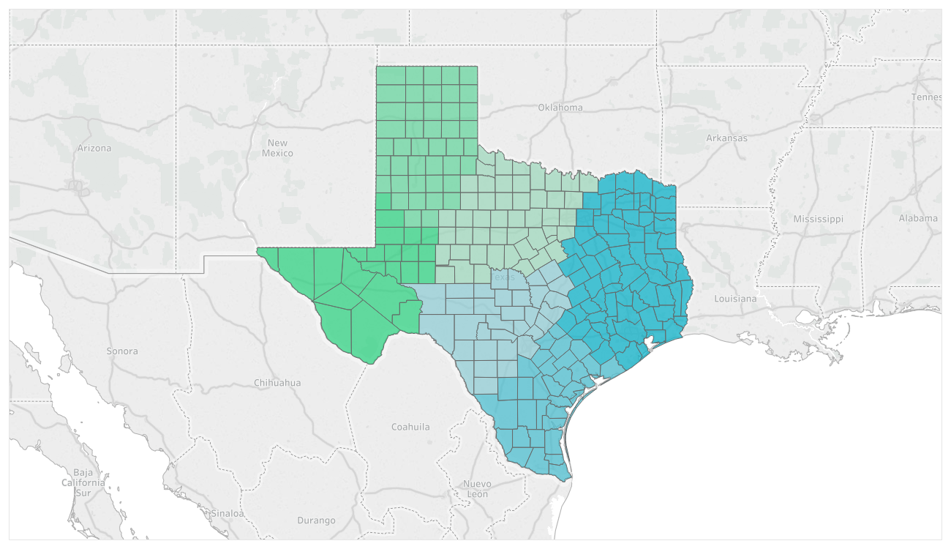
Proposed Solar Regions
Zone 5
Zone 4
Zone 6
Zone 1
Zone 3
Zone 2
Notes:
Includes only installed capacity

Slide 5
Proposed Solar Regions – Current Installed Capacity
Notes:
Includes only installed capacity

Slide 6
Proposed Solar Regions – IA Signed through 2021
Notes:
Includes both installed capacity and resource with a signed IA

