Slide 1
Southern Cross Transmission - Directive 9 - Discuss Frequency Overshoot Study and RRS Impacts
Sandip Sharma
Manager Operations Planning
Feb. 26, 2019

Slide 2
Frequency Overshoot Study – Impact of SCT DC Tie trips when exporting
Sudden instantaneous trip of SCT DC Tie when exporting power could cause ERCOT grid frequency to overshoot. If the resulting frequency overshoot is too high, the high overshoot values could trigger other Generation Resources to trip on over-frequency protection.
Assumptions and Methodology
All governors of on-line synchronous Generation Resources will be enabled to provide frequency response
All on-line wind farms with PFR capability will be modeled to provide downward response to over frequency
Trip SCT DC Tie while exporting 2,100 MW.
The sensitivity study with load damping factor assumed to be 0% and 2% will be conducted for each case.
Record frequency trend and identify any frequency overshoot that exceeds 60.6 Hz.
In the cases where frequency overshoot exceeds 60.6 Hz, additional sensitivity studies will be conducted to identify an export limit on the SCT DC Tie such that frequency overshoot will not exceed 60.6 Hz.

Slide 3
Scenarios Used for Frequency Overshoot Study
Scenario Name | Inertia (GW·s) | Load (GW) | Wind (GW) | Synchronous Gen (GW)
Scenario 0 | 130 | 34 | 15.5 | 19
Scenario 1 | 130 | 34 | 10 | 24.5
Scenario 2 | 130 | 32 | 5 | 27.5
Scenario 3 | 130 | 32 | 3.5 | 29
Scenario 4 | 120 | 29.9 | 3.5 | 26.9
Scenario 5 | 110 | 27.2 | 3.5 | 24.2

Slide 4
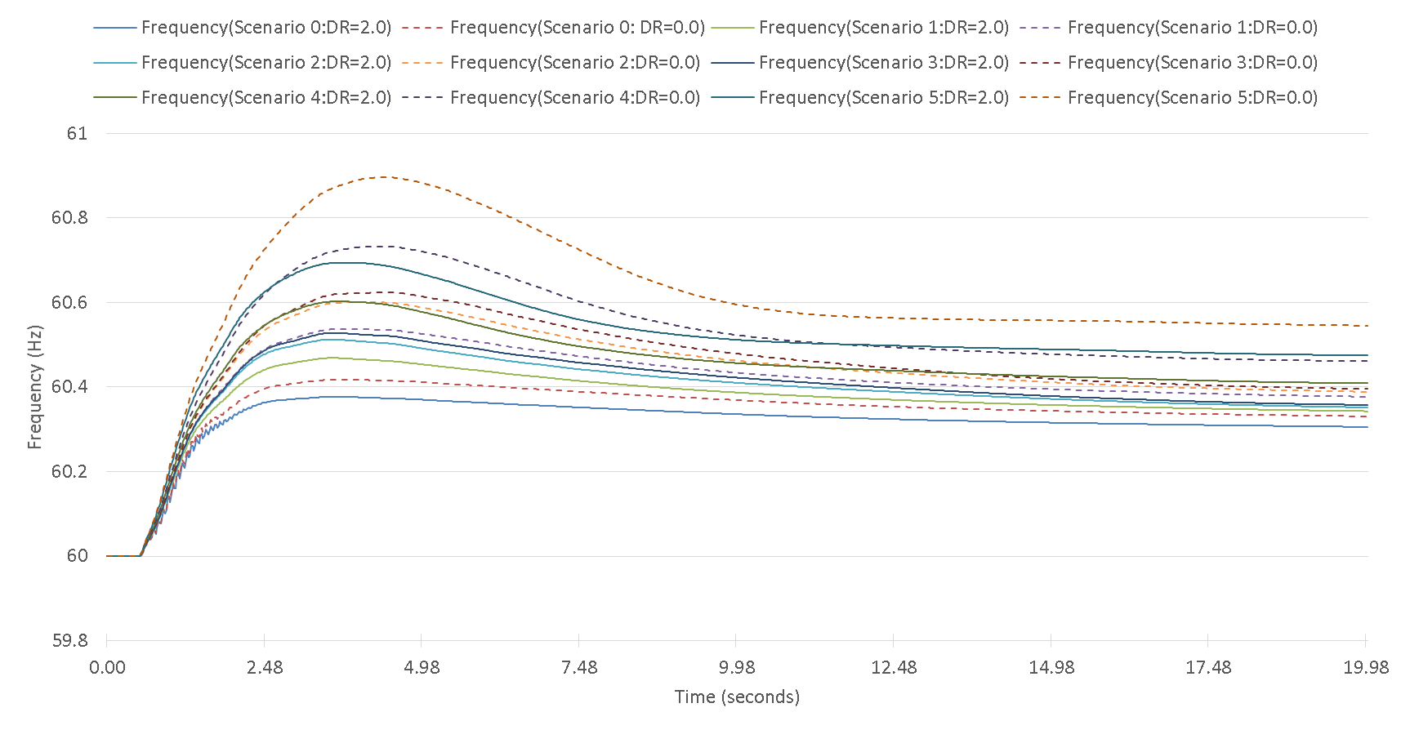
Frequency Response when Tripping SC DC Tie Export at 2,100 MW
 | Scenario 0 | Scenario 1 | Scenario 2 | Scenario 3 | Scenario 4 | Scenario 5
Highest Frequency Overshoot (Hz) DR=2.0 | 60.38 | 60.47 | 60.51 | 60.53 | 60.60 | 60.70
Highest Frequency Overshoot (Hz) DR=0.0 | 60.42 | 60.54 | 60.60 | 60.62 | 60.73 | 60.89

Slide 5
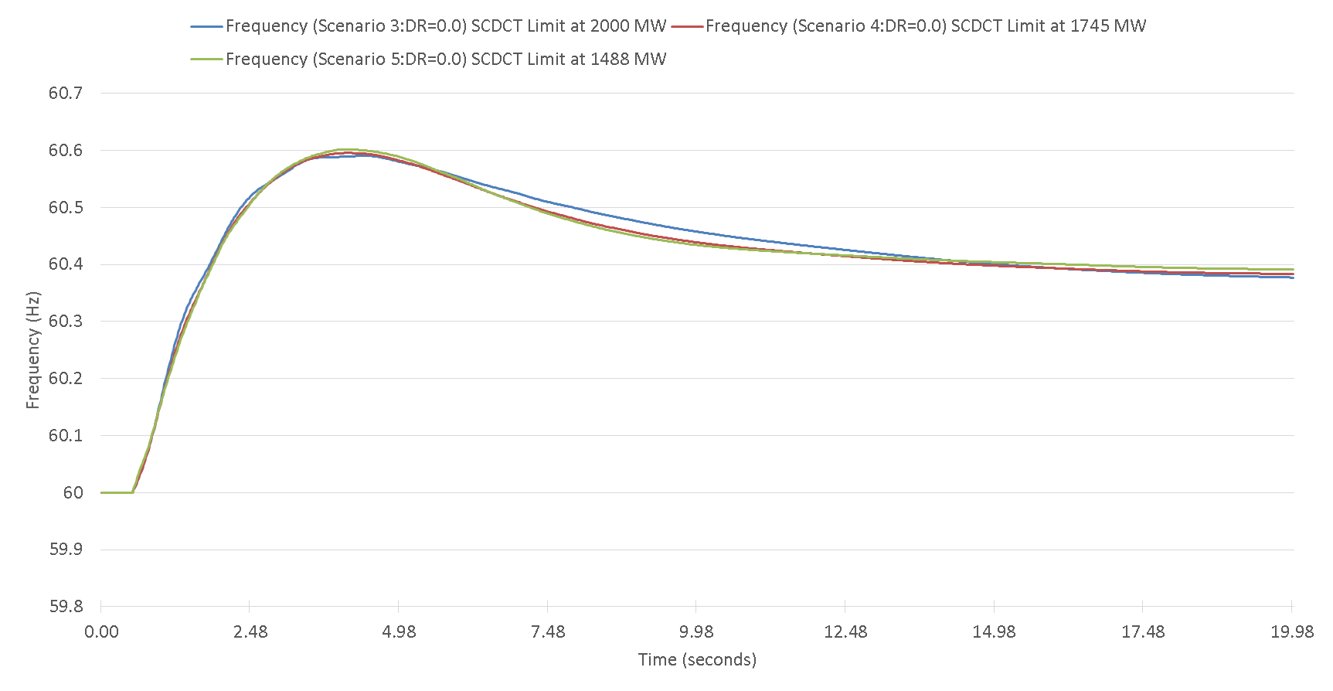
Limit Imposed on SC DC Tie Export
 | Scenario 3 (130 GW·s) | Scenario 4 (120 GW·s) | Scenario 5 (110 GW·s)
Limit on SC DC tie export | 2,000 MW | 1,745 MW | 1,488 MW

Slide 6
Responsive Reserve Service (RRS)
Per ERCOT’s current AS Methodology, minimum quantities of RRS are established based on historic (last two years) system inertia conditions and RRS studies (most recently conducted in 2017). RRS Studies are set up to determine at what amount of RRS a Generation Resource trip equal to ERCOT’s Resource Contingency Criteria (RCC) as established by BAL-003, Under Frequency Load Shed (UFLS) would not be triggered.
Scenario 1 - SCT DC Tie import is limited to existing ERCOT Most Severe Single Contingency (MSSC) at 1,375 MW
Scenario 2 - SCT DC Tie import is above existing ERCOT MSSC up to 2,000 MW

Slide 7
Scenario 2: RRS Case Study
Case No. | Time | INERTIA (GW·s) | PFR (MW) | LR (MW) |  | LR/PFR Ratio |  | PFR (No LR) (MW)
 |  |  |  | w/o SCDCT | w/ SCDCT | w/o SCDCT | w/ SCDCT | w/o SCDCT | w/ SCDCT
*Case1 | 10-Feb-17 01:00:00 | 130 | 1150 | 1900 | 2650 | 2.39 | 2.94 | 5691 | 8941
Case2 | 31-Mar-14 02:00:00 | 140 | 1150 | 1800 | 3250 | 2.17 | 3.29 | 5056 | 11843
Case3 | 21-Mar-14 02:00:00 | 150 | 1150 | 1750 | 2900 | 1.85 | 2.59 | 4388 | 8661
Case4 | 23-Oct-16 00:00:00 | 160 | 1150 | 1700 | 2550 | 1.85 | 2.43 | 4295 | 7347
Case5 | 28-Oct-13 00:00:00 | 180 | 1150 | 1650 | 2375 | 1.71 | 1.98 | 3972 | 5853
Case6 | 24-Nov-16 15:00:00 | 200 | 1150 | 1450 | 2100 | 1.43 | 1.53 | 3224 | 4363
Case7 | 02-Apr-14 10:00:00 | 220 | 1150 | 1500 | 2150 | 1.55 | 1.68 | 3475 | 4762
Case8 | 05-Oct-13 18:00:00 | 260 | 1150 | 1450 | 2150 | 1.10 | 1.17 | 2745 | 3666
Case9 | 28-May-14 18:00:00 | 290 | 1150 | 1300 | 1950 | 1.00 | 1.06 | 2450 | 3217
Case10 | 03-Sep-13 18:00:00 | 359 | 1150 | 1150 | 1800 | 1.00 | 1.12 | 2300 | 3166
Case11 | 07-Aug-13 17:00:00 | 376 | 1150 | 1050 | 1700 | 1.00 | 0.95 | 2085 | 2765
*Case 1 : With RCC increased to 3,375 MW, ERCOT’s critical inertia goes up to around 130 GW*s. As a result, current RRS mix is insufficient to arrest system frequency above 59.4 Hz. Therefore, for the case with 130 GW*s inertia, LRs’ response time are shortened to 15 cycles to improve frequency nadir.

Slide 8
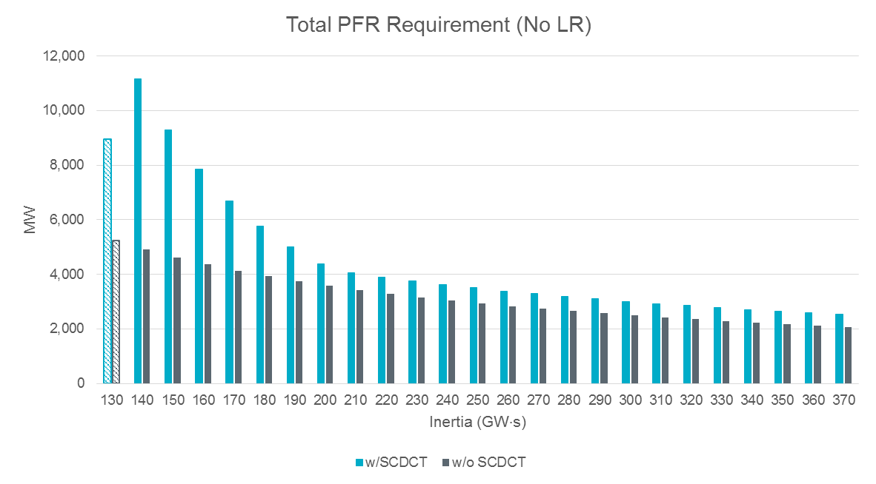
Interpolated PFR (No LR) Quantities
*Note: With RCC increased to 3,375 MW, ERCOT’s critical inertia becomes 130 GW·s. As a result, current RRS mix is insufficient to arrest system frequency above 59.4 Hz. Therefore, for the case with 130 GW·s inertia, LRs’ response time are shortened to 15 cycles to improve frequency nadir. PFR quantity related to 130 GW·s is not included for interpolation.

Slide 9
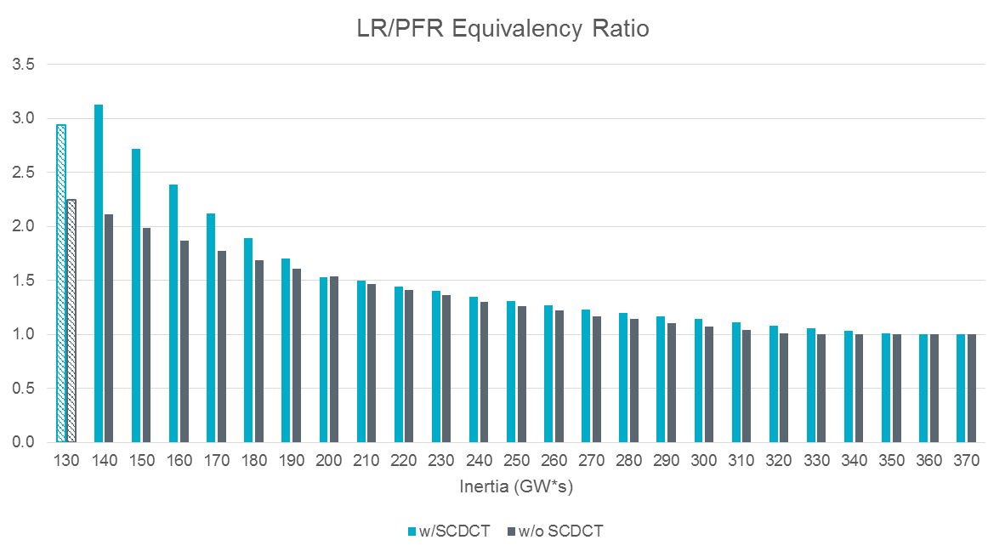
Interpolated LR/PFR Equivalency Ratio
*Note: With RCC increased to 3,375 MW, ERCOT’s critical inertia becomes 130 GW·s. As a result, current RRS mix is insufficient to arrest system frequency above 59.4 Hz. Therefore, for the case with 130 GW·s inertia, LRs’ response time are shortened to 15 cycles to improve frequency nadir. PFR quantity related to 130 GW·s is not included for interpolation.

Slide 10
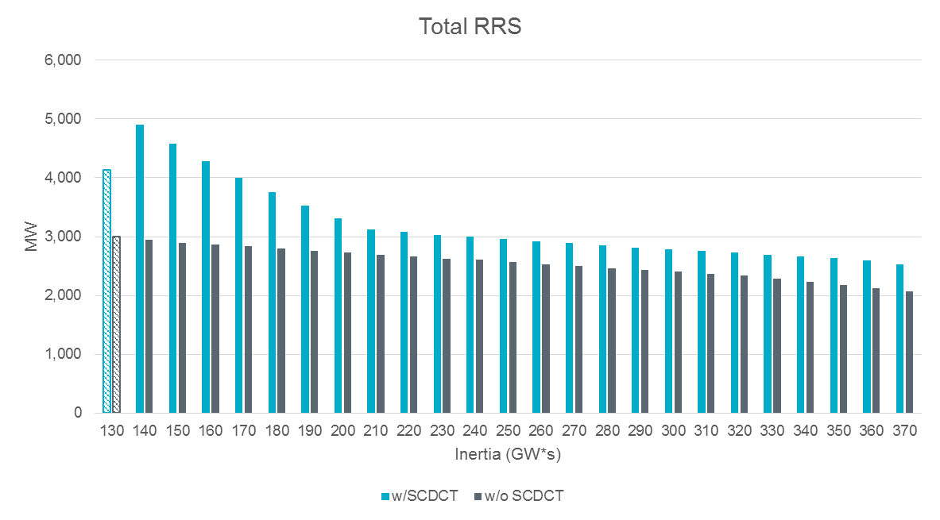
Interpolated RRS Quantities
*Note: With RCC increased to 3,375 MW, ERCOT’s critical inertia becomes 130 GW·s. As a result, current RRS mix is insufficient to arrest system frequency above 59.4 Hz. Therefore, for the case with 130 GW·s inertia, LRs’ response time are shortened to 15 cycles to improve frequency nadir. PFR quantity related to 130 GW·s is not included for interpolation.

Slide 11
RRS Quantity Increase
2019 Total RRS (w/o SCDCT) | 2019 Total RRS (w/ SCDCT) | Delta
23,716,368 MWh | 28,986,904 MWh | 5,270,536 MWh

Slide 12
Study Conclusions
RRS Impact
Scenario 1: The addition of the 2,000 MW SCT DC Tie import would increase ERCOT’s Resource Contingency Criteria (RCC) from the current 2750 MW to 3375 MW, per BAL-003¹ Standard. ERCOT studies show additional RRS would be needed to protect against the larger RCC. Using the 2019 expected system inertia, ERCOT studies show an additional 5,270,536 MWh of RRS would be required for 2019.
Scenario 2: If SCT DC Tie imports are limited to the current ERCOT-defined MSSC (i.e. not considering the SCT DC Tie), then ERCOT’s Resource Contingency Criteria (RCC) would not change and there would be no incremental RRS requirement.
Frequency Overshoot
Instantaneous trip of a 2100 MW SCT DC Tie export during certain low inertia hours could cause frequency overshoot.
Without an export limit for low inertia conditions, a new ancillary service would be required to protect against possible frequency overshoot.
During certain low inertia hours, an export limit for the SCT DC Tie would address the potential overshoot problem and would eliminate the need for new ancillary services. ERCOT studies of the modeled scenarios showed the export limit to be as low as 1,488 MW. This limit could be higher or lower under system conditions that differ from the ones studied.
1. The NERC BAL-003 Standard is currently under review. These conclusions may need to be revisited if the RCC changes.
.

Slide 13
Questions?

