Slide 1
Intra-Hour Wind Forecast Accuracy Updates (Feb. 2019)
WMWG
Operations Analysis
February 25, 2019

Slide 2
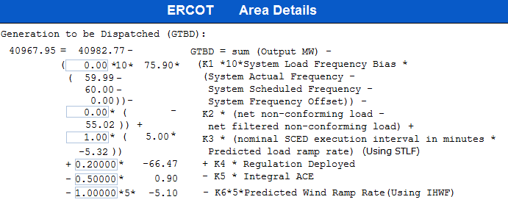
Current GTBD Parameters
Historical K factor tuning events:
12/4/18 10:05 AM – K6 Changed from 0 to 0.5
2/12/19 2:15 PM – K6 changed from 0.5 to 1.0
Notes:
3/12/18 – Integral ACE Time Constant Changed from 60 min to 45 min
5/17/18 – K4 Changed from 0.3 to 0.2 and K5 Changed from 0.4 to 0.5
12/4/18 – 10:05 AM – K6 Changed from 0 to 0.5
2/12/19 – 2:15 PM – K6 changed from 0.5 to 1.0

Slide 3
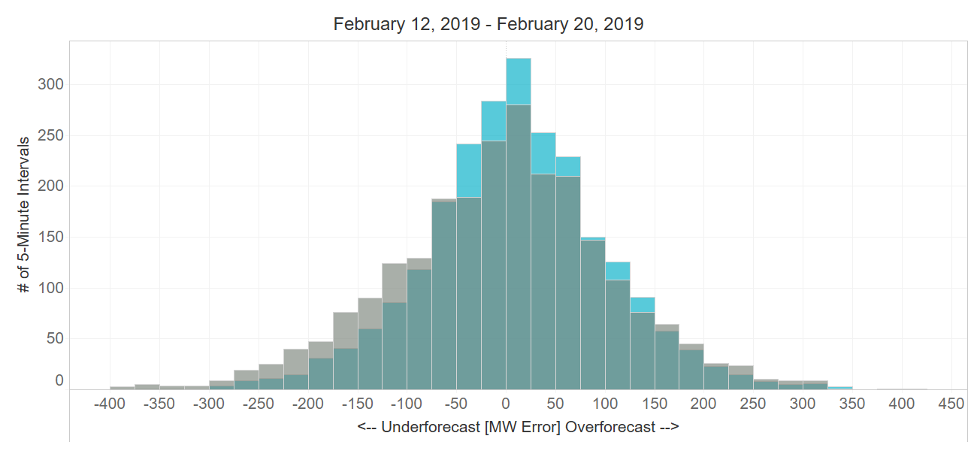
Projected Wind Ramp Rate (PWRR) Error
Performance Metric | SCED PWRR (12/4 – 2/12) | Persistence Ramp* (12/4 – 2/12) | SCED PWRR (2/12 – 2/20) | Persistence Ramp* (2/12 – 2/20)
Monthly MAE (MW) | 65 | 74 | 71 | 86
Monthly MAE when 5-Min. Wind Ramp > 100 MW | 130 | 162 | 134 | 167
SCED PWRR
Persistence Ramp*
* Persistence Ramp assumes using a 0 MW wind ramp in PWRR

Slide 4
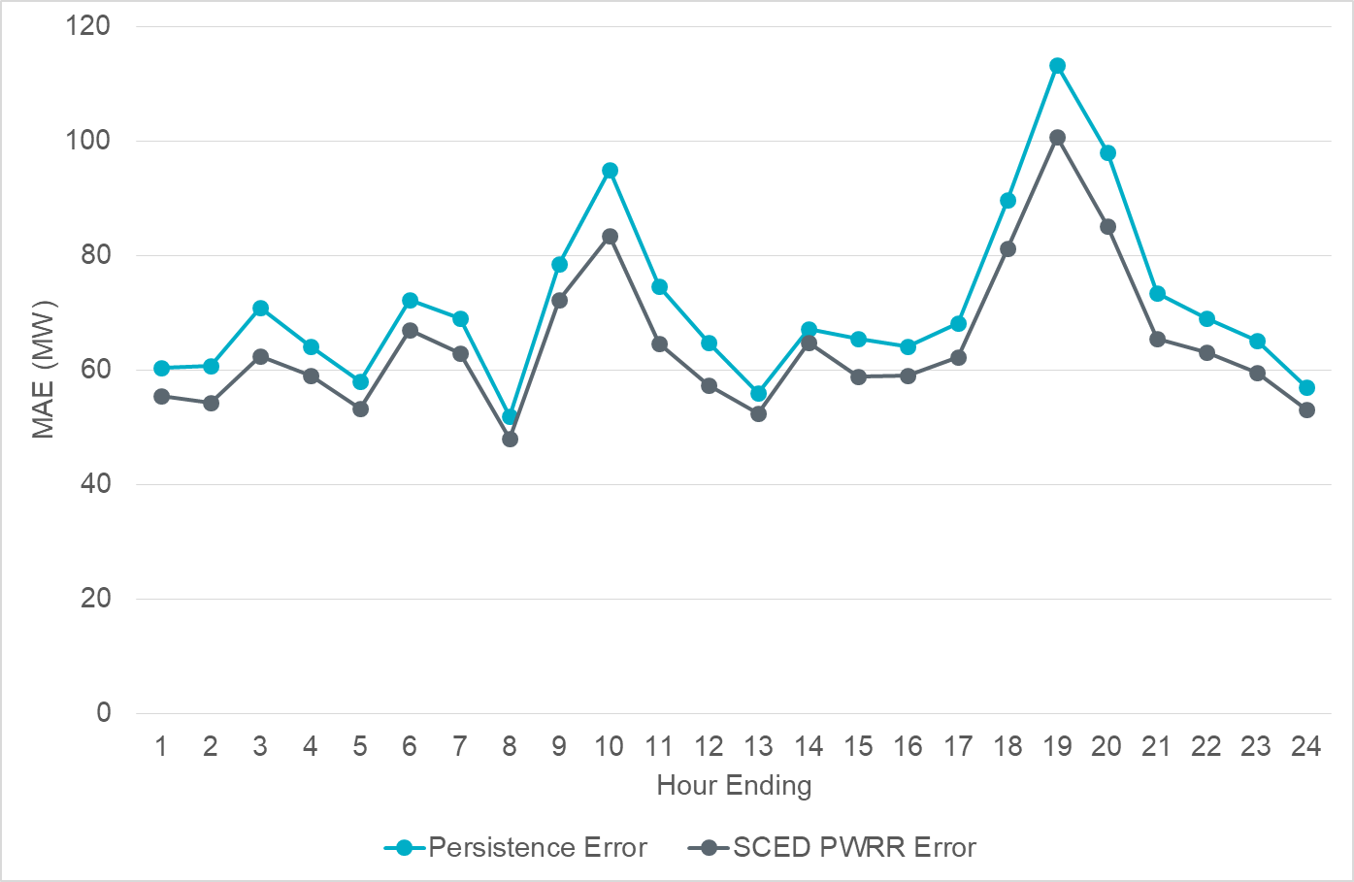
Intra-Hour Wind Ramp Forecast Error (January 2019)

Slide 5
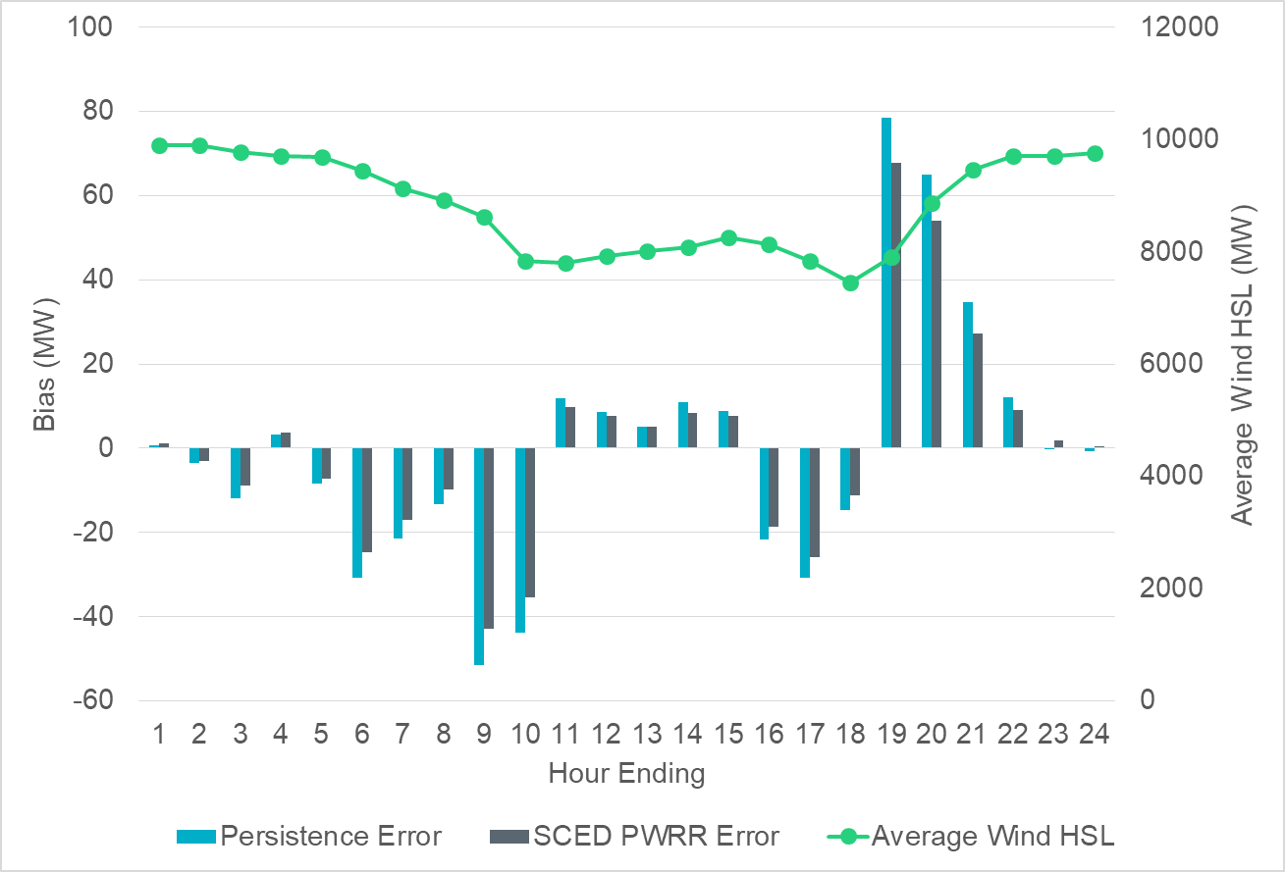
Intra-Hour Wind Ramp Forecast Error (January 2019)

