Slide 1
NPRR 917
Nodal Pricing for Settlement-Only Distributed Generators and Settlement-Only Transmission Generators
ERCOT Staff
WMWG / CMWG / MSWG
Feb. 25-26, 2019

Slide 2
Background
From Section 2 of the ERCOT Nodal Protocols, as amended by NPRR 889 (a.k.a., RTF1), approved by Board Dec. 11, 2018:
Settlement Only Distribution Generator (SODG)
A generator that is connected to the Distribution System with a rating of:
(1) One MW or less that chooses to register as an SODG; or
(2) Greater than one and up to ten MW that is capable of providing a net export to the ERCOT System and does not register as a Distribution Generation Resource (DGR).
SODGs must be registered with ERCOT in accordance with Planning Guide Section 6.8.2, Resource Registration Process, and will be modeled in ERCOT systems for reliability in accordance with Section 3.10.7.2, Modeling of Resources and Transmission Loads.

Slide 3
Background
Also from Section 2 as amended by NPRR 889:
Settlement Only Transmission Generator (SOTG)
A generator that is connected to the ERCOT transmission system with a rating of ten MW or less and is registered with the Public Utility Commission of Texas (PUCT) as a power generation company. SOTGs must be registered with ERCOT in accordance with Planning Guide Section 6.8.2, Resource Registration Process, and may be modeled in ERCOT systems for reliability in accordance with Section 3.10.7.2, Modeling of Resources and Transmission Loads.
Prior to NPRR 889, SODGs and SOTGs were known as Registered DG and Non-Modeled Generators in the ERCOT Protocols
http://www.ercot.com/mktrules/issues/NPRR889

Slide 4
The NPRR 889 landscape
The Old:
REGISTERED DG / NON-MODELED GENERATOR
The New:
SETTLEMENT-ONLY GENERATOR (SOG)
Settlement-Only Distribution Generator (SODG)
Settlement-Only Transmission Generator (SOTG)
Settlement-Only Transmission Self-Generator (SOTSG)
Distribution-connected ≤10 MW
DG is required to register if >1 MW and injects to grid
Optional if ≤1 MW
Trans-connected <10 MW
Registered as SOTG with ERCOT
Registered as PGC at PUCT
Trans-connected generator >1 MW registered with PUCT as Self-Generator
NPRR 917 addresses SODGs & SOTGs

Slide 5
NPRR 917 pricing proposal
NPRR 917 would extend applicable nodal pricing to SODGs and SOTGs
This would provide incentives for behavior consistent with Nodal market design and the reliability needs of the ERCOT system
In the Real-Time Market, a nodal price is calculated for each electrical bus in the system at every SCED run
There are ~13,100 electrical buses in the system
The NPRR would establish nodal pricing as follows:
SODGs (distribution-connected generators) would be paid the time-weighted price created at the Load point (electrical bus) to which the unit is mapped, per NPRR 866
SOTGs (transmission-connected generators), which are already fully modeled, would be paid the time-weighted price at the electrical bus determined by ERCOT in review of the meter location in the Model
There are 4 SOTG units with a total of 35.5 MW on the system today

Slide 6
Settlement Only DG in ERCOT 2010-2018
SODGs | No. of Units | MW
Non-Renewable | 160 | 498
Renewable | 55 | 320
TOTALS | 215 | 818
73 units totaling 148 MW added since 1/1/18
SODG formerly known as Registered DG
Accumulated Count
Non-renewables
Accumulated Count
Renewables

Slide 7
Benefits of Nodal Pricing
SODGs and SOTGs have always been settled at the applicable Load Zone price
Nodal (instead of zonal) pricing would provide proper incentives for Non-Modeled Generators and registered DG in transmission-constrained areas, such as:
Generation pockets where Generation Resources are receiving negative LMPs due to transmission constraints, but the zonal price remains positive. In such cases, positive zonal price signals provide adverse incentives for Non-Modeled Generators to continue producing or even increase production.
Load pockets where Generation Resources are receiving LMPs that are much higher than the zonal price due to transmission constraints. In such cases the diluted zonal prices fail to provide Non-Modeled Generators and DG registered with ERCOT with the incentive to produce and thus help to resolve the constraint.

Slide 8
PUC Subst. Rule §25.501 (f)
(f) Nodal energy prices for resources. ERCOT shall use nodal energy prices for resources. Nodal energy prices for resources shall be the locational marginal prices, consistent with subsection (e) of this section, resulting from security constrained, economic dispatch.
From the preamble to the rule (Project 26376, implementing the nodal market design, 9/23/03), emphasis added:
“The commission believes that the potential for technological advance and corresponding competition is an important reason for the deregulation of electricity markets. Distributed generation (DG), such as solar panels and fuel cells, may eventually grow into this quick-response model as well, and nodal pricing of resources and direct assignment of local congestion rents will be required to ensure that customers realize the greatest efficiency gains with the least amount of risk. Correct and site-specific valuation of power delivery costs is an indispensable part of DG's cost-benefit equation, and nodal energy prices and direct assignment of all congestion rents greatly furthers that goal.”

Slide 9
Congestion impacts on prices
Load Zone Locational Marginal Price:
West: $91.76
North: $45.03
South: $148.19
Houston: $39.26

Slide 10
Example: Zonal pricing in a generation pocket

Slide 11
Precursor
NPRR 866 establishes the methodology for mapping SODGs to their appropriate Load point in the transmission system
Load point equates to an electrical bus
NPRR approved by ERCOT Board Aug. 7, 2017
CURRENT STATUS: Implementation by April 2019
http://www.ercot.com/mktrules/issues/NPRR866

Slide 12
What does NPRR 917 actually change?
The only change is the price signal
These generators often respond passively to price signals; this NPRR just provides the price at their location which is aligned with the reliability needs of the system
SODGs and SOTGs:
Are not Generation Resources;
Do not require Resource Node Settlement Points for Settlement purposes;
Are not eligible to participate in Security-Constrained Economic Dispatch (SCED) or in the Ancillary Services markets, and will not receive SCED Base Points;
Are not required to submit Current Operating Plans (COPs)
Are not subject to Reliability Unit Commitment (RUC)
Telemetry requirements are unchanged

Slide 13
Other options
If an SOG wants to participate in SCED, Ancillary Services, or DAM with a Resource Node price equal to the nodal electrical bus price:
An SOTG can register as a Generation Resource (GR)
An SODG can register as a Distribution Generation Resource (DGR)
DGR is another new term from NPRR 889
Distribution Generation Resource (DGR)
A Generation Resource connected to the Distribution System that is either:
(1) Greater than ten MW and not registered with the Public Utility Commission of Texas (PUCT) as a self-generator; or
(2) Ten MW or less that chooses to register as a Generation Resource to participate in the ERCOT markets.
DGRs must be registered with ERCOT in accordance with Planning Guide Section 6.8.2, Resource Registration Process, and will be modeled in ERCOT systems in accordance with Section 3.10.7.2, Modeling of Resources and Transmission Loads.

Slide 14
What NPRR 917 will NOT do:
This NPRR:
Would not create new Resource Nodes
Would not introduce new Settlement Points
Would not affect CRR Market clearing
The NPRR does not apply to unregistered DG (e.g., residential/commercial rooftop solar PV)
Registration is required for units >1 MW; optional for smaller units
The NPRR does not address Wholesale Storage Load (WSL) treatment for a storage facility registered as an SODG or SOTG
Under current rules, WSL is available only to Resources
This may be addressed in a subsequent NPRR after more dialogue with Market Participants

Slide 15
NPRR 917 Impact Analysis
Current IA:
Cost: $300K - $400K
Project duration: 9 to 12 months

Slide 16
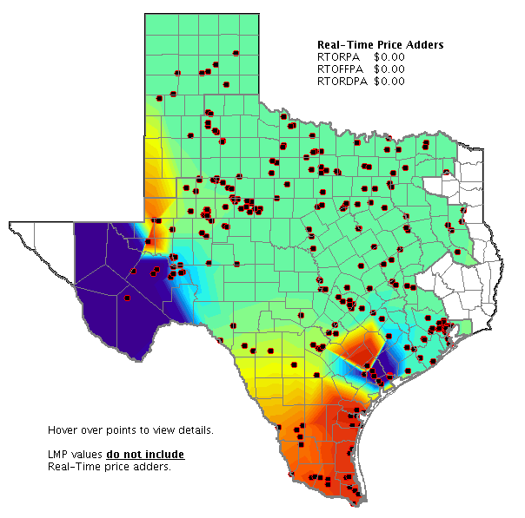
Questions?

