Slide 1
DG in Transmission Planning Studies
Jeff Billo
PLWG
February 20, 2019

Slide 2
DG in the ERCOT Load Forecast
Historical unregistered DG output (i.e. the vast majority is either rooftop solar or small wind) is naturally factored into the ERCOT Long-Term Load Forecast
Registered DG, or Settlement Only Distribution Generators (SODG), are not included in the ERCOT LTLF since they are metered separately

Slide 3
DG in the ERCOT Transmission Planning Studies
Registered DG (SODG) are not dispatchable by ERCOT
Contributions from Fossil DG are not well correlated to peak load, so are currently not included in transmission planning studies

Slide 4
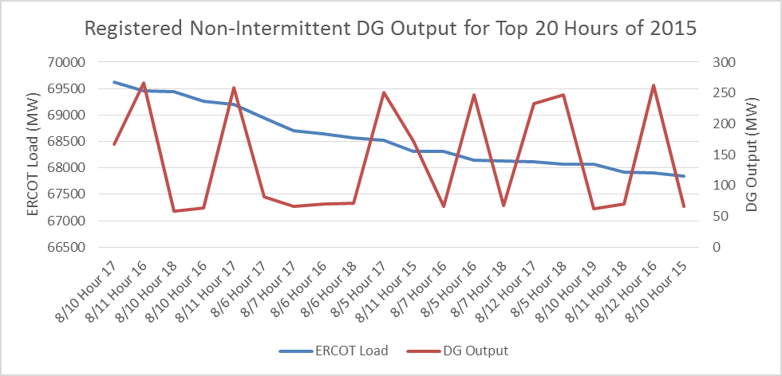
Registered Non- Intermittent DG vs. Peak Load
(primarily self-dispatched fossil-based units)

Slide 5
Future Changes?
Would NPRR917 implementation change planning study assumptions?
DG stability impacts need to be considered
Contributions from solar/wind SODG should be considered in transmission planning studies

Slide 6
Questions?

