Slide 1
Southern Cross Transmission - Directive 9 - Discuss Frequency Overshoot Study and RRS Impacts
Sandip Sharma
Manager Operations Planning
Feb. 13, 2019

Slide 2
Frequency Overshoot Study – Impact of SCT DC Tie trips when exporting
Sudden instantaneous trip of SCT DC Tie when exporting power could cause ERCOT grid frequency to overshoot. If the resulting frequency overshoot is too high, the high overshoot values could trigger other Generation Resources to trip on over-frequency protection.
Assumptions and Methodology
  All governors of on-line synchronous Generation Resources will be enabled to provide frequency response
  All on-line wind farms with PFR capability will be modeled to provide downward response to over frequency
  Trip SCT DC Tie while exporting 2,100 MW.
  The sensitivity study with load damping factor assumed to be 0% and 2% will be conducted for each case.
  Record frequency trend and identify any frequency overshoot that exceeds 60.6 Hz.
  In the cases where frequency overshoot exceeds 60.6 Hz, additional sensitivity studies will be conducted to identify an export limit on the SCT DC Tie such that frequency overshoot will not exceed 60.6 Hz.

Slide 3
Scenarios Used for Frequency Overshoot Study
Scenario Name | Inertia (GW·s) | Load (GW) | Wind (GW) | Synchronous Gen (GW)
Scenario 0 | 130 | 34 | 15.5 | 19
Scenario 1 | 130 | 34 | 10 | 24.5
Scenario 2 | 130 | 32 | 5 | 27.5
Scenario 3 | 130 | 32 | 3.5 | 29
Scenario 4 | 120 | 29.9 | 3.5 | 26.9
Scenario 5 | 110 | 27.2 | 3.5 | 24.2

Slide 4
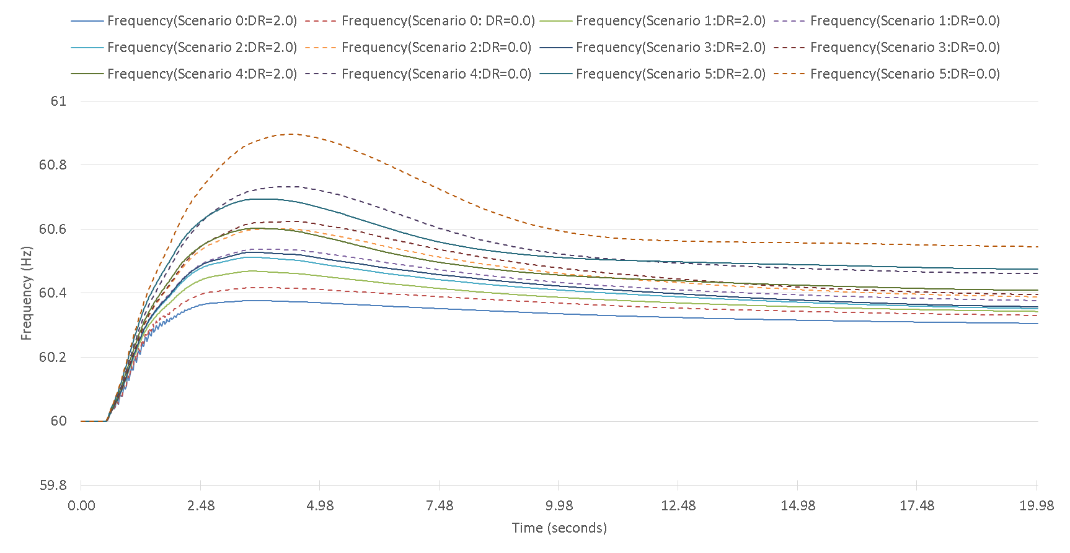
Frequency Response when Tripping SC DC Tie Export at 2,100 MW
 | Scenario 0 | Scenario 1 | Scenario 2 | Scenario 3 | Scenario 4 | Scenario 5
Highest Frequency Overshoot (Hz) DR=2.0 | 60.38 | 60.47 | 60.51 | 60.53 | 60.60 | 60.70
Highest Frequency Overshoot (Hz) DR=0.0 | 60.42 | 60.54 | 60.60 | 60.62 | 60.73 | 60.89

Slide 5
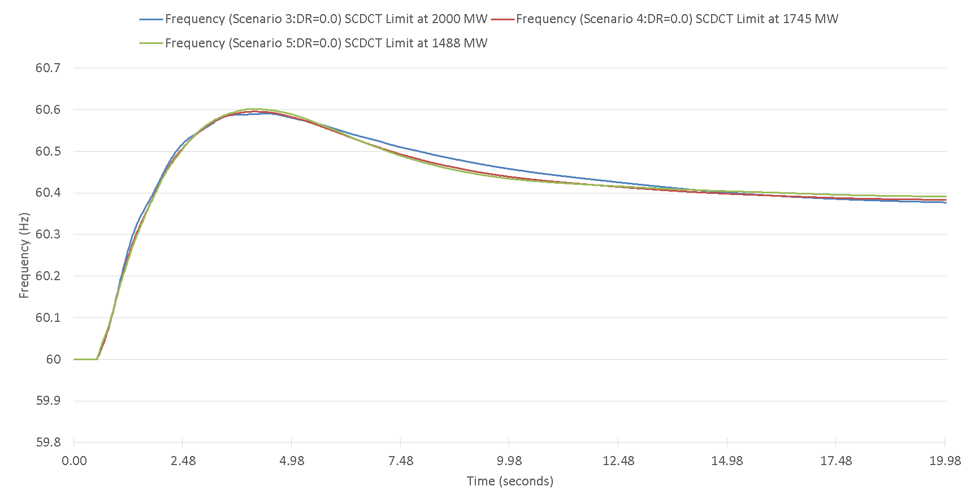
Limit Imposed on SC DC Tie Export
 | Scenario 3 (130 GW·s) | Scenario 4 (120 GW·s) | Scenario 5 (110 GW·s)
Limit on SC DC tie export | 2,000 MW | 1,745 MW | 1,488 MW

Slide 6
Responsive Reserve Service (RRS)
Per ERCOT’s current AS Methodology, minimum quantities of RRS are established based on historic (last two years) system inertia conditions and RRS studies (most recently conducted in 2017). RRS Studies are set up to determine at what amount of RRS a Generation Resource trip equal to ERCOT’s Resource Contingency Criteria (RCC) as established by BAL-003, Under Frequency Load Shed (UFLS) would not be triggered.
  Scenario 1 - SCT DC Tie import is limited to existing ERCOT Most Severe Single Contingency (MSSC) at 1,375 MW
  Scenario 2 - SCT DC Tie import is above existing ERCOT MSSC up to 2,000 MW

Slide 7
Scenario 2: RRS Case Study
Case No. | Time | INERTIA (GW·s) | PFR (MW) | LR (MW) |  | LR/PFR Ratio |  | PFR (No LR) (MW)
 |  |  |  | w/o SCDCT | w/ SCDCT | w/o SCDCT | w/ SCDCT | w/o SCDCT | w/ SCDCT
*Case1 | 10-Feb-17 01:00:00 | 130 | 1150 | 1900 | 2650 | 2.39 | 2.94 | 5691 | 8941
Case2 | 31-Mar-14 02:00:00 | 140 | 1150 | 1800 | 3250 | 2.17 | 3.29 | 5056 | 11843
Case3 | 21-Mar-14 02:00:00 | 150 | 1150 | 1750 | 2900 | 1.85 | 2.59 | 4388 | 8661
Case4 | 23-Oct-16 00:00:00 | 160 | 1150 | 1700 | 2550 | 1.85 | 2.43 | 4295 | 7347
Case5 | 28-Oct-13 00:00:00 | 180 | 1150 | 1650 | 2375 | 1.71 | 1.98 | 3972 | 5853
Case6 | 24-Nov-16 15:00:00 | 200 | 1150 | 1450 | 2100 | 1.43 | 1.53 | 3224 | 4363
Case7 | 02-Apr-14 10:00:00 | 220 | 1150 | 1500 | 2150 | 1.55 | 1.68 | 3475 | 4762
Case8 | 05-Oct-13 18:00:00 | 260 | 1150 | 1450 | 2150 | 1.10 | 1.17 | 2745 | 3666
Case9 | 28-May-14 18:00:00 | 290 | 1150 | 1300 | 1950 | 1.00 | 1.06 | 2450 | 3217
Case10 | 03-Sep-13 18:00:00 | 359 | 1150 | 1150 | 1800 | 1.00 | 1.12 | 2300 | 3166
Case11 | 07-Aug-13 17:00:00 | 376 | 1150 | 1050 | 1700 | 1.00 | 0.95 | 2085 | 2765
*Case 1 : With RCC increased to 3,375 MW, ERCOT’s critical inertia goes up to around 130 GW*s. As a result, current RRS mix is insufficient to arrest system frequency above 59.4 Hz. Therefore, for the case with 130 GW*s inertia, LRs’ response time are shortened to 15 cycles to improve frequency nadir.

Slide 8
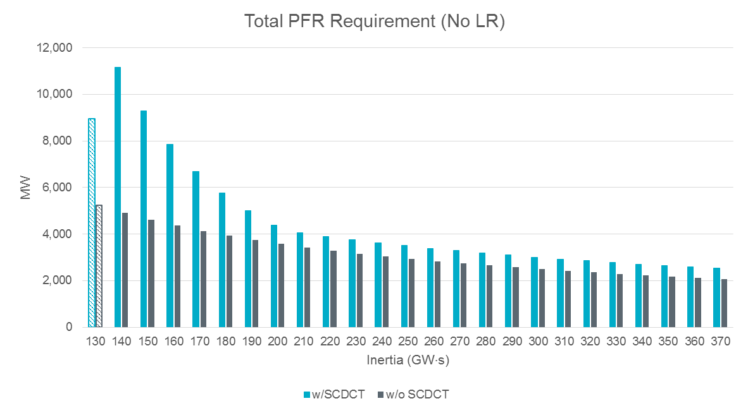
Interpolated PFR (No LR) Quantities
*Note: With RCC increased to 3,375 MW, ERCOT’s critical inertia becomes 130 GW·s. As a result, current RRS mix is insufficient to arrest system frequency above 59.4 Hz. Therefore, for the case with 130 GW·s inertia, LRs’ response time are shortened to 15 cycles to improve frequency nadir. PFR quantity related to 130 GW·s is not included for interpolation.

Slide 9
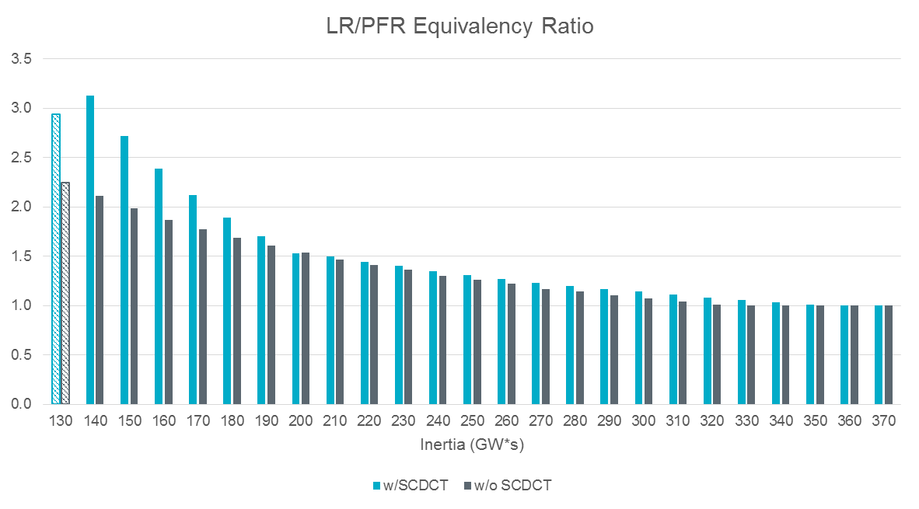
Interpolated LR/PFR Equivalency Ratio
*Note: With RCC increased to 3,375 MW, ERCOT’s critical inertia becomes 130 GW·s. As a result, current RRS mix is insufficient to arrest system frequency above 59.4 Hz. Therefore, for the case with 130 GW·s inertia, LRs’ response time are shortened to 15 cycles to improve frequency nadir. PFR quantity related to 130 GW·s is not included for interpolation.

Slide 10
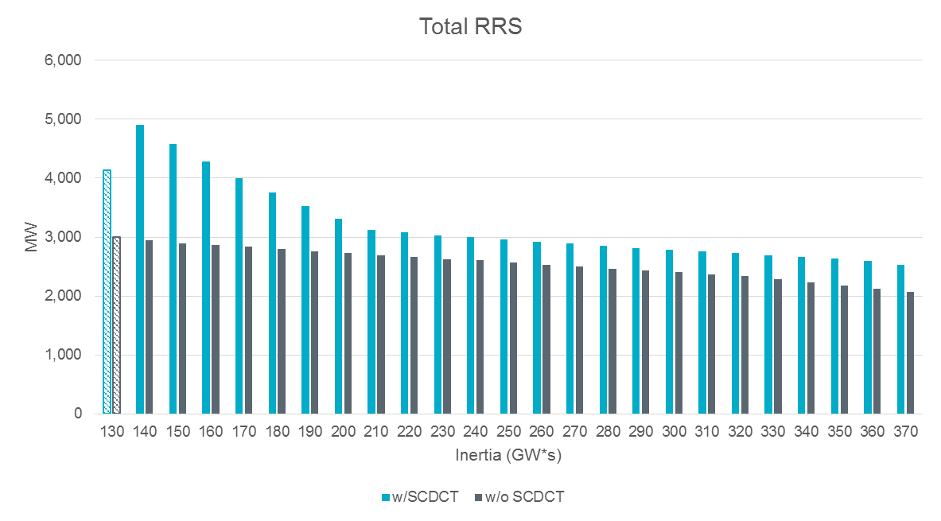
Interpolated RRS Quantities
*Note: With RCC increased to 3,375 MW, ERCOT’s critical inertia becomes 130 GW·s. As a result, current RRS mix is insufficient to arrest system frequency above 59.4 Hz. Therefore, for the case with 130 GW·s inertia, LRs’ response time are shortened to 15 cycles to improve frequency nadir. PFR quantity related to 130 GW·s is not included for interpolation.

Slide 11
RRS Quantity Increase
2019 Total RRS (w/o SCDCT) | 2019 Total RRS (w/ SCDCT) | Delta
23,716,368 MWh | 28,986,904 MWh | 5,270,536 MWh

Slide 12
Recommendations
RRS Impact
    With the addition of SCT DC Tie and non-restricted import limit of 2,000 MW, per BAL-003¹ Standard, ERCOT’s Resource Contingency Criteria (RCC) would increase from current 2750 MW to 3375 MW. ERCOT studies show additional RRS is needed to protect against larger RCC. Using the 2019 expected system inertia, ERCOT studies show additional 5,270,536 MWh of RRS is required for 2019.
    Additionally, if SC DC Tie were subject to an import limit that does not exceed current MSSC, then ERCOT RCC would not change and therefore no additional RRS is needed.
Frequency Overshoot
    ERCOT has identified a need for new Ancillary Service that would help prevent frequency overshoot during certain low inertia hours if SCT DC Tie is allowed to export without any export limit restriction.
    If SCT DC Tie export is limited to 1,488 MW, no additional Ancillary Service would be needed.
    Additionally, if SC DC Tie were subject to an export limit during those certain hours, than ERCOT studies do not reflect a need for new Ancillary Services.
1 -- Please note that NERC BAL-003 Standard is currently under review. These recommendations may need to be revisited if the RCC changes.

Slide 13
Questions?

