Slide 1
ERCOT Frequency Control Report
January 2019
ERCOT
Operations Planning
PDCWG | February 13th, 2019

Slide 2
Summary of January 2019
CPS1: 174.27%
Current CPS1 12-Month Rolling Average: 175.29%
3 BAAL Exceedance
2 hourly CPS1 scores below 100%
BAAL-003 Events have updated through 2018
2018 BAAL-003 FRM Performance: -895.19
2019 RMS1 Statistics
Mean: 15.16 mHz
Min: 12.92 mHz
Max: 18.95 mHz
Energy Statistics
Total Energy: 29,800,010 MWh
Wind Energy: 6,434,375 MWh
Percent Energy from Wind Generation: 21.59%
Minimum System Inertia
Mean: 195,476
Max: 273,060 on January 3rd
Min: 146,802 on January 18th
Notes:
Mean: 195,476
Max: 273,060 on January 3rd
Min: 146,802 on January 18th

Slide 3
Frequency Control
CPS1, BAAL, & RMS1

Slide 4
Hourly CPS1 by Day
January-19 CPS1 (%): 174.27
Notes:
Outliers:
1/18/19 00:00 90.8%
Large Expected Generation Deviation and Regulation Up Exhausted from 00:02 – 00:22
1/22/19 7:00 94.9%
Low starting frequency, DC Tie Schedule Change, Load Ramping, and Units in Startup, Regulation Exhausted

Slide 5
BAAL Exceedances & Violations
There were 3 BAAL exceedances
January 22, 2019
Unit Trip at 7:05:06
Loss of 657 MW
Less than 59.91 Hz for 3 minutes
Notes:
Low starting frequency, DC Tie Schedule Change, Load Ramping, and Units in Startup

Slide 6
15-Minute Average CPS1%
January-19 CPS1 (%): 174.27

Slide 7
12-Month Rolling Average CPS1
Current 12-Month Rolling Average: 175.29%

Slide 8
Daily RMS1 of ERCOT Frequency by Year
Notes:
Mean is 15.16 mHz

Slide 9
Daily RMS1 of ERCOT Frequency by Month

Slide 10
Daily RMS1 of ERCOT Frequency by Month
Notes:
Mean: 15.16 mHz
Min: 12.92 mHz
Max: 18.95 mHz

Slide 11
Frequency Profile Comparison

Slide 12
Frequency Profile Comparison

Slide 13
Frequency Profile Comparison

Slide 14
Time Error Correction

Slide 15
ERCOT Daily Time Error

Slide 16
Time Error Corrections Log Summary
There have been no time error corrections since December 2016

Slide 17
BAL-003 Performance

Slide 18
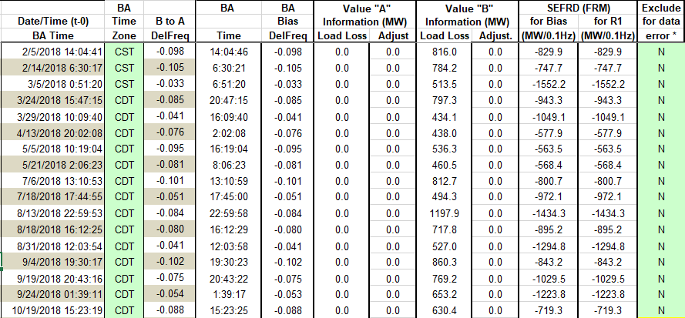
Op. Year 2018 BAL-003 Selected Events

Slide 19
Op. Year 2018 BAL-003 FRM Performance

Slide 20
ERCOT Energy Statistics

Slide 21
Total Energy
Notes:
29,8000,010 MWh

Slide 22
Total Energy from Wind Generation
Notes:
6,434,264 MWh

Slide 23
% Energy from Wind Generation
Notes:
21.59%

Slide 24
ERCOT System Inertia

Slide 25
Daily Minimum System Inertia
Notes:
Minimum Inertia = 128,759 MW*s on 11/3/2018. Need details here.
Previous Minimum was 130,014 MW*s on 10/27/2017. This was also our record wind day.
Data:
Mean: 195,476
Max: 273,060 on January 3rd
Min: 146,802 on January 18th

Slide 26
Questions?
Thank you!

Slide 27
Op. Year 2017 BAL-003 Selected Events
Notes:
Frequency Bias updated from 764 to 759 in April

Slide 28
Op. Year 2017 BAL-003 FRM Performance

