Slide 1
Resource Definition Task Force
Load Resources Review
Feb 2019

Slide 2
Agenda
Brief review of Resource Definition Task force (RTF) work on Generation Resources
Update on Load Resource Definitions
Existing Framework
NPRR863 Framework
Resource Options requested by Stakeholders.
Other responsive loads (small l, small r)
Proposed Load Resource Framework

Slide 3
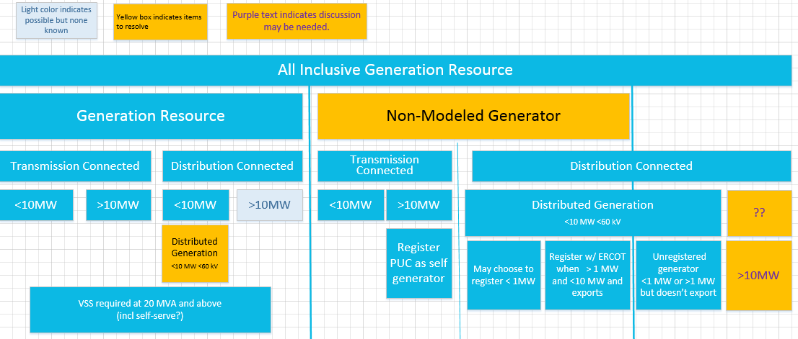
Original Generation Resource Definition Framework

Slide 4
Proposed Generation Category Nomenclature – using existing requirements
Transmission Generation Resource (TGR) Transmission-connected Registered with ERCOT as GR Participates in the market SCED A/S Modeled in ERCOT systems Telemetry, etc. Settled Nodally I |  | Settlement Only Transmission Generator (SOTG) Transmission-connected less than 10 MW Registered with ERCOT as SOG Settled for exported energy only Intermittent sources will typically export based on fuel availability. Self-dispatched may choose to export based on prices Modeled in ERCOT systems Reliability systems only Not scheduled/dispatchable Settled - Load Zone II | Settlement Only Transmission Self-Generator (TSG) Transmission-connected Registered with PUC as a Self-Generator and registered with ERCOT as SOG May occasionally export, but does not generate with the intent to sell at wholesale If it exports, then settled for exported energy only Continuous exports will be re-evaluated for TGR Modeled in ERCOT systems Reliability systems only Not scheduled/dispatchable Settled - Load Zone III
Distribution Generation Resource (DGR) Distribution connected Registered with ERCOT as GR >10 MW require to register as GR Participates in the market SCED A/S Pseudo-Modeled in ERCOT systems Future--Modeling light? Telemetry, etc. Settled Nodally IV |  | Settlement Only Distribution Generator (SODG) Distribution connected but less than 10 MW Registered with ERCOT as SOG Settled for exported energy only Intermittent sources will typically export based on fuel availability. Self-dispatched may choose to export based on prices Mapped in ERCOT systems Not scheduled/dispatchable Telemetry not required Settled - Load Zone V | Unregistered Distribution Self-Generator (UDSG) Distributed generation greater than 1 MW co-located with larger load, but smaller than minimum facility load. Registered with PUC as a Self-Generator but not registered with ERCOT May not export—otherwise must register with ERCOT as SODG. Neither Mapped nor modeled in ERCOT systems (future mapping?) No ERCOT settlement policy since no exports. VI | Unregistered Distributed Microgenerator* (UDMG) Distribution connected less than 1 MW No requirement for registration Reported by DSP per PUCT 25.211(n) (competitive choice) Reported by NOIEs per ERCOT protocol 10.2.2.1.b(ii) for 50kW -1 MW Not reported by NOIEs for <50kW Neither Mapped nor modeled in ERCOT systems (future mapping of accumulations?) ERCOT settles as negative load in competitive choice areas once meter configuration updated to DG No ERCOT settlement policy for NOIE areas. VII
 | **Settlement Only means that the generator may not participate in Ancillary Services Market, RUC, SCED, or make Energy OffersNote: Transmission connected resources are required to be modeled in ERCOT NMMS systems. Studies are determined based on requirements for size and resource category type. *Microgenerator definition may need resolution with PUC

Slide 5
Proposed Generation Resource Definition Framework
NPRR889 RTF-1
NPRR921 RTF-2

Slide 6
Current Protocol Load Resource Framework
Load Resources
Non-Controllable Load Resources*
Controllable Load Resources
UFR @ 59.7 Hz Required
Single Site
Aggregate Load Resource (ALR)
Distribution Connected Loads Only
* Also referred to in the Protocols as Load Resource controlled by high-set under-frequency relay, Load Resource other than Controllable Load, and other variations
Each site < 10 MWs of Demand Response Capability and all sites located in same Load Zone

Slide 7
Current Markets For Load Resources
Controllable Load Resource providing FRRS
Regulation
Controllable Load Resource w/ Gov Resp & LFC base points)
Controllable Load Resource w/ Gov Resp & LFC (SCED Dispatched)
Responsive Reserve Service
Non-Controllable Load Resource (UFR-30 cycle)
Non-Spin
Controllable Load Resource (SCED Dispatched)
Aggregate Load Resource (SCED Dispatched)
Real-Time Energy Market
SCED Qualified Controllable Load Resource

Slide 8
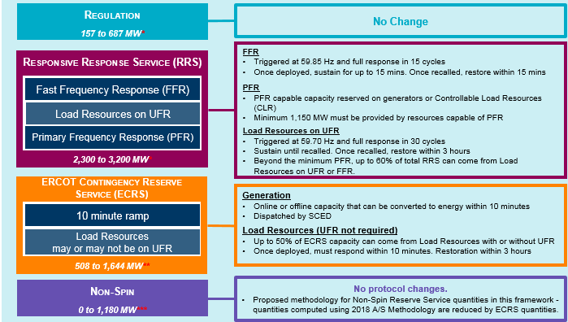
NPRR 863 Framework
Controllable Load Resource providing FRRS
Controllable Load Resource w/ Gov Resp & LFC base points
UFR Load Resource (15 cycle)
Auto Dispatch Controllable Load Resource (15 cycle)
Controllable Load Resource w/ Gov Resp & LFC basepoints
UFR Load Resource (30 cycle)
Auto Dispatch Controllable Load Resource (30 cycle)
Controllable Load Resource (SCED Dispatched)
Basic Load Resource
UFR Load Resource (30 cycle)
Controllable Load Resource (SCED Dispatched)
Real-Time Energy Market
Aggregate Load Resource (SCED Dispatched)
SCED Qualified Controllable Load Resource
Existing Load Resource Type
New Load Resource Type

Slide 9
Similarities between Qualification
List of Load Resource Types by Qualification Badge
Controllable Load Resource w/ Gov. Resp. & LFC basepoints
UFR Load Resource (15 cycle)
Auto Dispatch Controllable Load Resource (15 cycle)
UFR Load Resource (30 cycle)
Auto Dispatch Controllable Load Resource (30 cycle)
Controllable Load (SCED Dispatched)
Basic Load Resource
Aggregate Load Resource (SCED Dispatched)
SCED Qualified Controllable Load Resource
Grouped by similar qualification Badge
Controllable Load Resource w/ Gov. Resp. & LFC basepoints
Controllable Load Resource (SCED Dispatched)
Aggregate Load Resource (SCED Dispatched)
SCED Qualified Controllable Load Resource
UFR Load Resource (15 cycle)
Auto Dispatch Controllable Load Resource (15 cycle)
UFR Load Resource (30 cycle)
Auto Dispatch Controllable Load Resource (30 cycle)
Basic Load Resource
Controllable Loads
UFR Controlled w/ Manual Deployment
Manual Deployment only

Slide 10
Framework - Minimal Changes
Load Resource
Basic Load Resource
UFR Load Resource
Controllable Load Resource
Fast Response Regulation Service
ECRS
Responsive Reserve Service
FFR
UFR
Regulation Service
Fast Frequency Response Responsive Reserve Service
ECRS
Primary Frequency Response
ECRS
Non Spin (SCED Qualified)
Real-Time Energy Market (SCED qualified)
Register as a Basic Load Resource and deployed through Verbal Dispatch Only to provide ECRS,
Register as a UFR Load Resource with either a 15 cycle (FFR) or 30 cycle(UFR) response time and may qualify to provide ECRS or Responsive Reserve Service.
Register as a Controllable Load Resource to qualify to provide one or more of the following: FRRS, Regulation Service, Fast Frequency Response, Primary Frequency Response, ECRS, Non-Spin, and Real-Time Energy Market. May be an aggregation for providing Non-Spin only.

Slide 11
Framework Option 1- Modified Merit Badge
Load Resources
Basic Load Resource
UFR Load Resource
SCED LR
Frequency Responsive LR
Reserve LR
Responsive Reserve Service
FFR
UFR
Fast Response Regulation Service
ECRS
ECRS
RT Energy Market
Regulation Service
Non-Spin
ECRS
Fast Frequency Response Regulation Service
Primary Frequency Responsive

Slide 12
Framework Option 2 - Full Merit Badge
Load Resources
Basic Load Resource
UFR Load Resources
SCED LR
Fast Response LR
Balancing Controllable LR
10 Minute Reserve Controllable LR
30 Minute Reserve Controllable LR
Responsive Reserve Service
Regulation
ECRS
RT Energy Market
Fast Response Regulation Service
Fast Frequency Response Regulation Service
ECRS
Non-Spin
ECRS
PFR

Slide 13
Other Responsive loads - *not* Load Resources
*Remotely controlled thermostats, etc, etc.

Slide 14
Proposed Load Resource Framework
*attribute

Slide 15
Combined Proposed Resources Framework

