Slide 1
Supply Analysis Working Group Meeting
NPRR891: NOIE DG Capacity Charts
February 8, 2019

Slide 2
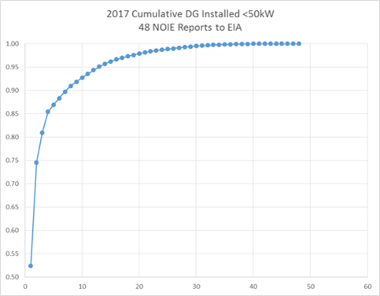
Coverage of <50 kW NOIE Capacity
87% of the <50kW DG would be 5 NOIEs
90% of the <50kW DG would be 7 NOIEs reporting quarterly.
95% of the <50kW DG would be 13 NOIEs reporting quarterly.
Percent
NOIE Count

Slide 3
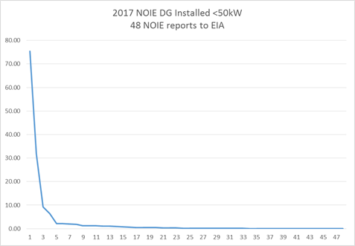
Coverage of <50 kW NOIE Capacity
Coverage of <50 kW NOIE Capacity
Capacity MW
Ideal threshold is 1.0 MW (covers 13 NOIEs)
NOIE Count

