Slide 1
Winter Wind Capacity Contributions with Proposed Changes
Connor Anderson
Resource Adequacy
02/08/2019

Slide 2
Effects of Changes on Winter 2018/2019 (May 2018 CDR)
1,460 MW of planned wind
 | Original CDR | Modified CDR | Modified CDR with Capacity-Weighted Contributions
Coastal Contribution | 43% | 43% | 46%
Panhandle Contribution | N/A | 30% | 28%
South Non-Coastal Contribution | N/A | 31% | 39%
Other Contribution | N/A | 17% | 17%
Non-Coastal Contribution | 20% | N/A | N/A
Change in Planned Wind Contribution | N/A | -20 MW | -22 MW

Slide 3
Effects of Changes on Winter 2019/2020 (Dec 2018 CDR)
7,704 MW of planned wind
 | Original CDR | Modified CDR | Modified CDR with Capacity-Weighted Contributions
Coastal Contribution | 43% | 43% | 46%
Panhandle Contribution | N/A | 30% | 28%
South Non-Coastal Contribution | N/A | 31% | 39%
Other Contribution | N/A | 17% | 17%
Non-Coastal Contribution | 20% | N/A | N/A
Change in Planned Wind Contribution | N/A | +158 MW | +212 MW

Slide 4
Preliminary Wind Correlation Analysis
Connor Anderson
Resource Adequacy
02/08/2019

Slide 5
Approach
Used 2018 hourly average HSL for all wind farms that were commercially operational for the full year (184 units)
Calculated Spearman’s rank correlation coefficients between all units
Chose four “representative units” to create correlation maps
Coastal: TGW_T1
Panhandle: BRISCOE_WIND
South Non-Coastal: LV4_UNIT_1
Other: BUFF_GAP_UNIT1

Slide 6
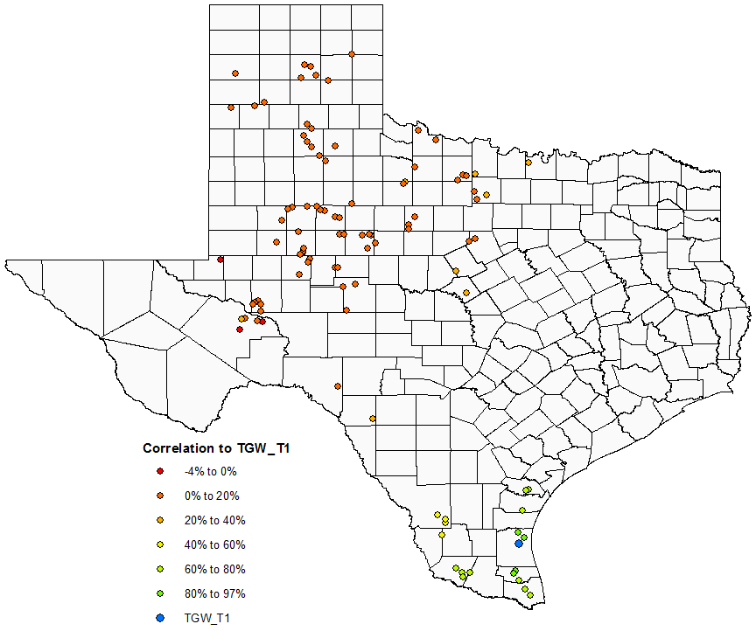
Correlation to TGW_T1 (Coastal)

Slide 7
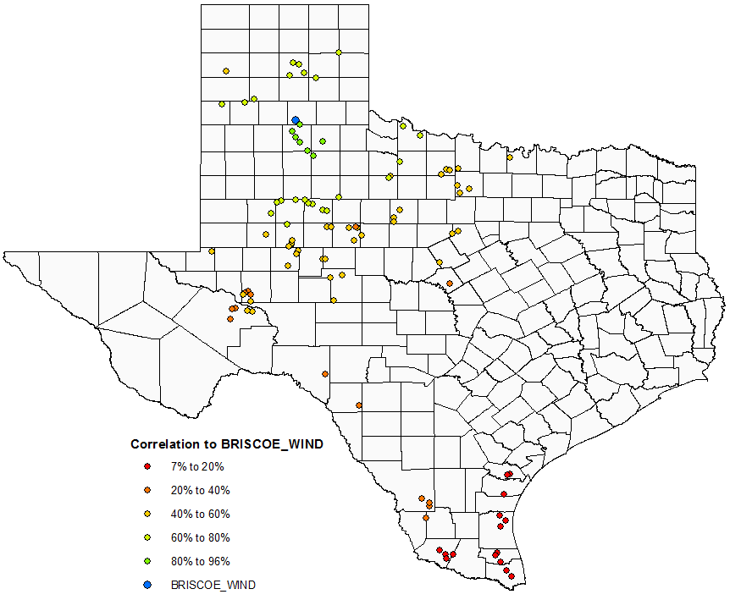
Correlation to BRISCOE_WIND (Panhandle)

Slide 8
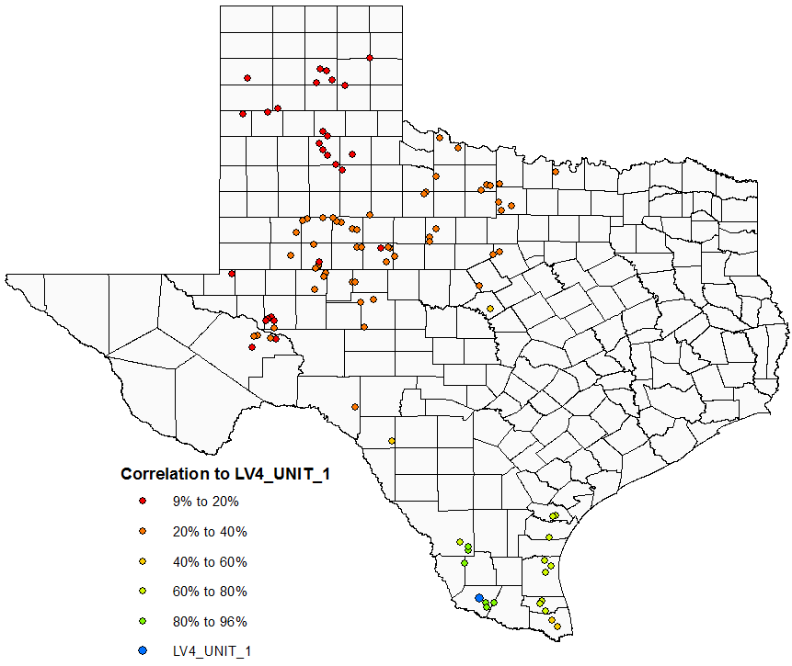
Correlation to LV4_UNIT_1 (South Non-Coastal)

Slide 9
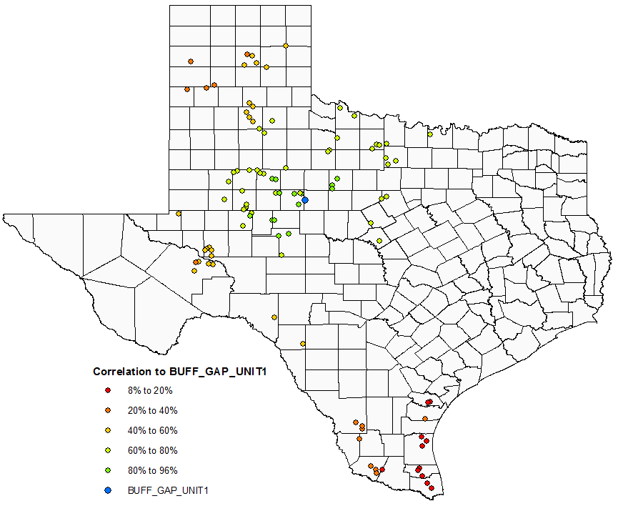
Correlation to BUFF_GAP_UNIT1 (Other)

Slide 10
Observations
Overall, most units fit well with one of the four proposed wind regions
This analysis is limited to operational units, so it can’t give exact county-level region definitions

