Slide 1
ERCOT WAN Refresh Project (Stage 2)
WAN Migration to VOIP (ROS)
Mike Stewart
Manager, Telecom Administration
Feb 5, 2019

Slide 2
Purpose of Discussion
To provide the ERCOT Market with advanced notice of a Wide Area Network (WAN) technology upgrade that will impact Participant billing and Control Room voice communication.

Slide 3
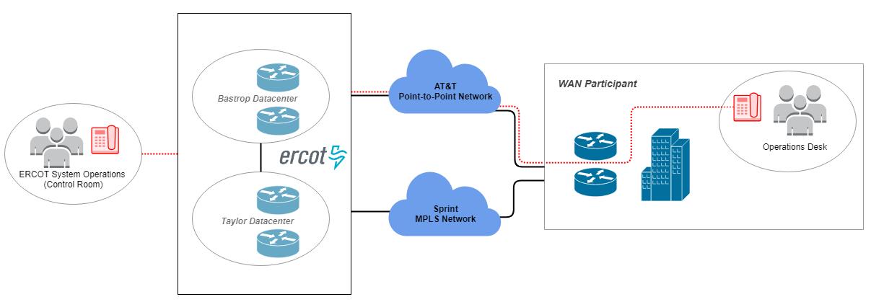
WAN Overview Current State

Slide 4
Project Overview
Objectives
Modernize the ERCOT WAN
Replace AT&T Point-to-Point Network
AT&T is sunsetting the Point-to-Point network
Avoid exorbitant fees/rate-hike associated with legacy technology
Migrate Voice Communication to Voice Over IP (VOIP)
Meet carrier compatibility requirements
Meet ERCOT Market demand for relevant technology
Implement voice high-availability

Slide 5
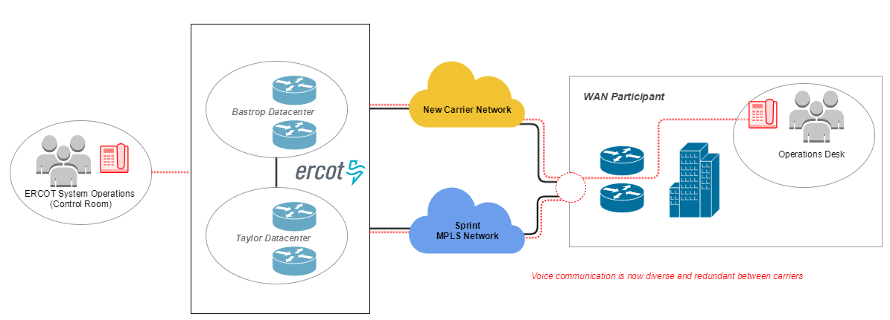
WAN Overview Future State

Slide 6
Impact to the Market
NOGRR required
Market Notices will be distributed as we progress
Costs not determined yet; however, we generally expect an improvement
There will be some overlap between old and new carrier billing, which may result in double-billing until migration completes
Market Participants will need to work with our carrier(s) to:
Define circuit access
Extend network demarcation
Schedule installation
ERCOT will work with Market Participants to:
Schedule and conduct VOIP testing & migration

Slide 7
Other
Technology Workshop to be scheduled
ERCOT will work with select participants to test VOIP options
Participants ARE NOT required to upgrade their internal systems
Compatible options will be provided
The current Sprint MPLS network will not be impacted
Contact Mike Stewart (mike.stewart@ercot.com) regarding questions/concerns

