Slide 1
Market Credit Working Group update to the Wholesale Market Subcommittee
Bill Barnes NRG, Chair
Josephine Wan Austin Energy, Vice Chair
02/06/2019

Slide 2
MCWG update to WMS
General Update
January 23rd Joint MCWG/CWG Meeting
6 NPRRS reviewed for their credit impacts
909NPRR Address Unavailability Gap for ERS and Other Minor Clarifications
910NPRR Clarify Treatment of RUC Resource that has a Day-Ahead Market Three-Part Supply Award
911NPRR Improved Calculation of Real-Time LMPs at Logical Resource Nodes for On-Line Combined Cycle Generation Resources
914NPRR Addition of Controllable Load Resources to 60-Day Reports
915NPRR Define Limited Duration Resource and Clarify Telemetered Resource Status Requirements
916NPRR Mitigated Offer Floor Revisions
All operational without any credit impact

Slide 3
MCWG update to WMS
2019 CWG/MCWG Officers
Ms. Spells thanked the group and the officers for their work in 2019 and informed the group that the following were re-elected as officers:
Donald Meek – CWG Chair
Loretto Martin – CWG Vice Chair
Bill Barnes – MCWG Chair
Josephine Wan – MCWG Vice Chair
ERCOT staff will submit to F&A and WMS committees for confirmation.
Review CWG Charter (vote)
Donald Meek submitted a motion to endorse the charter to remain the same for another year without change. Motion passed.
Note: The CWG Charter needs to be approved by F&A at February meeting

Slide 4
MCWG update to WMS
2019 Credit Working Group Goals
Review the ongoing impact on market participant credit exposure and collateral requirements resulting from the incorporation of a forward price curve-based methodology
Clarify the market’s risk tolerance/appetite level and provide regular updates on credit exposure to the ERCOT Board
Evaluate and quantify potential market risk under current credit rules and examine a framework for reviewing rules in flight
Effectively communicate credit risk to the market
Examine current protocol language to determine how effective current calculations capture actual credit risk
Donald Meek made a motion to endorse the above 5 new goals. Motion passed
Note: F&A will review the CWG Goals at their February meeting

Slide 5
MCWG update to WMS
Market Entry Qualifications
There was a lot of discussion within the group. Discussion topic such as:
Following the GreenHat Energy LLC default in the PJM market, many prompted discussion on further credit diligence on Market Participant (MP) background check
Discussion over whether ERCOT should have more discretion to suspend/liquidate or do MP’s have to make additional representations?
Protocols say if there’s an instance of default ERCOT can hold a one-time auction of MP’s CRR’s
Additional background checks are currently only performed by PJM and ISO-NE, ERCOT will enquire of these two ISOs how they perform these checks and identify this to the PUCT as a possible issue of concern.
ERCOT Legal handles the registration process
Only 1-2 additional non-reps each month; not believed to need to add staff
What is the level of discretion ERCOT (and PJM/other ISO’s) would have to deny someone entrance into Market?
Looking into company officers’ criminal backgrounds
Going to do additional research into what the other ISO’s are doing
Will discuss further on actual restrictions, appeals, further applications, coordination with other PUC’s

Slide 6
MCWG update to WMS
ERCOT Credit Exposure Updates
Ms. Papules at ERCOT presented an update of ERCOT credit exposure statistics for the months of November and December 2018.
December 2018 compared to November 2018
Market-wide average TPE decreased from $ 390.9 million to $338.6 million.
TPE decreased by $18.5 million for “Load and Gen” category.
TPE decreased by $ 33.4 million for “Trader” category.
Average Excess collateral increased from $ 2,004.3 million to $2,123.2 million.
increased by $85.0 million for “Load and Gen” category
increased by $28.2 million for “Load Only” category.
increased by $4.8 million for “Trader” category.
Number of active Counter-Parties remained flat.

Slide 7
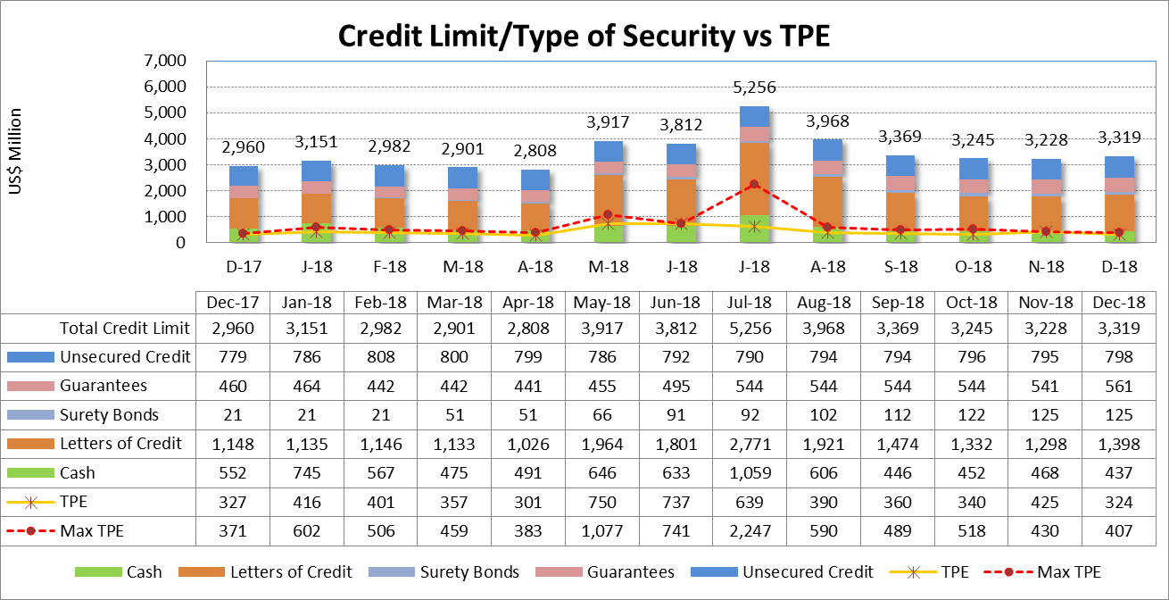
MCWG update to WMS
July 18 and August 18 RFAR and DFAF were high.

Slide 8
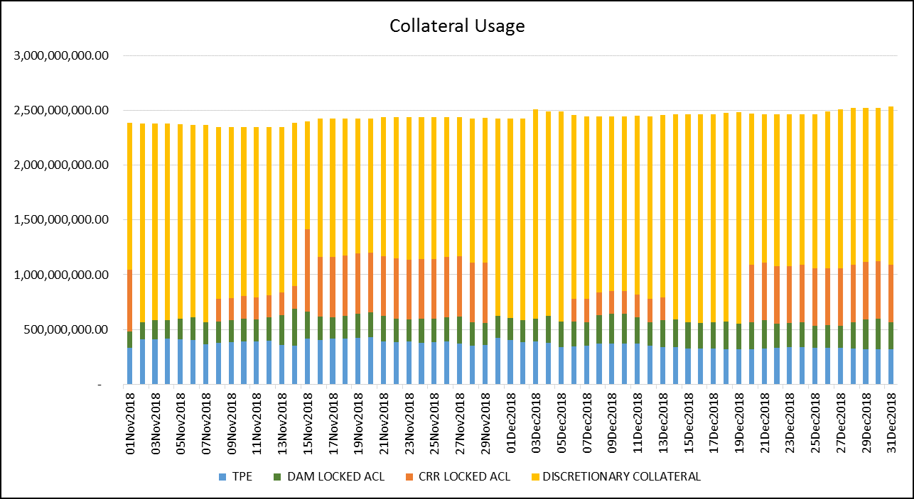
MCWG update to WMS
Discretionary collateral -only include letter of credit, surety bond, guarantee and NO unsecured credit

Slide 9
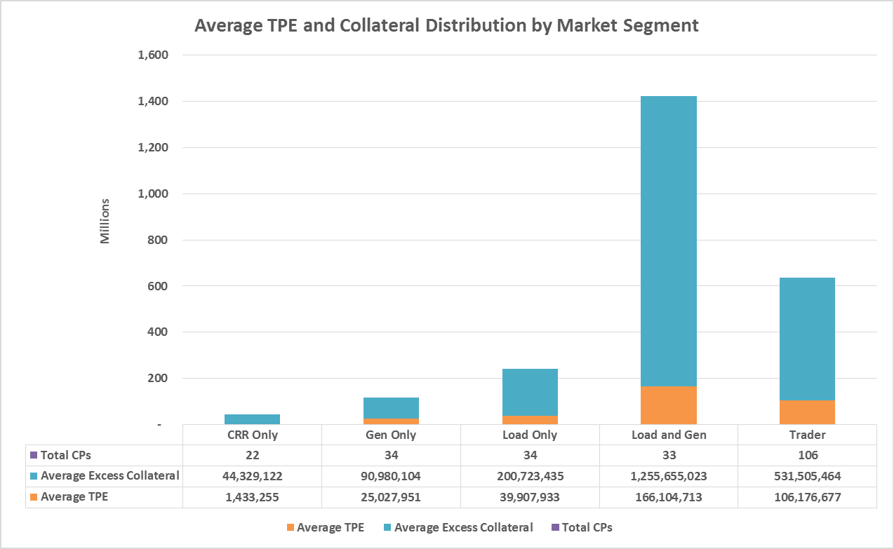
MCWG update to WMS

Slide 10
MCWG update to WMS
ERCOT Credit Exposure Updates –Cont.
There was a lot of discussion in regards to the excess collateral, few items as follows:
TPE is down; excess collateral is increased
Attributed to decreased generation
Concerns about ~300MM exposure and ~2.2BN in collateral
This is an unexplained observation as to why do market participants continually over-collateralize which requires further analysis
Will have a discussion with F&A on the details; they have expressed concern
Average of $1.0BN of discretionary appears over time
ERCOT will be revising some of their collateral slides to hopefully better show what types of collateral are posted by various market participants and which market participants tend to over collateralize (is it only a few or many, is over collateralization concentrated in certain market segments, etc.).
Some Market Participant are leaving large amounts of collateral deliberately and that’s okay

