Slide 1
MSWG Update to WMS 2/9/2019

Slide 2
MSWG Meeting 1/22/2019
Approval of Nominations Chair and Vice Chair (Vote)
Chair – Heather Boisseau (LCRA)
Vice Chair – Shuye Teng (Austin Energy)

Slide 3
MSWG Meeting 1/22/2019
Review of Settlement Stability Report
No Price Changes
100% of Disputes filed were resolved timely.
See Appendix A
Next Steps on Market Restart
NPRR 850 - are there improvements that need to be addressed in Follow Up
Initial NPRR is ok but Questions arose around settlements that may be better defined in another NPRR
½ Day Start – Beginning/end (timeline for settlement Data)
>30 Day outage
Look at example around Settlement restart – possible simulation to MSWG

Slide 4
MSWG Meeting 1/22/2019
NPRR917 Nodal Pricing for SODG and SOTG
MSWG had some minor language comments but would like for WMS to Remand back to them to discuss after CMWG/WMWG to review Settlement Calculations prior to WMS approval.
MSWG approach
MSWG would like to focus on looking at all NPRR’s that are added and review at meetings so that they can identify any with settlement impacts for possible securing a formal request for WMS to assign to the group.

Slide 5
MSWG Meeting 1/22/2019
Nodal Handbook vs Settlement Matrix
Nodal Handbook
Difficult to update and duplicated data from Matrix
MSWG would like to discontinue the Nodal Handbook and educate market on Matrix ( Possible Vote)
Charter/Scope (Vote)
The Market Settlement Working Group (MSWG) reporting to Wholesale Market Subcommittee (WMS) is responsible for reviewing Settlement issues, wholesale communication processes and data flow through reports and extracts. MSWG will focus on the accuracy of Settlements and efficiency of data flow to ensure that all market participants receive timely Settlement information. MSWG will analyze and work with ERCOT to interpret Market Participant Settlement results and anomalies. MSWG will maintain the Nodal Settlements Handbook, capturing changes in market rules that impact Settlements. MSWG will focus on any ERCOT system changes that would impact middle and back office systems and engage ERCOT in dialogue to understand such changes in content and design.

Slide 6
Questions?
Next Meeting 2/26/2019

Slide 7
8.2(2)(c)(i) Track number of price changes
Appendix A
Reporting Period: 2018 Q4
Operating Day | # of Corrected Settlement Point Prices |  |  |  | # of Intervals Affected
 | DASPP | RTSPP | RTRMPR | ORDC Adders | DASPP | RTSPP | RTRMPR | ORDC Adders
- | - | - | - | - | - | - | - | -
Notes:
There were no price changes in Q4 2018.
The price changes reported on this slide display the price corrections that have been done after the Settlement Statement has posted for the Operating Day.

Slide 8
8.2(2)(c)(ii) Track number and types of disputes submitted 8.2(2)(c)(iii) Compliance with timeliness of response to disputes
Submitted but not resolved disputes may be:
Not started
Open
Rejected
Withdrawn

Slide 9
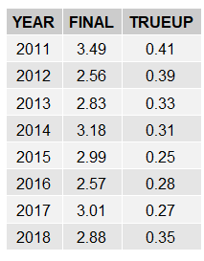
8.2(2)(c)(iv) Other Settlement Metrics
NOTE: ERS Final settlement OD data is not represented in graph.
Average percent change

Slide 10
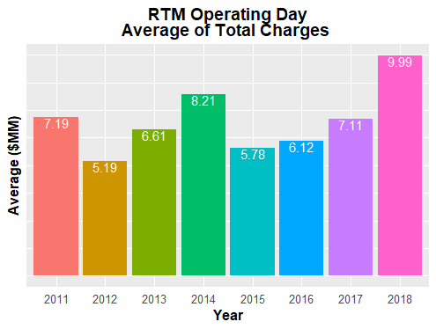
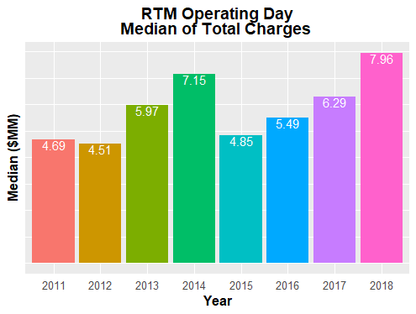
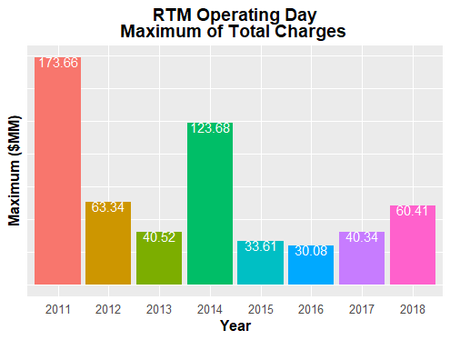
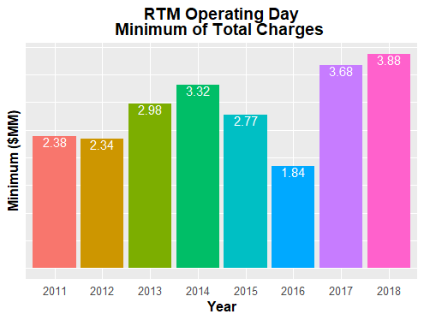
8.2(2)(c)(iv) Other Settlement Metrics

Slide 11
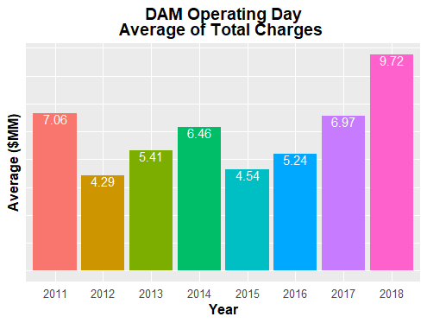
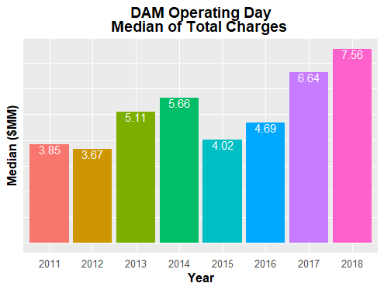
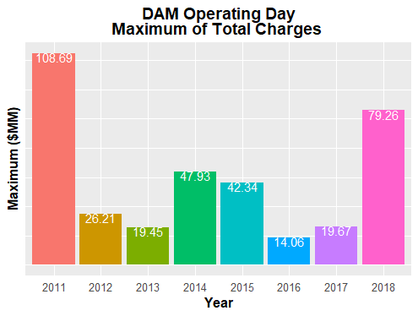
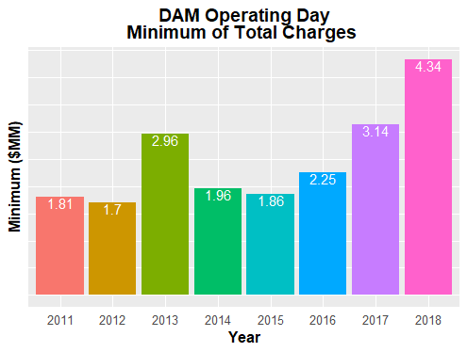
8.2(2)(c)(iv) Other Settlement Metrics

Slide 12
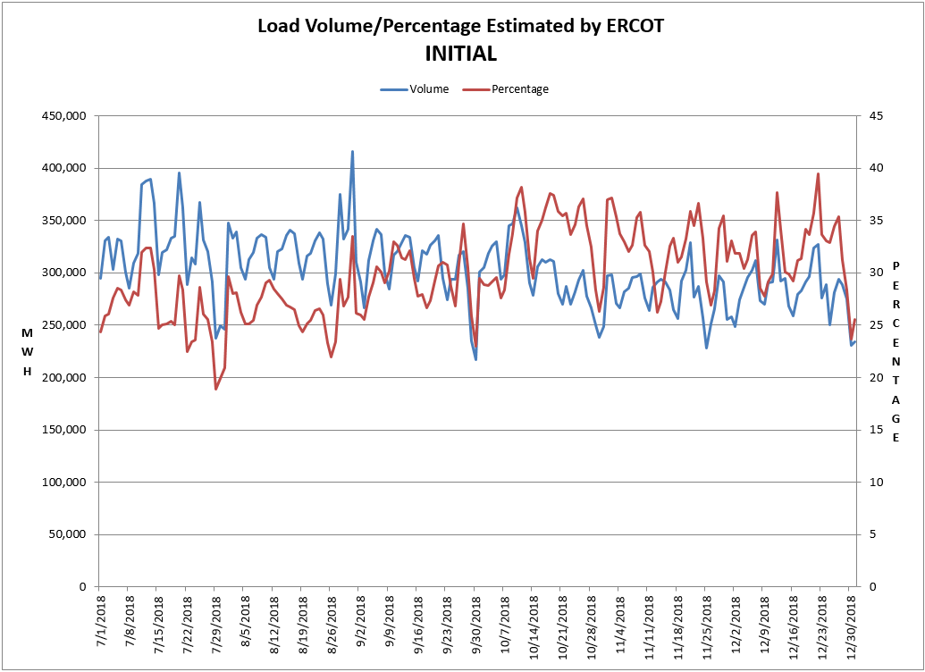
8.2(2)(c)(v) Availability of ESIID consumption data

Slide 13
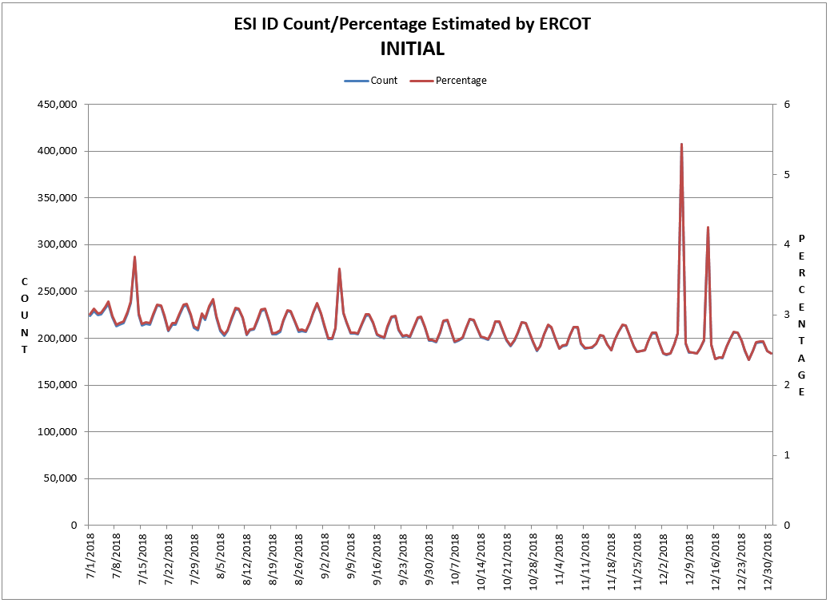
8.2(2)(c)(v) Availability of ESIID consumption data

Slide 14
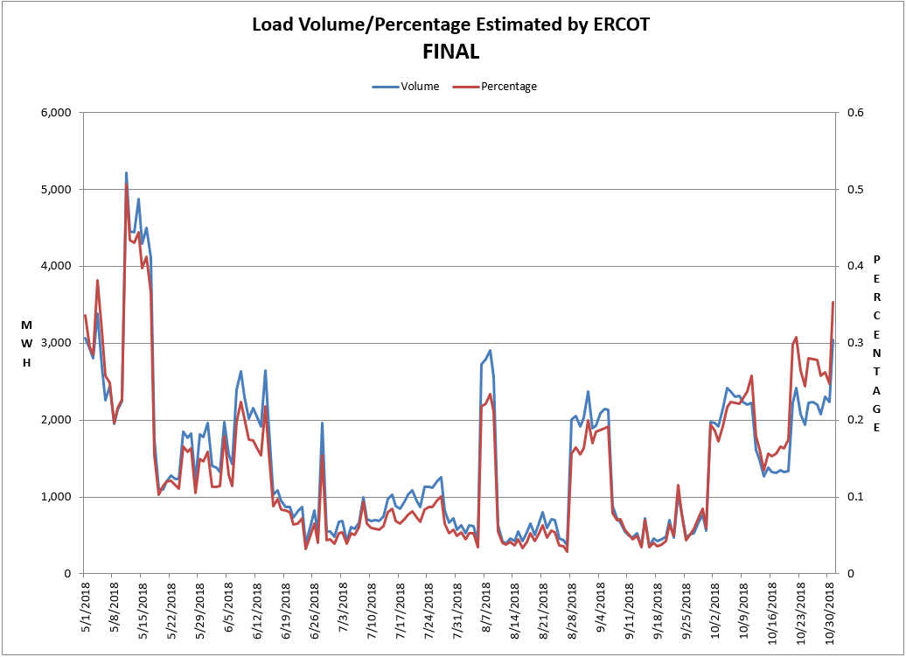
8.2(2)(c)(v) Availability of ESIID consumption data

Slide 15
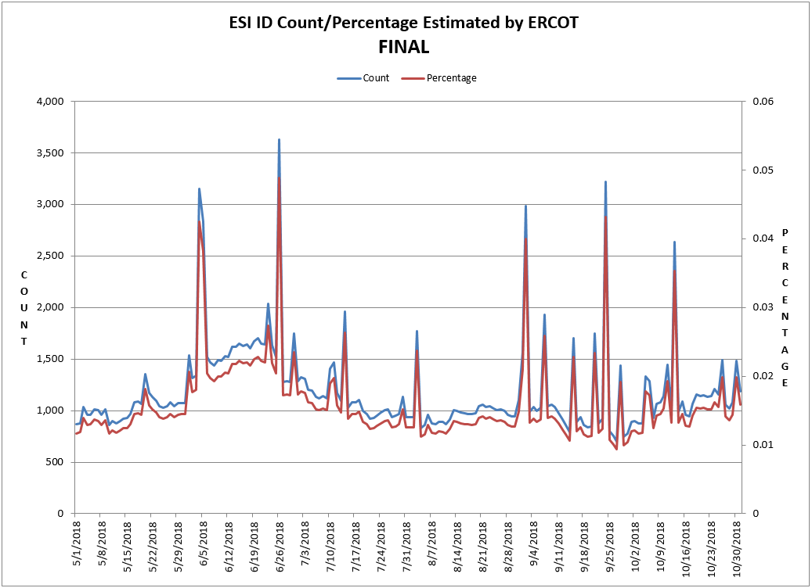
8.2(2)(c)(v) Availability of ESIID consumption data

Slide 16
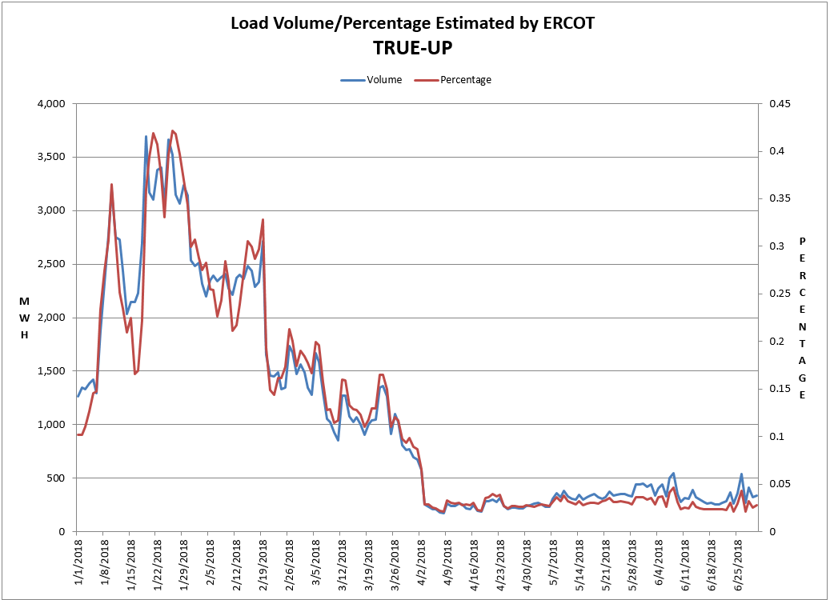
8.2(2)(c)(v) Availability of ESIID consumption data

Slide 17
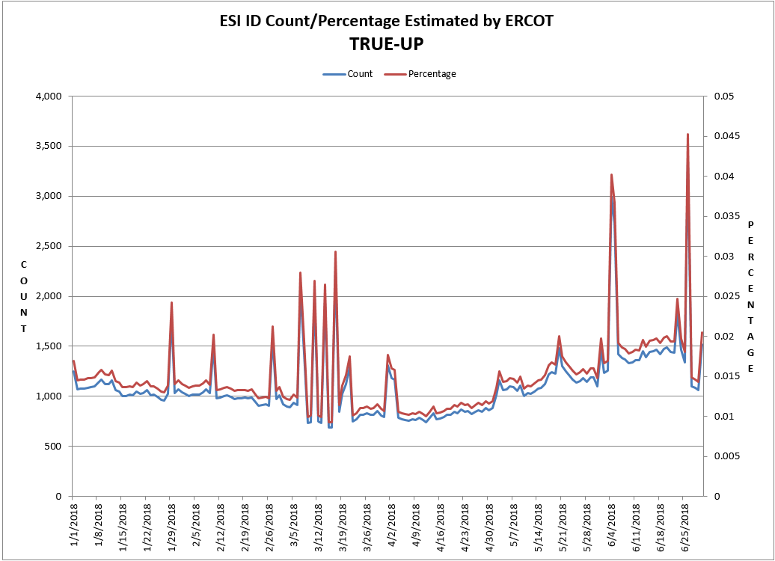
8.2(2)(c)(v) Availability of ESIID consumption data

Slide 18
8.2(2)(g) Net Allocation to Load - Totals and $/MWh
NET ALLOCATION TO LOAD ($M)
 | Dec 2017 | Jan 2018 | Feb 2018 | Mar 2018 | Apr 2018 | May 2018 | Jun 2018 | Jul 2018 | Aug 2018 | Sep 2018 | Oct 2018 | Nov 2018 | Dec 2018
Ancillary Service Settlement | 14.2 | 87.8 | 20.3 | 29.5 | 30.4 | 47.5 | 19.4 | 101.4 | 23.2 | 16.4 | 35.1 | 35.9 | 25.9
Balancing Account Payout to Load | -0.7 | -13.1 | -5.0 | -1.0 | -5.0 | -25.0 | 0.0 | 0.0 | -1.4 | -6.8 | -7.5 | 0.0 | 0.0
Base Point Deviation Payments | -0.2 | -0.5 | -0.2 | -0.2 | -0.2 | -0.4 | -0.3 | -0.3 | -0.2 | -0.2 | -0.2 | -0.2 | -0.2
Black Start Service Settlement | 0.6 | 0.6 | 0.6 | 0.6 | 0.6 | 0.6 | 0.6 | 0.6 | 0.6 | 0.6 | 0.6 | 0.6 | 0.6
Block Load Transfer Settlement | 0.0 | 0.0 | 0.0 | 0.0 | 0.0 | 0.0 | 0.0 | 0.0 | 0.0 | 0.0 | 0.0 | 0.0 | 0.0
Emergency Energy Charges | 0.2 | 0.2 | 0.2 | 0.1 | 0.3 | 0.3 | 0.1 | 0.2 | 0.2 | 0.1 | 0.2 | 0.3 | 0.3
ERCOT Admin Fee Settlement | 16.3 | 17.4 | 14.4 | 14.6 | 14.4 | 18.8 | 20.9 | 22.1 | 21.9 | 18.1 | 16.2 | 15.1 | 16.0
ERS Settlement¹ | 4.1 | 4.1 | 4.7 | 4.7 | 4.7 | 4.7 | 3.3 | 3.3 | 3.3 | 3.3 | 0.0 | 0.0 | 0.0
High Dispatch Limit Override | 0.0 | 0.0 | 0.0 | 0.0 | 0.0 | 0.0 | 0.0 | 0.0 | 0.0 | 0.0 | 0.0 | 0.0 | 0.0
Non-Zonal Auction Distribution | -7.6 | -11.4 | -9.4 | -15.6 | -16.5 | -14.6 | -11.4 | -8.4 | -7.3 | -8.3 | -13.6 | -12.0 | -9.4
ORDC Settlement | 0.0 | 0.4 | 0.0 | 0.0 | 0.1 | 3.7 | 0.1 | 2.2 | 2.1 | 0.4 | 0.2 | 0.3 | 0.2
Revenue Neutrality Total | 7.4 | 17.4 | 0.7 | 16.8 | 2.0 | 19.3 | 30.3 | 9.0 | 12.6 | 6.9 | 11.3 | 0.4 | 7.3
RMR Settlement | 0.0 | 0.0 | 0.0 | 0.0 | 0.0 | 0.0 | 0.0 | 0.0 | 0.0 | 0.0 | 0.0 | 0.0 | 0.0
RUC Settlement | 0.0 | -0.4 | 0.0 | 0.0 | 0.0 | -2.4 | 0.0 | 0.0 | 0.0 | 0.0 | -0.2 | -0.1 | 0.0
Voltage Services Settlement | 0.0 | 0.0 | 0.0 | 0.0 | 0.0 | 0.0 | 0.0 | 0.0 | 0.0 | 0.0 | 0.0 | 0.0 | 0.0
Zonal Auction Distribution² | -20.8 | -25.7 | -21.4 | -27.2 | -27.2 | -31.9 | -38.3 | -49.6 | -57.5 | -33.4 | -28.8 | -26.7 | -24.0
Total Allocation to Load | 13.5 | 76.8 | 4.9 | 22.3 | 3.6 | 20.6 | 24.7 | 80.5 | -2.5 | -2.9 | 13.3 | 13.6 | 16.7
Adjusted Metered Load (TWh) | 29.4 | 31.4 | 25.9 | 26.4 | 25.9 | 33.9 | 37.6 | 39.8 | 39.4 | 32.6 | 29.2 | 27.2 | 28.8
$/MWh³ | 0.5 | 2.4 | 0.2 | 0.8 | 0.1 | 0.6 | 0.7 | 2.0 | -0.1 | -0.1 | 0.5 | 0.5 | 0.6
Note: The Net Allocation to Load amounts provided in this presentation are for informational purposes only and cannot be relied upon for accurate measurements or forecasts of individual QSE charges and payments.
¹The total ERS charges have been evenly allocated across the contract period.
²Zonal Auction Distribution by 2003 Congestion Management Zone, shown below.
³The $/MWh value as calculated per PR 8.2 (2) g
⁴The $/MWh value by 2003 Congestion Management Zone, as calculated per PR 8.2(2) g

Slide 19
8.2(2)(g) Net Allocation to Load - Totals and $/MWh
ZONAL AUCTION DISTRIBUTION PER CONGESTION MANAGEMENT ZONE ($M)
 | Dec 2017 | Jan 2018 | Feb 2018 | Mar 2018 | Apr 2018 | May 2018 | Jun 2018 | Jul 2018 | Aug 2018 | Sep 2018 | Oct 2018 | Nov 2018 | Dec 2018
HOUSTON | -2.0 | -2.5 | -2.3 | -2.4 | -3.1 | -3.6 | -5.0 | -7.5 | -7.3 | -4.6 | -4.2 | -3.0 | -2.7
NORTH | -4.9 | -6.0 | -4.7 | -5.1 | -5.5 | -7.3 | -10.3 | -13.8 | -16.5 | -9.0 | -7.3 | -7.1 | -6.5
SOUTH | -5.7 | -6.8 | -5.6 | -7.5 | -7.1 | -9.2 | -11.2 | -15.1 | -15.1 | -10.9 | -8.5 | -7.4 | -6.4
WEST | -8.3 | -10.3 | -8.8 | -12.2 | -11.5 | -11.8 | -11.8 | -13.2 | -18.5 | -9.0 | -8.8 | -9.2 | -8.4
TOTAL | -20.8 | -25.7 | -21.4 | -27.2 | -27.2 | -31.9 | -38.3 | -49.6 | -57.5 | -33.4 | -28.8 | -26.7 | -24.0
REAL-TIME ADJUSTED METERED LOAD BY CONGESTION MANAGEMENT ZONE (TWh)
 | Dec 2017 | Jan 2018 | Feb 2018 | Mar 2018 | Apr 2018 | May 2018 | Jun 2018 | Jul 2018 | Aug 2018 | Sep 2018 | Oct 2018 | Nov 2018 | Dec 2018
HOUSTON | 7.4 | 7.7 | 6.5 | 7.2 | 7.0 | 9.3 | 9.9 | 10.5 | 10.5 | 8.9 | 8.1 | 7.0 | 7.1
NORTH | 10.9 | 12.0 | 9.8 | 8.9 | 8.8 | 12.0 | 13.9 | 15.0 | 14.3 | 11.6 | 10.0 | 9.7 | 10.6
SOUTH | 8.0 | 8.5 | 6.8 | 7.3 | 7.1 | 9.4 | 10.2 | 10.7 | 10.9 | 8.9 | 7.9 | 7.2 | 7.5
WEST | 3.1 | 3.2 | 2.8 | 2.9 | 2.9 | 3.3 | 3.5 | 3.6 | 3.7 | 3.3 | 3.2 | 3.2 | 3.5
TOTAL | 29.4 | 31.4 | 25.9 | 26.4 | 25.9 | 33.9 | 37.6 | 39.8 | 39.4 | 32.6 | 29.2 | 27.2 | 28.8
ZONAL AUCTION REVENUE PER CONGESTION MANAGEMENT ZONE ($/MWh)
 | Dec 2017 | Jan 2018 | Feb 2018 | Mar 2018 | Apr 2018 | May 2018 | Jun 2018 | Jul 2018 | Aug 2018 | Sep 2018 | Oct 2018 | Nov 2018 | Dec 2018
HOUSTON | -0.3 | -0.3 | -0.4 | -0.3 | -0.4 | -0.4 | -0.5 | -0.7 | -0.7 | -0.5 | -0.5 | -0.4 | -0.4
NORTH | -0.4 | -0.5 | -0.5 | -0.6 | -0.6 | -0.6 | -0.7 | -0.9 | -1.2 | -0.8 | -0.7 | -0.7 | -0.6
SOUTH | -0.7 | -0.8 | -0.8 | -1.0 | -1.0 | -1.0 | -1.1 | -1.4 | -1.4 | -1.2 | -1.1 | -1.0 | -0.9
WEST | -2.7 | -3.2 | -3.1 | -4.2 | -4.0 | -3.6 | -3.4 | -3.7 | -5.0 | -2.7 | -2.8 | -2.9 | -2.4
TOTAL | -0.7 | -0.8 | -0.8 | -1.0 | -1.1 | -0.9 | -1.0 | -1.2 | -1.5 | -1.0 | -1.0 | -1.0 | -0.8
NET ALLOCATION TO LOAD PER CONGESTION MANAGEMENT ZONE ($/MWh)⁴
 | Dec 2017 | Jan 2018 | Feb 2018 | Mar 2018 | Apr 2018 | May 2018 | Jun 2018 | Jul 2018 | Aug 2018 | Sep 2018 | Oct 2018 | Nov 2018 | Dec 2018
HOUSTON | 0.9 | 3.0 | 0.6 | 1.6 | 0.8 | 1.2 | 1.2 | 2.6 | 0.7 | 0.4 | 0.9 | 1.1 | 1.0
NORTH | 0.8 | 2.8 | 0.5 | 1.3 | 0.6 | 1.0 | 1.0 | 2.4 | 0.2 | 0.1 | 0.7 | 0.8 | 0.8
SOUTH | 0.5 | 2.5 | 0.2 | 0.9 | 0.2 | 0.6 | 0.6 | 1.9 | 0.0 | -0.3 | 0.3 | 0.5 | 0.5
WEST | -1.5 | 0.1 | -2.1 | -2.3 | -2.8 | -2.0 | -1.7 | -0.4 | -3.6 | -1.8 | -1.4 | -1.4 | -1.0
TOTAL | 0.5 | 2.4 | 0.2 | 0.8 | 0.1 | 0.6 | 0.7 | 2.0 | -0.1 | -0.1 | 0.5 | 0.5 | 0.6

