Slide 1
RIOO-Interconnection Services

Slide 2
RIOO-IS
Feedback

Slide 3
RIOO-IS
Payment

Slide 4
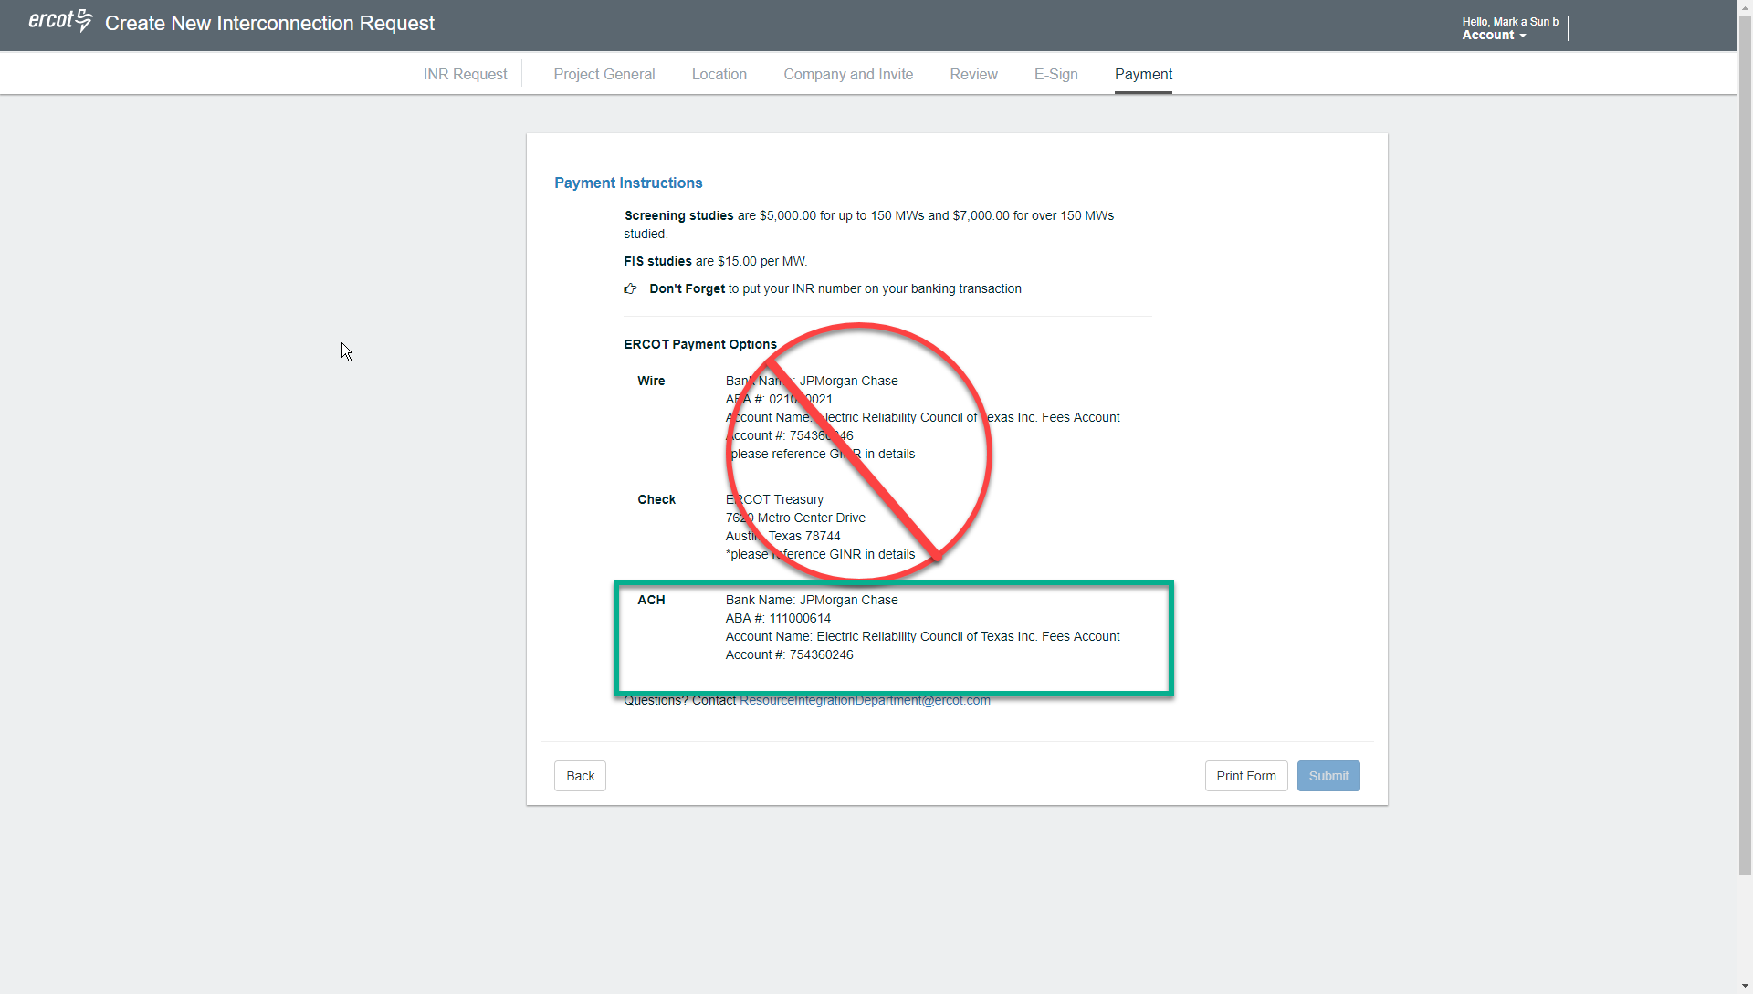
Payment: This old screen will be removed from current flow

Slide 5
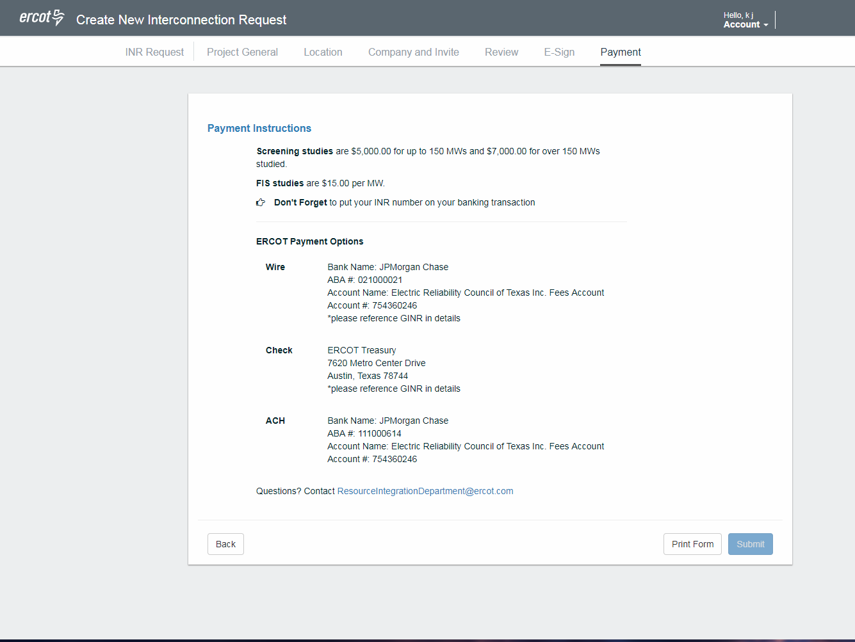
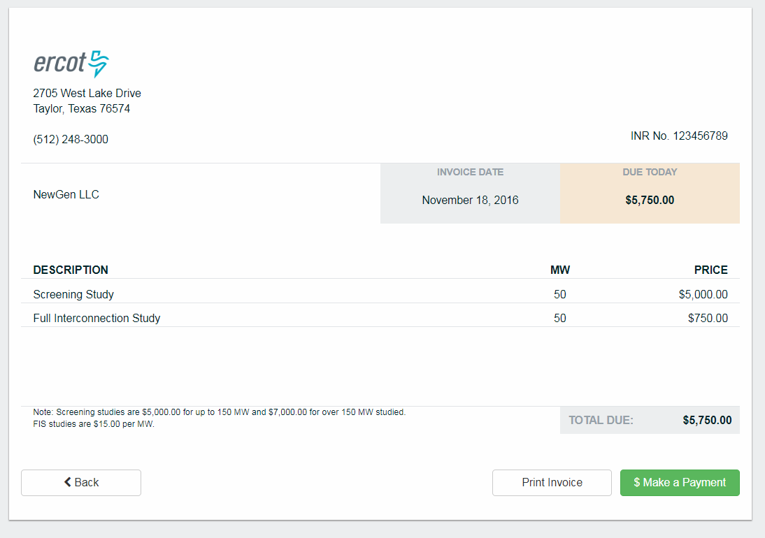
Payment: Invoice

Slide 6
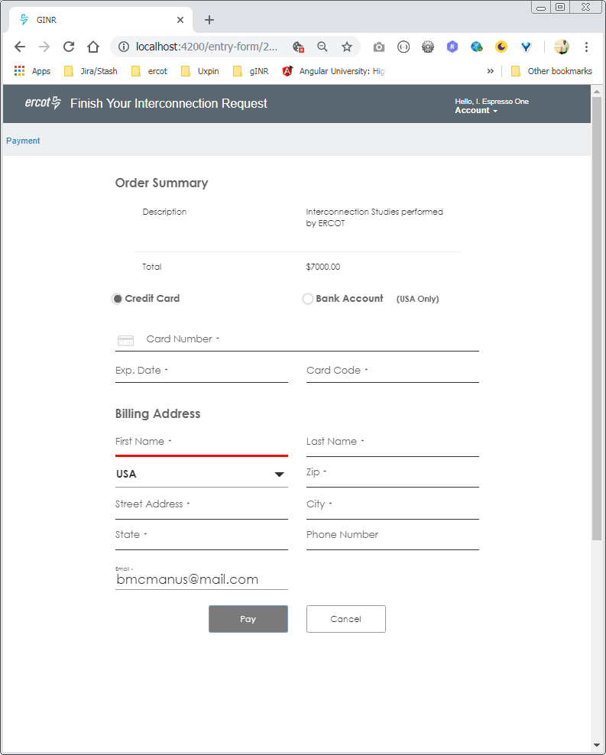
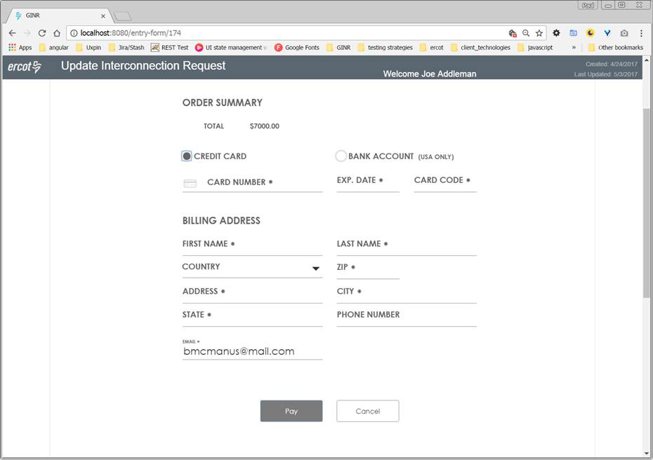
Payment: Credit Card

Slide 7
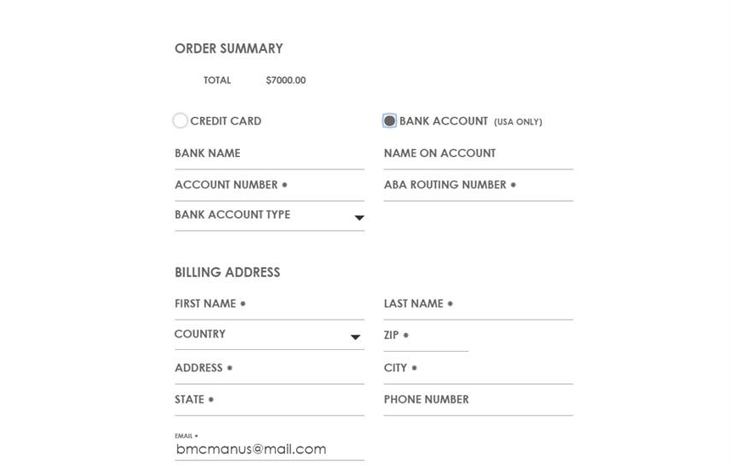
Payment: ACH

Slide 8
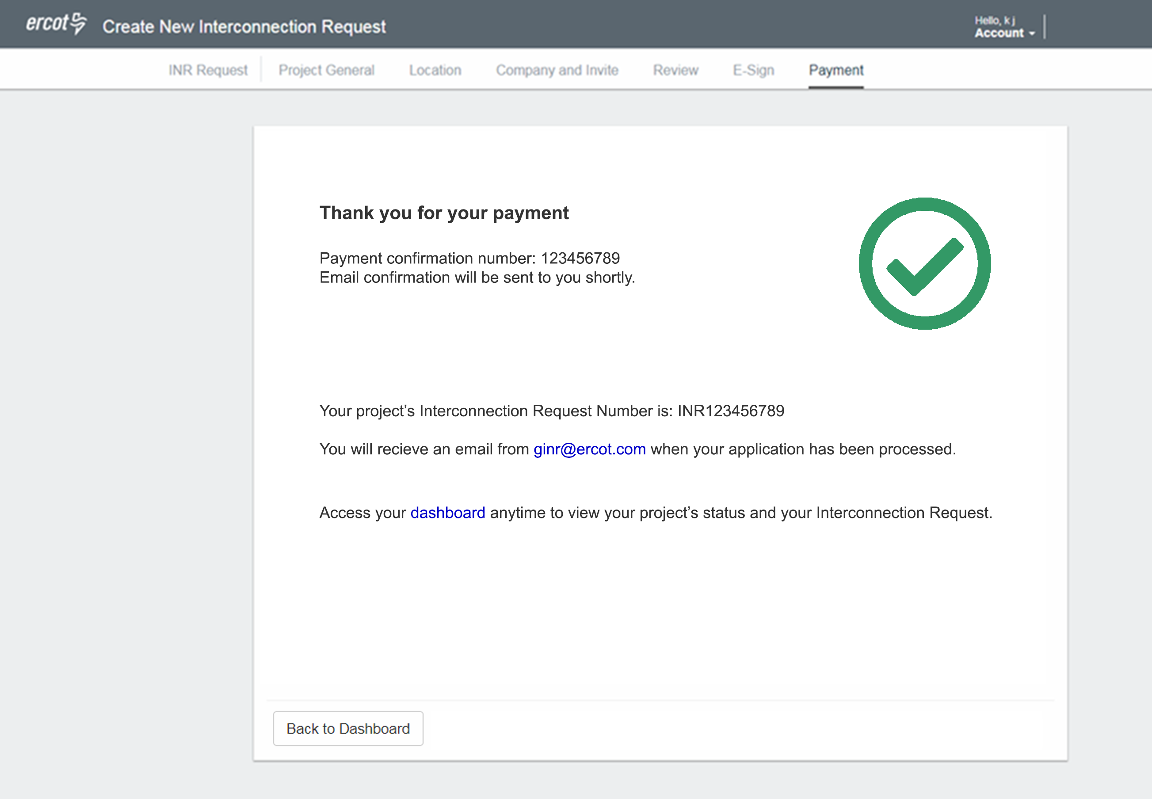
Payment: Confirmation

Slide 9
RIOO -
RARF Replacement Update

Slide 10
What’s Next?
Resource Integration & On-going Operations (RIOO) Application

