Slide 1
VRT Evaluations and Dynamic Model Performance
Discussion
John Schmall
ERCOT Transmission Planning
Resource Integration Workshop
January 29, 2019

Slide 2
Voltage Ride-Through Assessment
VRT Test – Purpose and Evolution
Does
Model
Trip?
Is Model Performance Acceptable?

Slide 3
What is acceptable performance?
Dynamic Reactive
  Nodal Protocol 3.15(3)(c)
  Nodal Operating Guide 2.7.3.5 sections (2) thru (5)
No Momentary Cessation
  Nodal Operating Guide 2.9 (2)
AVR Response
  Nodal Protocol 3.15.3(4) and 3.15(4)
  Nodal Operating Guide 2.7.3.5(4)

Slide 4
HVRT Guidelines
Drive POI voltage to HVRT boundary (NOG 2.9.1) for test
Exhibit dynamic reactive response
  Absorb reactive power during high voltage transient
  Absorb reactive power for sustained 1.1pu POI voltage
    Exhibit AVR response
Maintain active power output level
No momentary cessation

Slide 5
LVRT Guidelines
Drive POI voltage to LVRT boundary (NOG 2.9.1) for test
Exhibit dynamic reactive response
  Inject reactive power during low voltage transient
  Inject reactive power for sustained 0.9pu POI voltage
    Exhibit AVR response
Recovery of active power output
No momentary cessation

Slide 6
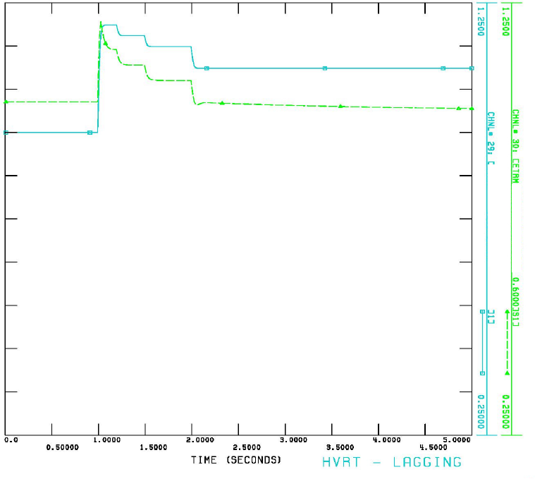
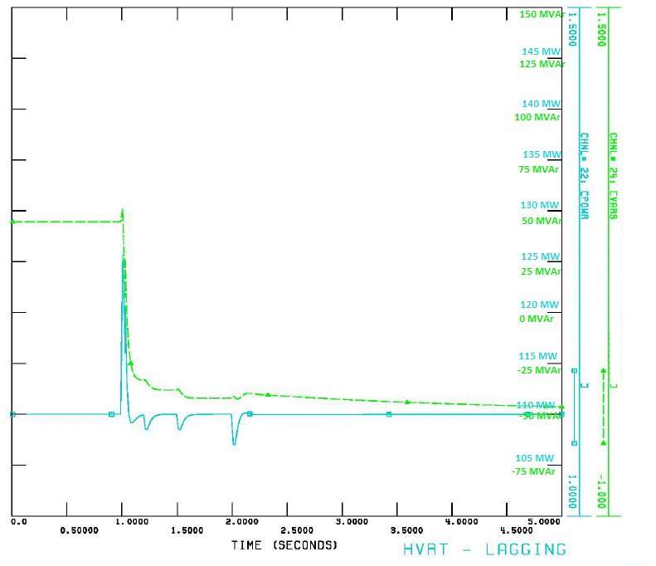
Acceptable HVRT Example
POI Voltage
Terminal Voltage
Aggressive dynamic VAR response to sudden high voltage
Slower AVR in response to sustained 110% voltage; inverter moves towards Qmin
Sustained real power

Slide 7
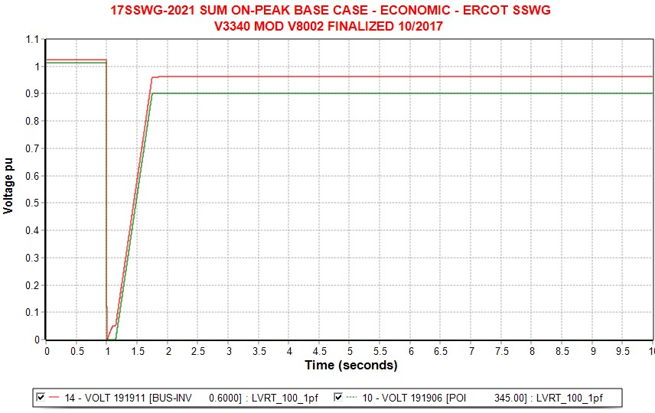
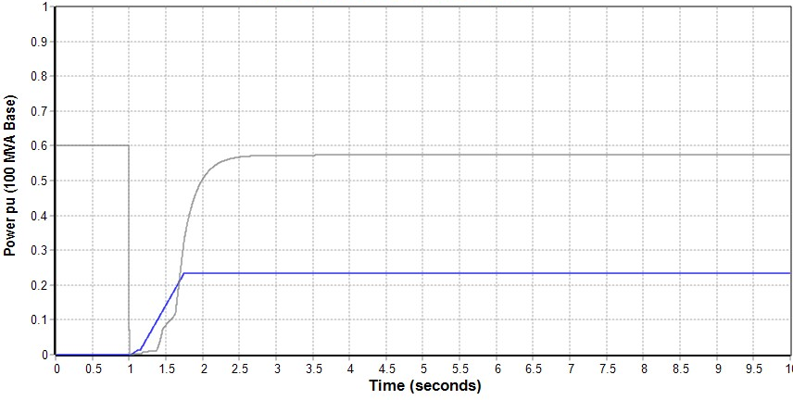
Acceptable LVRT Example
Terminal Voltage (pu)
POI Voltage (pu)
Real Power (pu)
Reactive Power (pu)

