Slide 1
Credit Exposure Update
Spoorthy Papudesi
Credit Work Group
ERCOT Public
January 23, 2019

Slide 2
Credit Exposure Update
Inputs and Assumptions:
Only Active Counter-Parties are included
Counter-Parties are classified by rating and market activity
TPE and collateral balances used are averages for November and December of 2018
Counter-Parties that are subsidiaries of, or guaranteed by, rated entities are given the parent/guarantor’s rating, adjusted down one notch

Slide 3
Credit Exposure Update
December 2018 compared to November 2018
Market-wide average TPE decreased from $ 390.9 million to $338.6 million.
TPE decreased by $18.5 million for “Load and Gen” category.
TPE decreased by $ 33.4 million for “Trader” category.
Average Excess collateral increased from $ 2,004.3 million to $2,123.2 million.
increased by $85.0 million for “Load and Gen” category
increased by $28.2 million for “Load Only” category.
increased by $4.8 million for “Trader” category.
Number of active Counter-Parties remained flat.

Slide 4
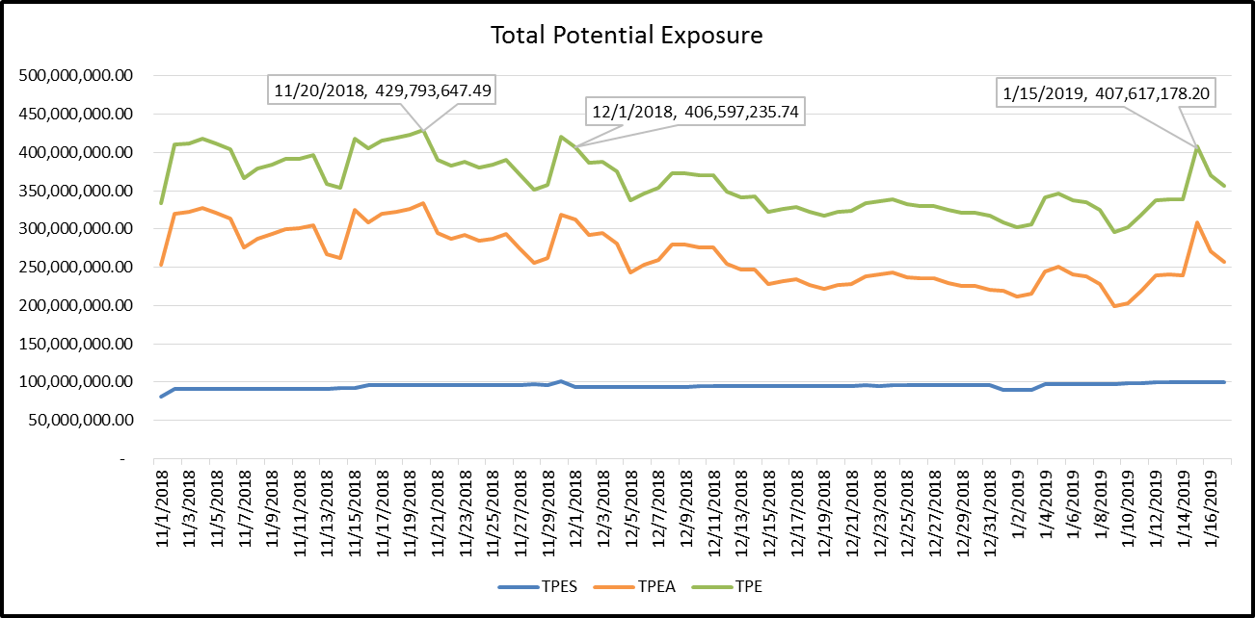
Credit Exposure Update

Slide 5
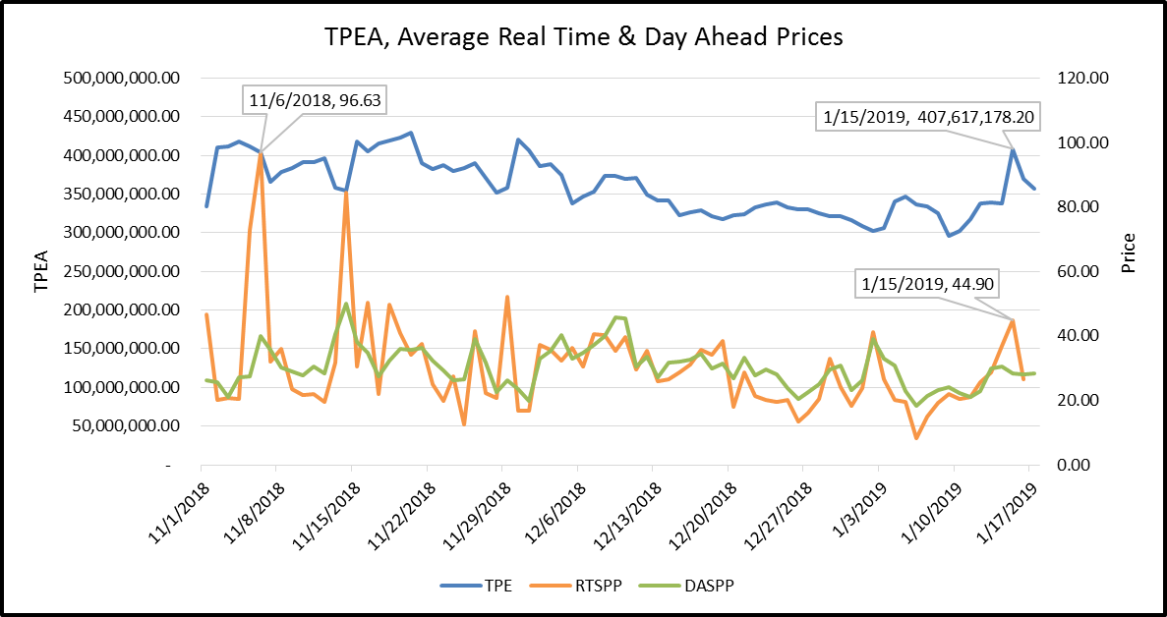
Credit Exposure Update

Slide 6
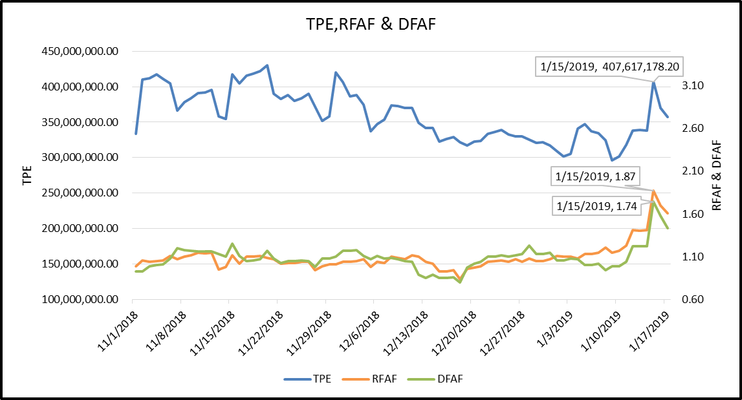
Credit Exposure Update

Slide 7
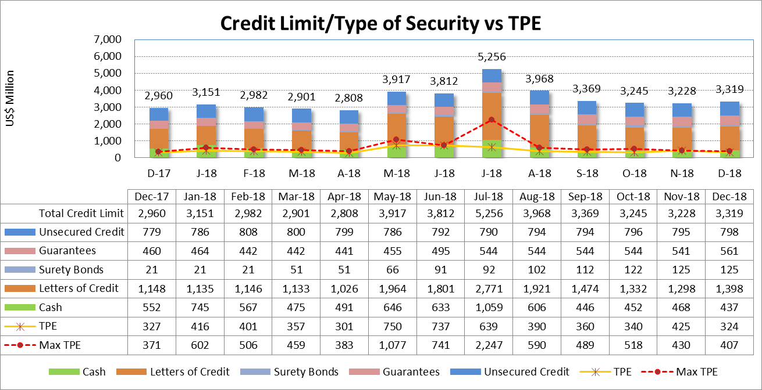
Credit Exposure Update

Slide 8
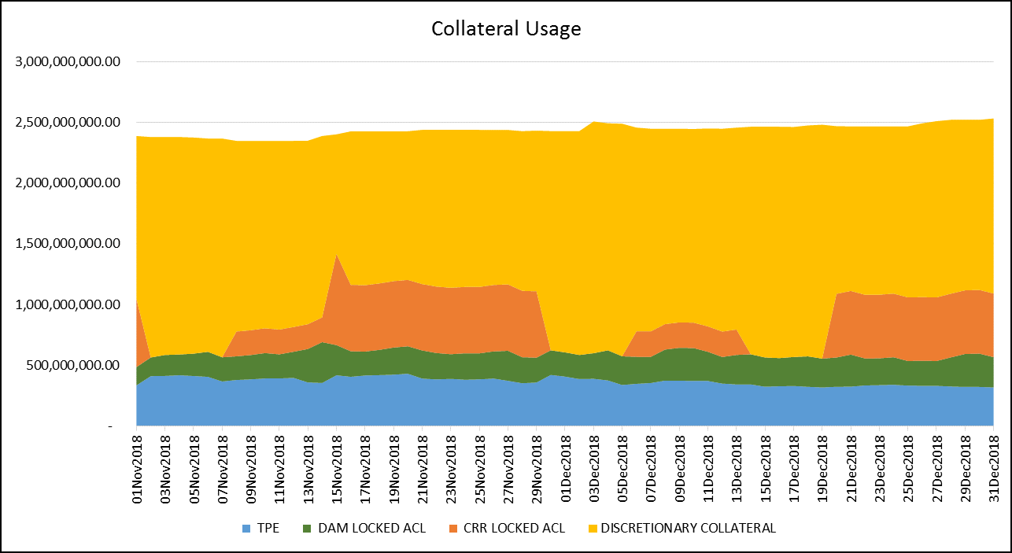
Credit Exposure Update

Slide 9
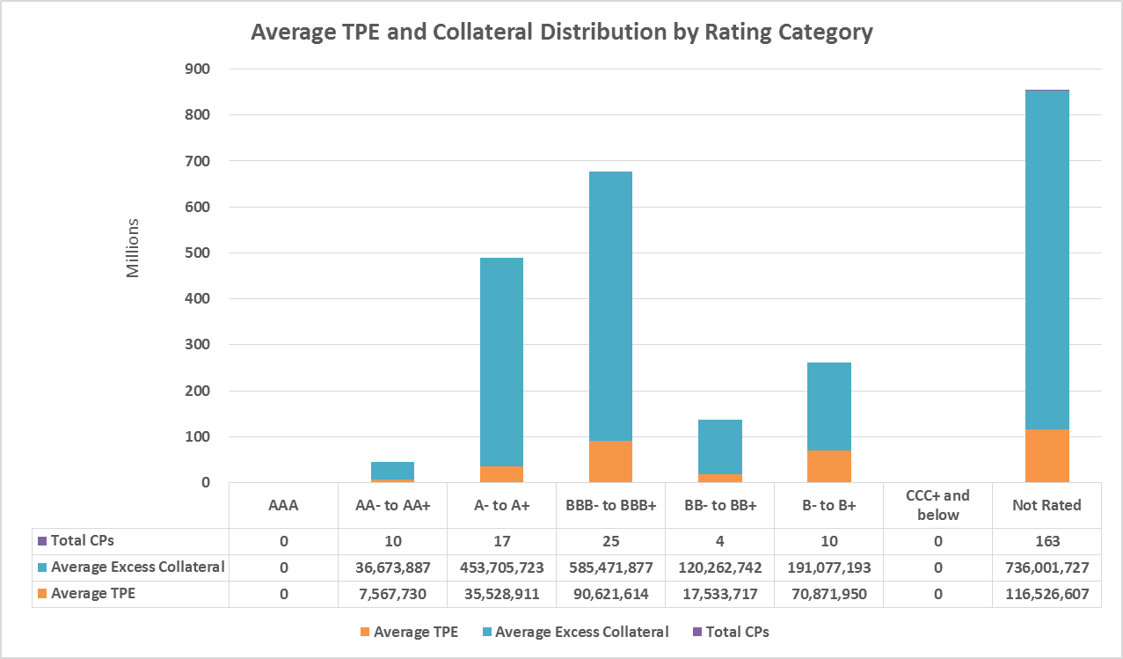
Credit Exposure Update

Slide 10
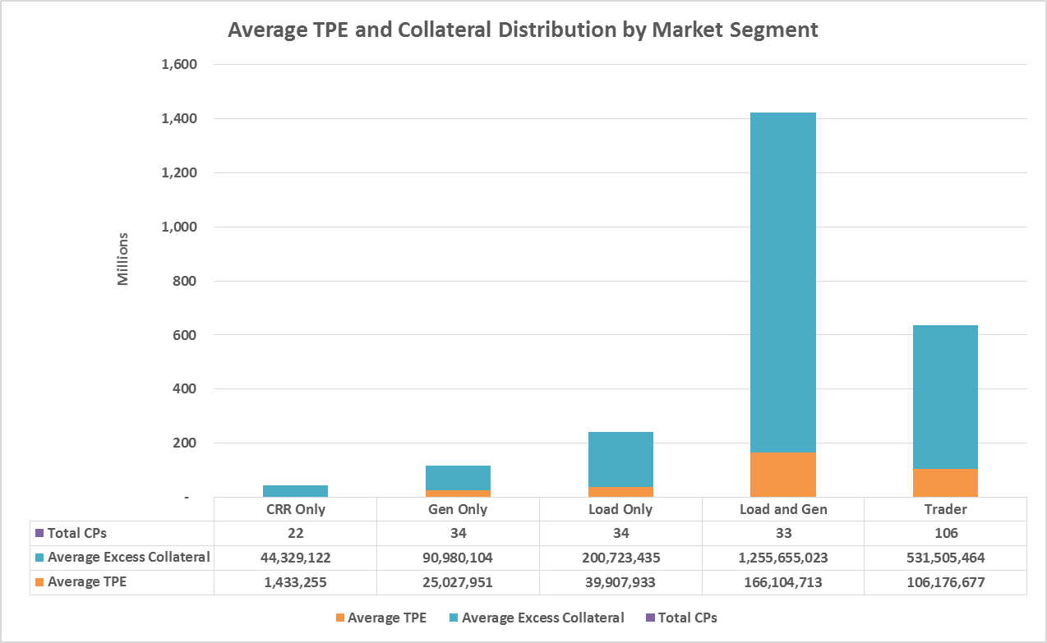
Credit Exposure Update

Slide 11
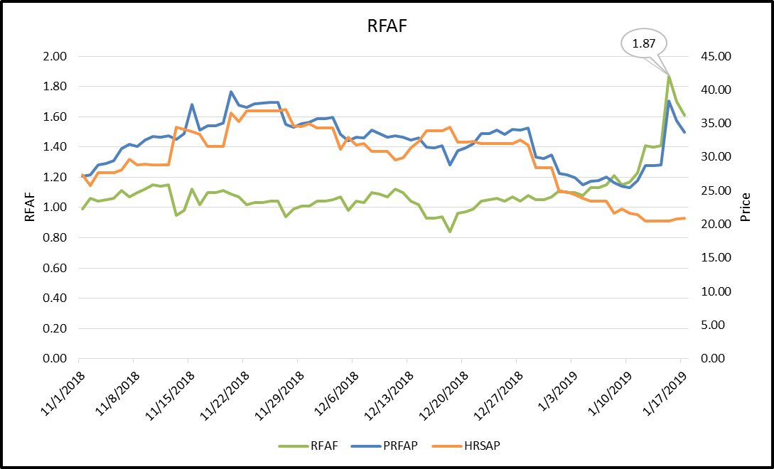
Credit Exposure Update
Real-Time Forward Adjustment Factor (RFAF)
RFAF is calculated using 21 days of ICE future prices and 14 days of ERCOT Real Time Settled Prices for HB_NORTH settlement point

Slide 12
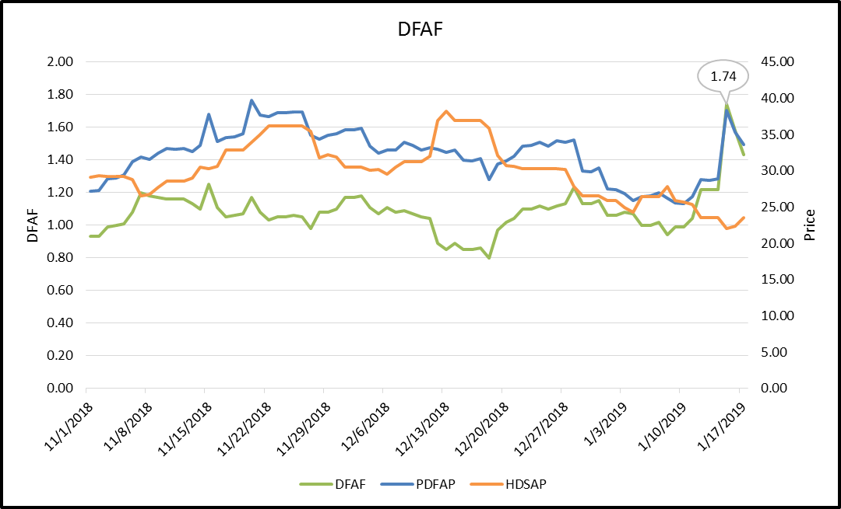
Credit Exposure Update
Day-Ahead Forward Adjustment Factor (DFAF)
DFAF is calculated using 21 days of ICE future prices and 7 days of ERCOT Day Ahead Settled Prices for HB_NORTH settlement point

Slide 13
Credit Exposure Update
Appendix

Slide 14
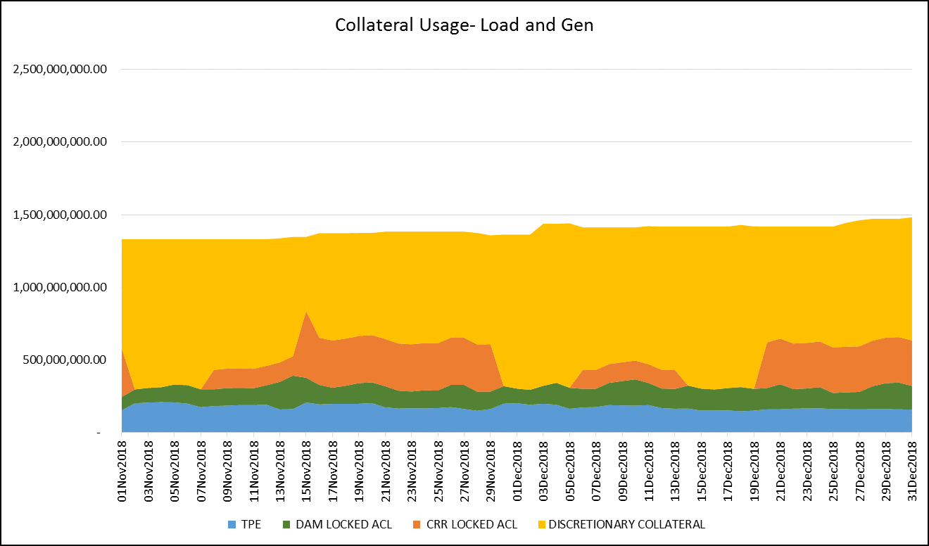
Credit Exposure Update

Slide 15
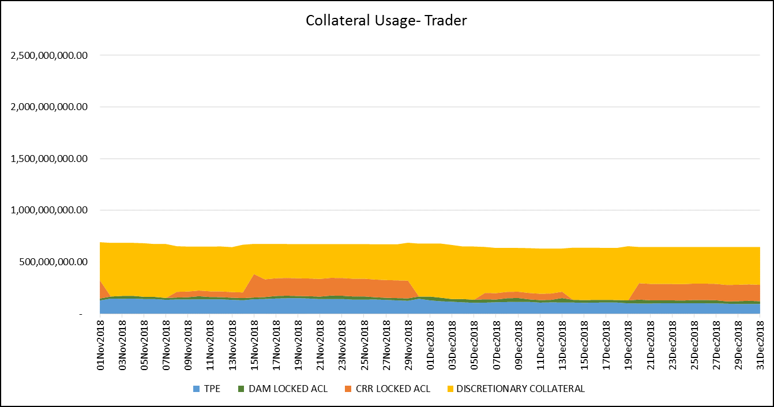
Credit Exposure Update

Slide 16
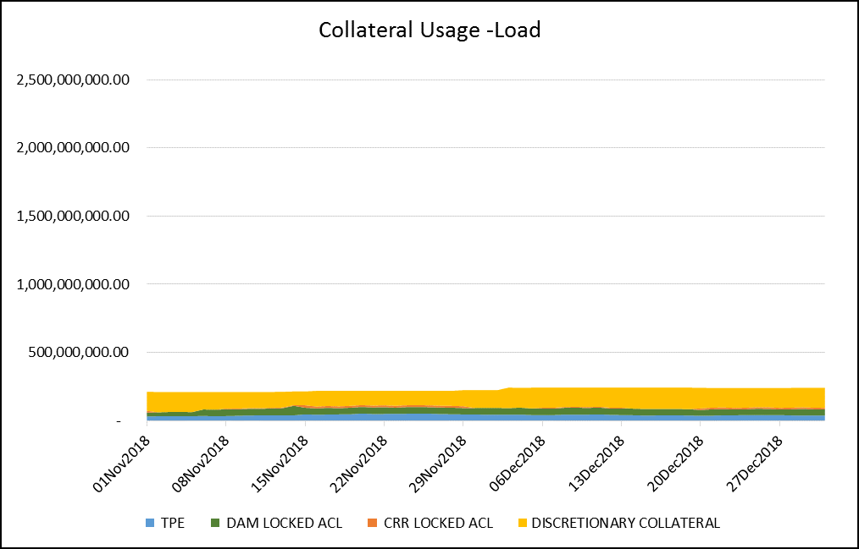
Credit Exposure Update

Slide 17
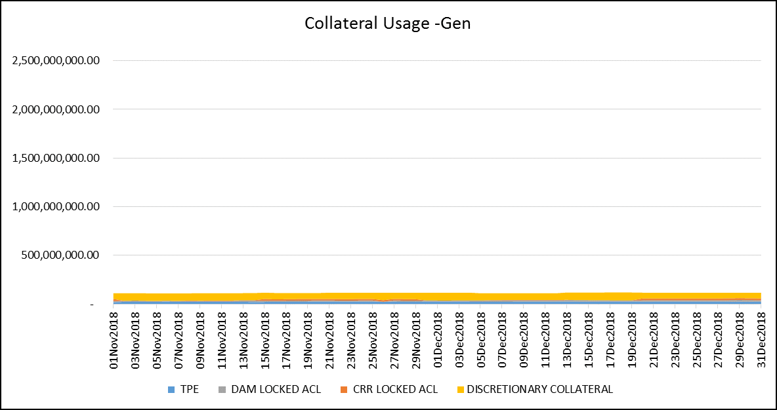
Credit Exposure Update

Slide 18
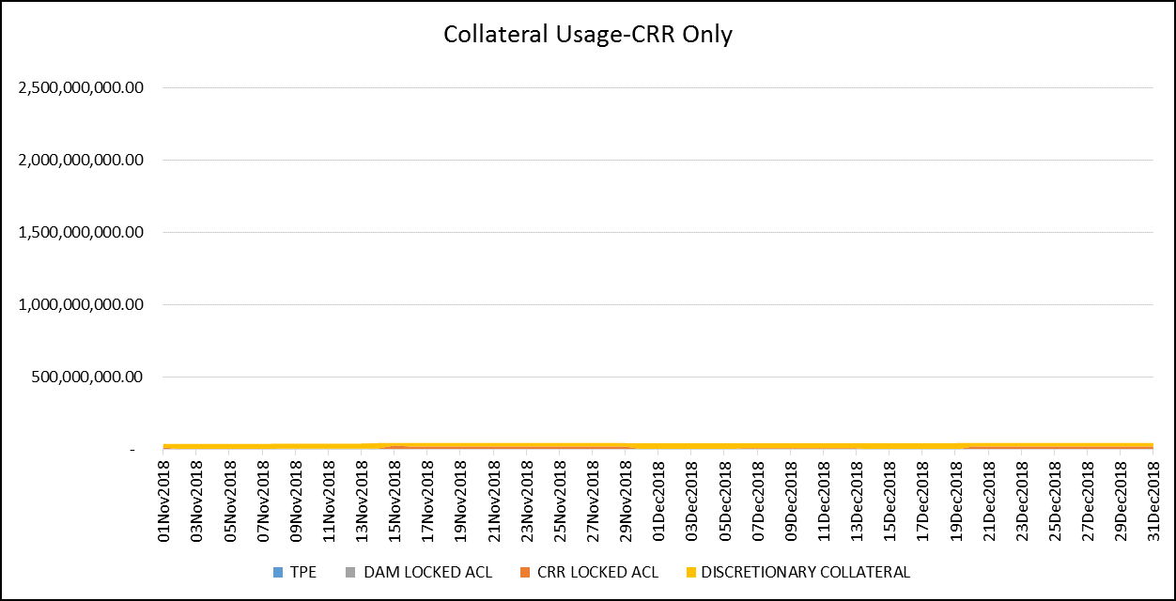
Credit Exposure Update

Slide 19
Credit Exposure Update
Summary statistics by Market Segment

Slide 20
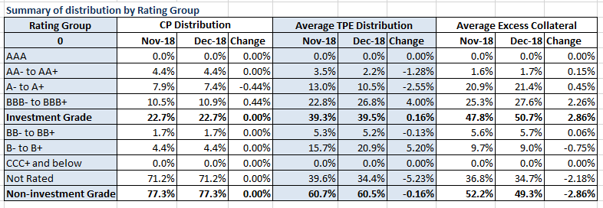
Credit Exposure Update
Summary statistics by Rating Group

Slide 21
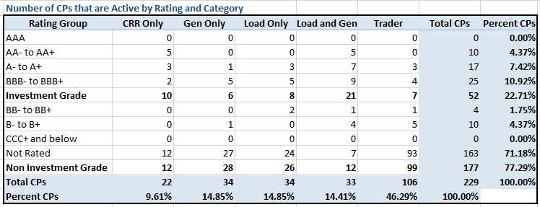
Credit Exposure Update
Active Counter-Parties distribution by rating and category- Dec 2018

Slide 22
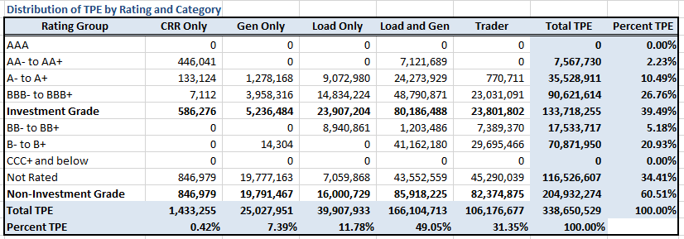
Credit Exposure Update
Average Total Potential Exposure distribution-Dec 2018

Slide 23
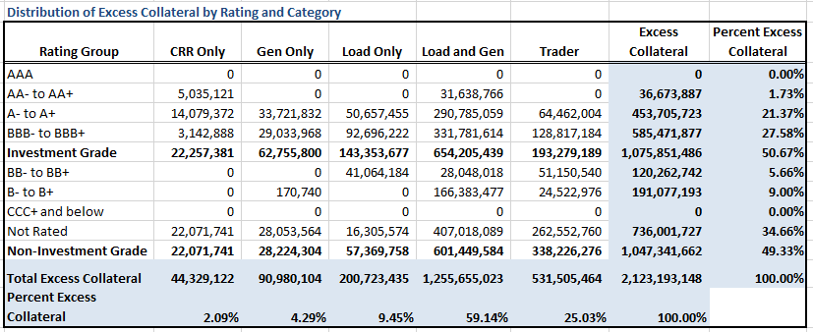
Credit Exposure Update
Average Excess Collateral distribution^{*-}Dec 2018
*Excess Collateral is a voluntary disposition by Counterparty

Slide 24
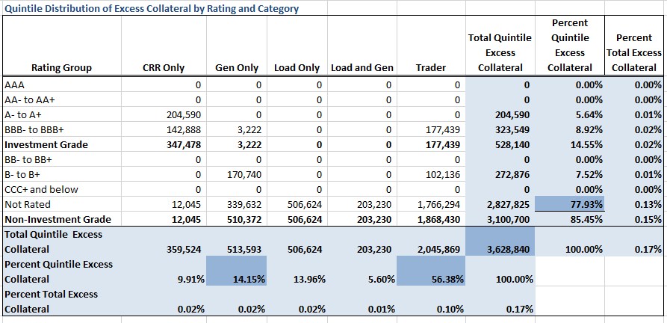
Credit Exposure Update
Distribution in the Bottom Quintile of Excess Collateral^{*-}Dec 2018
*Excess Collateral is a voluntary disposition by Counterparty

Slide 25
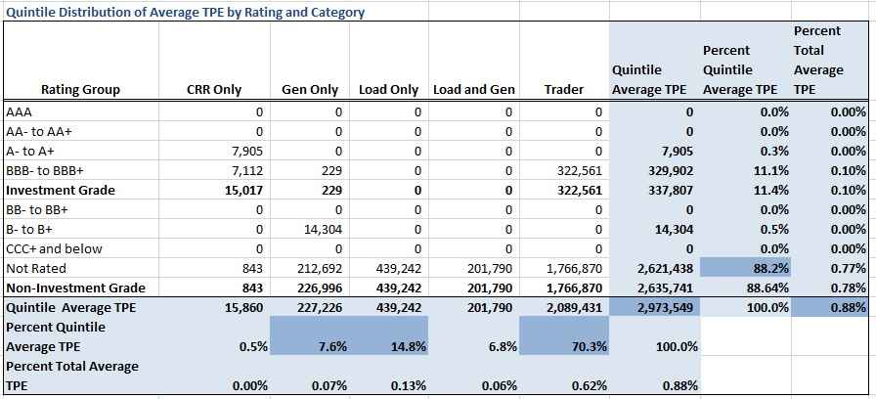
Credit Exposure Update
Distribution of TPE in the Bottom Quintile of Excess Collateral^{*-}Dec 2018
*Excess Collateral is a voluntary disposition by Counterparty

Slide 26
Credit Exposure Update
Questions

