Slide 1
Intra-Hour Wind Forecast Accuracy Updates (Jan. 2018)
WMWG
Operations Analysis
1/25/2019

Slide 2
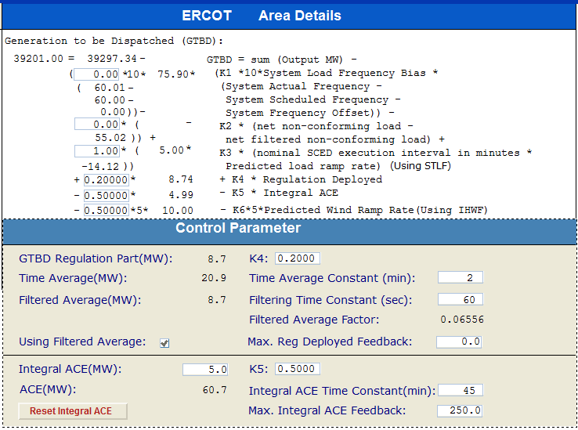
Current GTBD Parameters
Notes:
3/12/18 – Integral ACE Time Constant Changed from 60 min to 45 min
5/17/18 - K4 Changed from 0.3 to 0.2 and K5 Changed from 0.4 to 0.5
12/4/18 10:05 AM – K6 Changed from 0 to 0.5

Slide 3
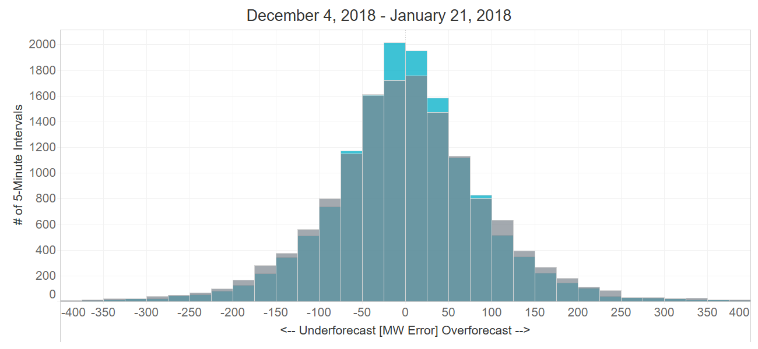
Projected Wind Ramp Rate (PWRR) Error
Performance Metric | SCED PWRR | Persistence Ramp*
Monthly MAE (MW) | 65 | 72
Monthly MAE when 5-Min. Wind Ramp > 100 MW | 145** | 162
SCED PWRR
Persistence Ramp*
* Persistence Ramp assumes a 0 MW wind ramp
** Improvements limited by K6 of 0.5 and PWRR Threshold of 10 MW/Min

Slide 4
Intra-Hour Wind Ramp Forecast Error

Slide 5
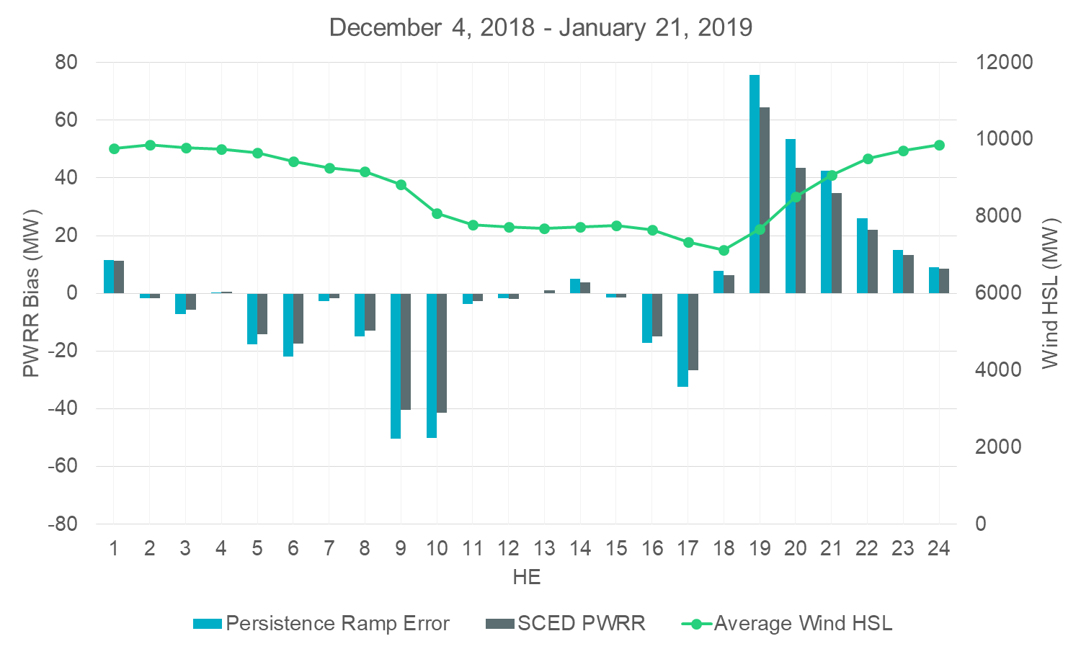
Intra-Hour Wind Ramp Forecast Error

